Slide 1
The Birth of the Church
Acts – Chapter 2

Slide 2
Three Jewish Feasts
Exodus 23:14-17 Three important Jewish feasts:
Unleavened Bread: seven days to remember the Exodus, ending with Passover
Harvest: give the “first fruits” of the harvest to God, 50 days after Passover (Pentecost)
Ingathering: end of year, gathering all of the fruit of their labor and God’s provision
All Jewish men required to come to Jerusalem
Maintained social and religious unity

Slide 3
The Holy Spirit Comes
Acts 1:4,5,8 The apostles and 120 others were waiting in Jerusalem for the “Promise of the Father”
Acts 2:1-4 Greek word for Spirit is “pneuma,” literally “movement or air” or “breath”
“tongues of fire” reminds us of God’s presence (Exodus 3:2-6)
“rested on each one of them” shows that all believers are given God’s Holy Spirit (1 Cor 6:19)
“filled with the Holy Spirit” = controlled by the Holy Spirit (Ephesians 5:18)
“speak in other tongues” = known languages
Notes:
The word translated “tongues” (Gk. glōssa, plural) can also be translated “languages,” and that is the sense that it has in this verse. In this case the other languages were understood by various people present in Jerusalem

Slide 4
The Jews are Confused
Acts 2:5-13 “devout Jews” – ones who came from every nation to celebrate Pentecost
v.6 “at this sound” – the noise of the wind, and then, the variety of languages
v.7 “Galileans” – people from the uneducated northern province (“country folks”)
v.8 “in his own native language” – God will help every hungry heart to know the gospel.
v.12-13 Given the same evidence, there are 2 groups: believers and skeptics

Slide 5
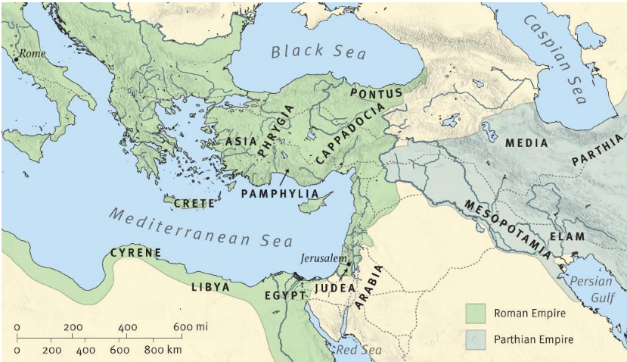
Nations where Jewish Communities Existed
“Parthians and Medes and Elamites and residents of Mesopotamia, Judea and Cappadocia, Pontus and Asia, Phrygia and Pamphylia, Egypt and the parts of Libya belonging to Cyrene, and visitors from Rome,…” Acts 2:9,10

Slide 6
The Confusion is Clarified
Acts 2:14-21 The first result of the Holy Spirit’s arrival – a gospel sermon
v.16 “through the prophet Joel” – Joel’s prophecy has two meanings: “near” and “far.” The near meaning is Acts 2; the far meaning will be seen in the “millennial kingdom.”
v.17 “the last days” – the final event on God’s calendar of saving the world.
v.20 “the day of the Lord” – Christ’s return to judge the earth and those who live on it.
v.21 “everyone who calls upon the name of the Lord shall be saved.”
Notes:
As a sermon to Jews it consists primarily of scriptural proofs: vv. 14– 21 interpret the miracle of tongues as a fulfillment of Joel 2: 28– 32; Acts 2: 22– 36 presents Christ as Messiah in fulfillment of Ps. 16: 8– 11 and Ps. 110: 1; and Acts 2: 37– 41 concludes the sermon with a call to repentance and baptism.
The last days are not just in the distant future but were inaugurated at Pentecost (cf. 1 Cor. 10: 11; 2 Tim. 3: 1; Heb. 1: 2; James 5: 3; 2 Pet. 3: 3) and will continue until Christ’s return. They are the “last days” in that the coming of the Messiah, long predicted in the OT, has now occurred.
ESV Bibles. ESV Study Bible (Ebook) (p. 9070). Crossway. Kindle Edition.

Slide 7
The Jews are Confronted
Acts 2:22-36 They knew the claims of Jesus and saw His supernatural works (John 3:2)
v.23 “definite plan and foreknowledge of God” reminds us that everything is under the control of our Sovereign God (Ephesians 1:3-4).
v.23 “you crucified” – they were still guilty
v.32-33 “raised up…exalted” – the heart of the gospel: Jesus is the risen Lord of all!
v.36 “whom you crucified” – instead of following their Messiah, they tried to silence Him!

Slide 8
The Jews are Convicted
Acts 2:37-41 They were “cut to the heart,” the important mission of the Spirit (John 16:8)
v.37 “what shall we do?” is the important question every person should ask!
v.38 “repent” – turn from your own way and turn to Him, receiving His forgiveness and grace
v.38 “baptized in the name of Jesus Christ” – first, be put into Jesus (Romans 8:1) and then be put into the water (Matthew 28:19).
v.39 “everyone whom the Lord calls to Himself” reminds us that God first calls us to be saved.
v.41 “there were added that day about 3000 souls.” The “first fruits” of God’s harvest!

Slide 9
The Church Begins
Acts 2:42-47 The priority of a good church – devotion to the teaching from God’s Word.
v.42 “fellowship…breaking bread…prayers” – important parts of every church.
v.43 “wonders and signs…apostles” – these important “signs” showed truth and authority.
v.45 “their possessions…as any had need” – generous sharing of their personal property
v.46 “in their homes” – small “house churches”
v.47 “the Lord added” reminds us that salvation comes from God – we trust Him for the results

Slide 10
Some “Take Aways”
God’s perfect plan of salvation is unfolding – Scripture is being fulfilled!
Meditate on God’s Word daily, surrender to His authority, and allow His Spirit to fill and empower you!
God uses “Galileans” like us!
Expect some to receive the gospel and others to reject it – leave the results in God’s hands.
Q: “What should we do?” A: “repent and call on the name of the Lord”
In a good church: Bible teaching, fellowship, baptism, breaking bread, prayers, and praising God.

