Slide 1
The Persecuted Church
Acts – Chapter 4

Slide 2
The Sign from the Last Lesson
Acts 3:6-10
“In the name of Jesus Christ” = by His power, authority, and character
A 40 year old man, lame from birth, begging daily for many years (everyone knew him)
“walking and leaping” – true and complete healing of body system
“they were filled with wonder” – all the people saw the miracle and were attracted to the true message of the gospel preached by Peter
Acts 4:4 – 5000 believers!
Notes:
Isaiah 35:5,6 points to messianic times with a similar prophecy: “Then the eyes of the blind shall be opened, and the ears of the deaf unstopped; then shall the lame man leap like a deer, and the tongue of the mute sing for joy. For waters break forth in the wilderness, and streams in the desert;”

Slide 3
Suffering for Jesus
Persecution = to attack someone or make them suffer because of religious beliefs
John 15:20 “Remember the word that I said to you: ‘A servant is not greater than his master.’ If they persecuted Me, they will also persecute you. If they kept My word, they will also keep yours.”
2 Timothy 3:12 “Indeed, all who desire to live a godly life in Christ Jesus will be persecuted,”
1 Peter 2:21 “For to this you have been called, because Christ also suffered for you, leaving you an example, so that you might follow in His steps.”
Acts 4 records the first persecution of the church
Notes:
Galatians 2:20 “I have been crucified with Christ. It is no longer I who live, but Christ who lives in me. And the life I now live in the flesh I live by faith in the Son of God, who loved me and gave himself for me.”
Persecution can be on the outside and on the inside. It is easier to see the external forms of persecution, but the internal forms can be just as difficult. Denying our own agenda or refusing to bend to the demands of unsaved parents (and suffering the consequences) can be a very severe form of suffering, especially for people from an honor/shame culture.
Mark 8:34 And calling the crowd to him with his disciples, he said to them, “If anyone would come after me, let him deny himself and take up his cross and follow me.

Slide 4
The Jealous Leaders (Acts 4:1-6)
v.1-2 Peter and John were not official teachers
The Sadducees didn’t believe in resurrection of the body, and they feared loss of their position.
The Jewish leaders were fearing shame for declaring Jesus guilty and executing Him.
v.5-6 Many top leaders of Israel gathered together, including those who convicted Jesus.
Persecution gave Peter and John the opportunity to preach to Israel’s religious leaders!
Notes:
The Sadducees didn’t want to lose their high positions by stirring up trouble with the Romans (John 11:47-48).

Slide 5
The Guilty Leaders (Acts 4:7-11)
v.7 A “name” represented authority. Who gave Peter and John permission to preach?
v.8 Filled with the Spirit, he speaks with respect
v.9 A good question: “are we being punished for doing a good thing?”
v.10 A clear, bold, and truthful statement about their sin and Jesus’ resurrection
v.11 They were supposed to be the builders, but rejected the cornerstone (1 Peter 2:4-6)

Slide 6
The Uneducated Apostles (Acts 4:12-16)
v.12 Peter gives the leaders a gospel invitation!
Jesus is the only One who can heal the body and the spirit.

Slide 7


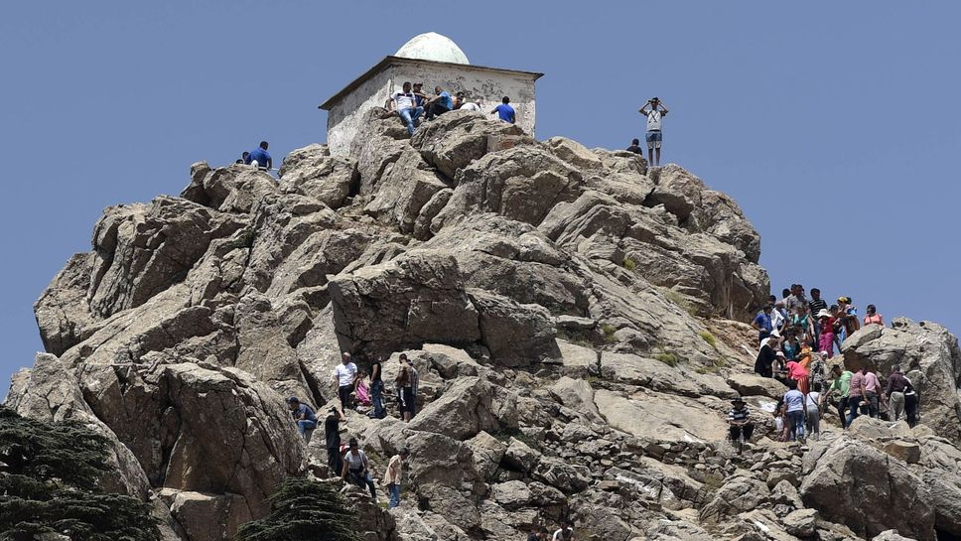
“All religions are just different paths to the top of the same mountain.”
“For my thoughts are not your thoughts, neither are your ways my ways,” declares the LORD. “As the heavens are higher than the earth, so are my ways higher than your ways and my thoughts than your thoughts.” Isaiah 55:8,9
Our only hope: God Himself will come down to save us. That is what Jesus did – He came from heaven to earth to die for us and give us new life!
Notes:
Many religions may lead to the top of the same mountain, but God does not live on top of an earthly mountain. If people reach the top of their religious mountain, they will still be infinitely far away from God:
“The God who made the world and everything in it is the Lord of heaven and earth and does not live in temples built by human hands.” Acts 17:24
“When you did these things and I kept silent, you thought I was exactly like you. But I now arraign you and set my accusations before you.” Psalm 50:21
We only have one hope: that God Himself will come down to us, wherever we are on the Earth. That is exactly what Jesus did – God came down to us and took on a human body, suffered the punishment we deserved, rose again to conquer death, and invites us to come to Him as a gift by His amazing grace.

Slide 8
The Uneducated Apostles (Acts 4:12-16)
v.12 Peter gives the leaders a gospel invitation!
Jesus is the only One who can heal the body and the spirit. There may be “many paths leading up a mountain,” but only one leading to God!
v.13-14 Two Galilean fishermen powerfully and successfully silenced all of the top leaders.
The reason: they had been with Jesus!
Luke 21:15 Jesus’ promise to His followers came true!
v.15-16 The leaders saw the miracles but were blind to their sin and the truth of Scripture
Notes:
The religious leaders could not deny the facts, but they were unwilling to accept the implications of this truth. It is also true of many people today, building their lives on the sand.

Slide 9
The Obedient Apostles (Acts 4:17-22)
v.17-18 The leaders say, “Shut Up!”
v.19 Another good, bold question: “should we obey you or obey God?” (Matthew 28:18-20)
1 Peter 2:13-14 key words: “for the Lord’s sake”
v.20 A clear and respectful response of a true witness (1 John 1:1,3)
v.21 The leaders had no basis for punishment and they couldn’t deny the obvious miracle.
Notes:
Note the context of 1 Peter 2:13ff, especially verses 7-8. Perhaps Peter was thinking about this interaction when he commanded (limited) obedience to leaders.

Slide 10
The Unified Church (Acts 4:23-32)
v.23 Their first priority – they go to the church. Persecution unites the true church with a clear mission (verse 32).
v.24 When suffering, find your comfort in God’s sovereign power and unfailing love.
V.28 God wrote history before it happened!
v.29-31 They did not pray for protection or safety – they prayed to continue preaching with boldness. They clearly understood their mission.

Slide 11
Some “Take Aways”
Living a godly life will lead to persecution (1 Pet 4:12)
When in a difficult situation, don’t be afraid or angry – look for the opportunity to speak God’s truth.
Jesus is the only hope for lost sinners.
Walk with Jesus and trust Him to speak through you. (“They had been with Jesus”)
In a clear case of conflict between God’s command and leadership’s demands, we must obey God.
Strength is found in trusting our Sovereign God and in worshiping in a true, unified local church.
Notes:
If we push back on opposition, we need to be respectful and gracious:
James 3:17-18 “But the wisdom from above is first pure, then peaceable, gentle, open to reason, full of mercy and good fruits, impartial and sincere. And a harvest of righteousness is sown in peace by those who make peace.”
1 Peter 3:15 “but in your hearts honor Christ the Lord as holy, always being prepared to make a defense to anyone who asks you for a reason for the hope that is in you; yet do it with gentleness and respect,”
2 Timothy 2:24,25a “And the Lord's servant must not be quarrelsome but kind to everyone, able to teach, patiently enduring evil, correcting his opponents with gentleness.”

