Slide 1
The First Gentile Church
Acts 11

Slide 2
From Last Lesson…
“For the LORD your God is God of gods and Lord of lords, the great God, mighty and awesome, who shows no partiality and accepts no bribes. He defends the cause of the fatherless and the widow, and loves the foreigner residing among you, giving them food and clothing. And you are to love those who are foreigners,” Deuteronomy 10:17-19
“There is neither Jew nor Greek, there is neither slave nor free, there is no male and female, for you are all one in Christ Jesus.” Galatians 3:28
Notes:
As much as the Jews hated the people from Samaria, they hated the Gentiles even more, looking upon them as dirty dogs. They would not eat with them or even associate with them.

Slide 3
More than Jewish (much more)
Acts 11:1-18 – When the Bible repeats a story, we need to pay attention! This is important for the global mission of Jesus – Christianity was not just Judaism plus Jesus!
Acts 11:1-3 – Accepting Jesus as their Lord was good, but accepting Gentiles as brothers was very hard!
Acts 10:4 – Instead of debating about prejudice, Peter shares a testimony (a better approach).
As Christians, our goal is not to win an argument, but to win people to Jesus.
Notes:
The temple was still the main meeting place for the church, and perhaps, some of the Jewish believers were wondering if they would not permit Gentiles into the temple.

Slide 4
God even saves Gentiles!
Acts 11:12 – “making no distinction” was an important command! He wisely brought six men to witness this.
Acts 11:15,16 – “the Holy Spirit” – an important sign that Gentiles could also be saved.
Acts 11:17 – a very good question: “who was I to stand in God’s way?” Do we ever stand in God’s way?
Acts 11:18 – the listeners could not argue with the Holy Spirit or the testimony of seven men. They now knew that God could save Gentiles (and they must go to them).

Slide 5
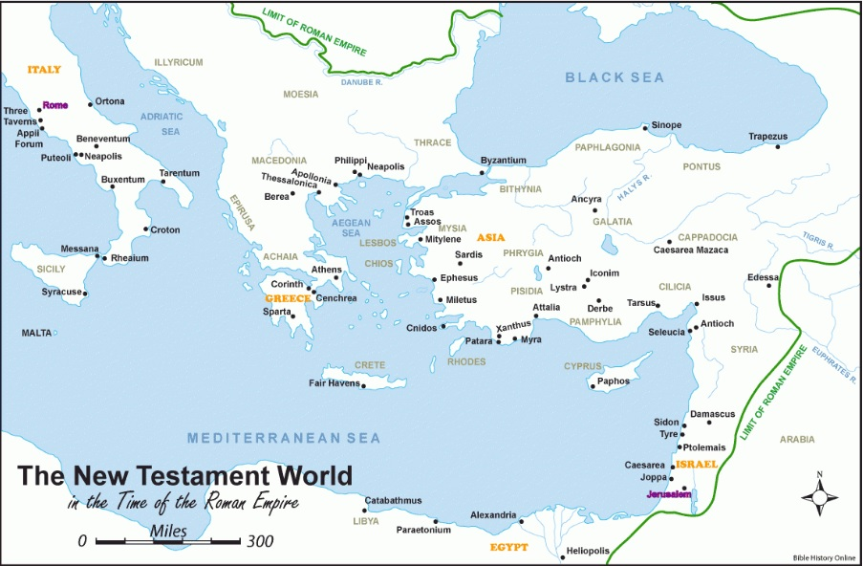
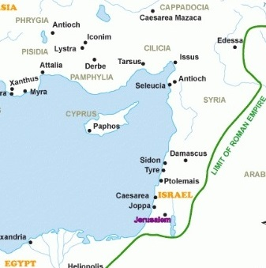
Scattered beyond Samaria

Slide 6
Scattered beyond Samaria
Acts 11:19,20
v.19 Now those who were scattered because of the persecution that arose over Stephen traveled as far as Phoenicia and Cyprus and Antioch, speaking the word to no one except Jews.
v.20 But there were some of them, men of Cyprus and Cyrene, who on coming to Antioch spoke to the Hellenists also, preaching the Lord Jesus.
Phoenicia
Notes:
This narrative picks up where Acts 8:4 leaves off – more about the Scattered church.
The Jewish evangelists didn’t know what happened between Peter and Cornelius.
The guys from Cyprus were already Greek speakers, so it was natural for them to preach to the Gentiles.

Slide 7
Many Gentiles Believe!
Acts 11:21 – As always, effective ministry comes from the working of God’s “hand” of blessing.
Acts 11:21 – two key words: “believed” and “turned to the Lord”:
Believed = put trust in Jesus’ sacrifice and resurrection
Turned to the Lord = repent (turn away from world & self and follow Him)

Slide 8
Sending Workers to a New Church
Acts 11:22,24a – Barnabas was from Cyprus, so he would be accepted among new Gentile believers. He was “a good man, full of the Holy Spirit and of faith.”
Acts 11:23 – “remain faithful to the Lord with steadfast purpose” is my great desire for you!
Acts 11:24b,25 – sometimes, the work is too big for one person (teams are good!).
Acts 11:26 – the high priority: teaching the word of God.
“Christians” literally means “the party of Christ.” A very good label (contrast with v.2 – the “circumcision party”)
Notes:
Barnabas was from Cyprus (Acts 4:36)

Slide 9
A Generous Church
Acts 11:27,28 – These New Testament prophets spoke the word of God, more like a preacher than an OT prophet.
Great famines are documented from AD 45-46 in Israel.
Acts 11:29,30 – two important principles for giving: “everyone” and “according to his ability.”
Acts 13:2,3 – the greatest gift sent from the church in Antioch: Barnabas and Saul – missionaries to the Gentile world!

Slide 10
“Some” Take Aways
Your personal testimony can be more effective than an argument to draw people to Jesus.
Always be ready for God to use you (don’t stand in His way).
Everyone should give according to their ability.
“Remain faithful to the Lord with steadfast purpose.”
Notes:
坚心靠主 Jiān xīn kào zhǔ
“Keep your heart strong in the Lord”

