Slide 1
Sent Out by the Holy Spirit
Acts 13
A transition from Peter to Paul and
from Jerusalem to the Gentile world

Slide 2
Good Church Leadership
A diverse group of five men in Syrian Antioch, united in Christ and leadership of His church
Acts 13:1 – Prophets (preachers proclaiming the gospel) and Teachers (instructing the church with Scripture).
Acts 13:2 – These leaders spent serious time focused on the Lord, not just doing activities. Their close walk with God helped them hear from the Holy Spirit.
Take more joy in your salvation than in your success (Luke 10:20).
The church did not choose Barnabas and Saul – the Holy Spirit called them into His work. God usually uses people who are already busy with His work (not idle).
Acts 13:3 – Laying hands showed unity and agreement.
Notes:
Like apostles, prophets were replaced in the early churches by pastors and evangelists.
Fasting is usually connected to times of vigilant, passionate prayer (Nehemiah 1:4; Daniel 9:3). While we usually connect fasting with food, it could be choosing to forego any distraction that might hinder seeking God.
Barnabas and Saul were God’s men, ready to be used by Him for his purposes.
“Sent them away” = let them go; released them

Slide 3
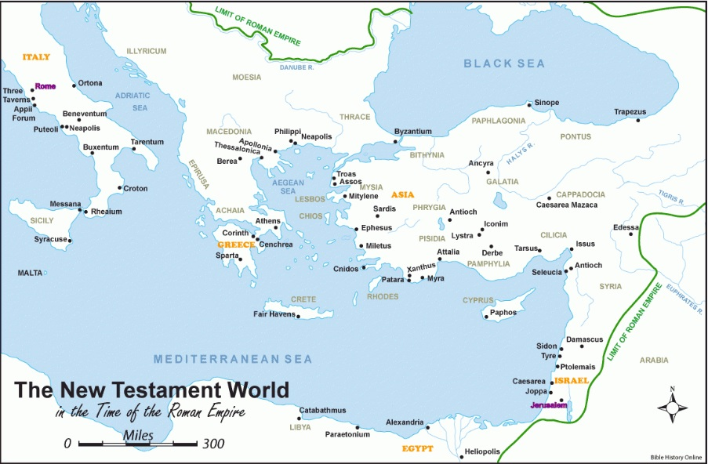
Set Apart for Me Barnabas and Saul

Slide 4
“So, being sent out by the Holy Spirit, they went down to Seleucia, and from there they sailed to Cyprus. When they arrived at Salamis, they proclaimed the word of God in the synagogues of the Jews. And they had John to assist them.” Acts 13:4,5
Perga
Salamis

Slide 5
Ministry in Eastern Cyprus
Salamis was the chief port and commercial center of Cyprus. Barnabas was from Cyprus (Acts 4:36), so it was familiar to him.
Acts 13:5 – the mission: proclaim the gospel; the audience: starting with the Jews in the synagogue. This was what Saul usually did when entering a new city.
If they met with Gentiles first, the Jews would have rejected them.
Matthew 10:5,6 – Jesus instructed the apostles to begin their gospel ministry among the Jews (Romans 1:16)
John Mark was Barnabas’ cousin (Colossians 4:10)

Slide 6
“When they had gone through the whole island as far as Paphos, they came upon a certain magician, a Jewish false prophet named Bar-Jesus. Acts 13:6
Perga
Salamis

Slide 7
Opposition in Western Cyprus
Paphos was the capital of Cyprus, a place filled with idolatry, especially worship of Aphrodite (Venus).
Acts 13:6 – the Bible constantly warns against false prophets. “Bar-Jesus” actually means “son of salvation” showing him to be a deceiver.
Acts 13:7 – the “intelligent” Roman governor was ready to compare Saul’s message with Bar-Jesus.
Acts 13:8 – whenever you set out to do God’s work, expect your adversary to send opposition. The goal of Satan is always to have people “turn away from the faith.”

Slide 8
Overcoming Evil with Good
Acts 13:9 – Saul (Hebrew) also called Paul (Greek)
Acts 13:10 – Very strong condemnation! This “son of the devil” is an “enemy of all righteousness.” His deceit is a trap to turn people away from truth.
Acts 13:11 – Bar-Jesus made others spiritually blind, and now he will be physically blind.
John 9:39-41 – Spiritual blindness is the worst.
Acts 13:12 – The miracle caused the governor to see the authority of Paul’s gospel, but the teaching of the Lord “astonished” him and caused him to believe.
Notes:
Villainy = trickery, fraud
Matthew 6:23 shows the deceptive danger of spiritual blindness.

Slide 9
“Now Paul and his companions set sail from Paphos and came to Perga in Pamphylia. And John left them and returned to Jerusalem, but they went on from Perga and came to Antioch in Pisidia.” Acts 13:13,14a
We’re not sure why John Mark left them, but Paul was not happy with his decision (Acts 15:38)
Perga
Salamis

Slide 10
Some “Take Aways”
Spend more “quiet time” with God and His Word. Stay close to Him in prayer and worship.
Don’t just sit and wait for Him to use you – serve now (prayer, telling others about Jesus, etc).
When you speak for God, expect opposition (but be bold!)
Be careful to recognize and avoid false teachers!

Slide 11
Preaching in Antioch
Acts 13:14b-15 – Paul (in the synagogue) is invited to preach (the longest of his recorded sermons).
Acts 13:16 – “you who fear God” = True Jews and Gentile converts to Judaism. Important for all people: fear God!
Deuteronomy 10:12,20-21 – The fear of the LORD is the basis for our walking in His ways, serving Him, and loving Him.
Hebrews 12:28-29 – True reverence and awe help us humbly surrender to the Creator of the Universe.
Isaiah 66:1-2 – God is pleased when we have a humble spirit and tremble at His Word.
Exodus 1:15-17 – To fear God means that we choose to obey Him above all others
Notes:
It was customary to invite visiting rabbis to address the synagogue, especially since he was a student of Gamaliel.
To fear God – recognize that He is the all powerful creator and center of everything. We exist for Him, and if we ignore this truth, we will endure His wrath!

Slide 12
Preaching in Antioch
Acts 13:14b-15 – Paul (in the synagogue) is invited to preach (the longest of his recorded sermons).
Acts 13:16 – “you who fear God” = Gentile converts to Judaism. Important for all people: fear God!
Acts 13:17-21 – Paul starts by repeating the history of Israel, showing how God’s plans continued to come true.
Acts 13:22 – David was not “a man after God’s heart” because of his perfect obedience, but because of his open confession and repentance.
Notes:
It was customary to invite visiting rabbis to address the synagogue, especially since he was a student of Gamaliel.
To fear God – recognize that He is the all powerful creator and center of everything. We exist for Him, and if we ignore this truth, we will endure His wrath!

Slide 13
Preaching in Antioch
Acts 13:23 – Good news! The “offspring of David”, the promised Savior has come! It is Jesus!
Acts 13:27-28 – Bad news! The Jewish leaders didn’t recognize Jesus and had him killed.
Acts 13:29-31 – Good news! God raised Jesus from the dead – it was all a part of his plan for your salvation!
Acts 13:38-39 – “through this man forgiveness of sins is proclaimed.” “everyone who believes is freed … could not be freed by the law of Moses.”
Acts 13:40-41 – Beware … don’t perish … believe!
Notes:
Hebrews 2:1-3 Therefore we must pay much closer attention to what we have heard, lest we drift away from it. For since the message declared by angels proved to be reliable, and every transgression or disobedience received a just retribution, how shall we escape if we neglect such a great salvation?

Slide 14
Two Reactions in Antioch
Acts 13:44-45 – whenever you set out to do God’s work, expect your adversary to send opposition.
Acts 13:46 – opposition did not stop Paul and Barnabas. They spoke out boldly.
Acts 13:46 – A negative reaction from the Jews: they “thrust aside” the word of God and “judge yourselves unworthy of eternal life.”
Acts 13:47-48 – A positive reaction from Gentiles: “rejoicing and glorifying the word of the Lord.”
Acts 13:49 – “And the word of the Lord was spreading throughout the whole region.”

Slide 15
God’s Choice / Man’s Responsibility
A poor choice by people (Acts 13:46) – A negative reaction from the Jews: they “thrust aside” the word of God and “judge yourselves unworthy of eternal life.”
Examples: John 3:36, Romans 10:13, Hebrews 2:1-3
God’s choice to save (Acts 13:48) – “as were appointed to eternal life believed.”
Examples: Ephesians 1:4-5, John 6:65, Romans 8:29-30
Both are true (but I can’t explain it)

Slide 16
“But the Jews incited the devout women of high standing and the leading men of the city, stirred up persecution against Paul and Barnabas, and drove them out of their district. But they shook off the dust from their feet against them and went to Iconium.” Acts 13:50,51
Perga
Salamis

Slide 17
Some “Take Aways”
Spend more “quiet time” with God and His Word. Stay close to Him in prayer and worship.
Don’t just sit and wait for Him to use you – serve now (prayer, telling others about Jesus, etc).
When you speak for God, expect opposition (but be bold!)
Be careful to recognize and avoid false teachers!
Be ready to go where He sends you to share His good news.
Fear the Lord!

