Slide 1
Directed by God
Acts 16
“immediately we sought to go on into Macedonia, concluding that God had called us to preach the gospel to them.”

Slide 2
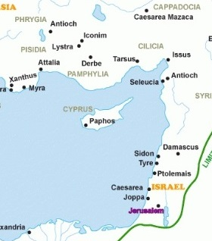
Going Back to Make Disciples
Acts 15:40-41
“Paul chose Silas and departed, having been commended by the brothers to the grace of the Lord. And he went through Syria and Cilicia, strengthening the churches.”
Paul and Silas
Phoenicia

Slide 3
In Lystra with Timothy
Acts 16:1,2 During his first ministry in Lystra, Paul was almost killed by stoning. But there was a young, half-Jewish disciple there, “well-spoken of,” named Timothy.
Acts 16:3 Timothy was not circumcised for salvation, but to remove any barriers for Jewish evangelism.
1 Corinthians 9:19-22 If we love people, we will be ready to do whatever is needed to reach them with the gospel.
Acts 16:4,5 The important message of salvation – it is: by grace alone through faith alone in Christ alone.
Notes:
An important attribute for ministers – be above reproach (1 Tim 3:2,10)
While Paul decided it was helpful to circumcise the half-Jewish Timothy, he did not circumcise the full-blooded Gentile, Titus (Gal 2:3).
Missionaries must be sensitive to the unique characteristics of the cultures in which they work.

Slide 4
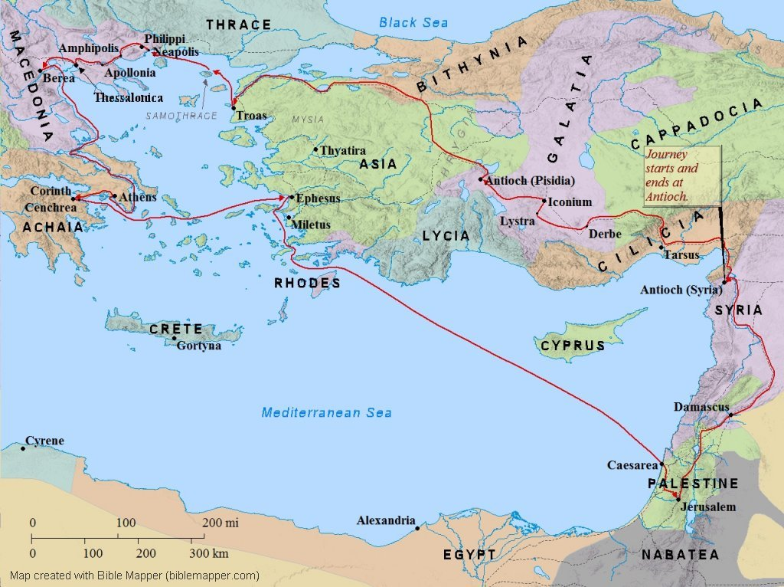
And they went through the region of Phrygia and Galatia, having been forbidden by the Holy Spirit to speak the word in Asia. Acts 16:6

Slide 5
And when they had come up to Mysia, they attempted to go into Bithynia, but the Spirit of Jesus did not allow them. So, passing by Mysia, they went down to Troas. Acts 16:7,8

Slide 6
And a vision appeared to Paul in the night: a man of Macedonia was standing there, urging him and saying, “Come over to Macedonia and help us.” And when Paul had seen the vision, immediately we sought to go on into Macedonia, concluding that God had called us to preach the gospel to them.” Acts 16:9,10

Slide 7
“So, setting sail from Troas, we made a direct voyage to Samothrace, and the following day to Neapolis, and from there to Philippi, which is a leading city of the district of Macedonia and a Roman colony.” Acts 16:11,12

Slide 8
Following God’s Direction
Acts 16:6-10 Paul knew his calling – to bring the gospel to new places (even difficult places). He knew that God would lead them as they kept doing His will.
A basic principle of knowing God’s will: do what God calls you to do, allowing Him to “close and open doors” along the way.
Acts 16:10 The first of the “we” passages in Acts. Luke, the writer of Acts, has now joined Paul’s missionary team.
“immediately we sought to go…” sets a good example for responding to God’s call.
Notes:
“slow obedience is no obedience” (Perry Bowers)

Slide 9
The First Christian in Europe
Acts 16:13 To form a synagogue required at least ten men, heads of households (not many Jews in Philippi).
A “place of prayer” was usually under the open sky and near water.
Don’t ever think that the Bible (or Paul) is prejudiced against women. The first gospel meeting in Europe was held with only women.
Acts 16:14,15 3 things about Lydia (from Thyatira, Asia):
A worshiper of God (already turned from idols)
Listened to the gospel being preached by Paul
God opened her heart to believe and obey
Notes:
God had given Lydia a heart to seek Him
Many hear the gospel but don’t really listen (Matthew 13:11-17)
God is the One who causes people to be saved (1 Corinthians 3:6-7)
Her salvation is demonstrated by baptism (obedience) and hospitality (love)
Although she was rich, she opened her home for service

Slide 10
Some “Take Aways”
If we love people, we will be ready to do whatever is needed to reach them with the gospel.
To know God’s direction: continue doing what He has called you to do and be aware of open/closed doors.
The Gospel and the Bible brought new levels of respect to all people: Gentiles and women

Slide 11
A Woman in Bondage
Acts 16:16 Paul established a regular practice of going to the place of prayer, preaching and praying every week.
A girl enslaved by demons and by men, used for profit.
Acts 16:17 She spoke the truth about God and Paul.
People may have assumed she was a part of the group, which could allow her to do harm to the cause of Christ.
Acts 16:18 God uses Paul to set her free from demonic control (and we hope, from sin).
Notes:
In contrast to Lydia, this woman was controlled by the devil to do his will.
We do not have apostolic powers of exorcism, but we do have the spiritual weapons described in Ephesians 6:10ff
Explain difference between prophet and profit.

Slide 12
Persecution Again…
Acts 16:19 Instead of rejoicing about her deliverance, the girl’s masters are angry about losing their business.
Acts 8:3 Who else brought Christians to prisons?
Acts 16:20,21 The real reason was not laws, but money.
Acts 16:22 The authorities were caught up in the mob frenzy, breaking Roman legal procedures
(Paul was beaten three times with rods – 2 Corinth 11:25)
Acts 16:23,24 Locked in stocks – maximum security prison
Notes:
Money can quickly blind people (1 Timothy 6:9,10)
Acts 16:21 It was illegal to practice any foreign religion not approved by the Roman government.
The rule about religion was rarely enforced – only when convenient to do so.

Slide 13
Focused on God, not Circumstances
Acts 16:25 Imagine praising God instead of complaining about false accusations and illegal treatment (Phil 2:14,15)
“What comes into our minds when we think about God is the most important thing about us.” (A.W. Tozier)
Acts 16:26 A natural earthquake usually crushes and kills people – this one sets people free
Acts 16:27,28 The jailer was also in bondage, but…
Acts 16:29,30 The situation has turned around – the jailer now kneels before God’s men
Notes:
God can quickly turn a bad situation into a good one for His glory.

Slide 14
Truly Set Free
Acts 16:31,32 God uses everything for good – the gospel is proclaimed and people are saved!
Believe in the Lord Jesus: He is God in the flesh, He died for your sins, and He rose to give you life!
Acts 16:33,34 Evidence of true salvation:
Love: he washed their wounds
Obedience: he was baptized
Hospitality: he fed them
Joy: he rejoiced along with his entire household
Acts 16:35-40 Paul uses his position, not to seek revenge, but to prevent future abuse of other Philippian Christians
Notes:
God can quickly turn a bad situation into a good one for His glory.

Slide 15
Some “Take Aways”
If we love people, we will be ready to do what is needed to reach them with the gospel.
To know God’s will: continue to do what He calls you to do and be aware of closed doors.
The Gospel and the Bible brought new levels of respect to all people: Gentiles and women
Guard yourself against fortune tellers and spiritual enemies
Bring the gospel to your household (like the jailer)
When suffering, focus on God, not on your circumstances

