Slide 1
Sharing in Three Places
Acts 17
Reasoning from the Scriptures

Slide 2
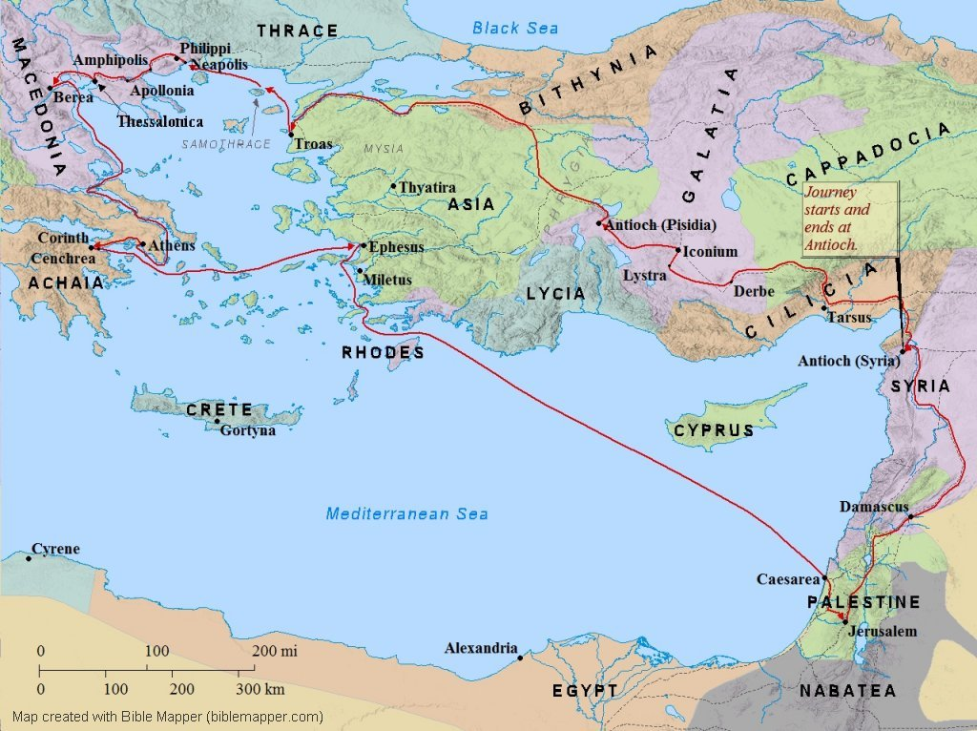
“Now when they had passed through Amphipolis and Apollonia, they came to Thessalonica, where there was a synagogue of the Jews.” Acts 17:1

Slide 3
Thessalonica : Trapped by Tradition
Acts 17:2 Three weeks in the synagogue, reasoning from the scriptures.
Acts 17:3 Reasoning = explaining and proving. His focus: Jesus’ death and resurrection – He is the Savior!
Acts 17:4 “some” Jews believe and a “great many” devout Greeks and women
Acts 17:5 “But the Jews were jealous.” Blinded by tradition instead of looking for truth.
Notes:
Thessalonica – the capital city of Macedonia with 200,000 people. A major port city and commercial center.

Slide 4
Thessalonica : Trapped by Tradition
Acts 17:6 “men who have turned the world upside down” is a great claim! The true gospel is opposite of the world.
Acts 17:7 The Jews were called to bring the gospel to the world. Sadly, they claimed Caesar to be above Jesus.
Acts 17:8,9 The crowd was troubled and confused instead of enlightened about God’s truth.
The first place: blinded by tradition. “If then the light in you is darkness, how great is the darkness!” (Matt 6:23c)
Notes:
One of the most serious offenses would be to acknowledge allegiance to any king but Caesar.

Slide 5
“The brothers immediately sent Paul and Silas away by night to Berea, and when they arrived they went into the Jewish synagogue.” Acts 17:10

Slide 6
Berea: Noble Scripture Students
Acts 17:11 Two wonderful things:
  “received the message with great eagerness”
  “examined the Scriptures every day to see if what Paul said was true.”
Acts 17:12 The wonderful result: “Many of them therefore believed,”
Acts 17:13 There is an enemy, and sometimes, he comes in religious clothing (2 Corinthians 11:14,15)
Notes:
Quotes from NIV

Slide 7
“Then the brothers immediately sent Paul off on his way to the sea, but Silas and Timothy remained there. Those who conducted Paul brought him as far as Athens, and after receiving a command for Silas and Timothy to come to him as soon as possible, they departed.” Acts 17:14,15

Slide 8
Athens: Philosophers and Talkers
Acts 17:16 Paul’s spirit was greatly distressed by idols. How do you feel in a Buddhist temple?
Acts 17:17 Paul taught in the synagogue and in the marketplace – people everywhere need the gospel.
Acts 17:18 What was Paul preaching about?
Acts 17:19-21 Some people enjoy the process of debate and discussion more than finding the answer (2 Tim 3:7).
When facing a strong debater, ask this: “If I answer your question, will you consider becoming a believer in Jesus?”
Notes:
Athens, home to the most famous philosophers in history: Socrates, Plato, Aristotle
Epicurus – founder of Epicureanism: taught that the chief end of man was the avoidance of pain. Believed that God was not involved in human affairs and that body and soul disintegrated at death.
Zeno – founder of Stoicism: that the goal of life was to reach a place of indifference to pleasure or pain.
Babbler = “seed picker” – someone who had no original ideas, but just picked preferences from others.

Slide 9
Athens: Preaching from Natural Law
Acts 17:22-23 Paul studied the people and their culture to find a common starting point for the gospel
Acts 17:24-25 The true God is Creator of all with perfect power – He doesn’t need us to build a house for Him!
Acts 17:26-28 God controls time and space – He brought us together right now to let you find Him!
Acts 17:29 It is ignorant to think people can create God with their own hands!
Acts 17:30-31 Fundamentals of the gospel: judgment, righteousness, resurrection, and repentance
Notes:
Areopagus – a court named for the hill on which it met.
God who made the world – neither Epicureans nor Stoics believed that God created the world. Epicureans believed the universe was eternal and Stoics were pantheists, who believed God was a part of everything and could not have created himself.

Slide 10
Athens: Gospel Responses
Acts 17:32-34 After hearing the gospel, three typical responses of people:
“some mocked” – these people are unwilling to accept the possibility of a supernatural resurrection
“we will hear you again” – these are people who delay, waiting for another time to decide (often, too late)
“some men joined him and believed” – people who receive the message with faith (God knows their names)

Slide 11
Some “Take Aways”
Tradition and confidence can blind people to the truth. They must see their need before believing.
Come to Bible study “hungry” and test the teaching to be sure it is true.
Try to learn about your audience before speaking, starting with points of common understanding.
The gospel of Jesus “turned the world upside down”!

