Slide 1
Serving God in our Weakness
Acts 18
“My grace is sufficient for you, for My power is made perfect in weakness.” 2 Corinthians 12:9

Slide 2
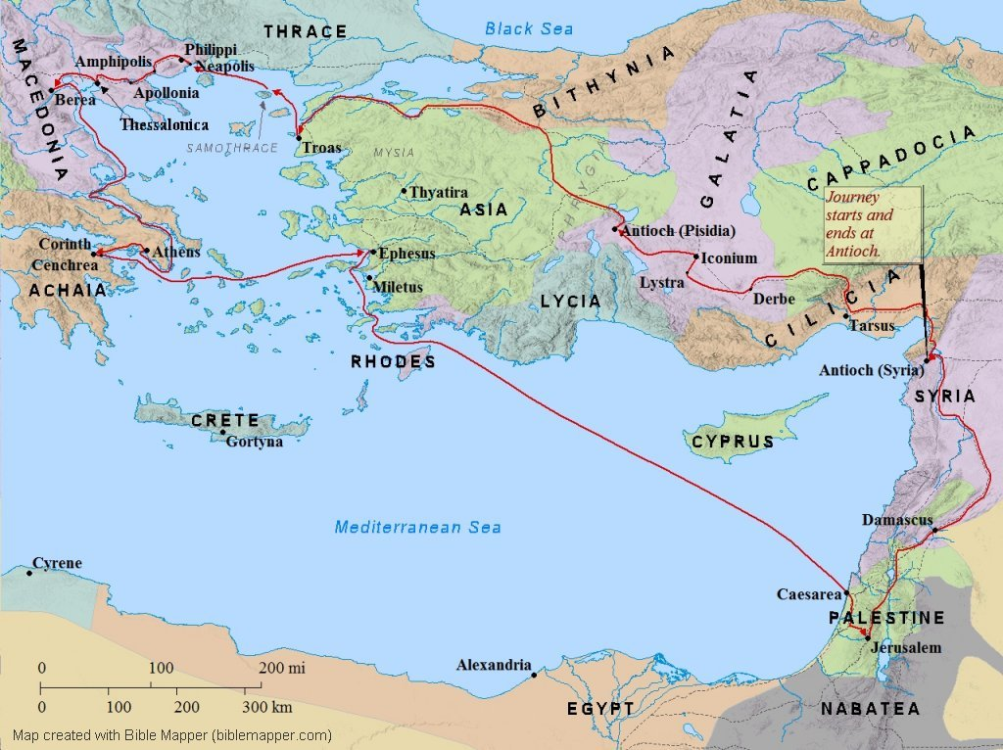
“After this Paul left Athens and went to Corinth.” Acts 18:1

Slide 3
“Tentmaking” in Corinth
As Paul left Athens, he may have been discouraged by their lack of belief and his loneliness (more later on this).
Corinth was known as a wicked city, home to the temple of Aphrodite, the “goddess of love,” worshiped with 1000 prostitutes.
Acts 18:2 Aquila and Priscilla were probably already believers, coming from the church in Rome (Romans 1:7-8).
Acts 18:3,4 Tentmakers: Paul’s goal was evangelism and discipleship, but worked to support himself. This term is now used to describe self-supporting missionaries.
Notes:
Corinth was the crossroads of business and prostitution, so much so that Korinththiazomai, “to Corinthianize,” meant to practice whoredom.
Paul’s tentmaking job was his initial position in Corinth. Often, missionaries start their work with a local job.

Slide 4
Rejecting the Rejecters
Acts 18:5 Silas and Timothy brought support from Macedonia (2 Cor 11:9), allowing Paul to stop making tents and focus completely on study and preaching about Jesus.
Acts 18:6 “They opposed and reviled him” – the Jews continued to reject the message (and messenger) of Jesus.
To “shake our your garment” was a traditional Jewish way to separate from dirty, ungodly people.
“Your blood be on your own heads!” – these people were fully responsible for what they were doing.
Matthew 7:6 Sometimes, we must decide that we are wasting time to debate with people who refuse truth.
Notes:
Remember – all of the preaching from “the Word” was using the Old Testament to demonstrate that Jesus fulfilled prophesy and was the anointed One, the Messiah.

Slide 5
Encouragement from People and God
Acts 18:7 Titius Justus, a Roman worshiper of God, finds the truth about Jesus!
Acts 18:8 Crispus, the Jewish synagogue leader believed, along with his family. This may have upset the other Jews.
“Many of the Corinthians believed” – God built His church!
Acts 18:9 “Do not be afraid” – why would God tell Paul this?
1 Corinthians 2:1-3 Paul came to Corinth feeling fear. Even Paul felt fear and weakness. Do you ever feel this way?
“I often think that God must have been looking for someone small enough and weak enough for Him to use, and that He found me.” (Hudson Taylor)
Notes:
God probably told Paul to “not be afraid” because Paul “was afraid.”

Slide 6
Protection from God
Acts 18:9,10 God encouraged Paul with a promise.
God had “many in this city who are My people.” God already knew those who would believe, but they still needed to hear the message of salvation (Rom 10:13-17)
Acts 18:11 Paul stayed and helped establish the church.
Acts 18:12,13 Gallio, was the proconsul from July-51 to June-52. The Jews hoped to take advantage of his lack of experience.
Acts 18:14-17 Gallio rejected their request. If accepted, it could have caused Christianity to be banned in Corinth.
Notes:
There were people in Corinth “chosen” for salvation, but this fact is balanced by the willful rejection of salvation by the Jews in verse 6. As we often see, election and human responsibility are both true, demonstrated in the same chapter.
Gallio was the brother of Seneca, the famous Roman philosopher and tutor of Nero. Seneca described Gallio as intelligent and hating flattery.

Slide 7
“After this, Paul stayed many days longer and then took leave of the brothers and set sail for Syria, and with him Priscilla and Aquila. At Cenchrea he had cut his hair, for he was under a vow.” Acts 18:18

Slide 8
The Nazarite Vow
Jewish traditions were very strong, even for Christians:
  Peter and John still joined daily prayers at the temple (3:1)
  Peter resisted eating “unclean” foods (10:9-16)
  Some felt they should continue following the law (15:5)
Acts 18:18 “he had cut his hair, for he was under a vow.”
  The Nazarite vow (Numbers 6:2-21) was a special promise to God
  Often made in thanksgiving to God for blessing
  He would not cut his hair until the end of the vow; he would then shave his head and burn the hair with a sacrifice.
  Must offer sacrifice in Jerusalem in 30 days
Notes:
In Leviticus 11, God describes things that are unclean and should not be eaten (to separate Israel from other nations. But when Jesus came to fulfil the law, in Mark 7:19, Jesus “declared all food clean”

Slide 9
“And they came to Ephesus, and he left them there, but he himself went into the synagogue and reasoned with the Jews.” Acts 18:19

Slide 10
Finishing his 2nd missionary trip
Acts 18:19 Aquila and Priscilla stayed in Asia, eventually having a church in their home (1Corinthians 16:19).
As usual, Paul reasoned with the Jews in the synagogue.
Acts 18:20 Even though the people in Ephesus were hungry for Paul’s teaching, he sensed that God was calling him away (for now).
Don’t always think that you should try to meet every need. Listen to God and follow His direction.
Acts 18:21 Keep serving God, always sensitive to where and when He guides you.
Notes:
Sometimes, when we assume that we should step up and try to meet a need, it may be that we are blocking the opportunity for someone else to fill the spot God has made for them.

Slide 11
“When he had landed at Caesarea, he went up [to Jerusalem] and greeted the church, and then went down to Antioch. After spending some time there, he departed and went from one place to the next through the region of Galatia and Phrygia, strengthening all the disciples.” Acts 18:22,23
Notes:
In order to accommodate people who did not live near the temple in Jerusalem, Jewish law allowed for 30 days to come to Jerusalem and offer the final sacrifice and complete a Nazarite vow. So Paul needed to go to Jerusalem to finish the sacrifice (and burn up his severed hair).

Slide 12
Apollos: Bold and Humble
Acts 18:24 Apollos, a Jew who knew the Old Testament and understood some things about the promised Messiah.
Acts 18:25 “the way of the Lord” is often used in the Old Testament to describe truth from God (e.g. Gen 18:19).
His faith was based on God’s promises and John the Baptist’s message of repentance and the coming Messiah
Acts 18:26 Apollos was humble, willing to be taught by a tentmaker and his wife.
Acts 18:27,28 Apollos traveled back to the capital of Achaia (Corinth) and powerfully served the church there.
Notes:
Sadly, the Corinthian church eventually broke into factions based on their favorite powerful preacher (1Corinthians 3:3-6)
Malachi 3:1 – John the Baptist would immediately precede Jesus

Slide 13
Some “Take Aways”
Don’t let fear and weakness stop you from trusting God to speak through you.
Look for opportunities to share the good news, asking God to lead you to people hungry for truth.
Keep serving God, always sensitive to where and when He guides you.
If God can use a tentmaker and his wife, He can use all of us.

