Slide 1
The Powerful Word of God
Acts 19a
“So the word of the Lord continued to increase and prevail mightily.” Acts 19:20

Slide 2
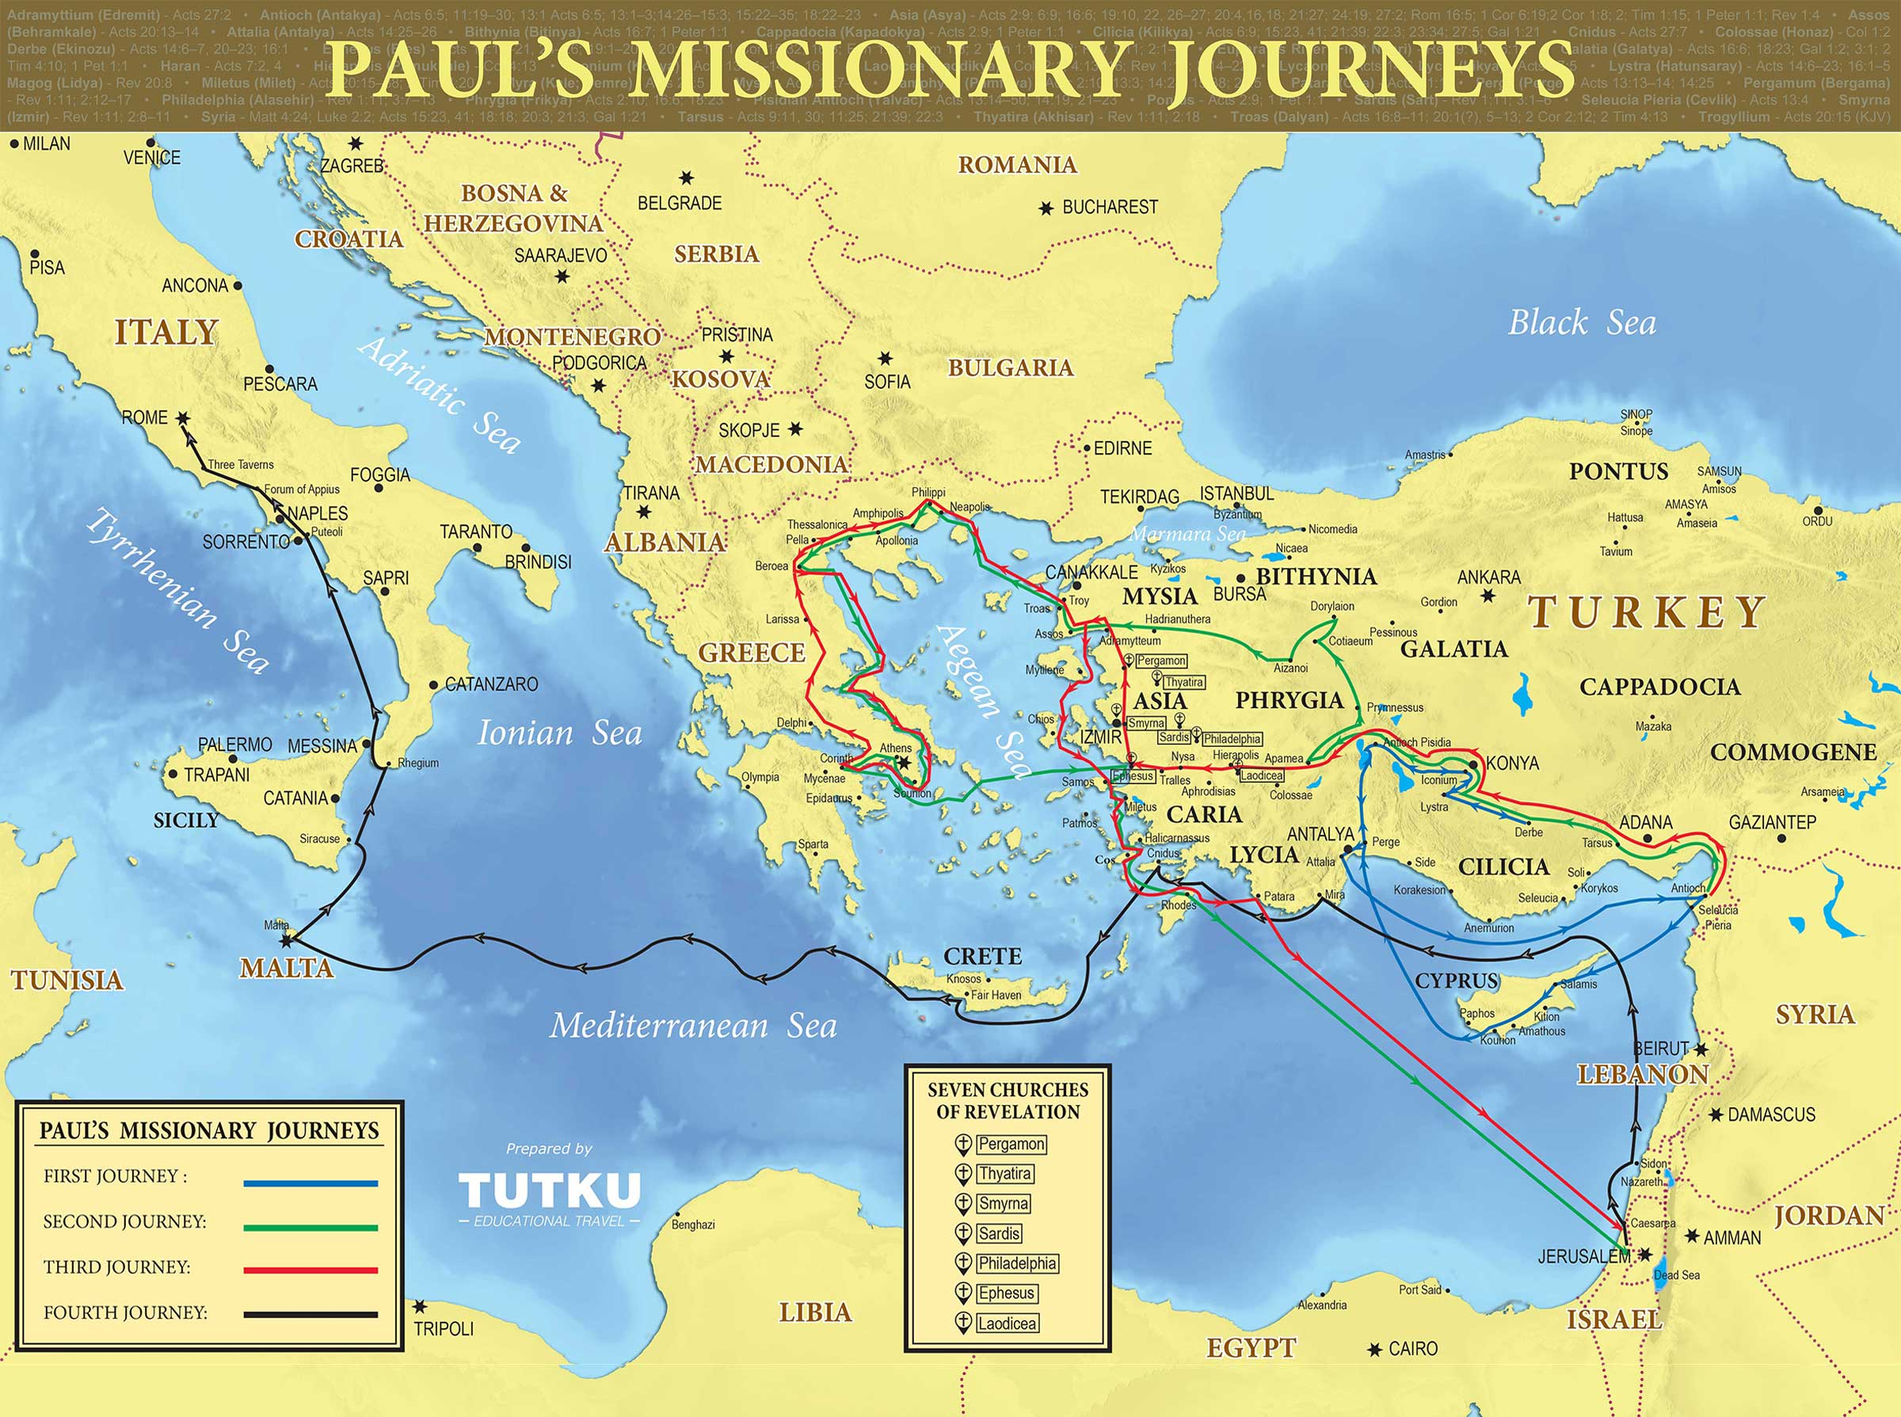
“And it happened that while Apollos was at Corinth, Paul passed through the inland country and came to Ephesus.” Acts 19:1

Slide 3
Old Testament Believers
Acts 19:1,2 Disciples = “follower.” Not all are disciples of Jesus (Mark 2:18). All true NT believers in Jesus have the Holy Spirit (1 Corinthians 6:19; Ephesians 1:13).
Acts 19:3,4 Paul tested their understanding and faith (and so should we - 2 Cor 13:5). Genuine Christians repent and believe in Jesus (Mark 1:14-15).
Acts 19:5 “On hearing this…” – they repented, then heard the rest of the gospel from Paul and believed (Rom 10:17).
Acts 19:5-7 These 12 men were Old Testament believers: ones who looked forward with belief to the promised Savior.
The church is now complete with all four groups of Christians: Jews, Samaritans, Gentiles, OT believers (Acts 2,8,10)
Notes:
These men were waiting for the promised Messiah, but they didn’t know He was Jesus and had already come (like Apollos before getting the complete story from Paul).
Laying on hands was a special act of fellowship, incorporating these new believers into the church. As with the other three representative groups, they manifested the presence of the Holy Spirit with tongues and prophecy.

Slide 4
Hardened Jews and Open Gentiles
Acts 19:8 Paul had an open door to return to Ephesus and preach (18:19-21). Reasoning (Ggk. dialegomai) involved questions and answers, not just lecture.
Acts 19:9 When the truth is repeatedly rejected, the heart grows hard and resistant to the gospel (Heb 3:8,13). Jews who refused to believe soon spoke evil of Jesus.
Since nothing else was to be gained by teaching in the synagogue, Paul left, along with those who believed.
Acts 19:10 Paul was always ready to teach anywhere. His daily “marketplace ministry” helped make many new disciples that brought the good news to their Asian towns.
Notes:
Sadly, the ones who should’ve been ready to receive the gospel remained trapped in religion, hardening their hearts and even growing antagonistic to the truth.

Slide 5
Apostolic Power and the Message
Acts 19:11,12 God gave the apostles special power to demonstrate the trustworthiness of the message.
Other people do not have miracle powers of the apostles:
Acts 19:13-14 Ancient magicians would borrow any name or power they thought might work for them (Acts 8:9).
Acts 19:15-16 These men did not have the authority of the apostles and the name “Jesus” is not a magical charm.
Acts 19:17 The devil may have thought this would frighten people away from Jesus, but instead, their fear of God’s power/glory brought them to Jesus (Revelation 1:10-18)
Notes:
The sons of Sceva may have fooled the gullible Ephesians with their fake magic, but they were not able to fool the evil spirits.
May choose NIV for verse 17 to simplify wording.

Slide 6
Signs of True Repentance
Acts 19:18 Many people in Ephesus used magic to try and gain personal power, but found Jesus to be greater. To “divulge” their magic spells = eliminating their power.
Acts 19:19 Burning their books “in the sight of all” showed they were serious about following Jesus.
50,000 silver pieces is a huge amount of money (200 years of typical wages). God had truly set them free from evil!
Acts 19:20 The power of salvation is in the Word of the Lord, greater than any other power!
Notes:
Note that the people didn’t monetize their sin – they sacrificed it to the Lord.

Slide 7
Some “Take Aways”
Not everyone who claims to be a Christian is a true disciple of Jesus. It is OK to test and see.
When people feel the conviction of sin, encourage them to believe before their hearts grow cold/hard.
Seek to know the “fear of the Lord” as you read His holy word – it is a good thing!
When a people truly come to the Lord, they “put off” their former sins and “put on” righteousness (Ephesians 4:20-24).

