Slide 1
Growing Under Pressure
Acts 19b
“An effective church is a bold church, and a bold church is often made strong through suffering.” John MacArthur, Jr.

Slide 2
Some Sources of Persecution (to make someone suffer because of religious beliefs)
Acts 5:17-18 Organized religion
Acts 13:44-45 Jealousy
Acts 16:18-19 Love of money
Acts 17:5 Jealousy and mob violence
Acts 17:32 Worldly philosophy
Acts 18:12-13 Tradition
Acts 19:22-41 Today’s lesson…

Slide 3
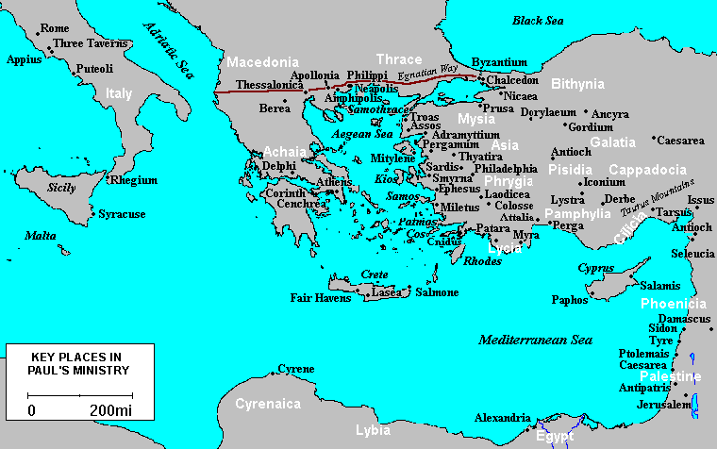
Now after these events Paul resolved in the Spirit to pass through Macedonia and Achaia and go to Jerusalem, saying, “After I have been there, I must also see Rome.” Acts 19:21

Slide 4
Paul’s Travel Plans
Acts 19:21 Before returning to Jerusalem, Paul revisited Macedonia and Achia to collect an offering for the church in Jerusalem (Romans 15:25-26). This showed the unity of the church across cultural lines.
“I must also see Rome.” Paul had a strong desire to preach the gospel to those who had never heard about Jesus (Rom 15:20).
From this point in Acts, Paul’s focus is to reach Rome. He will get there, but by a different way than he expected.
Paul delayed his travel plans and remained in Ephesus a bit longer (1 Corinthians 16:8-9). Two things that often go together: an open door for service and many adversaries.

Slide 5
Reasons for the Riot
Acts 19:23 “The Way” – the message of the early church
Acts 19:24 The worship of Artemis was widespread in the Roman Empire, but Ephesus had the most famous temple.
Acts 19:25 Their biggest worry was about money – the gospel was a threat to their business.
Acts 19:26 Questions: Which is greater, the creator or the thing created? If a man makes a “god,” how great is that god?
“turned away a great many people” – Demetrius knew that the gospel turned away many people from idolatry (1 Thess 1:9).
Acts 19:27 Worship = putting high value on something. It is sad when people worship man-made things (Psalm 135:15-18).
Notes:
Demetrius knew what Paul was teaching, but had no other charge against Paul. He was not accused of wrongdoing…
(Problem: people choose gods that they can control; idolatry = self-worship).

Slide 6
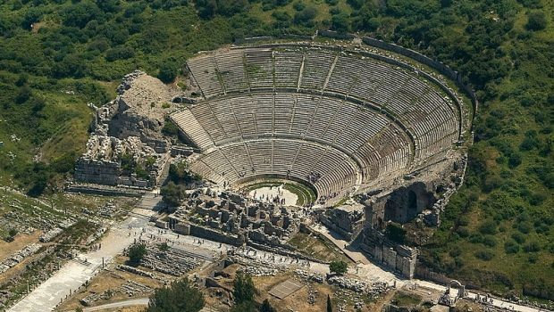
A Very Large Crowd
Acts 19:28-29. The theater at Ephesus could hold 25,000 people (it has been amazingly preserved).
Notes:
Aristarchus was a beloved traveling companion of Paul, accompanying him on the ill-fated voyage to Rome (Acts 27:2) and sharing his imprisonment there (Colossians 4:10)

Slide 7
A Confused Crowd
Acts 19:28-29 When people spend their life worshiping something, even if it is false, it can be hard to stop.
Acts 19:30-31 “Asiarchs” were members of wealthy and noble families, committed to Caesar. The fact that such men supported Paul shows they did not consider him to be dangerous or doing anything illegal.
Acts 19:32 The mob wasn’t sure why they were rioting
Acts 19:33-34 Pagan idolaters saw no difference between Jews and Christians – both worshiped an invisible God.
Notes:
False worship of a fake God is “sunk cost” – it has no lasting value and should be totally left behind, having no impact on future decisions.

Slide 8
The Calming of the Crowd
Acts 19:35 Two other temples of Artemis had meteorites to worship, one in Rome and the other in Tarsus.
Acts 19:36 He claimed that nothing Paul said could stop people from worshiping Artemis. He was wrong. Today, no one worships Artemis and millions worship Jesus.
Acts 19:37-38 The Christians had not broken the law. If Demetrius had a real complaint, he should follow the legal process.
Acts 19:39-41 There is no historical record that Demetrius and his fellow craftsmen took the matter further.

Slide 9
Some “Take Aways”
When you find an open door for serving Jesus, expect that you will also meet opposition.
Persecution will come from different people for different reasons. Stand strong in your faith!
Idolatry is ugly and idol temples are not beautiful.
The gospel of Jesus always wins!

