Slide 1
Following God into Difficulty
Acts 21-22
“I do not account my life of any value nor as precious to myself, if only I may finish my course and the ministry that I received from the Lord Jesus...” Acts 20:24
Notes:
Paul continues his ministry under the leadership of the Holy Spirit, even though it is perfectly clear he will suffer greatly. But his focus is very clear…

Slide 2
God’s Plan for Paul
Acts 20:22,23 “And now, behold, I am going to Jerusalem, constrained by the Spirit, not knowing what will happen to me there, except that the Holy Spirit testifies to me in every city that imprisonment and afflictions await me.”
John 16:20-22 Good things are not always easy. Sometimes, the greatest joy comes after the greatest pain (Isaiah 51:11)
2 Corinthians 6:8b-10 “We are treated as impostors, and yet are true; as unknown, and yet well known; as dying, and behold, we live; as punished, and yet not killed; as sorrowful, yet always rejoicing; as poor, yet making many rich; as having nothing, yet possessing everything.” (Matthew 5:11-12)
Acts 20:36-38 Paul’s friends from Ephesus grieved about his future. But after praying, he went.
Notes:
When a person becomes a Christian, he now has a much greater capacity to feel deep sorrow and experience great joy. Unbelievers around us ignore eternally significant issues and try to cover up their emptiness and sorrow with jokes and alcohol. But Christians grieve over their lost loved ones (Romans 9:2-3) and the sin of the world. But we also have come to know the God who made us and love the Christ who saved us. We have a rock-solid hope in the Word of the living God to help us face death and the troubles of this sinfully broken world.
The paradoxes in 2 Corinthians 6 all have some truth in them:
“as impostors, and yet are true” Remember that Jesus said, “Woe to you, when all people speak well of you, for so their fathers did to the false prophets” (Luke 6:26). You can’t be a true prophet if all speak well of you.
“as unknown, and yet [we are] well known.” Yes, we are nobodies in the Roman Empire. A tiny movement following a crucified and risen King. But we are known by God, and that is what counts (1 Corinthians 8:3; Galatians 4:9).
“as dying, and behold, we live.” Yes, we die every day. We are crucified with Christ. Some of us are imprisoned and killed. But we live because Christ is our life now, and he will raise us from the dead.
“as punished, and yet [we are] not killed.” Yes, we endure many human punishments, but over and over God has spared us from death. And he will spare us until our work is done.
“as sorrowful, yet [we are] always rejoicing.” Yes, we are sorrowful. There are countless reasons for our hearts to break. But in them all we do not cease to rejoice, living for the greatest purpose of all!
“as poor, yet [we are] making many rich.” Yes, we are poor in this world’s wealth. But we don’t live to get rich on things, we live to make people rich on Jesus.
“as having nothing, yet [we are] possessing everything.” In one sense, we have counted everything as loss for the surpassing value of knowing Christ Jesus (Philippians 3:8). But, in fact, we are children of God, and if children, then heirs of God and fellow heirs with Christ (Romans 8:17).
His oath, his covenant, his blood, Support me in the whelming flood. When all around my soul gives way, He then is all my Hope and Stay.

Slide 3
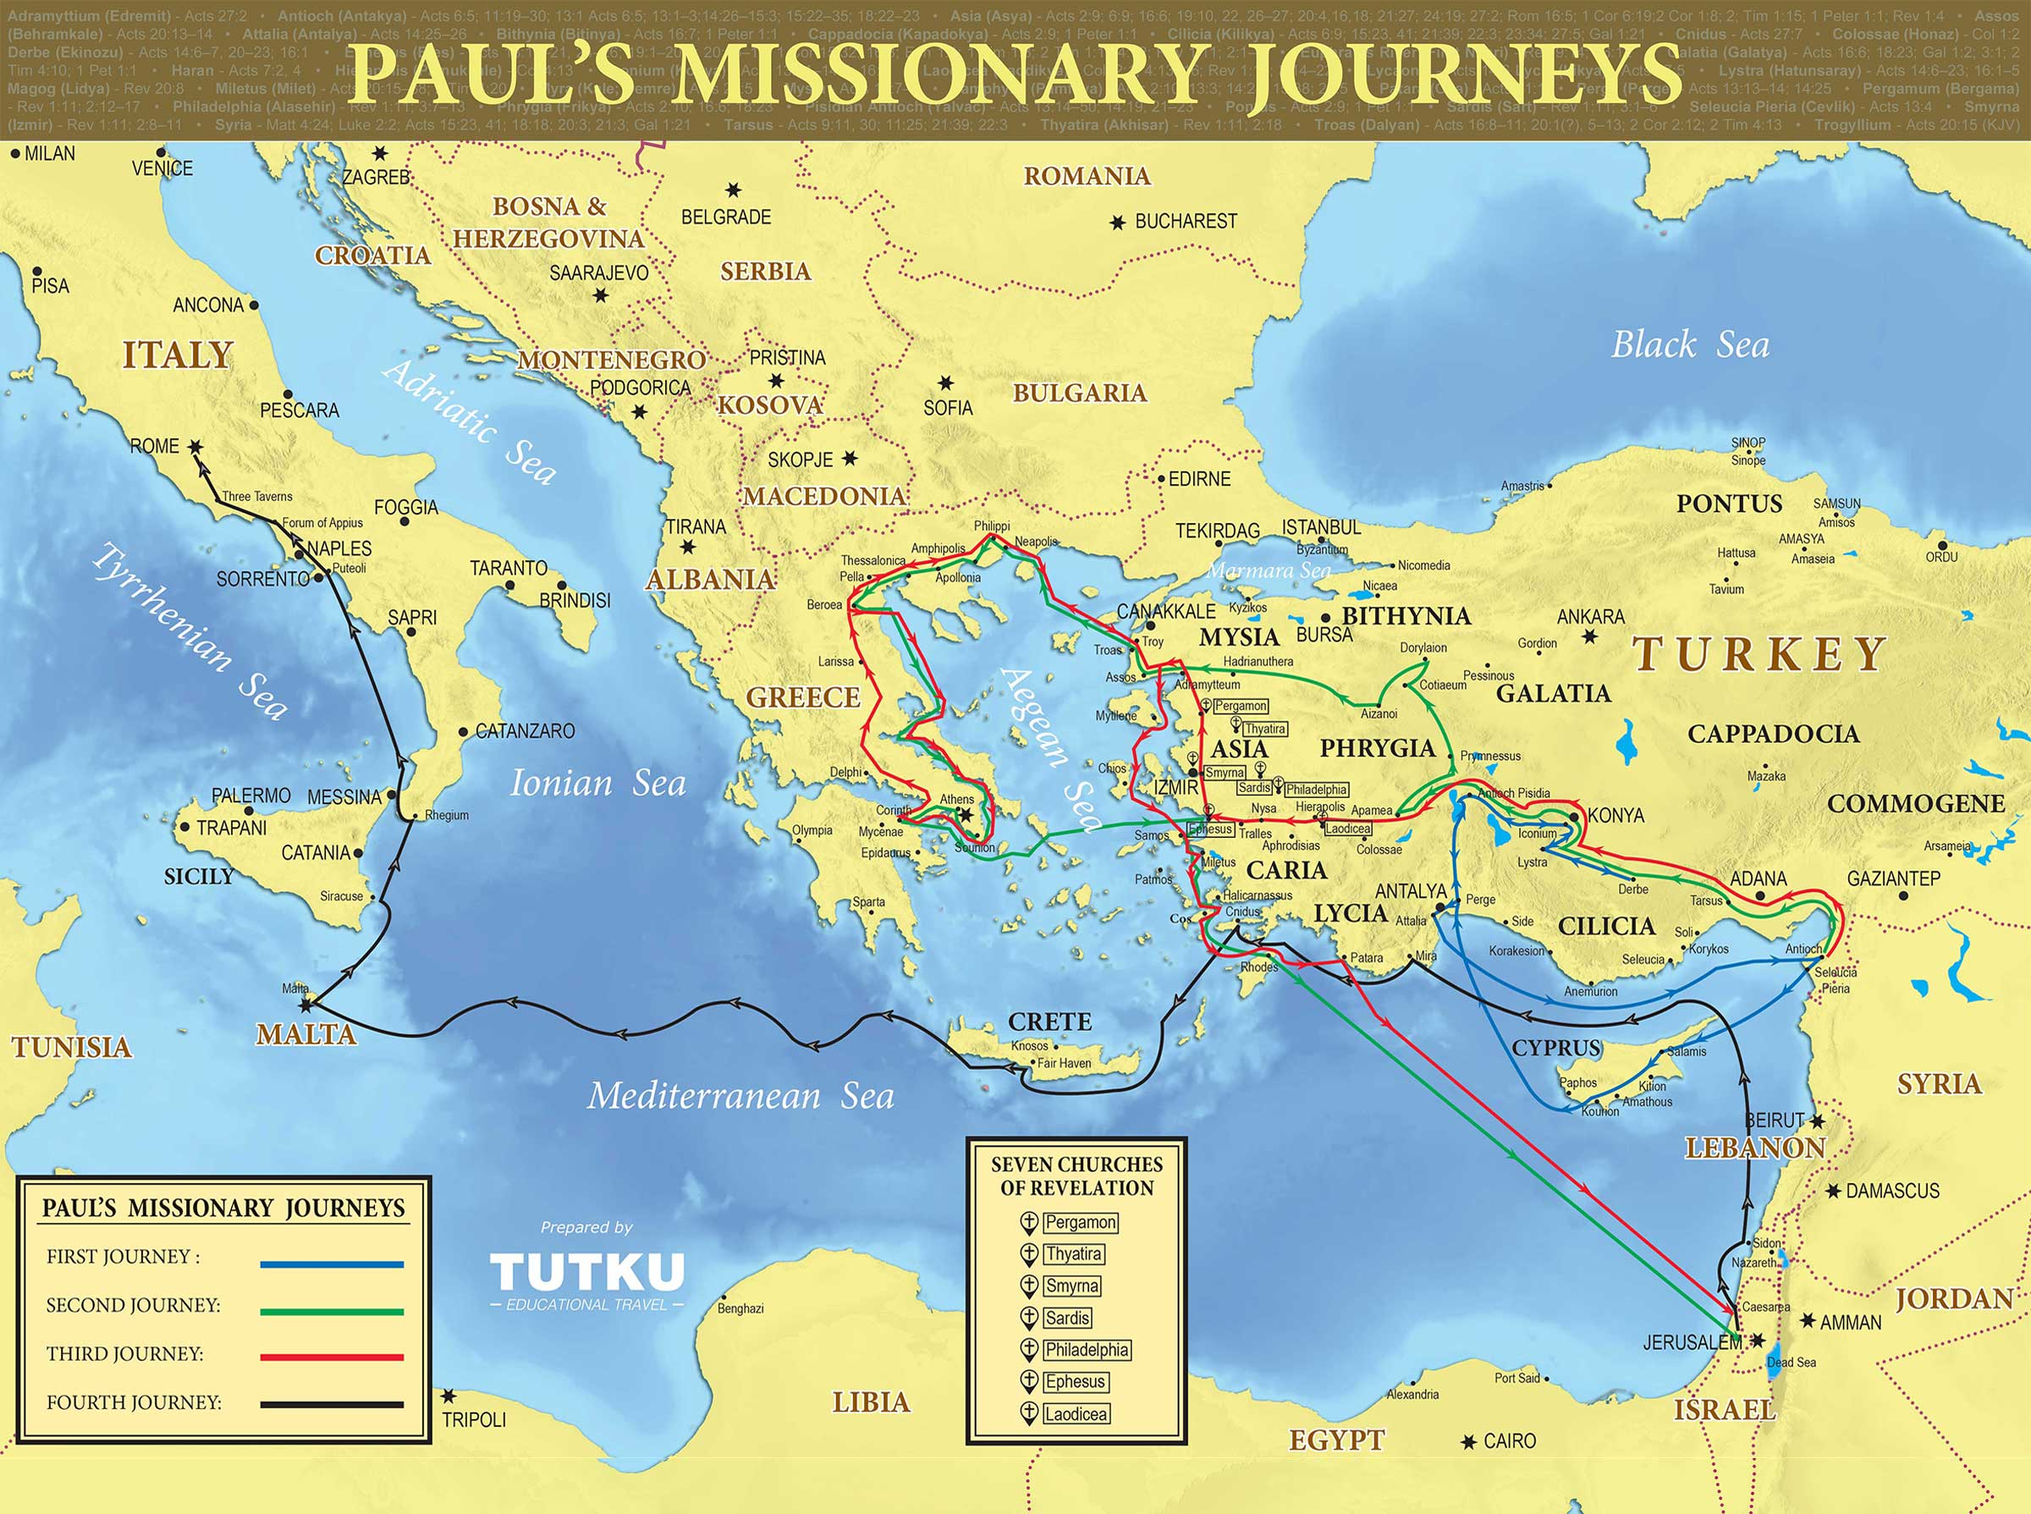
Paul journeyed around this region for 22 years, planting and serving churches
And when we had parted from them and set sail, we came by a straight course to Cos, and the next day to Rhodes, and from there to Patara. And having found a ship crossing to Phoenicia, we went aboard and set sail. When we had come in sight of Cyprus, leaving it on the left we sailed to Syria and landed at Tyre, for there the ship was to unload its cargo. Acts 21:1-3

Slide 4
Confident Paul / Cautious Friends
Acts 21:3,4 The disciples in Tyre knew Paul was about to suffer and warned him not to go. But after praying (v.5), he went.
Acts 21:10-12 The believers in Caesarea knew Paul would suffer in Jerusalem and urged him not to go.
Acts 21:13-14 What do we say (and pray) to a person willing to suffer and die for Jesus’ name? Do we break their heart or trust “the will of the Lord”?
Some of our biggest “idols”: health and safety.
Notes:
2 Timothy 4:7 shows that Paul finished his course and kept the faith.

Slide 5
Joy in Jerusalem
Acts 21:17-20a “the things God had done among the Gentiles through his ministry.” “they glorified God.” This is our purpose for living and our greatest privilege.
Acts 21:21-22 Paul taught from the OT Scriptures and did not tell Jews to “forsake Moses.” He would only speak against man-made traditions that conflicted with the gospel of grace.
Acts 21:23-24 The church leaders had a plan to prove Paul was still following important Jewish traditions.
Acts 21:25 Another reminder that salvation is by grace, not the law.

Slide 6
Anger in Jerusalem
Acts 21:27-28 Paul is falsely accused (always check the facts before judging someone).
Acts 21:30 The crowd loses control.
Acts 21:31-34 A Tribune commanded 600 soldiers. He trusted the crowd and assumed Paul was guilty.
Acts 21:40 – 22:2 Paul begins his defense.
Acts 22:3-4,12 Paul identifies with his audience, calming their anger and sharing his testimony.
Acts 22:21-22 One word (“Gentiles”) sparks new fury in the crowd. There is great danger in zealous nationalism!
Notes:
An interesting observation about “mob mentality”: When people are in groups, there tends to be polarization— that is, majority rules and anyone who disagrees gets cast out. The main opinion becomes the only opinion, and the more that people outside their group disagree, the more those inside the group want to show they are right. Once the group becomes loud enough or intense enough, even those inside the group who begin to think that it has gone too far are afraid to disagree because they do not want to be outcast from their group.

Slide 7
Some “Take Aways”
Remember the amazing sacrifice of Jesus, who left the comforts of heaven to suffer on the cross for you.
Focusing on our inheritance makes it possible to be “sorrowful, yet always rejoicing.”
What is most important to me: safety, comfort or Jesus?
Be very aware of the dangers of “mindless mob thinking” or zealous nationalism!

Slide 8
A Serious Letter (written by Adoniram Judson ~1810 to the father of Ann Hasseltine)
“I have now to ask whether you can consent to part with your daughter early next spring, to see her no more in this world?”
Whether you can consent to her departure to a heathen land, and her subjection to the hardships and sufferings of a missionary life?
Whether you can consent to her exposure to the dangers of the ocean; to the fatal influence of the southern climate of India; to every kind of want and distress; to degradation, insult, persecution, and perhaps a violent death?
Can you consent to all this, for the sake of Him who left His heavenly home and died for her and for you; for the sake of perishing, immortal souls; for the sake of Zion and the glory of God?”
Notes:
Judson lived from 1788-1850 and was a missionary to Burma for almost 40 years. His commitment to the cause of Christ was (is!) phenomenal, humbling, and inspiring. Before he left for the mission field, he fell in love with Ann Hasseltine. Knowing that he wanted to marry Ann, but also knowing the hardships that they were sure to face being on the mission field, he wrote Ann’s father a letter asking for her hand in marriage with these realities in mind.
Adoniram Judson’s letter to Mr. Hassltine was fulfilled: Ann did go through many hardships while on the mission field. She had 3 pregnancies: The first ended in a miscarriage while moving from India to Burma; her second child, Roger, was born in 1815 and died at 8 months of age; her third child, Maria, lived only 6 months after Ann herself died in 1826 of smallpox. Adoniram Judson himself lost 2 wives and 6 of 13 children on the mission field. Ann, and Adoniram, suffered through many other trials while serving as missionaries. Ann, herself, suffered hardships and died, but she died “for the sake of Him who left His heavenly home,” as Judson wrote above. They left their homes and their family to spread the glory of God to an unreached people group.
Ultimately, their sacrifice was worth it. While Judson only had 18 converts after 12 years, when he died he left 100 churches and over 8,000 believers.
Here is the whole unedited letter: “I have now to ask whether you can consent to part with your daughter early next spring, to see her no more in this world ? Whether you can consent to her departure to a heathen land, and her subjection to the hardships and sufferings of a missionary life? Whether you can consent to her exposure to the dangers of the ocean; to the fatal influence of the southern climate of India; to every kind of want and distress; to degradation, insult, persecution, and perhaps a violent death? Can you consent to all this, for the sake of Him who left His heavenly home and died for her and for you; for the sake of perishing, immortal souls; for the sake of Zion and the glory of God? Can you consent to all this, in hope of soon meeting your daughter in the world of glory, with a crown of righteousness brightened by the acclamations of praise which shall resound to her Savior from heathens saved, through her means, from eternal woe and despair?”

