Slide 1
Stormy Seas
Acts 27
“When neither sun nor stars appeared for many days and the storm continued raging, we finally gave up all hope of being saved.” Acts 27:20

Slide 2
Paul’s Voyage to Rome – Acts 27
Acts 27 Luke gives a very detailed description of the sea voyage from Caesarea to Rome.
Read the whole chapter together and look for truths about God and lessons to be learned.
Then I will share some more details and ideas

Slide 3
The Voyage Begins – Acts 27
v.1-2 “a ship of Adramyttium” – from Egypt. “about to sail to the ports along the coast of Asia” – the plans of man do not always go as planned (Proverbs 16:9).
v.3 “the next day … at Sidon” – 110 km in one day. Julius already trusted Paul to go and visit friends.
v.4-5 “Cyprus … Cilicia … Pamphylia … Myra in Lycia.” A very detailed trip report!
v.6-7 “slow headway for many days” – sailing into a northwest wind. “Cnidus … lee of Crete” – not the plan.
v.8 “came to … Fairhavens”

Slide 4
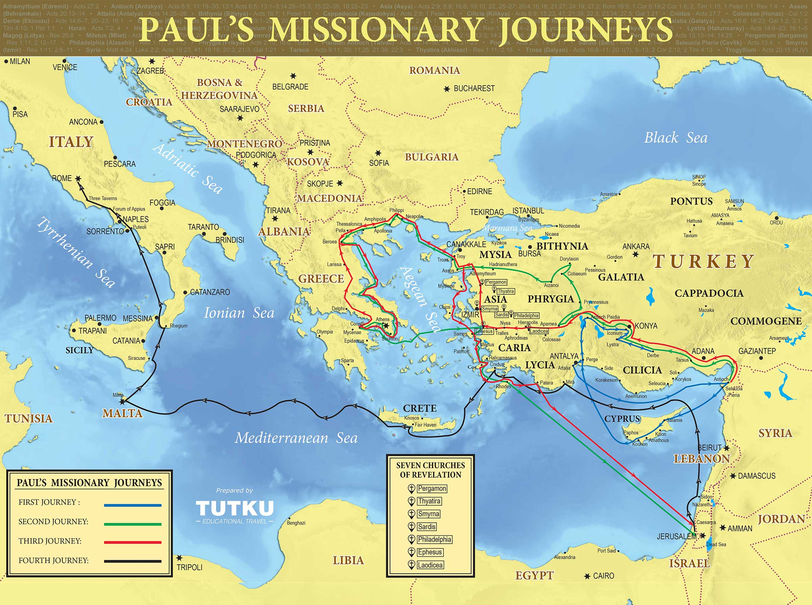

Slide 5
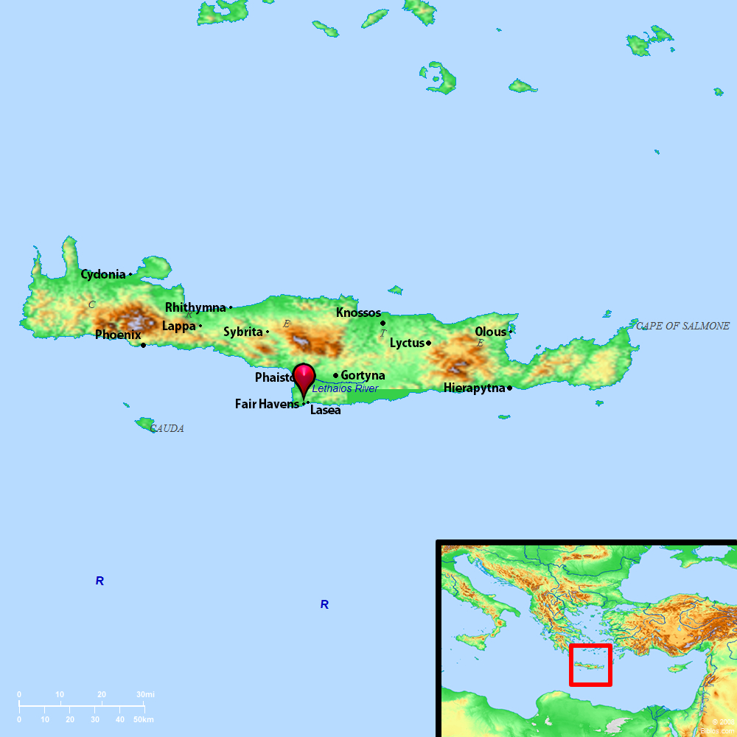
A Warning from Paul – Acts 27
v.9 “after the Day of Atonement.” – too late in the season for sailing ships, usually in port from September to February.
v.10 Paul had already been shipwrecked three times (2Corinthians 11:25 – much more than most people)
v.11-12 Decided to sail to Phoenix (about 60 km) for a better harbor.

Slide 6
A Bad Decision – Acts 27
v.13 “a moderate south wind” – things were looking good!
v.14-15 “a wind of hurricane force called the Northeaster” – “the ship was caught … so we gave way”
v.16-17 “passed to the lee of Cauda”
v.18-19 to help the ship float higher, they threw every heavy thing into the sea
v.20 “When neither sun nor stars appeared for many days and the storm continued raging, we finally gave up all hope of being saved.”
Notes:
v.20 desperate men, unable to navigate and fearing death

Slide 7
Encouragement from Paul – Acts 27
v.21 It’s better to listen to the words of Paul than to watch the weather report!
v.23-24 A word from the angel of God: “you must stand before Caesar” and all with you will survive! (Acts 23:11)
Genesis 39:5 Sometimes, people around you will receive some of the blessings that God gives to you.
v.26 But (sorry to say), the ship will be destroyed…
Notes:
Explain that God used (and uses) His angels to send messages to people. Before the NT, God spoke supernaturally to His apostles, but most of those messages come now to us through the Bible. But it is still possible angels bring messages to people in places where they don’t have a copy of the Bible.
If God has given you a Bible, don’t spend time praying for God to send an angel to you.

Slide 8
Encouragement from Paul – Acts 27
v.29 Even pagan people pray when they are about to crash and die.
v.30-32 Paul stopped the sailors from escaping – they were necessary to properly guide the ship to land.
v.33-36 Although Paul was just a prisoner, God used him to provide guidance and encouragement in time of trouble.
Notes:
The Adriatic sea mentioned here is not the modern Adriatic Sea (located between Italy and Croatia). In Paul’s day, it referred to the central Mediterranean.
“Not a hair of your head will perish” was a Jewish idiom that their lives would be saved.

Slide 9
Safely on Shore – Acts 27
v.41 The ship stuck and huge waves broke it into pieces.
v.42-43 God used the Centurion to save Paul’s life (and his fellow prisoners).
v.44 If the ship capsized, many would’ve drown. But since it broke into pieces, each piece was a life preserver for men who could not swim!
It is 768 km from Clauda to Malta. Detailed studies show that a ship like this would take just over 13 days to travel this distance driven by a Northeaster (v.27).
To land on this tiny island in the middle of the Mediterranean Sea was a miracle!
Notes:
The Adriatic sea mentioned here is not the modern Adriatic Sea (located between Italy and Croatia). In Paul’s day, it referred to the central Mediterranean.
“Not a hair of your head will perish” was a Jewish idiom that their lives would be saved.

Slide 11
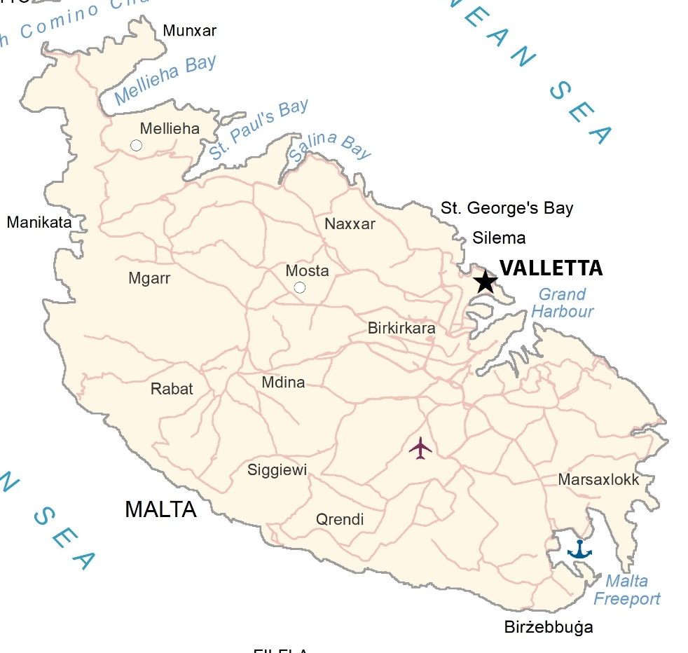
Some “Take Aways”
God’s promises and plans will never fail.
In the midst of troubled times, we can encourage others by our faith in God.
This amazingly accurate details of this chapter serve as a reminder of the accuracy of the Bible.
Notes:
Note that “St. Paul’s Bay” is on the North side of Malta (the side they would’ve been blown into with a Northeaster)

