Slide 1
The Final Chapter
Acts 28
Or is it?
Notes:
For years, Paul had desired to visit Rome and preach the gospel there.
Acts 19:21 says “Now after these events Paul resolved in the Spirit to pass through Macedonia and Achaia and go to Jerusalem, saying, “After I have been there, I must also see Rome.”
Romans 1:11,15; 15:23 says “For I long to see you, that I may impart to you some spiritual gift to strengthen you; … So I am eager to preach the gospel to you also who are in Rome. ; … But now, since I no longer have any room for work in these regions, and since I have longed for many years to come to you.”

Slide 2
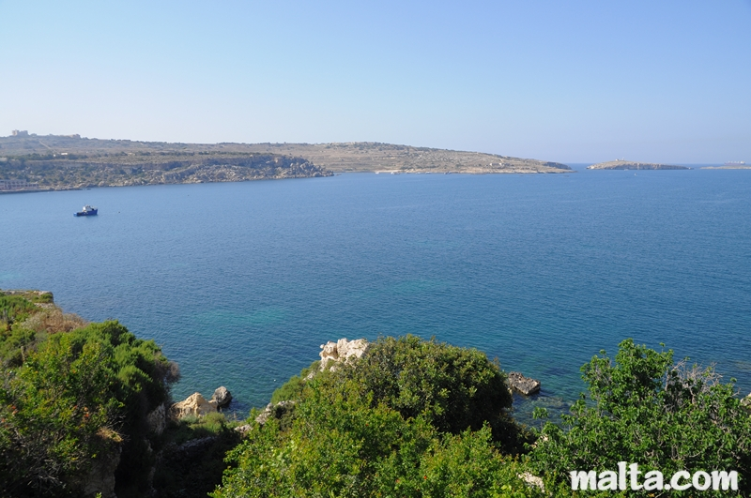
St. Paul’s Bay, Malta
St Paul’s Bay was named after St Paul, who was shipwrecked on an Island located in the bay. St Paul was shipwrecked on Malta during his journey from Caesarea to Rome and the Maltese people believe that it was St Paul himself who introduced Christianity to the local population.
It is believed that it was St Paul who brought Christianity to Malta around 60 A.D. and since then Malta remained a Christian country. St Paul was being taken to Rome to be tried as a political rebel, however his ship, with himself and the 274 passengers, was caught in a violent storm and it crashed two weeks later on the Maltese coast.
Notes:
Information from the website Malta.com

Slide 3
Ministry on Malta
v.1,2 This was unusual kindness – it was not unusual for shipwrecked sailors to be murdered or taken as slaves.
v.3 Paul was a humble servant, gathering sticks. A cold, sleepy snake, awakened by the heat, struck Paul.
v.4,5 Luke was a trained doctor and would recognize a poisonous snake. Notice that, even the natives had a God-given sense of justice.
Acts 23:11; 27:24 Paul knew God had promised that he would see Rome, so he trusted God’s promise.
v.6 A quick change of opinion, quickly corrected as in Acts 14:11,15.

Slide 4
Ministry on Malta
v.7 The governor cared for all 276 people until winter lodging could be arranged.
v.8 Dysentery was common due to poor sanitation.
Paul prayed before healing which showed his dependence on God.
v.9 Paul always used miracles as an opportunity to preach the gospel, starting the first church on Malta. His chains didn’t stop him from his ministry.
v.10 This expression of love and honor suggests that some on the island believed the gospel.
Notes:
Malta was not on Paul’s travel plan, but God supernaturally re-directed the ship to there. It may be possible that someone on the island (Publius?) had called out to God for help, seeking for Him with a willing heart (Jeremiah 29:13).

Slide 5
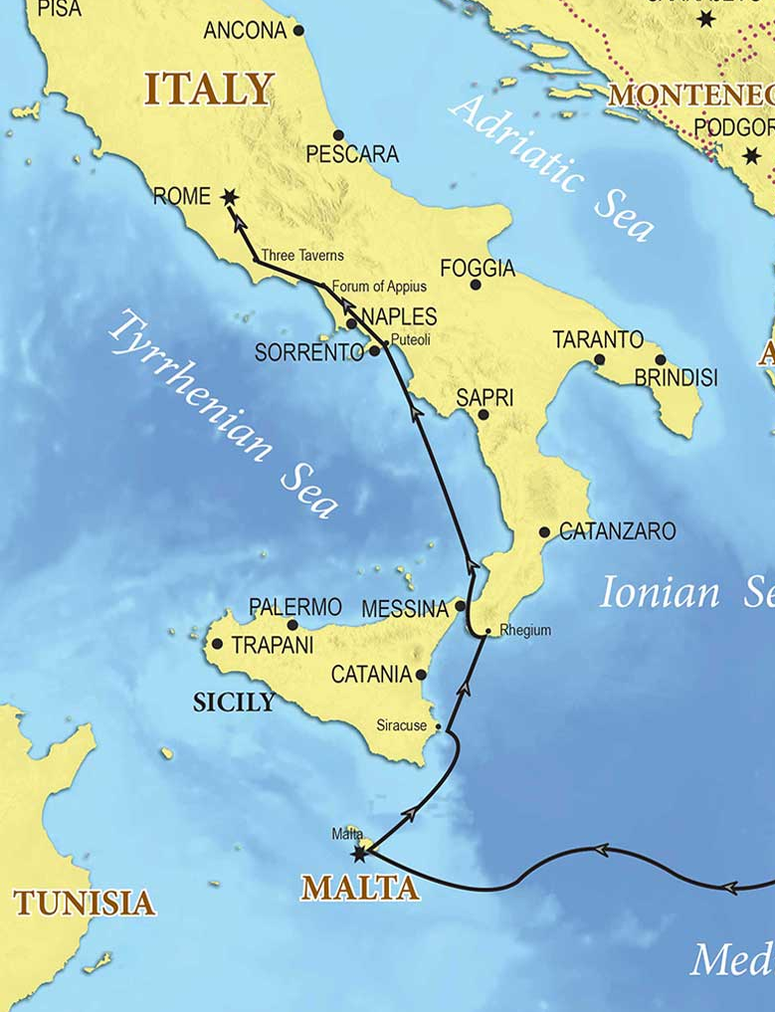
“After three months we set sail in a ship that had wintered in the island, a ship of Alexandria, with the twin gods as a figurehead. Putting in at Syracuse, we stayed there for three days. And from there we made a circuit and arrived at Rhegium. And after one day a south wind sprang up, and on the second day we came to Puteoli. There we found brothers and were invited to stay with them for seven days. And so we came to Rome. Acts 28:11-14

Slide 6
Encouragement and Outreach
v.15 On his journey to Rome, Paul was greeted by Christian brothers along the way, encouraging him.
v.16 Paul was blessed to stay in a private residence with a guard (probably several, chained at his wrist – Phil 1:13)
v.17 It is typical that the book of Acts would end with Paul speaking the gospel to the Jews and Gentiles.
v.18,19 He continues to express his innocence, accepted by Claudius Lysias, Felix, Festus, and Agrippa. Only the “closed minded” Jews continued to accuse him.
v.20 “the hope of Israel” – a Savior who would arise from the dead (constant message of the gospel).
Notes:
v.17 Although Paul was accused of being anti-Jewish, he always began his outreach with the Jews, seeking to convince them from the Scriptures that Jesus was the promised Messiah.
v.18 Claudius Lysias was a Tribune, Festus and Felix were governors, Agrippa was a king.
Share an example of people who use their suffering as an opportunity for evangelism (e.g. Tandons).

Slide 7
Mixed Opinions in Rome
v.21,22 these Jewish leaders didn’t have any official notice about Paul, but because of public opinions, they already had a negative opinion of Christianity.
v.23 Paul spoke all day about God’s kingdom (eternal salvation, God’s glory, etc) and Jesus (the Messiah). He used the Law of Moses and the Prophets (Luke 24:27).
v.24 Some were convinced (☺) / others disbelieved (☹)
v.25-27 Paul quoted Isaiah 6:9-10 about unbelief, a very serious warning against closed eyes and deaf ears.
v.28 The pride of the Jews closed their eyes while the humility of the Gentiles opened their hearts (1 Pet 5:5).
Notes:
v.22 Beware of propaganda and social media – these tools are used by the spirit of the age to close our minds to the truth! (Luke 9:19).
v.28 Beware of nationalism that can harden your heart against truth from the God who is greater than any nation.

Slide 8
Not the end of Paul…
v.30,31 While a prisoner in Rome, Paul taught the gospel and wrote four epistles: Ephesians, Philippians, Colossians, and Philemon.
Most scholars believe that, afterwards:
Paul may have been released around 62AD (since Roman rulers had already found him innocent and the Jewish leaders from Jerusalem may not have come to Rome)
Paul trained pastors (including Timothy), preparing the church for a new generation of leaders as it grew globally.
Paul continued to travel, preach and write until he was re-arrested and executed under Nero around 68AD.
Notes:
Paul may have traveled as far west as Spain (Romans 15:24)

Slide 9
Not the end of the story…
The book of Acts showed the birth and growth of the church from Jerusalem to Samaria and Gentile countries.
Chapter 28 is the last chapter of Acts, but not the last chapter of the growth of the church.
After Paul is executed, the apostle John leads the church through the end of the century.
The Holy Spirit continues to guide the church in its global mission to share the gospel and disciple believers, walking in the Spirit, and guarding the truth against false teachers.
Notes:
Chapter 28 ends rather suddenly, almost as though there should be more to come. And that’s because there is – the church doesn’t stop growing!

Slide 10
Some “Take Aways”
Some things about Paul’s preaching:
He used every opportunity: all times, places, people, in chains or free, on a ship or at a campfire,…
His always spoke based on Scriptural facts.
He spoke the hard truths, even when the audience was unwilling to listen.
He ministered with humility and grace.
Beware of believing every popular opinion (on social media, etc).
Jesus’ command in Acts 1:8 continued on…

