Slide 1
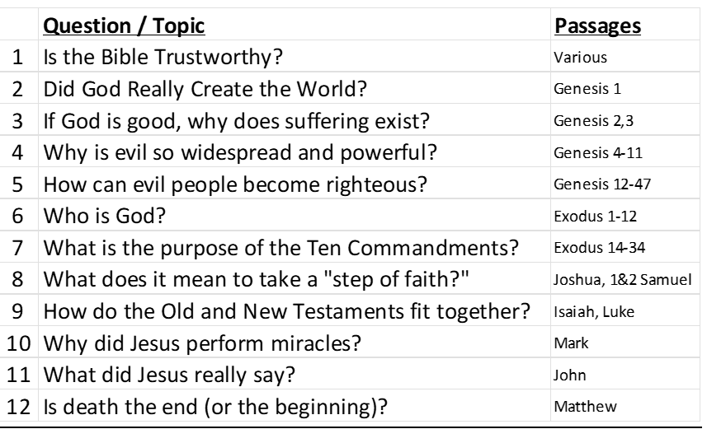
Study Plan

Slide 2
Did God Really Create the World?
And if so, does it really matter?
Notes:
Today's lesson is a very important topic in our study. Did God really create the world or is everything here all by accident?

Slide 3
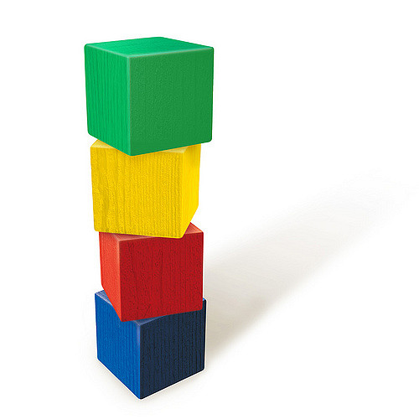
If you saw some blocks stacked on a table, what would you think?
Where did they come from?
How did they get stacked up like this?
Are you 100% certain?
We often select an option based on “most probable.”
Notes:
Imagine you came into my house and saw these blocks stacked up on a table. Then I asked you where the blocks came from and how did they get stacked up like this. What would you say? Are you 100% certain? You didn't see it happen, but you made a judgment based on what seems most probable. We often make judgments based on “most probable,” even though are not 100% certain.

Slide 4

A man comes to the hospital with chest pain…
* The doctor must decide what the problem is and what to do.
* Is the doctor 100% certain?
* What would you do?
Notes:
Imagine you're working in a hospital and a man comes into the clinic with chest pain. You are the doctor and need to make a decision about what to do. What do you think this man's problem is? What will you do next? Your decision may determine his life or his death. Are you 100% certain about his problem? Sometimes, you need to take action even though you don’t have 100% certainty.

Slide 5
Some Very Important Questions
Origin : Where did I come from?
Meaning : Why am I alive?
Morality : How to know right from wrong?
Destiny : What happens after I die?
The answer to the first question guides our thinking about all of the others!
Notes:
In life, we all need to answer four very important questions:
2. Meaning: is there purpose for my life? Why am I here?
3. Morality: how do I know what's right and wrong and how can I tell the difference?
4: Destiny: what happens after I die? Do I just disappear or is there something else?
Our answers to these questions are all based on the very first question –
1. Origin: where did I come from?
The answer to this first question guides our thinking about all of the others.

Slide 6
You decide which is most probable
Evolution and Creation can both be studied logically, but both require faith (believing unseen events from the past).
We have been taught that evolution is fact proven by science. This is NOT true.
Be open to think for yourself.
Life requires choices – sometimes, with very important consequences!
Notes:
If you are like me, you heard a lot about evolution in high school and college. Evolution and Creation are the two possible explanations for our origin. Both of them can be studied logically, but both of them require faith, because they are based on things from the past.
In school, we were taught that Evolution is a proven fact of science. But this is impossible. For the scientific method to work well, things must be observable, measurable, repeatable. Since the origin of the universe and existence of life don’t fit those possibilities, we must use the evidentiary method, asking questions like a detective seeking clues and looking for consistency of testimony, relevance, authenticity, trustworthiness, etc.
Today as we discuss this topic please be open to think for yourself. Because life requires choices and sometimes those choices have very important consequences.
As with many important decisions, we will approach it seeking what is most probable, not absolutely certain.

Slide 7
Where did everything come from?
Two Ideas:
Evolution Creation
Everything came from A powerful Creator
nothing made everything
Life began by accident Life was created
Complex creatures Each living creature was
evolved by a series designed and made by
of random accidents an intelligent Creator
Notes:
We could spend many hours discussing this topic, but today we plan to discuss just three aspects of this topic. As we do I want you to think about each one, asking whether evolution or creation is most probable.

Slide 8
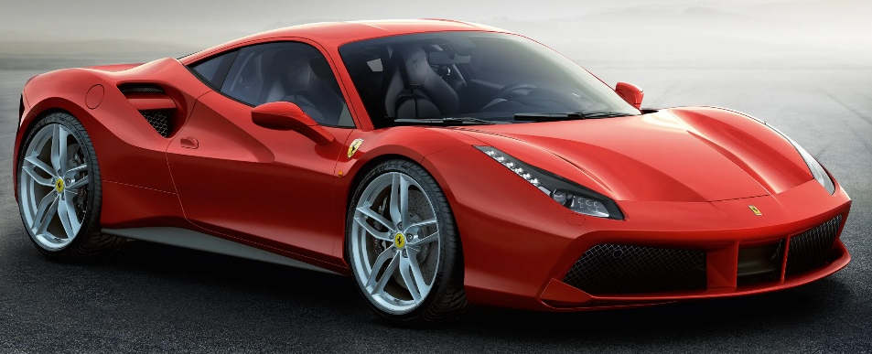
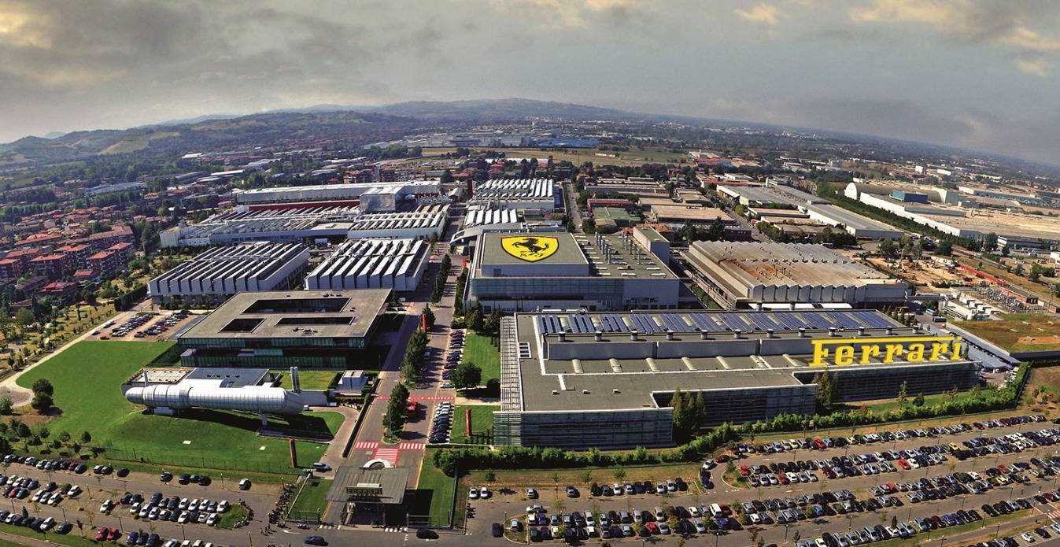
If you see this on the road:
Where do you think it came from?
OR
Notes:
First of all, imagine you're driving down the road and you see this red sports car go by. Where do you think it came from? An empty space of nothing, or a Ferrari factory?

Slide 9
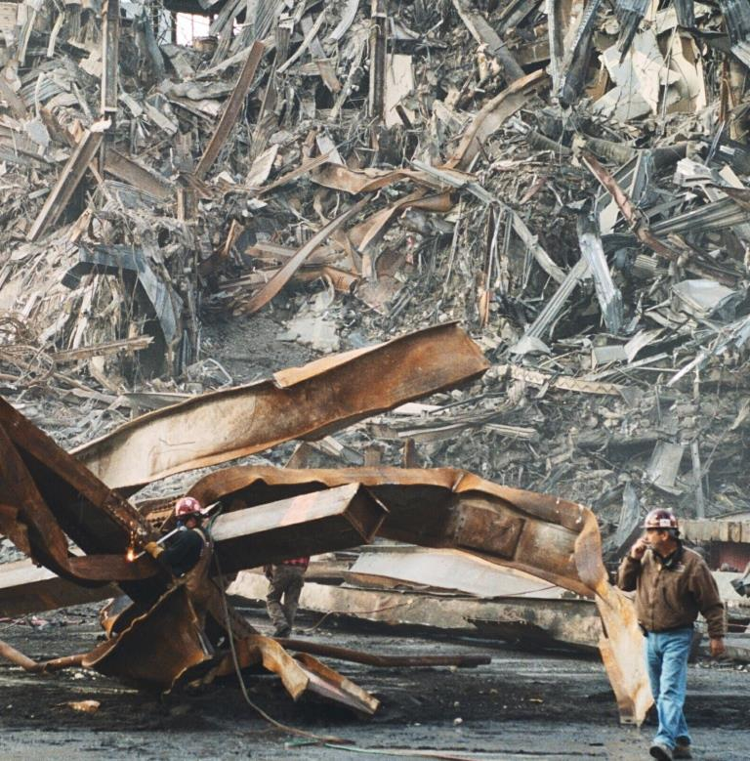

If you have an uncontrolled explosion, what is the most probable result:
OR
Notes:
The next question: if you have an uncontrolled explosion, what is the most probable result: the picture on the left or the picture on the right?

Slide 10
Two Realities:
1. Something doesn’t come from nothing
(first law of thermodynamics)
2. Intelligent designs do not arise by accident
(statistical information theory)
Notes:
Your ideas are reasonable because we know two realities:.
First – things don’t instantly appear from nothing. This is defined by the first law of thermodynamics
Second – intelligent designs do not arise by accident – they need an intelligent source. This is expressed by statistical information theory.

Slide 11
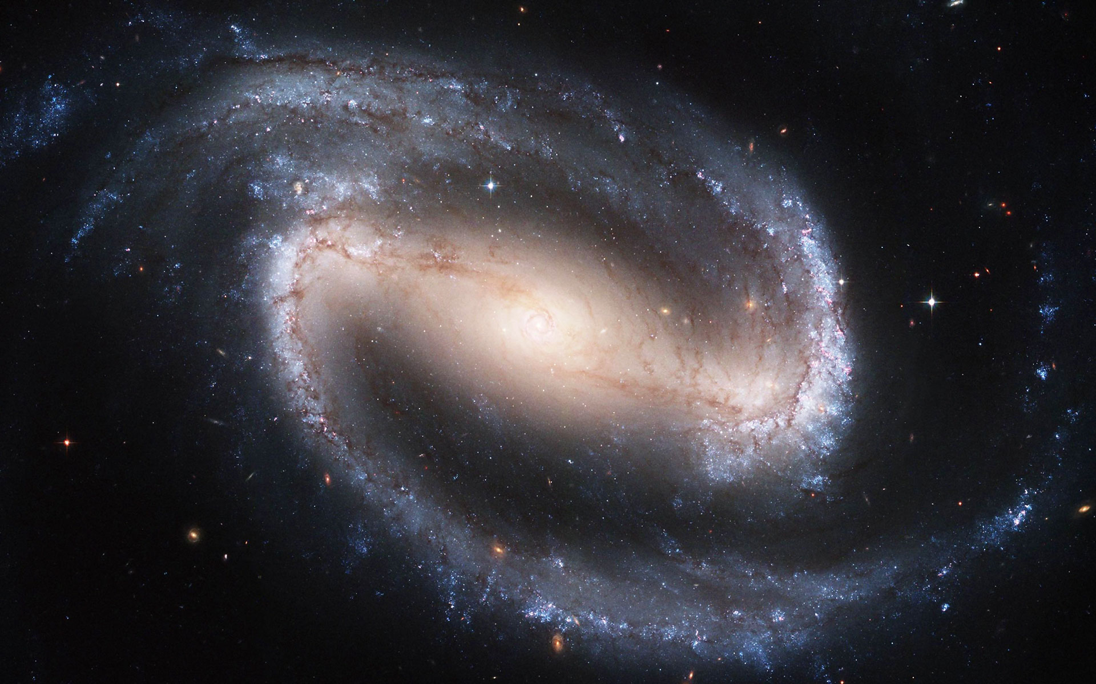
Did this come from nothing?
Notes:
With that in mind, if you look through a powerful telescope and see a spiral barred galaxy like this, would you assume that it came from nothing?

Slide 12
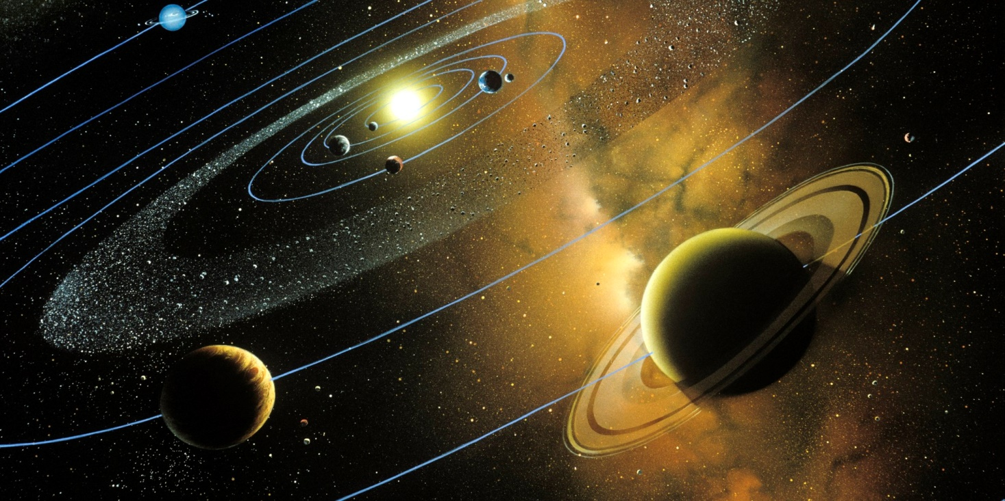
Did this design arise by accident?
Notes:
When you look at the solar system in which we live, with the balance of planets and moons, do you think this design is here by accident?

Slide 13
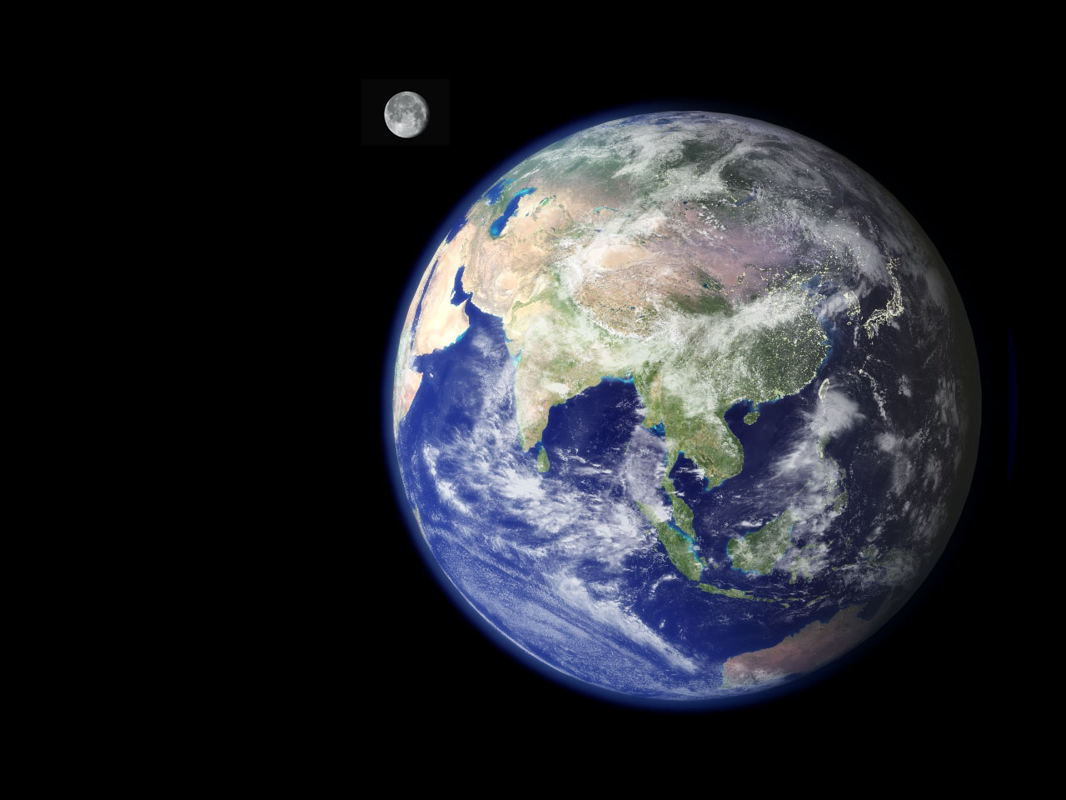
Was this planet designed for life?
Notes:
Consider the planet Earth with its water, atmosphere and perfectly balanced moon. I think that you will quickly decide that this special planet was designed for life.

Slide 14
You decide – which is most probable?
Evolution Creation
Everything came from A powerful Creator
nothing made everything
Notes:
So, between these two options, which seems most probable to you? Everything that exists came from nothing, or a powerful Creator made everything?

Slide 15

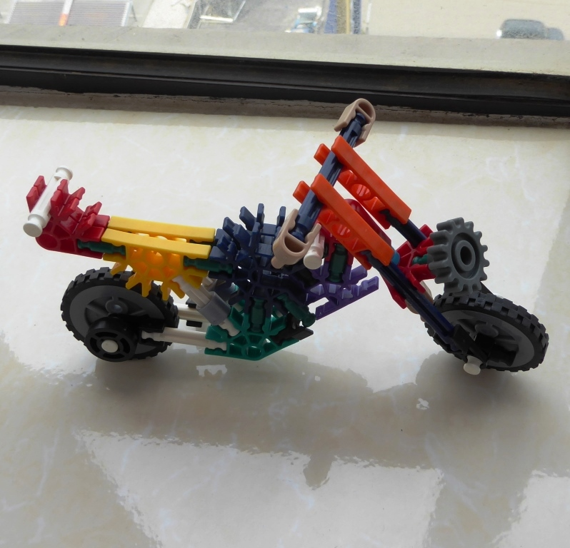
What is the difference?
How do you change this…
into this?
Can it happen by random accidents?
Notes:
Look at these two pictures. What is the difference between the picture on the left and the one on the right? If you said they are the same, you are partly right. Both pictures have the same pieces. But the one on the right has all of the right pieces put into the right places. How do you change the picture on the left into the picture on the right?

Slide 16
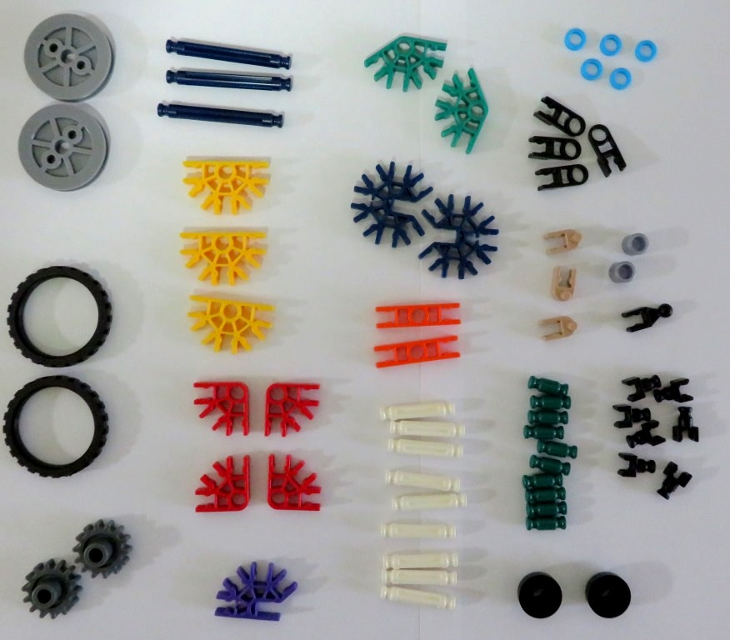
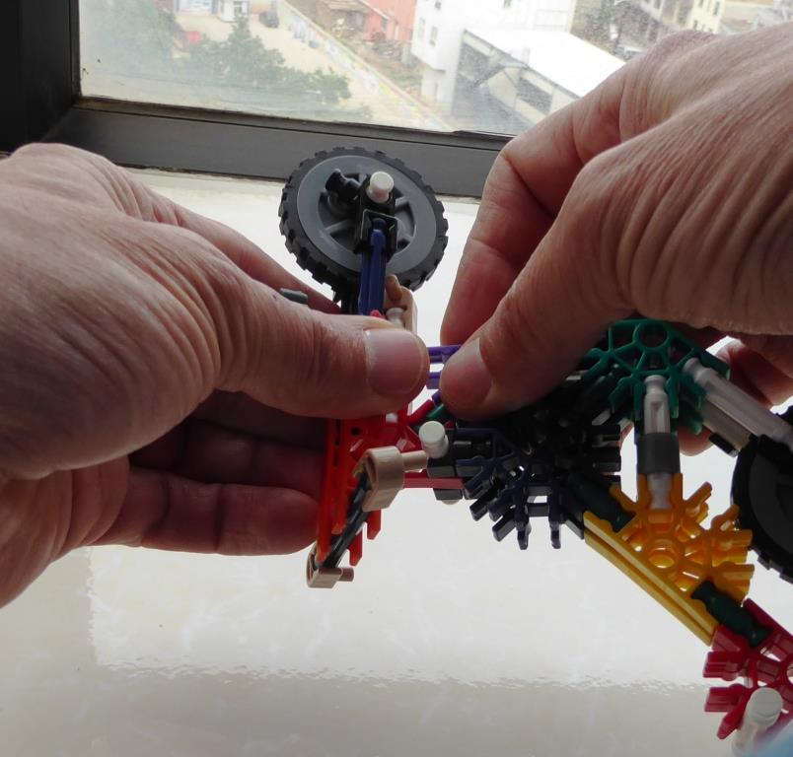
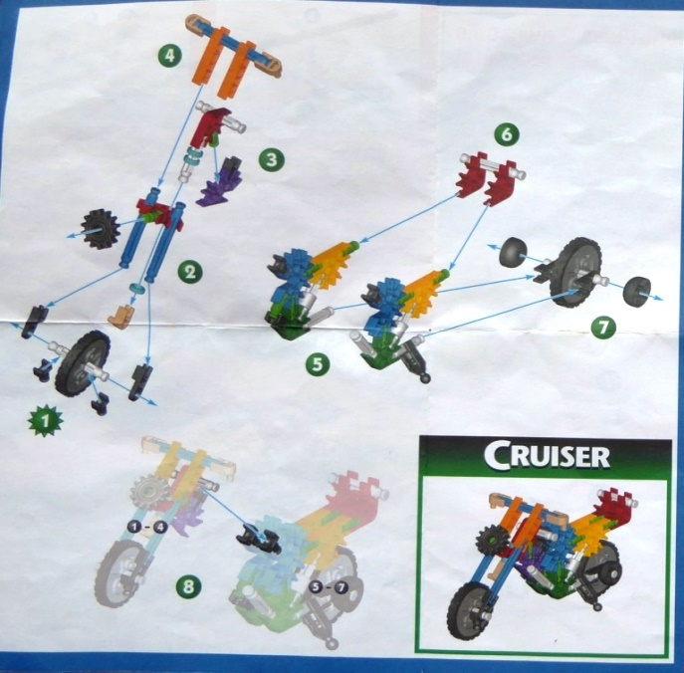
You need
this:
this:
and this:
The Right Pieces,
(66 pieces / 19 types)
a Design,
and a Process
Notes:
To change the pieces on the left into the motorcycle, you need several things: you need the right pieces (there are 66 pieces of 19 different types), you need a design, and you need a process to follow that design and assemble the pieces.

Slide 17
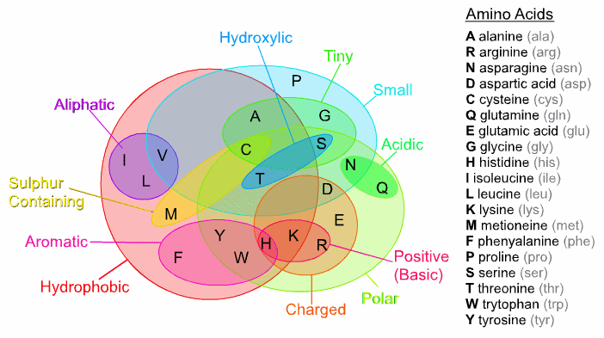
Every living thing is made of Proteins
Proteins are made from Amino Acids
Notes:
Every living thing is made of proteins. And proteins are made from amino acids. This is a simple picture of a protein and the amino acids from which it is made.

Slide 18
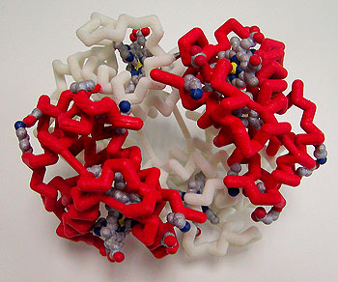
Hemoglobin protein, essential for life
Notes:
This is a model of hemoglobin, a very important protein essential for our life.

Slide 19
What is the difference?
Not much!
Similar number of parts
Must be built correctly to work
Notes:
What is the difference between the hemoglobin protein and the motorcycle I showed you earlier? Actually, not much. They both have a similar number of pieces which must be assembled correctly in order to work.

Slide 20
How to make this?
You need:
The right pieces
A design
A process
Notes:
How would you make a hemoglobin protein? Just like the motorcycle, you need the right pieces, you need a design, and you need a process.

Slide 21
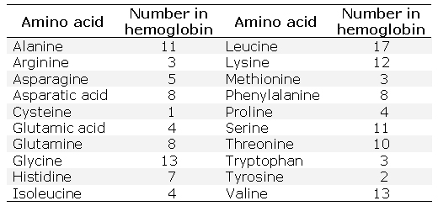
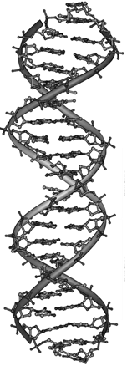
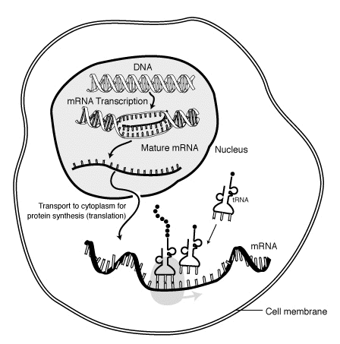
Specifically, you need: this this, and this
The Right Pieces,
(148 pieces / 20 types)
the Design,
and a Process
Notes:
Specifically, you need 148 pieces of 20 types. And you need a design – one that we call DNA. And you need a process to put all of the amino acids into the right places, one that is called RNA synthesis, a process that proceeds at amazing speed.
All of these things are required to make a hemoglobin protein necessary for life. The hemoglobin protein is complicated, but not the most complicated protein in your body.

Slide 22
You decide – which is most probable?
Evolution Creation
Everything came from A powerful Creator
nothing made everything
Life began by accident Life was created
Notes:
So, which seems most probable? Life all began by an accident: all of the parts magically appeared at the same time, assembled themselves in exactly the right positions, and began to create additional copies of itself? Or was life created by an intelligent source?

Slide 23
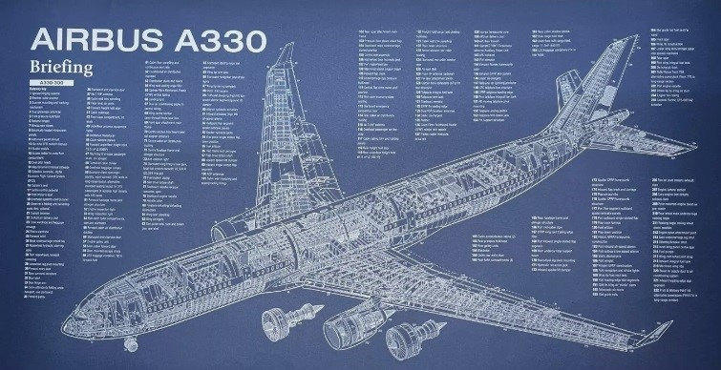
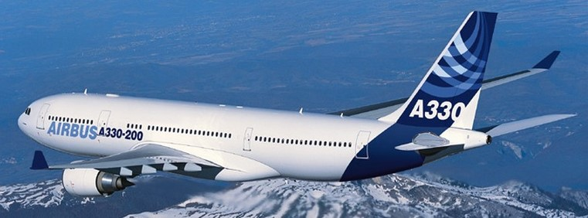
Every complex thing requires a design and a builder
No design + No builder = No airplane
Notes:
We all know that every complex thing requires a design and a builder. This Airbus A330 aircraft will not come about unless there's a good design and all of the pieces put together by engineers and builders. You would not want to fly on this airplane unless it was well designed and built by very smart people.

Slide 24
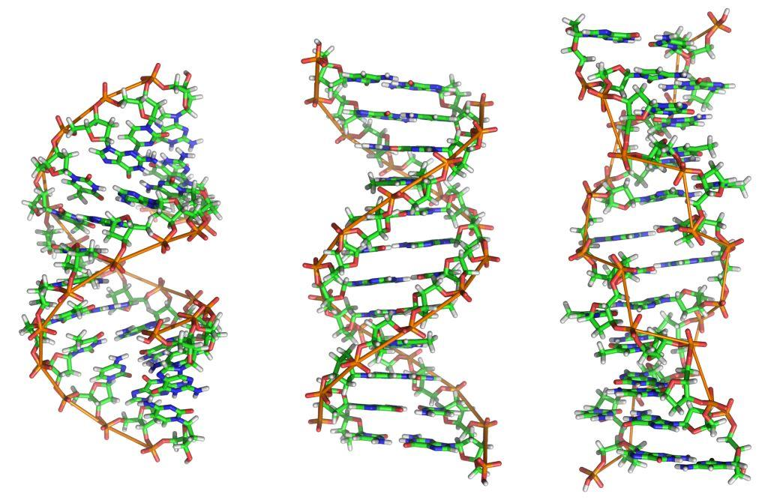
The design of life : DNA
Notes:
The design for life is DNA. Every cell of your body has a copy of what's necessary to make other cells of your body. This design is so complicated it would take books stacked from floor to ceiling in order to contain all of the same information.

Slide 25
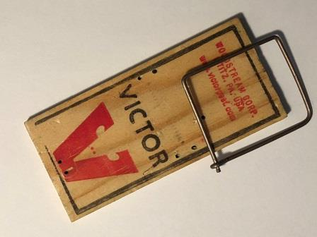
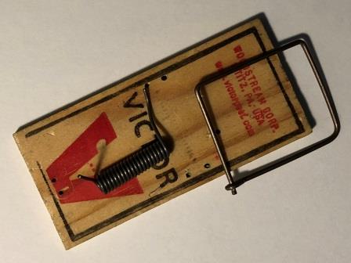
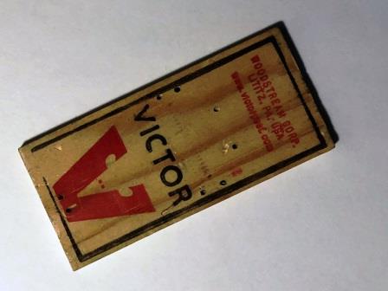
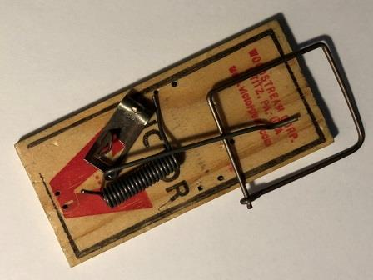
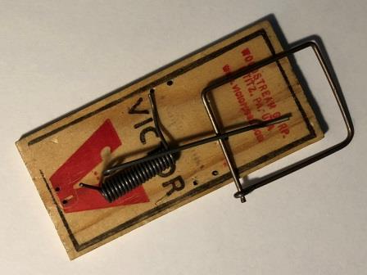
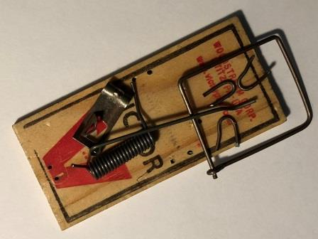
“Natural Selection” requires unguided, step-by-step improvements
How many mice will this catch?
How about this?
or this?
or this?
or this?
or this?
Notes:
Evolution requires “natural selection.” This means that step-by-step changes occur and each step along the way improves the function of the organism. So let's do a “thought experiment” to test how this might work.
This mouse trap starts with a wooden base. How many mice would this one piece of wood capture? (none)
Next, if I add a hammer, how many mice will this capture now? (none)
How about if I add a spring? (none)
What if I add a retainer wire? (none)
What if I add a trigger? (none)
I think you see what I mean. Each simple step does not make this more effective at catching mice. Unless the whole trap is assembled at one time it will catch no mice.

Slide 26

Evolution requires unguided, step-by-step improvements
But even simple machines do not work without all of the pieces in the right places
Notes:
This mousetrap is a very simple machine. But even simple machines do not work unless all of the right pieces are in the right places. We call this “irreducible complexity.” And we see this exact same thing in every living creature. Let me show you an example in our human body

Slide 27
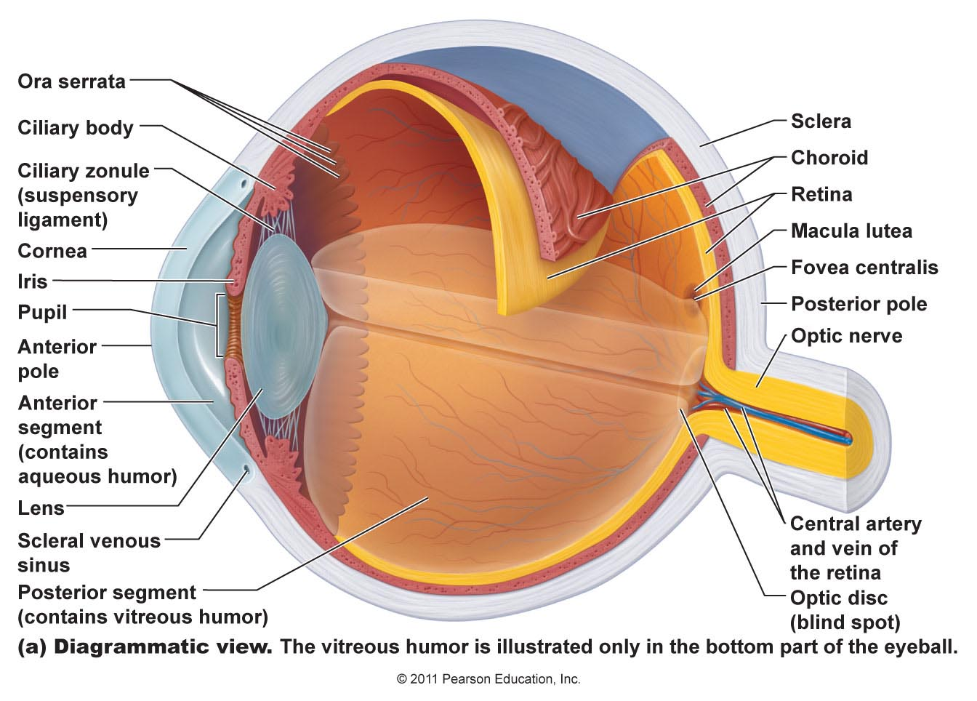
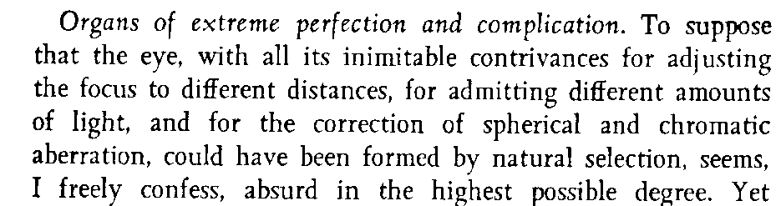
Your eye – a very complex machine
Origin of the Species – Charles Darwin
Notes:
This is a diagram of your human eye. There are 66 major parts to everyone's eyeball. All of the parts must be in the right place and working properly have any vision. It cannot evolve, step-by-step over time by natural selection. (And I haven’t included the complex brain network to process images).
Charles Darwin who wrote the “Origin of the Species” said that it is “absurd in the highest possible degree” to imagine such a thing developing by natural selection.

Slide 28
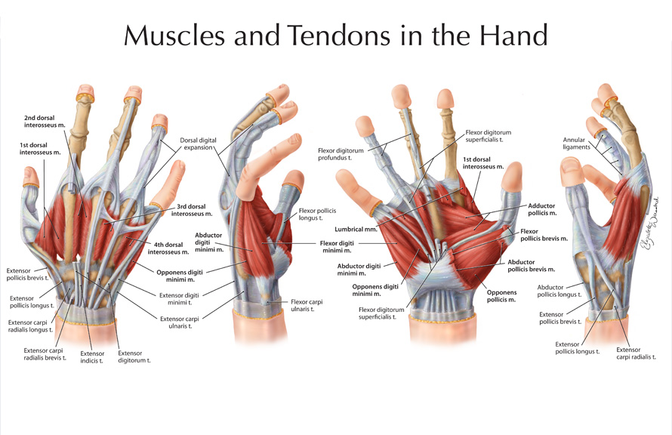
What does this look like to you?
Design or Accident?
Notes:
Look at this sketch of a human hand. Look at the tendons, the muscles, the channels and little pulleys. Does this look like something that accidentally evolved, or does it look like a design to you? Engineers will tell you that artificial hands are some of the most difficult parts of a robot to design and build.

Slide 29
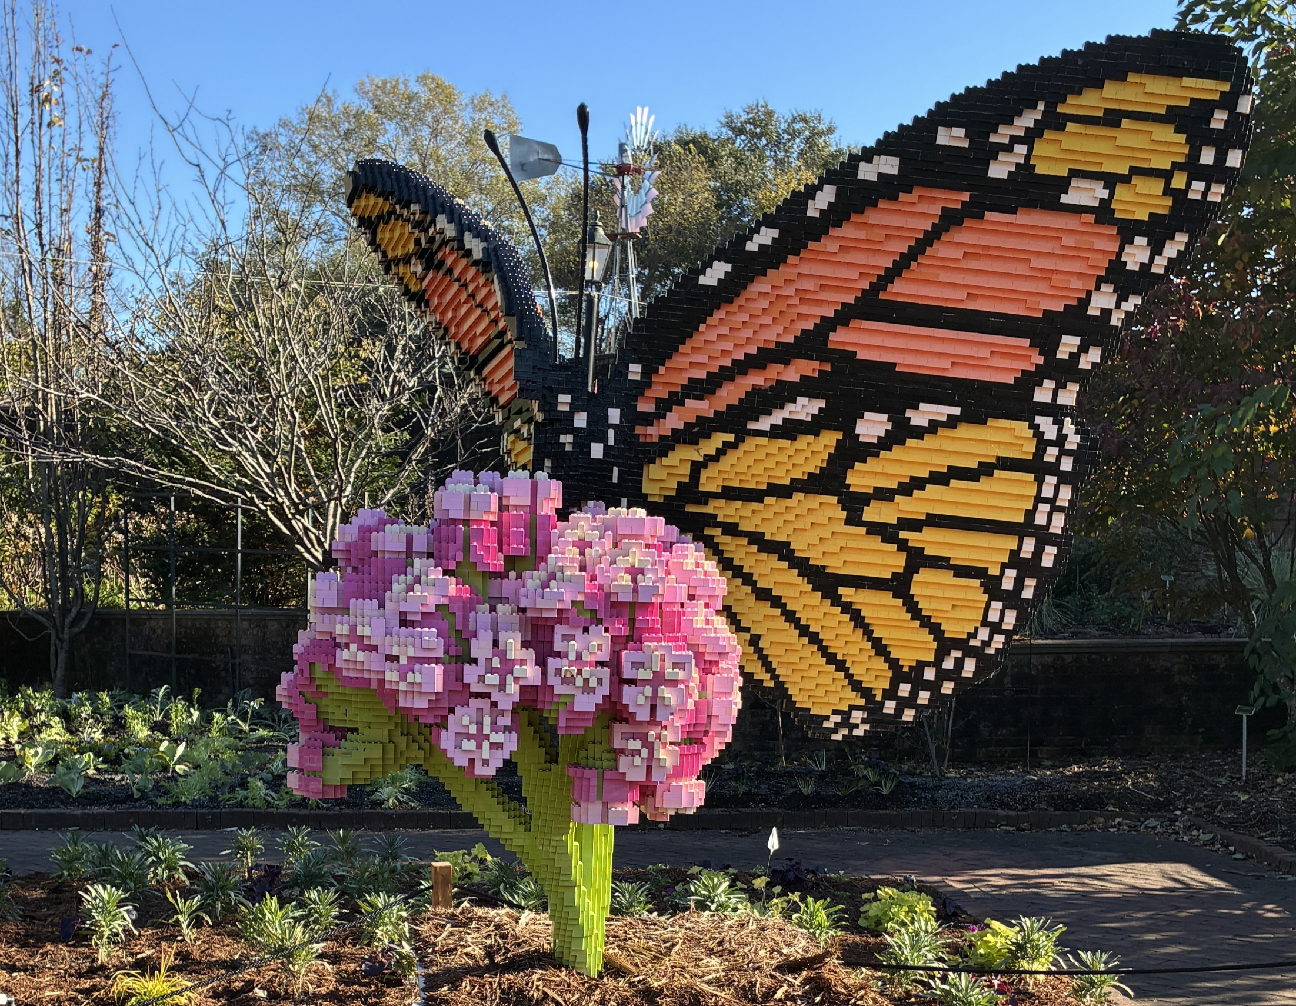
A Huge Monarch Butterfly
Notes:
I was with my grandchildren at our local zoo last year. There was a display where someone had built this huge monarch butterfly out of Lego Blocks. Do you think that all 60,549 of those Lego pieces could possibly have come together all by accident?

Slide 30
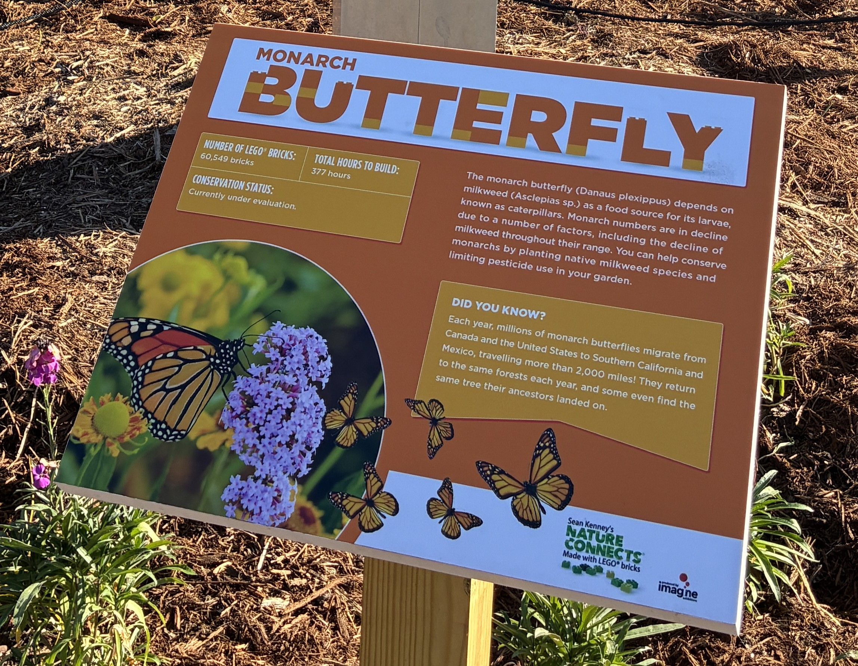
What is the probability of 60,549 Lego bricks randomly assembling into this structure?
Since milkweed is necessary for survival, which evolved first: the weed or butterfly?
Notes:
Also, for monarch butterflies to survive, they need a food source. The food for monarch butterflies is called milkweed. Without milkweed monarch butterflies will not survive. But without butterflies, milkweed will not propagate. Do you think that this creature and the plants evolved together step-by-step?

Slide 31
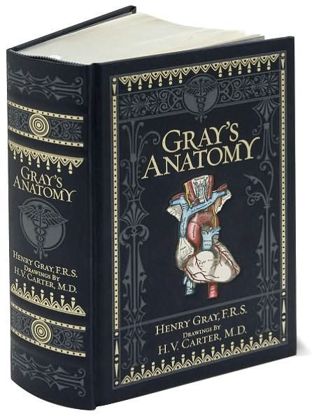
Is it reasonable to think this book could appear by accident?
How about the human body it describes?
Notes:
This is a copy of the most famous anatomy book used by medical universities. Gray's Anatomy has thousands of sketches of every part of the human body. Do you think it's reasonable that this book could appear by accident? Could there be an explosion in a printing shop, and all of the ink and paper flies around until it comes together and this book is accidentally created? How about the human body that it describes? It is much more complex than the book.

Slide 32
You decide – which is most probable?
Evolution Creation
Everything came from A powerful Creator
nothing made everything
Life began by accident Life was created
Complex creatures Each living creature was
developed by a series designed and made
of random accidents by their Creator
Notes:
Finally, the third question – which is most probable: complex creatures developed by a series of random accidents, or that every living creature was designed and made by their Creator?
By these three simple tests, creation is a much more probable option than evolution for the origin of people.

Slide 33
Before the beginning…
God
Notes:
Before the beginning, there was no planet Earth, no stars, no universe – only God. Remember – He is the central figure of everything (not us).

Slide 34
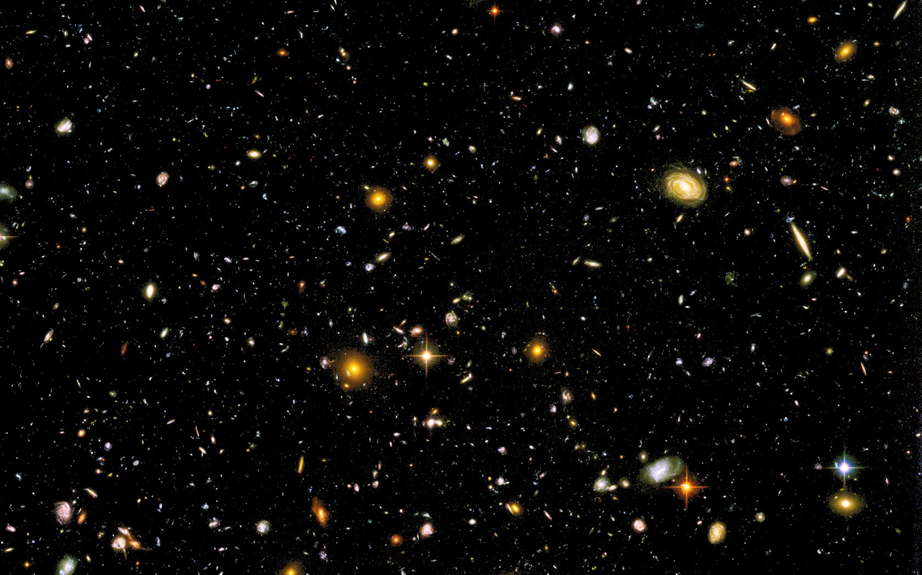
“In the beginning, God created the heavens and the earth.” Genesis 1:1
Notes:
And God made a choice – a choice to create us, a planet on which we can live, and a universe surrounding the planet. Remember – It is His universe and we are His creatures.
This first verse in the Bible tells us three important things:
A beginning – the Bible stated this long before science proved it to be true (and while other religions claimed the universe was eternal)
God – He existed before the beginning and is the source of everything that exists.
He created – the universe came into being by His choice, not by some cosmic accident

Slide 35
What is Faith?
Faith : believing something that you can’t see
(everyone has faith in something)
“By faith we understand that the universe was created by the word of God, so that what is seen was not made out of things that are visible.” Hebrews 11:3
Notes:
The Bible talks a lot about faith. Faith is believing in something that you cannot see. We all have faith in many things. Every time you eat food in a restaurant, you have faith that the cook has prepared it in a way that's safe to eat. Every time you get on an airplane and buckle your seat belt, you have faith that the pilot can safely transport you from one airport to another. Faith is a natural and important part of life.
The Bible says that by faith we understand that the universe was created by the word of God. In His power, God created the things that are seen out of things that are visible. Basically, the Bible is saying that God created the physical matter of the universe using His own invisible energy. And we now know that this is reasonable and scientific by the special theory of relativity (E=mc2). So let's go to the first book of the Bible and see what it says about creation.

Slide 36
Creation – Genesis 1
v.2-5 light/dark, day/night (time measurement system)
“The earth was without form and void, and darkness was over the face of the deep. And the Spirit of God was hovering over the face of the waters. And God said, ‘Let there be light,’ and there was light. And God saw that the light was good. And God separated the light from the darkness. God called the light Day, and the darkness he called Night. And there was evening and there was morning, the first day.”
Notes:
In verses 2 through 5, God speaks powerfully into the darkness, bringing light from His own glory. He takes an earth that is without form and creates a stable, rotating planet, creating the day/night cycle, allowing us to keep track of time. The first “day” begins and ends.

Slide 37
Creation – Genesis 1
v.2-5 light/dark, day/night (time measurement system)
v.6-8 atmosphere, clouds and water cycle
“And God said, ‘Let there be an expanse in the midst of the waters, and let it separate the waters from the waters.’ And God made the expanse and separated the waters that were under the expanse from the waters that were above the expanse. And it was so. And God called the expanse Heaven. And there was evening and there was morning, the second day.”
Notes:
On the second day, God separates some of the water on the surface of the planet and layers of water and gases in a protective canopy around the earth. This will be important to protect living creatures from the radiation of the sun. The earth is very unique among planets in that it has a very perfectly balanced atmosphere for plants and animals to survive.

Slide 38
Creation – Genesis 1
v.2-5 light/dark, day/night (time measurement system)
v.6-8 atmosphere, clouds and hydrologic cycle
v.9-13 dry land and …
“And God said, ‘Let the waters under the heavens be gathered together into one place, and let the dry land appear.’ And it was so. God called the dry land Earth, and the waters that were gathered together he called Seas. And God saw that it was good.” (9-10)
Notes:
On the third day, God lifts up dry land from the water-covered world, creating continents and seas.

Slide 39
Creation – Genesis 1
v.2-5 light/dark, day/night (time measurement system)
v.6-8 atmosphere, clouds and hydrologic cycle
v.9-13 dry land and plants with seeds and fruit
“And God said, ‘Let the earth sprout vegetation, plants yielding seed, and fruit trees bearing fruit in which is their seed, each according to its kind, on the earth.’ And it was so. The earth brought forth vegetation, plants yielding seed according to their own kinds, and trees bearing fruit in which is their seed, each according to its kind. And God saw that it was good. And there was evening and there was morning, the third day.” (11-13)
Notes:
On day three, He also creates plants with seeds and fruit. A seed is a very complicated thing, containing everything required to produce a duplicate of the original plant.
Some people wonder if these early earth days are the same as our current 24-hour days, thinking that the earth looks too old for such a short creation period. But remember: God created trees with fruit and seed, trees that are actually only one day old, but have an “apparent age” of many years.

Slide 40
Creation – Genesis 1
v.2-5 light/dark, day/night (time measurement system)
v.6-8 atmosphere, clouds and hydrologic cycle
v.9-13 dry land and plants with seeds and fruit
v.14-19 sun, moon, and stars
“And God said, ‘Let there be lights in the expanse of the heavens to separate the day from the night. And let them be for signs and for seasons, and for days and years, and let them be lights in the expanse of the heavens to give light upon the earth.’ And it was so. And God made the two great lights—the greater light to rule the day and the lesser light to rule the night—and the stars. … And God saw that it was good. And there was evening and there was morning, the fourth day.”
Notes:
On the 4th day God created the sun, moon and stars. You might wonder where the light came from on day 3 for photosynthesis in the plants. On the first day God created light, but it didn't come from the sun. Where did it come from? It came from God himself. And by creating an orbiting moon, God stabilized earth’s rotation and created tidal cycles.

Slide 41
Creation – Genesis 1
v.2-5 light/dark, day/night (time measurement system)
v.6-8 atmosphere, clouds and hydrologic cycle
v.9-13 dry land and plants with seeds and fruit
v.14-19 sun, moon, and stars
v.20-23 fish and birds; reproduction in kind
“And God said, ‘Let the waters swarm with swarms of living creatures, and let birds fly above the earth across the expanse of the heavens.’ So God created the great sea creatures and every living creature that moves, with which the waters swarm, according to their kinds, and every winged bird according to its kind. And God saw that it was good. And God blessed them, saying, ‘Be fruitful and multiply and fill the waters in the seas, and let birds multiply on the earth.’ And there was evening and there was morning, the fifth day.”
Notes:
On the 5th day God created fish and birds, giving them the ability to reproduce according to their “kind.” The word “kind” is the same one that we use for “species.” What is God saying? He is saying that He created every species unique and genetically designed to stay true to its species. He didn’t create a simple organism and start the process of evolution. And this is exactly what we find in the geologic record, a period of time known as the “Cambrian Explosion” when all species are found originating at the same time.

Slide 42
Creation – Genesis 1
v.2-5 light/dark, day/night (time measurement system)
v.6-8 atmosphere, clouds and hydrologic cycle
v.9-13 dry land and plants with seeds and fruit
v.14-19 sun, moon, and stars
v.20-23 fish and birds; reproduction in kind
v.24-25 land animals
“And God said, ‘Let the earth bring forth living creatures according to their kinds—livestock and creeping things and beasts of the earth according to their kinds.’ And it was so. And God made the beasts of the earth according to their kinds and the livestock according to their kinds, and everything that creeps on the ground according to its kind. And God saw that it was good.”
Notes:
On day 6 God creates land animals. Again, he creates them all unique and designs them with ability to reproduce according to their individual species.

Slide 43
Creation – Genesis 1
v.2-5 light/dark, day/night (time measurement system)
v.6-8 atmosphere, clouds and hydrologic cycle
v.9-13 dry land and plants
v.14-19 sun, moon, and stars
v.20-23 fish and birds; reproduction in kind
v.24-25 land animals; v.26,27 people
“Then God said, ‘Let us make man in our image, after our likeness. And let them have dominion over the fish of the sea and over the birds of the heavens and over the livestock and over all the earth and over every creeping thing that creeps on the earth.’ So God created man in his own image, in the image of God he created him; male and female he created them.”
Notes:
On day six God also does His most amazing work of creation – He creates people. But He doesn’t make people like all of the animals – God creates people in his own image. What does that mean?

Slide 44
Made in His Image
How can physical people be made in the image of a spiritual God? God gave us:
Heart – Deep Feelings (Gen 2:23)
  To respond to God with love
Will – Ability to Choose (Gen 2:16,17)
  To choose to follow God
Mind – Intellect (Gen 2:19,20)
  To hear and understand God’s words
Authority – Rule over the Earth (Gen 1:28)
  Responsibility to serve Him
Notes:
Since God is a spiritual being, how can He create physical people in His image? When God created people, He gave us at least 4 attributes similar to his own:
He gave us emotions – we say that He gave us a “heart.” This gives us the ability to respond with love to Him. He gave us a “will,” the ability to make choices. Because of our will, we can choose to follow him or reject him. He gave us a “mind.” With our mind, we can hear and understand His words and we can get to know Him.
He also gave us “authority,” giving us the ability and responsibility to rule the earth and serve him.
Perhaps God has given us these four attributes so that we can fully love Him – “And you shall love the Lord your God with all your heart and with all your soul and with all your mind and with all your strength.” Mark 12:30

Slide 45
Made in God’s Image – Very Special
God gave us His breath of life (Genesis 2:7):
  “then the LORD God formed the man of dust from the ground and breathed into his nostrils the breath of life, and the man became a living creature.”
He gave us an eternal destiny (Ecclesiastes 3:11)
  “He has made everything beautiful in its time. Also, He has put eternity into man's heart,”
Notes:
Since we are made in His image, He also gave us two very important things different than animals”
He personally formed us from the dirt and breathed into us the breath of life. This is not just a breath of physical existence – it is a spiritual breath of life from the spiritual God.
He also put into our heart a sense for eternity. This is why all over the world, people are trying to figure out how to live beyond death. Animals don't care about this, but we do.

Slide 46
We live on a very good planet
“And God saw everything that He had made, and behold, it was very good.”
Genesis 1:31a
Notes:
In summary we live on a very good planet.

Slide 47
A very good planet with a purpose
“For this is what the LORD says — He who created the heavens, He is God; He who fashioned and made the earth, He founded it; He did not create it to be empty, but formed it to be inhabited — He says: “I am the LORD,
and there is no other.”
Isaiah 45:18
Notes:
And this planet was created for a purpose. It was created to be inhabited by people, people who can know and glorify God.

Slide 48
But we are small…
Notes:
But this planet is actually a very small place.

Slide 49
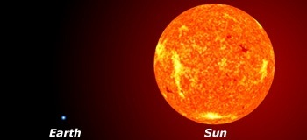
But we are small…
Notes:
Compared to the sun it seems like just a small dot.

Slide 50
We are very small !

Slide 51
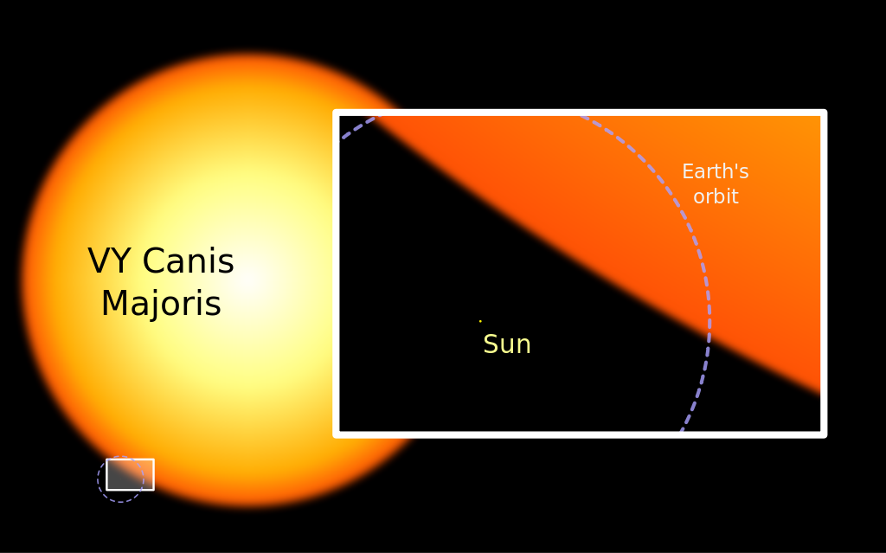
We are very small !
Notes:
But our sun is a small dot compared to a large star like VY Canis Majoris.

Slide 52
…in a Very Big Universe!
We are very, very small !
Notes:
Even our Galaxy is a very small dot in the whole universe. I love this picture from the Hubble Space Telescope of a single shot into outer space showing thousands of galaxies.

Slide 53
But everything is small when compared to God…
The heavens declare the glory of God,
and the sky above proclaims his handiwork.
Day to day pours out speech,
and night to night reveals knowledge.
There is no speech, nor are there words,
whose voice is not heard. Psalm 19:1-3
Notes:
The Bible describes the universe in this way in Psalm 19. Some people wonder why the universe is so large with so many galaxies. But the Bible is clear dash-God made the universe to give him glory.

Slide 54
Just as the earth has a purpose,
God created you for a purpose!
When I consider your heavens,
the work of your fingers,
the moon and the stars,
which you have set in place,
what is mankind that you are mindful of them,
human beings that you care for them?
Psalm 8:3-4
Notes:
But in a universe so large, does God really think about you and me? This is where the Bible helps us understand. Even though He reveals His glory through creation, He reveals something extra through the Bible. He tells us that He thinks of each one of us. That's the beauty of the Bible and creation. That is one of the important purposes of the Bible – it reveals our purpose!
We see the glory of His powerful creation and we hear about the glory of His personal love. He is truly the God of our worship and attention.

Slide 55
A few additional slides if there is extra time…

Slide 56
Period of Time – Why?
What is the physical reason for each of these?
One year
One month
One day
One week
“So God blessed the seventh day and made it holy, because on it God rested from all His work that He had done in creation.” (Genesis 2:3)
Notes:
As we proceed down this page, we find that each measurement of time has a physical reason for existence:
One year = the time it takes the earth to go around the sun
One month = the time it takes the moon to go around the earth
One day = the time it takes the earth to rotate around itself
But when we get to one week, there is no clear physical reason for this. The only explanation for this global measurement of time is found at the end of the Biblical creation story in Genesis 2:3.

Slide 57
Why do people choose Evolution?
It is NOT because of what they see through the telescope of the microscope
It is NOT based on scientific evidence
It is a choice from the heart:
“For although they knew God, they neither glorified him as God nor gave thanks to him, but their thinking became futile and their foolish hearts were darkened. Although they claimed to be wise, they became fools. They exchanged the truth about God for a lie and worshiped and served created things rather than the Creator.” (Romans 1:21,22,25)
Notes:
People might wonder why so many people actually believe in evolution. Sadly, we were taught it in school as though it is a scientific fact, so we just accepted evolution based on the “experts.”
Many “scientists” choose to believe evolution because it frees them from the authority of God. They no long feel a need to submit to Him as the ultimate law-giver and judge. Other people working in the academic world accept evolution because it has become the only acceptable option in their culture.
Aldous Huxley (the grandson of Thomas Henry Huxley, “Darwin’s Bulldog”), did not adopt evolution because of scientific observations; he famously admitted it offered a philosophical justification to escape traditional morality. In his 1937 book “Ends and Means“ he wrote “I had motives for not wanting the world to have a meaning... The philosophy of meaninglessness was essentially an instrument of liberation from a certain system of morality. We objected to the morality because it interfered with our sexual freedom."

Slide 58
Look at creation with open eyes!
“For what can be known about God is plain to them, because God has shown it to them. For His invisible attributes, namely, his eternal power and divine nature, have been clearly perceived, ever since the creation of the world,” Romans 1:19,20
“The heavens declare the glory of God, and the sky above proclaims his handiwork. Day to day pours out speech, and night to night reveals knowledge.” Psalm 19:1,2

Slide 59
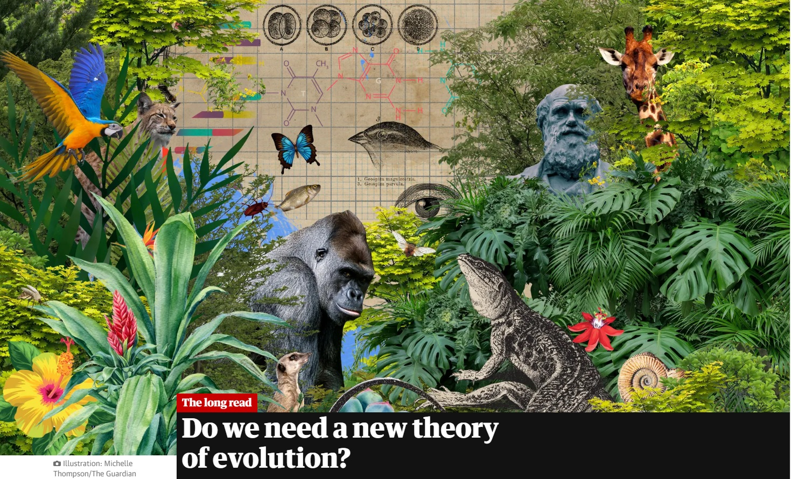
The Guardian Stephen Buranyi, 28 Jun 2022
“This is the basic story of evolution, as recounted in countless textbooks and pop-science bestsellers. The problem, according to a growing number of scientists, is that it is absurdly crude and misleading.”
“This classic idea of gradual change, one happy accident at a time, has so far fallen flat.”
“The issue at stake,” says Arlin Stoltzfus, an evolutionary theorist at the IBBR research institute in Maryland, “whether the idea of a grand story of biology is a fairytale we need to finally give up.”
Notes:
I regularly see new articles like this, casting strong doubt on evolution as a theory of origin, suggesting that we need to find something that better fits with the evidence.

