Slide 1
Study Plan
1 | Is the Bible Trustworthy?
2 | Did God Really Create the World?
3 | If God is good, why does suffering exist?
4 | Why is evil so widespread and powerful?
5 | Why is Israel so important?
6 | Who is God?
7 | What is the purpose of the Ten Commandments?
8 | Are Biblical heroes all good guys?
9 | How do the Old and New Testaments fit together?
10 | Why did Jesus perform miracles?
11 | What did Jesus really say?
12 | Is death the end (or the beginning)?

Slide 2
Who is God?
A very important name
Notes:
Tonight is our 6th Bible study together. So far, we’ve seen how the world was created by a God with amazing power. We saw how He made people in His image and for His glory. We also saw that the first people chose to disobey God (“sin”), and as a result, all people were separated from God and will die. And even when God calls people back to Himself, they quickly drift away into wickedness.

Slide 3
Things to Remember
Sin = breaking God’s law → death
Righteousness does not come from perfect behavior – it comes from faithful belief in the true God
An important picture from the story of Abraham:
  The only son of a father climbed the mountain with the wood of sacrifice on his back
  God provided the lamb as a substitute sacrifice
  “On the mountain of the Lord, it will be provided”

Slide 4
Also from last lesson…
Genesis 47:25 > God used Joseph to save Egypt and Israel
Genesis 47:5-6 > Israel welcomed as guests in Egypt
God revealed His plan for the future of Israel:
  Genesis 15:13-14 – Israel would be slaves in a foreign land 400 years, but God will come to rescue them
Isaiah 25:1 > God is in control of world history (His story)
Notes:
As I’ve said before, the Bible is not a book of rules to help sinful people get along with each other – it is the true story of a loving God who is reaching out to bring sinful people back into a relationship with Himself.
Last week, we saw how God chose a man named Abraham to follow Him, making a promise that one of his descendants would become a blessing to all nations. His grandson, Israel, moved his entire family to Egypt at the invitation of Pharaoh, settling in the best part of land.

Slide 5
Israel in the land of Egypt
~1300 BC ; During 商朝 (Shang Dynasty)
Exodus 1:6-7 > Joseph’s generation passed away, but the Israelite people multiplied
Exodus 1:8-10 > Egypt became afraid of Israel
Exodus 1:11-14 > To control Israel, Egypt made them slaves and mistreated them
Exodus 1:15-17, 22 > To reduce growth rate of Israel, Pharaoh commanded that Israelite baby boys be killed or thrown into the river
Notes:
But all of the Egyptian Pharaohs did not appreciate the Israelites. During the Shang Dynasty (Shāng cháo ~1300BC), we see that Joseph and his generation died, but the Israelite population grew very fast (Exodus 1:6-10 OT93). A new leader came into power over Egypt who did not show kindness to Joseph’s relatives. He was afraid that the Israelites may fight against the Egyptians if war broke out (Exodus 1:11-14). They then forced the Israelites to become slaves. They made them work hard and treated them badly.
But Israel kept growing. So Pharaoh ordered all of the Hebrew midwives to kill any male child born (Exodus 1:15-17), but the midwives feared God, and they did not do what Pharaoh said. So the people of Israel kept increasing, and God blessed the midwives. Once Pharaoh realized that this was not working, he ordered all male children born to be thrown into the Nile River (vs.22).

Slide 6
Moses
Exodus 2:1,2 > An Israelite baby is born
Exodus 2:3-6 > The baby was put into the river, but found by the daughter of Pharaoh
Exodus 2:10 > The boy is adopted by Pharaoh’s daughter and named Moses
Exodus 2:11,12 > Powerful Moses tried to use his own strength to defend and rescue his people
Exodus 2:13-15 > Moses quickly left Egypt to avoid trouble, going to the land of Midian.
Exodus 2:23-25 > God heard the cries of Israel
Notes:
At this time an Israelite woman gave birth to a boy (Exodus 2:1,2 OT94) and hid him for 3 months. When she did not think she could hide him any longer, she put him in a basket and placed the basket among the reeds on the Nile River. Pharaoh’s daughter went to the river and found the baby. She took him in as her own son and named him Moses (Exodus 2:10). What are some of the advantages Moses would have living in Pharaoh’s household?
Even though he was raised as an Egyptian prince, Moses still understood that He was a child of Israel. One day, while watching an Egyptian beating an Israelite (Exodus 2:11-15), he decided to try and solve the problem with his own efforts. As a result of his actions, he fled from Egypt. What did Moses do to try to help his people? Did the people appreciate his help? Could one human release the children of Israel from Egypt?
In Exodus 2:23-25, we see that the king of Egypt died. The Israelites were still in slavery, and they cried to God for help. God heard their cries, and He honored His promises to Abraham, Isaac, and Jacob.

Slide 7
God sends a deliverer
Exodus 3 > Moses in the desert (40 years later)
  Verse 1: Moses was once a powerful prince, but is now just an 80 year old shepherd, alone in the wilderness
  Verses 2-4: God appeared to Moses in a burning bush
  Verses 5-6: Moses is now humble enough to be useful (1 Peter 5:6)
  Verses 9-10: God tells Moses that he will bring the Israelites out of Egypt
Notes:
In Exodus 3:1, we see that Moses had a major career change, from Prince of Egypt to a lowly shepherd on the edge of the desert.
Step 1 (v.2) – enlightenment: God appeared to Moses in a flame of fire from within the bush.
Step 2 (v.3) – investigation: Moses saw the bush on fire, but noticed that it was not burning up so he went to see it.
Step 3 (v.4) – calling: When the LORD saw that he had gone over to look, God called to him by name from within the bush. God told him that He is the God of Abraham, Isaac and Jacob.
Step 4 (v.5,6) – humility: At this, Moses hid his face because he was afraid to look at God.
God then told Moses that He was concerned about the children of Israel and planned to lead them out of slavery in Egypt to a new land (v.9,10).

Slide 8
Who am I ? Who are You ?
Exodus 3 > Moses and God in the desert
  Verses 11: Moses is humble and afraid
  Verses 12: God promises that He will go with Him
  Verses 13: Egypt had many gods with many names: Khnum, Hapi, Osiris, Heqt, Seb, Uatchit, Ptah, Mnevis, Hathor, Amon, Sekhemet, Serapis, Imhotep, Nut, Isis, Seth, Shuh, Serapia, Re, Aten, Atum, Orus, Thoth, ...
  Verses 14: The name of the true God … “I AM” … eternally self-existent. The essential center of all things.
Notes:
Moses told God that he did not feel like he was the right man for the job (v.11). God told Moses that He would be with him (v.12 – step 5 – relationship) and he told him that when he had brought the people out of Egypt, they would worship God on that very mountain.
Moses had been educated in the courts of Pharaoh, taught about many Egyptian gods like “Ra” the sun god, “Geb” the earth god, “Isis” the goddess of magic, “Heket” the goddess of frogs, “Hapi” the god of the Nile, etc. So to him, it seemed important to know the name of God so that the people would believe he had truly been sent on this mission (Exodus 3:13).
In response, God says something very important about Himself in verse 14. He is not like manmade gods, invented in the human imagination. He is entirely different – He is “I AM” – the only One who is self-existent, without beginning or end. And soon, He will make it very clear to the Egyptians, the Israelis, and the entire world that He is the One true God.

Slide 9
Pharaoh does not know God
Exodus 5:1 > Moses: “Let My people go”
Exodus 5:2 > Pharaoh: “I do not know the Lord” and “I will not let Israel go.”
Exodus 6:6-8 > God reminded the people that He was still their almighty and loving God
Exodus 7:4,5 > God will bring Israel out of Egypt
  God will bring judgment on Egypt so that the whole world will know that He is the true Lord of all.
  But even in the middle of judgment, God will show mercy
Notes:
Before Moses began his journey to Egypt, God made it clear that Moses should expect Pharaoh to resist (v.19,20). And as God had said, Pharaoh was stubborn and proud (Exodus 5:1,2). Based on his answer, Pharaoh sounds like He did not know God now and didn’t expect to know Him in the future. He was the king, he gave the commands, and he was satisfied with worshiping the gods of Egypt and the physical things that they represented.
Although the Israelites living in Egypt had heard about the Lord and what He had done for Abraham, Isaac, Jacob, and Joseph, they had never experienced His power personally. Now the Lord was going to use this evil Pharaoh and his rebellion to display His power and wisdom to the Israelites so that they would know that He was still the almighty and caring God of Israel (Exodus 6:7). He also planned to show the Egyptians that He alone is the true and living God with power over the whole earth (Exodus 7:5). The gods whom they trusted and worshipped were unable to protect them from the true and living God of all. But remember this: even in the midst of God’s judgment, He has a merciful plan. He knows that all people, Israelite or Egyptian, are never satisfied with weak and powerless gods, including money, fame, and power. Keep that in mind – I’ll show you something special about that later.

Slide 10
The judgment of God against Egypt
Exodus 7:20-21 > The river turned to blood
  Verse 22: the magician’s trick turns Pharaoh’s heart away
Exodus 8:6-8 > Millions of frogs
  Verses 8,15: Pharaoh hardened his heart
Exodus 8:16,19 > Gnats on men and animals
  Verse 19: Pharaoh hardened his heart
Exodus 8:21-24 > Flies in Egypt but not in Goshen
    Verses 30-32: Pharaoh hardened his heart
Exodus 9:6,7 > Egyptian cattle die
  Verse 7: Pharaoh hardened his heart
Notes:
Step by step, God begins to bring judgment to all of the things that the Egyptians worshiped, starting by turning the Nile river into blood (Exodus 7:20,21). But Pharaoh’s magicians did a trick, turning some water of their own into blood (v.22), helping Pharaoh to ignore the judgment of God (harden his heart). Notice this – whenever God seeks to reach out to people, there is a liar (Satan) who will produce a counterfeit (fake) to try and lead people away. The next week, God brought millions of frogs up into everyone’s houses (Exodus 8:6-8). Even though the magicians did their own trick, Pharaoh asked for mercy. But when the pain was over, Pharaoh hardened his heart again (vs.15).
Next, God turned the dust of the earth into gnats (vs.16). Don’t just think that “the hand of God” works on the scale of planets and stars – the “finger of God” (vs. 19) also works on the microscopic level. But Pharaoh has refused to believe in spite of the evidence. Next, God does something even more amazing: He sends swarms of flies into Egypt, but keeps them out of the province of Goshen (vs.22-24). But once again, Pharaoh hardens his heart when the flies are gone (vs. 30-32).
Now, the severity of the plagues rises. God brings a sickness among the Egyptian cattle but spares the Israelite ones (Exodus 9:6,7). But in spite of this great loss, the stubborn Pharaoh continues to harden his heart.

Slide 11
The judgment of God against Egypt
Exodus 9:10 > Boils and sores on men and beasts
  Verse 12: Pharaoh has hardened his heart so often, now God hardens it for him
  Verse 15: God has shown great mercy by not destroying the people of Egypt quickly and completely
  Verses 19,20: God gives a merciful warning to the people
Exodus 9:25,26 > Supernatural hail storm
  Verses 34: Pharaoh hardened his heart
  Exodus 10:7 Pharaoh is warned by his own counselors
Exodus 10:15 > Locusts
Exodus 10:21-24 > Darkness
Notes:
So the next plague comes upon the people, bringing festering boils upon their bodies (vs.10). Pharaoh has hardened his own heart so many times, that now, God hardens it for him (vs. 12) Here is a lesson to learn – when someone continues to resist God, eventually, their heart becomes too hard to change, regardless of the amount of evidence.
Perhaps it seems like God is being too hard on Pharaoh and the Egyptians. But remember – God could easily have just killed them all instantly (vs.15). Actually, God is merciful, giving people time to listen to Him and follow (v.19,20). And those who ignore the word of God suffer devastation because of the supernatural hailstorm (vs.25,26). But Pharaoh continues to ignore God and his own counselors (Exodus 10:7), experiencing two more plagues: locusts (v.15) and darkness (vs.21,22).

Slide 12
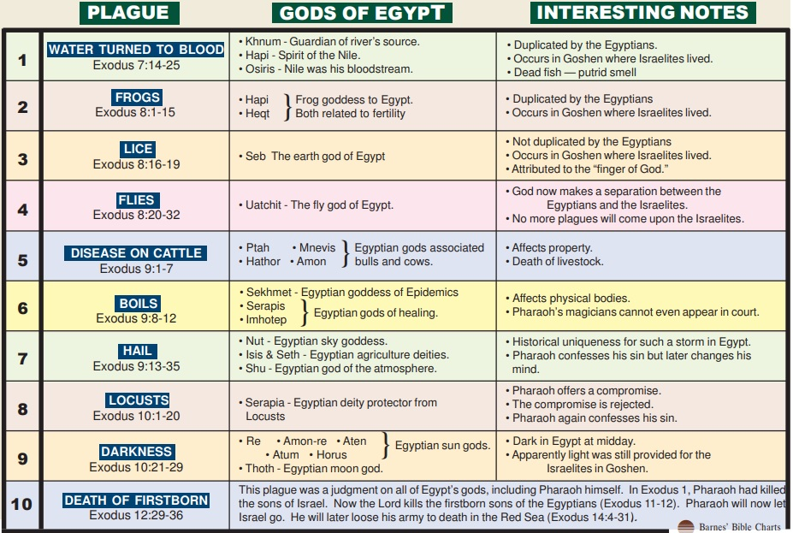
Exodus 12:12 – Judgments against false gods of Egypt
God loves us too much to allow idolatry to harden us against Him (Psalm 115:8)

Slide 13
The Final Judgment
Two purposes of this final judgment:
  Save the people of Israel from slavery
  A picture of God’s plan to save the world from sin
Exodus 12 > The Passover
  Verses 5-7: Kill a lamb; paint blood on the doorposts
  Verses 12-13: Every house with blood – a safe place
  Verse 14: Remember this “pass over” miracle annually
  Verses 29-30: Death in every house without blood
  (Remember that Egypt killed Israel’s babies)
Notes:
Although the Lord already sent 9 terrible plagues on the rebellious Egyptians, the king of Egypt still refused to obey the Lord and refused to let the Israelites go free. God was about to send the final plague, one that would free the people from slavery, but one that would also have a far greater significance in the long-term history of God’s saving plan for the world.
In Exodus 12:5-7 we see that God told the people to take a sheep or goat, one year old with no defects. All of the Israelites were supposed to kill their animal at twilight and put some of the blood on the sides and tops of the door-frames of the houses. That night, if anyone’s house did not have the blood of the lamb painted on the door, someone inside would die (vs.12,13). Note that God was bringing judgment on all of the false gods of Egypt. But if the blood of the lamb was on the door, death would “pass over” that house. Notice also that God commanded the people to celebrate this “Passover Feast” every year (vs.14), remembering what He had done to save them from slavery by the sacrifice of a lamb.
This event contains a very important salvation clue: everyone deserved to die, even Moses, the murderer. There was only one way to escape death: the blood of a lamb on the wooden doorposts.

Slide 14
The Exodus (Exit from Egypt)
Exodus 12 > The Journey begins
  Verses 31-33: The people are set free
  Verses 37: Israel grew from 70 to ~2,000,000 people
  Verses 38: Some Egyptians also followed God (mercy)
Things to remember from these true stories:
  Before Moses could lead the people out of Egypt, God humbled him (Isaiah 55:8). God uses weak people for His great purposes (1 Corinthians 1:26).
  Each time Pharaoh hardened his heart, he became less aware of God’s work around him (Sin blinds people to the truth).
  The Passover – Only one way to be saved from death: the blood of a lamb, painted across the wooden doorposts
Notes:
And God did exactly as He promised, prompting Pharaoh to let the people go (vs. 31-33).
When the Israelites first went to Egypt, there were only 70 of them. Now there are probably about 2.5 million Israelites. Also notice this: Egyptians joined the Israelites as they followed God (vs.38). As I said earlier, God is calling all people back to Himself, regardless of their nationality.
God loved the Israelites and took care of them, guiding their steps all the way (Exodus 13:21,22). Sometimes, the Israelites didn’t like where God was taking them. But God makes no mistakes, using each step of their path to teach them (and us) some important truths.

Slide 15
One final thought…
Exodus 3:14 > God’s Name : “I AM”
  God is the only eternal being
  God chose to create everything that exists
  Everything and everyone exists for Him (Col 1:16,17)
  Compared to God, the universe is a tiny dot
  He is much more important than anything else
  Since this is true, how should we respond to Him?
Notes:
As we finish our lesson tonight, I want to take you back to Exodus 3:14 (OT96). Take a moment to consider the fact that God Is. He always has been. He is the source of everything else. Next to Him, the universe is a tiny, temporary speck. He is of ultimate importance. Every other thing that absorbs our attention is minor compared to Him. Since this is true, how should we respond to Him?
Colossians 1:16,17

Slide 16
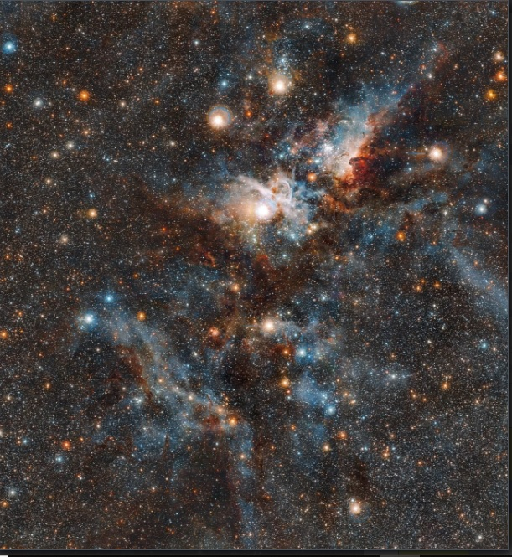
你们不曾知道吗？你们不曾听见吗？不是从起初就已经告诉过你们吗？自从大地的根基立了以来，你们还不曾明白吗？ 神坐在大地的圆穹之上，地上的居民好像蚱蜢，他铺张诸天如铺张幔子，展开众天像展开可以居住的帐棚。 他使诸侯都归于无有，使地上的审判官成为虚空。 他们才刚刚栽上，刚刚种上，他们的树头刚刚在地里扎根，他一吹在其上，他们就枯干了，旋风把他们像碎秸一样吹去。
那圣者说："你们把谁来跟我相比，使他与我相等呢？" 你们向天举目吧！看是谁创造了这些万象？是谁按着数目把万象领出来，一一指名呼唤？因他的大能大力，连一个也不缺少。
To whom then will you compare me, that I should be like him? says the Holy One. Lift up your eyes on high and see: who created these? He who brings out their host by number, calling them all by name, by the greatness of his might, and because he is strong in power not one is missing.
Isaiah 40:25-26

