Slide 1
Who is Jesus?
What did He say?
God speaks…

Slide 2
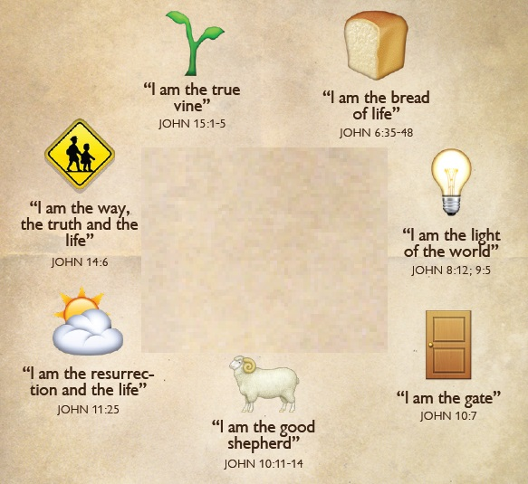
Who is Jesus? What did He say?

Slide 3
The Power of Jesus
Power to heal
Power over nature
Power over demons
Power to rebuild a body
Power to create matter
Power over death
Power to forgive sin
Notes:
We only looked at a sampling of the miracles of Jesus, but it should quickly become obvious that Jesus is not just a man – He is God in the flesh (Immanuel). Especially when we see the power to forgive sin!

Slide 4
But is it true…?
Jesus had powerful enemies
  Bad news – they didn’t listen to Him
  Good news – they tried to prove He was a fake, but were not able to do it
  This “test” helps us know that Jesus’ miracles are true
Why did He do these things? What was His important message? (John 20:30-31)
We need to see His works AND hear His words…
Notes:
Children and adults enjoy make-believe stories. These are interesting and fun to read, but when we talk about eternity, we need to have the truth, not make-believe. Something to remember about these stories: Jesus had very powerful enemies, people who tried very hard to discredit his mighty works. If Jesus was a fraud, they would have quickly found out and told the world. But as you read the Bible (and other writings of those days), you will never find words that prove His works to be fraudulent.
It is not enough to just look at the powerful works of Jesus. We also need to listen to His words – why did He come and what message does He have for us. Let’s look at a famous Bible passage which clarifies His central message – His purpose for coming to this world: John 20:30-31

Slide 5
Who is Jesus?
John 1:29-31 He is the Lamb of God
John 1:49-51 He is the ladder to heaven
John 2:18-22 He is the temple to be torn down and raised up again
John 3:14-16 He will be lifted up like the snake on the pole (to save dying sinners)
Our response: Believe
Notes:
Remember these stories from the Old Testament:
Passover
Jacob’s Ladder into heaven from Israel
The temple where people worshiped God
The snake on the pole

Slide 6
I am the Bread of Life
John 6:11 Jesus had just created bread and fish, enough to feed 10,000+ people
John 6:30-31 The people want physical bread every day
John 6:32-35 The bread from heaven is a person, and His name is Jesus
Our response: Believe
Notes:
Other Old Testament Stories:
The bread in the Wilderness

Slide 7
I am the Light of the World
John 1:1-5,9 The Word enlightens the world
John 9:5-7 Jesus heals a man born blind
John 8:12 He is the light of the World
Our response: Follow
Notes:
Remember the prophecy in Isaiah 7:2 - “The people who walked in darkness have seen a great light;
those who dwelt in a land of deep darkness, on them has light shone.

Slide 8
I am the Door and the Good Shepherd
Psalm 23:1 The Lord is my Shepherd
John 10:7-9 Jesus is the door for the sheep
John 10:11,14 He is the good shepherd who dies for His sheep
Our response: Enter
Notes:
The Old Testament often talked about the Lord God being the shepherd of His people (e.g. Psalm 23). An amazing fact of the New Testament is Jesus’ claim to be the good shepherd – the same one spoken of in the Old Testament

Slide 9
I am the Resurrection and the Life
John 11:25-26 Jesus claims to be the resurrection and the life.
John 11:27 He accepts the title: Christ, Son of God
John 11:43-44 Jesus raises a dead man back to life, proving His claim
Our response: Believe

Slide 10
I am the Way, the Truth, and the Life
John 1:1 The True Word (道) was in the beginning, was with God, and was God
John 1:4 In Him was life
John 14:6 Jesus is the Way (道路), the Truth, and the Life
John 14:6 Jesus is the only way to the Father
John 14:7 If you know Jesus, you know the Father
Our response: Know Him
Notes:
太初 有 道， 道 与 神 同 在， 道 就是 神。
John 1:1 Tàichū yǒu dào, dào yǔ shén tóng zài, dào jiùshì shén.
John 14:6 耶稣 对 他 说：Yēsū duì tā shuō:
“我 就是 道路、真理、 生命， 如果 不是 藉着 我， 没有 人 能 到 父 那里 去。
“Wǒ jiùshì dàolù, zhēnlǐ, shēngmìng, rúguǒ bùshì jízhe wǒ, méiyǒu rén néng dào fù nàlǐ qù.
I am the* way truth life if not thru me no person can go father where to
*就 (precisely) 是 (am)

Slide 11
I am the true Vine
John 15:1 Jesus is the vine – the Father is the gardener
John 15:5 Only one way to have a fruitful life – remain in Him (stay close and connected).
John 15:10-11 Keep His commandments (John 6:28-29).
Our response: Believe and Remain

Slide 12
I Am
Exodus 3:14 The name of God: I Am
John 8:56-59 Before Moses and Abraham, Jesus existed as “I Am.”
John 10:30-33 Jesus is one with the Father
John 18:4-6 “I Am” – they fall to the ground
Our response: Worship

Slide 13
The amazing love of God
The God of the Bible is not a “gentle grandfather”
Exodus 34:6,7 – God is loving and forgiving, but He is just and must punish sin
To understand God’s amazing love (John 3:16), we must see His holiness and justice
Just like God called out to Adam in the garden, He sent Jesus to die for us and bring us back to Himself
Believe. Not just to know the facts, but understand our serious sin problem and trust in His sacrifice on the cross for us.

Slide 14
Our great problems – His great solution
Remember: sin causes death and breaking the law requires punishment. Our two problems are so great that God became a man to solve them.
Mark 10:32-34 – Jesus didn’t just come to be the king of a small Jewish nation. He came for a much more important purpose, one with a very high price.

