Slide 1
Are all religions basically the same?
“It doesn’t matter what you believe, so long as you are sincere.” (Or does it…?)

Slide 2

A Short Quiz : Question #1
What is the current price of this beautiful mansion in Vero Beach, FL, USA?
$12,950
$129,500
$1,295,000
$12,950,000

Slide 3
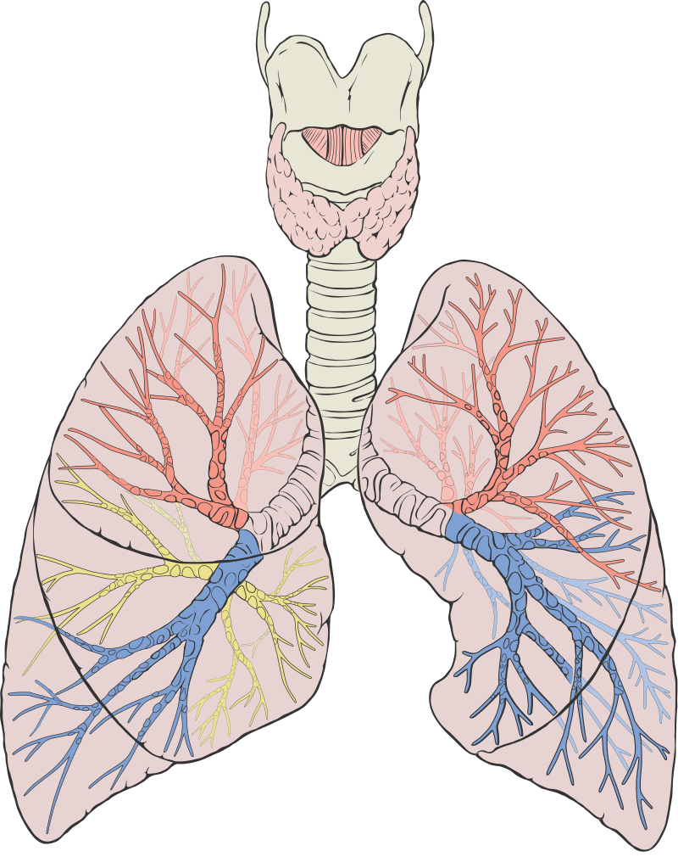
A Short Quiz : Question #2
What body part is shown in this picture?
Heart
Hand
Lungs
Brain
By Patrick J. Lynch, medical illustrator - Patrick J. Lynch, medical illustrator, CC BY 2.5, https://commons.wikimedia.org/w/index.php?curid=1496626

Slide 4

A Short Quiz : Question #3
Mark is the President of the United States.
TRUE
or
FALSE

Slide 5
Truth and Error
Some things are true:
  The house price is $12,950,000
  The picture is of human lungs
  Mark is not President of the USA
What if I strongly believe that the picture is of a human hand?
What if I really desire to be the president?
Strong belief and strong desire do not change facts about truth.
Notes:
OK, how did you do? How many of the questions above were true? How many were false? Are you sure? What if I want question 3 to be true – will my desire make it true for me? But what if I really, strongly desire for it to be true – can my strong desire make it true? Of course not.

Slide 6
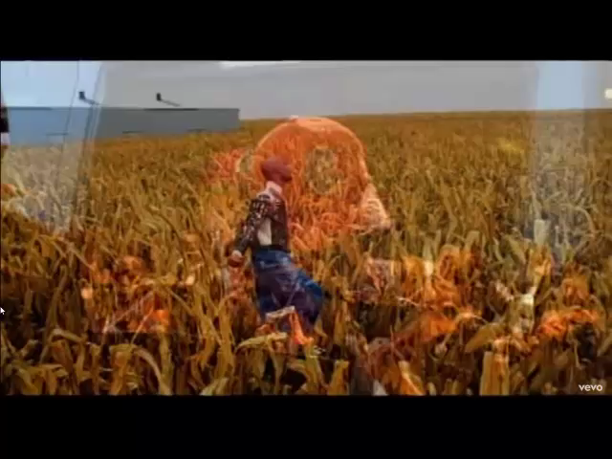
Sincere Belief Doesn’t Change Facts
I believe I can fly, I believe I can touch the sky
I think about it every night and day
Spread my wings and fly away
Belief is beautiful,
but truth is what
really matters!
“I believe I can fly”; 26-Nov-1996
Label: AtlanticJive; Written by: Robert Kelly

Slide 7
One more time…
Are some things true while other things are false?
If I really, really believe something is true, does my sincere belief make it true?
People say: “It really doesn’t matter what you believe – just be very sincere.” Is that true?
If I really believe that I can fly, should I jump off of a tall building?
Notes:
Just to be sure that you don’t forget, let me ask you again: Are some things true while other things are false? And if I really want to believe that a false idea is true, does my sincerity make it true?
Here is the point: some things are true and some things are false. Even if I have a very, very strong belief that I can fly, if I jump out of the window and flap my arms, I will still fall to the ground, accelerating at the speed of 9.8 m/s². And even if my belief is very sincere, I will probably still die if I fall from our 18th story window.

Slide 8
Why do people believe?
Society, culture, family
  It is easy to passively blend into culture
It helps me cope / feel better
  But so do drugs and alcohol (for a while)
It is true
Notes:
When it comes to spiritual things, there are three main reasons why people believe what they do:
1) They accept the belief systems of their culture or their family members.
2) They accept a belief system that makes them feel good.
3) They search for a belief system that is true.
Which of these seems like the best approach? Unfortunately, when it comes to choosing a spiritual belief system, many people abandon wisdom and just hope that everything will work out in the end. Or perhaps, they believe that “it doesn’t really matter what religious group you join, just so long as you are sincere.”
Hopefully, you are wise enough to recognize that there is no amount of sincerity that can take a false belief and make it true. Regardless of whether you accept a religious system from another culture or inherit the one into which you were born, truth is truth and error is error.

Slide 9
What is Religion?
Religion is system of belief and faith which guides our life. It helps us answer important questions, such as:
  Origin: where did I come from
  Meaning: why am I here?
  Morality: how to judge between good and evil?
  Destiny: is there life after death?
Our religion defines what we consider to be of highest importance. What are some things that people “worship”?
Notes:
Before we answer tonight’s question, it is important to ask the fundamental question: What is Religion? A simple fact is this: everyone has some form of religious belief. Because ultimately, everyone adopts a system of belief and faith that guides their lives. This is even true for people who reject the existence of God, a decision that is made by faith (believing in something unseen) and one that directs important life choices.
Practically speaking, we are all religious people, because each of us define what we consider to be of supreme importance. The word “worship” comes from the idea of what something is worth. We all choose to worship something: God, money, position, power, family, knowledge, adventure, etc.

Slide 10
Some Important Religious Beliefs
God: Does God exist? What is God like?
Heaven: What comes after death?
Salvation: What is required to please God? How do I become “good”?
Tonight’s question: Are all religions basically the same?
Notes:
Many people have been taught that it’s wrong to point at someone else’s religion and say that it is false. But here is something that you must remember: just as there is truth and error in the physical world, there is also truth and error in the spiritual world. While it might feel better to say that everyone’s religion is right, our feelings cannot take something that is false and make it true. The fact is that truth is exclusive, and it doesn’t take too much thinking to see that everyone’s opinions and beliefs cannot be true. And when we see ideas that totally contradict each other, we quickly know that they cannot all be true.

Slide 11
God
Atheism: God does not exist.
Islam: Allah is God and does not forgive (Koran, p.65)
Buddhism: There isn’t really a God, just an unending system of Karma
Hinduism: there are (at least) 330 million gods, and you can become a god
Christianity:
• God is righteous and just, and must punish sin
• Jesus (God in the flesh) died to forgive sin
• Jesus over came death and rose from the grave
Notes:
Every religion has a different view of God. This is the most fundamental starting point, and clearly proves that all religions are not the same.
What do you think? Do all religions teach the same thing about God?

Slide 12
Heaven / Afterlife
Atheism – life is simply a chemical accident, gone at the point of death
Islam – if judged worthy, enter a sexual paradise (Koran p.406)
Buddhism – endure suffering and continual rebirths until karma balance permits cessation
Hinduism: continual rebirth until mental skill helps break away from “me” and unite with God
Christianity – after life comes judgment
  Heaven is a place of God’s presence (Revelation 21:3,4)
  Heaven is reserved for those in Christ (1 Peter 1:3,4)
  Believers can know they have eternal life (1 John 5:13)
Notes:
It’s quite clear that the major religions disagree about God. So what do they say about the afterlife?
Buddhism – (p.127, 100)
Hinduism: (p.69)

Slide 13
Salvation
Hinduism – Focus entirely on Krishna at moment of death
Buddhism – the Eightfold Path and laws of Karma govern destiny
  • Wisdom: 1) right view, 2) right intention
  • Ethical Conduct: 3) right speech, 4) right action, 5) right livelihood
  • Mental Development: 6) right effort, 7) right mindfulness, 8) right concentration
Islam – the five pillars:
  1. Declaring and believing the Shahada or Creed ("There is no god but Allah, and Mohammed is the messenger of Allah.")
  2. Observing daily prayers (Salat) and attending the Friday public services
  3. Fasting during Ramadan
  4. The giving of alms (Zakat).
  5. The pilgrimage to Mecca (Hajj).
Notes:
Since atheism rejects the idea of God and Heaven, it obviously doesn’t believe in sin or salvation.
Ultimately, what matters the most is salvation. The Bible teaches us that our sin has separated us from the Holy God (Isaiah 59:1,2) and that everyone is sinful (Romans 3:23). When we look at the world around us (and the heart within us), we quickly agree that this is true. So we all have a basic need to be “saved” from sin and death. So, what do the major religions teach about this?
Hinduism (p. 126)
Buddhism (p.105, 87)

Slide 14
Salvation
Christianity – By human effort, people are unable to save themselves, so they need God to save them. He sacrificed Jesus in our place and offers salvation as a free gift to those who believe.
  He saved us, not because of righteous things we had done, but because of his mercy. He saved us through the washing of rebirth and renewal by the Holy Spirit, (Titus 3:5)
  For the payment for our sin is death, but the gift of God is eternal life in Christ Jesus our Lord. (Romans 6:23)
  If you declare with your mouth, “Jesus is Lord,” and believe in your heart that God raised him from the dead, you will be saved. (Romans 10:9)

Slide 15
Aren’t all religions basically the same?
NO! They have different views of God, heaven, and salvation.
Most religions require followers to continue doing good works, and if they do enough, they earn salvation:
  Hinduism requires disciplined meditation
  Buddhism requires people to follow the “Eightfold Path”
  Islam requires followers to obey the “Five Pillars”
But, one religion is different from all others: Christianity. It does not require followers to earn salvation – it is simply a gift of God through faith.
Notes:
As you can see above, all other religions are systems of works; Christianity is a work of faith (Titus 3:5). All other religions require people to keep “doing” something; Christianity is “done”, John 19:30.

Slide 16
Do, do, do, do … OR Done!
Jesus came to die for us:
  “He himself bore our sins in His body on the cross, so that we might die to sins and live for righteousness; by His wounds you have been healed.” (1 Peter 2:24)
  “When he had received the drink, Jesus said, ‘It is finished.’ With that, he bowed his head and gave up his spirit.” (John 19:30)
Notes:
We do not need a religion, we need to restore our broken relationship with God. Because human effort took us away from God, human effort is never sufficient to bring us back to Him. What we need is for God Himself to come and rescue us – and that’s what He did. He became a man (Jesus Christ) in order to die for us and bring us back.

Slide 17
Closing words from the Bible:
Jesus answered, “I am the way and the truth and the life. No one comes to the Father except through me.” John 14:6
“Enter through the narrow gate. For wide is the gate and broad is the road that leads to destruction, and many enter through it. But small is the gate and narrow the road that leads to life, and only a few find it.” Matthew 7:13,14
“Salvation is found in no one else, for there is no other name under heaven given to mankind by which we must be saved.” Acts 4:12
Notes:
If every religion could save people, God would not have sent Jesus to die for us (Galatians 2:21). But that was not possible. And since He paid such an unimaginably high price for our salvation, it is clear that there cannot possibly be a man-made way to achieve the same goal.
In closing, I want you to consider three reasons important exclusive points made in the Bible:
Jesus was very clear about the narrow way: John 14:6, Matthew 7:13,14, Acts 4:12
The Father was very clear that there was no other way: Matthew 26:38,39, Galatians 2:21
Jesus gave his final command because His gospel is critical: Matthew 28:18,19, Jn 3:36
Obviously, Jesus didn’t think that all religions were the correct paths to heaven.

