Slide 1
False Teachers and Cults
Serious Warnings!
Notes:
During these days of the Coronavirus pandemic, we are constantly hearing warnings from people about how to stay out of danger: don’t touch your face, wash your hands often, avoid contact with people who display symptoms, wear a mask in public, stay home unless you must go out, etc. Warnings are very important, and it is wise to obey warnings from people with wisdom and authority.

Slide 2
Some Warnings
Matthew 7:15 Jesus warned us to watch out for false prophets – they come to us dressed in sheep’s clothing, but inside, they are hungry wolves.
Acts 20:28-30 Paul warned church leaders of about people who will rise up and twist the truth, destroy the church.
2 Peter 2:1-3 Peter warned about false teachers in the church who will lead people away from the truth.
False teachers confuse and mislead non-believers, and they shake the faith of believers.
Notes:
In the same way, the Bible contains many warnings about false teachers. Here are just a few examples:
Matthew 7:15 Early in the New Testament, Jesus warned us to watch out for false prophets – they come to us dressed in sheep’s clothing, but inside, they are hungry wolves.
Acts 20:28-30 Paul warns the leaders of growing churches against people who will rise up and twist the truth, hungry wolves ready to destroy the church.
2 Peter 2:1-3 Peter warns us to beware of these false teachers who will show up around us, even in the church, and will try to lead you away from the truth. Sadly, many who are not paying attention will follow them in their wrong teachings.
These are very serious warnings from our Lord and those that He put in authority over the early church. We must pay attention so that we are not deceived!

Slide 3


Identifying Fakes
1 Thessalonians 5:21,22; Acts 17:10,11 Do not accept counterfeits! Train yourself with truth in order to examine every spiritual claim carefully!
Ephesians 4:14 Grow up to be mature so that you will not be deceived by the cunning and crafty ones
Notes:
{Hold up a thorn branch on which grapes have been stuck} At first glance, this plant might appear to the untrained eye to be a grape bush. You’ll notice that it has delicious fruit attached to it. In the same way, some religious groups appear very nice at first glance. But when you look more carefully, there is something very ugly and dangerous hiding just under the surface. (The Bible often uses thorns as a picture of the curse of sin.)
In the same way, we are commanded to train ourselves to examine every spiritual truth carefully: 1 Thessalonians 5:21,22 “Test everything. Hold on to the good. Avoid every kind of evil.” We must grow up to be mature Christians so that we will not be deceived by the cunning and crafty ones (Ephesians 4:14).
When I moved to China, I was warned about the risk of counterfeit 100 RMB bills. I was taught to examine each bill carefully: feel the hair and look at the number 100 on an angle. When you get to know the appearance of real money, it is much easier to recognize fake money if someone gives it to you.

Slide 4
Some Ways that They Work
Making Empty Promises
Creating Confusion and Doubt
Demanding Acceptance of everything and everyone
Notes:
Here are three common ways that false teachers work. There are certainly others, but here are some to be aware of…

Slide 5
Some Ways that They Work
Empty Promises: Genesis 3:1-5 A false teacher with a “magnetic personality” can attract people by promising to give them special privileges and powers.
2 Timothy 3:2-5 Lovers of pleasure rather than lovers of God
1 Timothy 6:3-5 They think that godliness is a means to financial gain (but then, see verses 9-10)
Revelation 13:13-14 The devil will also perform signs
Promises of healing (Acts 19:11-12 was true of apostles; but also see 2Timothy 4:20 and Philippians 2:25-27)
Notes:
By making empty promises: Genesis 3:1-5 This is the oldest trick in the book, starting with Satan who promised Eve that disobedience to God was the quick path to success (obviously a lie). False teachers can seduce people by promising to fulfil their worldly desires or granting them special privileges and powers. These teachers can be very exciting and impressive, easily attracting people based on their magnetic personality.
When people seek pleasure, money, signs and healings (above God), they are easily drawn away from the truth.

Slide 6
Some Ways that They Work
Empty Promises: Genesis 3:1-5
Confusion and Doubt: Colossians 2:8 By asking questions that are difficult to answer (e.g. the Trinity, predestination), false teachers create doubt about the truth. When faith is shaken, people become open to twisted ways of thinking.
Romans 16:17-18 Smooth talk + flattery = divisions
2 Timothy 2:16-18; 3:7,13 Always learning, but never arriving at the truth
2 Thessalonians 2:9-12 They refuse to love the truth
Notes:
Confusion: Colossians 2:8 False teachers often try to confuse people by asking questions that are hard (or impossible) to answer (e.g. the Trinity). They will then use our confusion to make us doubt our understanding of anything and everything. Eventually, our faith in the truth gets shaken and we can become more open to their twisted ways of thinking, taking a person captive.
Earthly philosophy glorifies the search and criticizes those who claim to find the truth, even though a decision must eventually be made.
Just because you don’t understand something, don’t assume that it is false.

Slide 7
Some Ways that They Work
Empty Promises: Genesis 3:1-5
Confusion and Doubt: Colossians 2:8
Demand Acceptance: 2 Timothy 4:3-4 False teachers may encourage “tolerance” (acceptance) of every belief of every person, leading people away from God’s absolute truths about right and wrong.
Isaiah 5:20 Calling good evil and evil good
1 Corinthians 6:9-11; Ephesians 5:5-6 Immorality has a very high price – no inheritance in God’s kingdom
Galatians 6:7 People reap what they sow
Notes:
Cultural Adaptation and Acceptance: 2 Timothy 4:3-4 is a good description of many modern religious leaders. Our culture has changed the meaning of the word “tolerance.” The actual word means that we should treat people with respect even though they are different than us. But now, the word has come to mean that we should accept every belief of every person, regardless of how offensive it might be or how contrary it might be to the Bible. Bible-believing Christians are often labeled as “intolerant” or “hateful” because they take a firm stance on Biblical principles. False teachers in the church will move people incrementally away from God by encouraging adaptation of worldly ideas, eventually diluting truth to the point that it no longer matters.

Slide 8
Some Ways that They Work
Empty Promises: Genesis 3:1-5 A false teacher with a “magnetic personality” can attract people by promising to give them special privileges and powers.
Confusion and Doubt: Colossians 2:8 By asking questions that are difficult to answer (e.g. the Trinity, predestination), false teachers create doubt about the truth. When faith is shaken, people become open to twisted ways of thinking.
Demand Acceptance: 2 Timothy 4:3-4 False teachers may encourage “tolerance” (acceptance) of every belief of every person, leading people away from God’s absolute truths about right and wrong.
Notes:
So, how do we deal with this danger? By being very clear on the most important things. Almost every false teacher will be wrong in one or more of three areas. Just because someone says that they are Christian (or that their group is a Christian church), it doesn’t mean that they are truthful. These three things help you to sort out some of the groups that are not truly Christian.

Slide 9
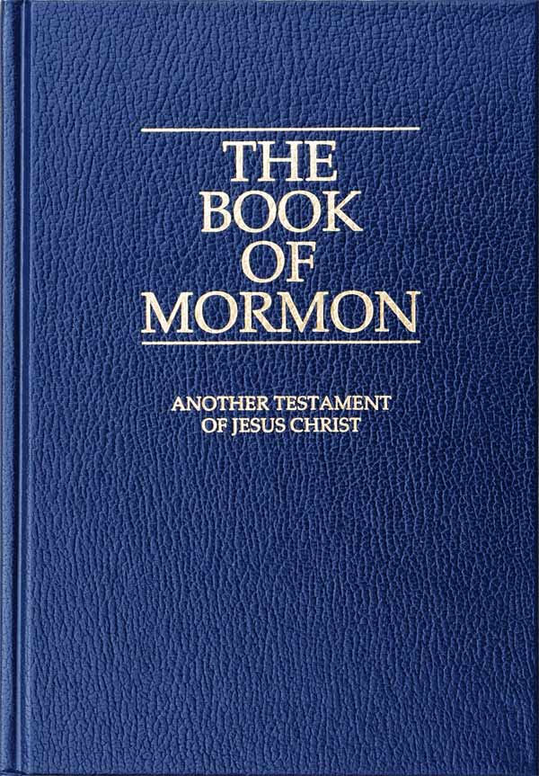
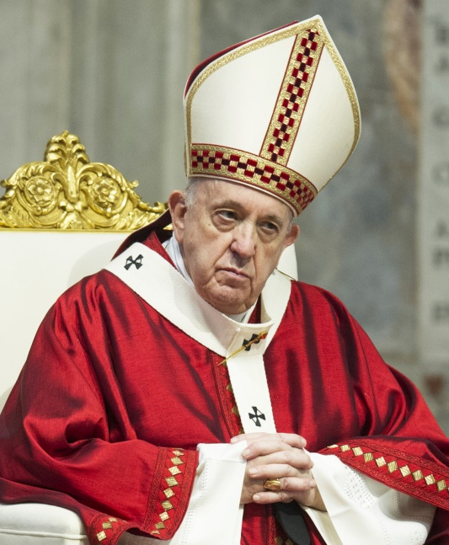
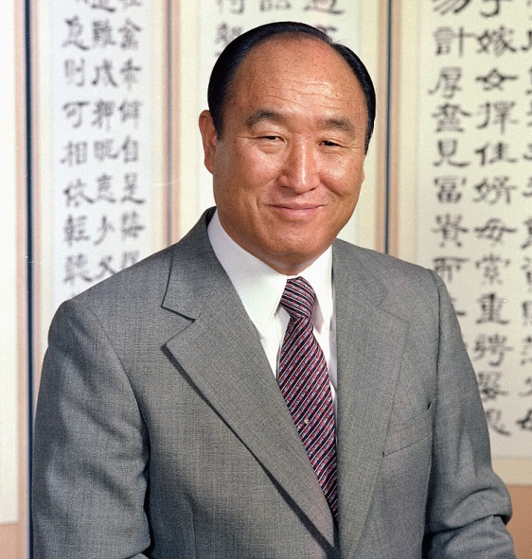


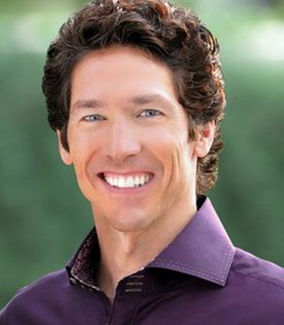
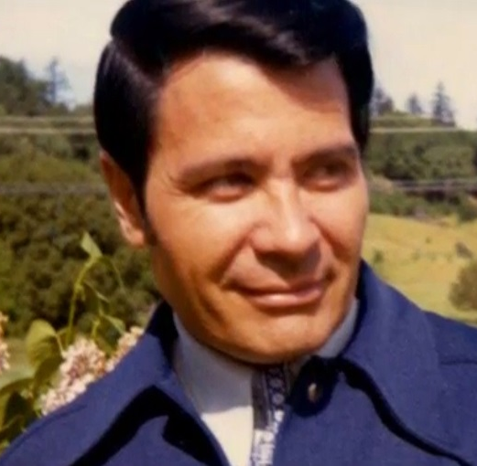
Some False Teachers
Sun Young Moon (Unification Church)
Joel Osteen
(Lakewood Church)
Jim Jones
(Jonestown, Guyana)
Notes:
Sun Young Moon fled from North to South Korea near the end of Korean War, where he founded his church and began to formulate his doctrinal views. The result was a religion based on marriage and family values that included a mix of Confucian and Christian beliefs. Three years after creating his church, Moon published Exposition of the Divine Principle, a reinterpretation of the Bible that his followers treat as holy scripture.
Jim Jones was seen as a beacon of peace across the racial divide and a leading advocate for socialism. He moved hundreds of cult members to "Jonestown" in Guyana, where he and followers believed they could create a "socialist paradise." After shooting a congressman and three reporters, Jones led 918 followers into a mass murder-suicide known now as the "Jonestown Massacre" on November 18, 1978. Most died by drinking cyanide mixed with Kool-Aid. The reverend, however, died of a self-inflicted gunshot wound to the head.
Joel Osteen is senior pastor at Lakewood Church, the largest Protestant church in America. Weekly attendance at the Houston-based church is 52,000 and 7 million people in 100 different countries watch Lakewood Church broadcasts every week. Osteen’s book Your Best Life Now was on the New York Times Best Seller list for 200 weeks. Royalties from Osteen’s book sales, radio show, public speaking fees, and church collection reportedly generate $55 million per year. He and his wife, co-pastor Victoria Osteen, live with their two kids in a $10.5 million mansion in the Houston suburbs. Osteen’s net worth is reported as $40 million. Osteen’s message promotes the name-it-claim-it or word-faith theology: “We have to conceive it on the inside before we’re ever going to receive it on the outside.” Listening to Osteen, a person would think God primarily wants to make poor people wealthy, sad people happy, and insecure people self-confident. But, according to the Bible, God primarily wants to make dead people live (John 5:24) and wicked people righteous (Matthew 9:13).

Slide 10
Test #1: Source of Authority
The Bible is the only source of authority that is worthy of our complete trust:
2 Peter 1:20,21 The Bible came from God through men
2 Timothy 3:16,17 The Bible is “God-breathed” and has everything we need to live and grow.
Revelation 22:18,19 Warns that anyone who adds to the Bible will be punished.
Galatians 1:8,9 Warns that anyone who preaches a different gospel will be condemned.
Isaiah 1:18 Shows that God encourages us to test for the truth
Leaders with strong personalities can attract followers, gain trust, and develop a position of absolute authority. If a leader criticizes or condemns followers for asking questions or challenging decisions, watch out!
Notes:
False teachers often have an attractive personality, one that draws people to them. They have the ability to gain the trust of others and will often speak or write in such a way that seems wonderful (even supernatural). As the group grows, that leader becomes the source of ultimate source of authority for the group members. If a member of the group has a different idea than the man in leadership, he is criticized and condemned.
Some examples of well-known false teachers include Sun Yung Moon (of the Moonies), William Taze Russell (of the Jehovah’s Witnesses), Joseph Smith (of the Mormons), the Pope (Roman Catholic Church) and Lightning Deng (of Eastern Lightning¹). Often, the leader of the cult will write a book, and the words of that book will be considered to be direct revelation from God. But not all false teachers are famous – some are just leaders of a small group.
When we place our ultimate trust in the authority of a single man, we will find ourselves heading the wrong way. Sometimes, the pastor of a church can exercise too much direction and control over the congregation. When someone disagrees with him and chooses to leave the group, they are slandered and considered a troublemaker. There is only one source of authority that is worthy of our complete trust: The Bible. If anyone claims to have an “extra” revelation or a special interpretation of the Bible, run away, fast! You must know these verses – memorize them and cling to them:
2 Timothy 3:16,17 Only the Bible is God-breathed, not the individual teaching of a man (2 Peter 1:20,21). It alone is enough for Christians to live and grow.
Revelation 22:18,19 warns us that anyone who adds to the Bible will be punished.
Galatians 1:8,9 warns that anyone who preaches a gospel contrary to the Bible will be condemned.
Isaiah 1:18 shows that God encourages us to reason together about the truth. If the leader of your group every makes you feel bad for asking questions, he may be trying to keep you from discovering the truth.

Slide 11
Test #2: Who is Jesus Christ?
Jesus is God
Isaiah 9:6 calls Christ "mighty God" and “everlasting Father”
Matthew 1:23 Jesus is Immanuel = "God with us"
John 20:28 "My Lord and my God" is accepted by Jesus
Colossians 2:9 In Jesus, God dwells in bodily form
Hebrews 1:3,8 The Father calls Jesus “God”
Colossians 1:15,16 We exist for Him (not the other way around)
Jesus was a physical man
1 Timothy 3:16 He appeared in the body
1 John 4:2 Jesus Christ has come in the flesh
2 John 7 How to tell a deceiver
Jesus is the only way to heaven
John 14:6 I am the way, no one comes except through Me
Acts 4:12 Salvation is found in no one else
Notes:
Almost every false teacher will lie about the identity of Jesus. They will deny that He is really God, they will deny that he was really a physical man, they will deny that He is the only Savior, they will deny His resurrection from the dead, etc. We must be clear on what the Bible, our source of authority, says about who Jesus is.
Jesus is God
Isaiah 9:6 calls Christ "mighty God" and “everlasting Father”
Matthew 1:23 Jesus is Immanuel = "God with us"
John 20:28 "My Lord and my God" is accepted by Jesus
Colossians 2:9 In Jesus, God dwells in bodily form
Hebrews 1:3,8 The Father calls Jesus “God”
Jesus was a physical man
1 Timothy 3:16 He appeared in the body
1 John 4:2 Jesus Christ has come in the flesh
2 John 7 How to tell a deceiver
Jesus is the only way to heaven
John 14:6 I am the way, no one comes except through Me
Acts 4:12 Salvation is found in no one else

Slide 12
Test #3: Salvation by Grace Alone
Religion tries to save people by a series of good works
The Bible teaches that Jesus Christ sacrificed Himself to pay for our sins, giving forgiveness and righteousness as a free gift of grace.
Romans 3:23 Every person is separated from God by their sin
Romans 6:23 All deserve death, but can receive the gift of salvation
Genesis 15:6 The first mention of righteousness resulted from belief
Isaiah 53:4,5 Jesus brought us peace by His punishment
Galatians 2:16 Religious rituals do not save
1 Peter 2:24 Christ died to pay for our sin.
Ephesians 2:8,9 Salvation comes by faith, not good works
Ephesians 2:10 Good works result from salvation
Matthew 7:16-20 People are saved totally by the grace of God. When people are truly saved, they are changed and bear “good fruit.” (Galatians 5:22,23)
Notes:
Many false teachers have a hidden agenda – they often seek to trap their members into a life of activity and financial contributions to their cause (often, the enrichment and power of their leader). Something that sets true Christianity apart from every other religion is the process of salvation.
While every other religion seeks to bring man back to God through a series of good works, the Bible teaches that Jesus Christ actually brings man to God through his self-sacrifice. From beginning to end, the Bible makes it clear that true salvation is a gift that we receive when we put our faith in the sacrifice of Jesus Christ by God’s grace. Most false teachers develop a legalistic process that members must follow, allowing them to control the group by measuring behavior, relationships with outsider, etc.
Genesis 15:6 The first mention of righteousness resulted from belief
Isaiah 53:4,5 Jesus brought us peace by His punishment
Romans 6:23 All deserve death, but can receive the gift of salvation
Galatians 2:16 Religious rituals do not save
1 Peter 2:24 Christ's death allows salvation
Ephesians 2:8,9 Salvation comes by faith, not good works
Ephesians 2:10 Good works result from salvation
Don’t misunderstand me about this. While the Bible is clear that people are saved totally by the grace of God, it also indicates that real Christians will have a heart-felt desire to please God. Their lives with be changed and they will bear “good fruit.” As we read onward in Matthew 7:16-20, we see that we can recognize the false teachers by their fruit. If they claim to believe all of the things above, but do not demonstrate the fruit of the Spirit (Galatians 5:22,23), they may have knowledge in their head by lack Jesus in their heart.

Slide 13
Defend Gently
Understand what the Bible teaches on these three areas and learn these verses and get a clear understanding of these critical truths.
When you are very clear about true Christianity, it will be easier to recognize a fake religion – a cult.
1 Thessalonians 5:21,22 “Test everything. Hold on to the good. Avoid every kind of evil.”
1 Peter 3:15 Prepare yourself to make a defense to anyone who asks about your faith
2 Timothy 2:24-26 When you tell people about your faith, do it in a spirit of love – it is hard for anyone to argue with a loving person who patiently shares the truth. (John 13:34,35)
Notes:
I purposely selected three things in our discussion that are good indicators of a false gospel. In almost every case, you can recognize a false religion by errors in one of these areas. Please examine what the Bible teaches on these three areas. Learn these verses and get a clear understanding of these critical truths. When you are very clear about true Christianity, it will be easy to recognize a fake religion – a cult.
Also, if you understand these simple but important differences, you will be ready to make a defense to anyone who asks about your faith (1 Peter 3:15). And when you tell people about your faith, do it in a spirit of love – it is hard for anyone to argue with a loving person who patiently shares the truth. (John 13:34,35, 2 Timothy 2:24-26)

