Slide 1
What does the Bible say about Heaven and Hell?
Two destinies…

Slide 2
Important Truth from the Bible
Time and Eternity
Life after Death
Life after Life after Death
Death after Death

Slide 3
Old Timeline
April 17, 2021
No Beginning
Bible Study
No
End

Slide 4
Old Timeline
1957
20XX
No Beginning
No
End
Mark
born
Mark
dies

Slide 5
Modified Timeline
The Universe
No Beginning
Beginning
No
End
Outside of time and space:
God
In the beginning,
“with the Lord one day is as a thousand years, and a thousand years as one day.” 2 Peter 3:8

Slide 6
Modified Timeline
The Universe
No Beginning
Beginning
No
End
Outside of time and space:
God
“in the hope of eternal life, which God, who does not lie, promised before the beginning of time.” Titus 1:2

Slide 7
Biblical Time
The Universe
No Beginning
The End
Beginning
No
End
Outside of time and space:
God
“But the day of the Lord will come like a thief, and then the heavens will pass away with a roar, and the heavenly bodies will be burned up and dissolved,” 2 Peter 3:10

Slide 8
Biblical Time and Eternity
The Universe
No Beginning
The End
Beginning
No
End
Mark
born
Mark
dies
“He has also set eternity in the hearts of men.” Ecclesiastes 3:11
God

Slide 9
Life after Death
“And if Christ has not been raised, your faith is futile and you are still in your sins. Then those also who have fallen asleep in Christ have perished.” 1Corinthians 15:17,18 (John 11:11-14)
“But in fact Christ has been raised from the dead, the firstfruits of those who have fallen asleep.” 1Corinthians 15:20
“For since we believe that Jesus died and rose again, even so, through Jesus, God will bring with him those who have fallen asleep.” 1Thessalonians 4:14

Slide 10
Life after Death
“If I am to live in the flesh, that means fruitful labor for me. Yet which I shall choose I cannot tell. I am hard pressed between the two. My desire is to depart and be with Christ, for that is far better.” Philippians 1:22,23
“Yes, we are of good courage, and we would rather be away from the body and at home with the Lord.” 1Corinthians 5:8
At the point of death, the spirit of a Christian immediately goes to be with Christ. (2 Corinthians 5:2-5)
This is Life after Death.

Slide 11
Life after Life after Death
Your body is important:
“Now may the God of peace himself sanctify you completely, and may your whole spirit and soul and body be kept blameless at the coming of our Lord Jesus Christ.” 1 Thessalonians 5:23
“Though our outer self is wasting away, our inner self is being renewed day by day. For this light momentary affliction is preparing for us an eternal weight of glory beyond all comparison. For we know that if the tent that is our earthly home is destroyed, we have a building from God, a house not made with hands, eternal in the heavens.” 1Corinthians 4:16,17; 5:1

Slide 12
Life after Life after Death
The Christian hope includes a body:
“So will it be with the resurrection of the dead. The body that is sown is perishable, it is raised imperishable; it is sown in dishonor, it is raised in glory; it is sown in weakness, it is raised in power; it is sown a natural body, it is raised a spiritual body.” 1 Corinthians 15:42-44
“For the Lord himself will descend from heaven with a cry of command, with the voice of an archangel, and with the sound of the trumpet of God. And the dead in Christ will rise first. Then we who are alive, who are left, will be caught up together with them in the clouds to meet the Lord in the air, and so we will always be with the Lord. ” 1Thessalonians 4:16,17

Slide 13
Life after Life after Death
We need a new body to survive in the presence of God! “And one called to another and said: “Holy, holy, holy is the LORD of hosts; the whole earth is full of his glory!” And the foundations of the thresholds shook at the voice of him who called, and the house was filled with smoke. And I said: “Woe is me! For I am lost; for I am a man of unclean lips, and I dwell in the midst of a people of unclean lips; for my eyes have seen the King, the LORD of hosts!” Isaiah 6:3-5
We need a new body to enjoy heaven personally! “In my Father's house are many rooms. If it were not so, would I have told you that I go to prepare a place for you? And if I go and prepare a place for you, I will come again and will take you to myself, that where I am you may be also.” John 14:1-3
This is Life after Life after Death.

Slide 14
What is Heaven Like?
The most important fact: God is there!
“And I heard a loud voice from the throne saying, ‘Behold, the dwelling place of God is with man. He will dwell with them, and they will be his people, and God himself will be with them as their God.’” Revelation 21:3
“For a day in your courts is better than a thousand elsewhere. I would rather be a doorkeeper in the house of my God than dwell in the tents of wickedness.” Psalm 84:10

Slide 15
What is Heaven Like?
Everything will be perfectly restored:
“He will wipe away every tear from their eyes, and death shall be no more, neither shall there be mourning, nor crying, nor pain anymore, for the former things have passed away. And he who was seated on the throne said, ‘Behold, I am making all things new.’” Revelation 21:4,5
“But, as it is written, “What no eye has seen, nor ear heard, nor the heart of man imagined, what God has prepared for those who love him.” 1Corinthians 2:9

Slide 16
Who will be in Heaven?
“behold, a great multitude that no one could number, from every nation, from all tribes and peoples and languages, standing before the throne and before the Lamb, clothed in white robes, with palm branches in their hands, and crying out with a loud voice, ‘Salvation belongs to our God who sits on the throne, and to the Lamb!’” Revelation 7:9-14

Slide 17
From History, a picture of Hell:
The nation of Israel had many kings, some good and some bad. Manasseh was a bad one:
“And he built altars for [false gods] in the two courts of the house of the LORD. And he burned his sons as an offering in the Valley of the Son of Hinnom, and used fortune-telling and omens and sorcery, and dealt with mediums and with necromancers. He did much evil in the sight of the LORD, provoking him to anger.”
2 Chronicles 33:5-6

Slide 18
From History, a picture of Hell:
The “Valley of the Son of Hinnom” was a terrible place where human sacrifices (typically sons and daughters) were burned to worship Molech, an evil false god.
It was eventually renamed “Gehenna” and became a pit for burning garbage and burying dead criminals.
When the Bible talks about hell, it often uses this word – a graphic image for those living nearby.

Slide 19
What is Hell Like?
It is eternal suffering far from the presence of God!
“Then he will say to those on his left, ‘Depart from me, you who are cursed, into the eternal fire prepared for the devil and his angels. Then they will go away to eternal punishment, but the righteous to eternal life.” Matt 25:41,46
“And if your eye causes you to sin, tear it out. It is better for you to enter the kingdom of God with one eye than with two eyes to be thrown into hell, ‘where their worm does not die and the fire is not quenched.” Mark 9:47-48
Jesus is not encouraging people to tear out eyes, but He is giving a very strong warning about the seriousness of hell.

Slide 20
Who will be in Hell?
“And I saw the dead, great and small, standing before the throne, and books were opened. Then another book was opened, which is the book of life. And the dead were judged by what was written in the books, according to what they had done. Then Death and Hades were thrown into the lake of fire. This is the second death, the lake of fire. And if anyone's name was not found written in the book of life, he was thrown into the lake of fire.” Revelation 20:12-14
This is Death after Death.

Slide 21
Justice and Mercy of God
God does not want people to go to hell: “The Lord is not slow to fulfill his promise as some count slowness, but is patient toward you, not wishing that any should perish, but that all should reach repentance.” 2 Peter3:9
God’s Justice and Mercy meet at the cross: “But God demonstrates his own love for us in this: While we were still sinners, Christ died for us. Since we have now been justified [declared not guilty] by his blood, how much more shall we be saved from God’s wrath through him!” Romans 5:8-9

Slide 22
Seek Him and Find Him
“Then you will call on me and come and pray to me, and I will listen to you. You will seek me and find me when you seek me with all your heart.” Jeremiah 29:12,13
“If you declare with your mouth, “Jesus is Lord,” and believe in your heart that God raised him from the dead, you will be saved. For it is with your heart that you believe and are justified, and it is with your mouth that you profess your faith and are saved. for, “Everyone who calls on the name of the Lord will be saved.” Romans10:9,10,13
There would not be a resurrection without the cross.

Slide 23
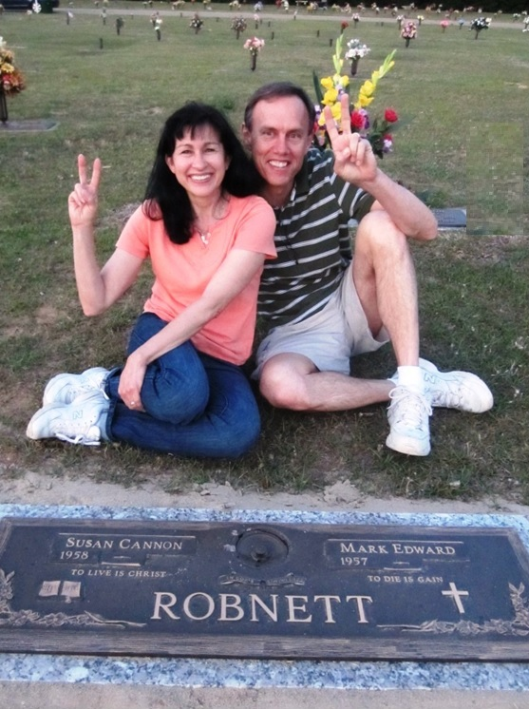
I write these things to you who believe in the name of the Son of God so that you may know that you have eternal life. 1 John 5:13

