Slide 1
Salvation and Security
1 Peter 1:1-9

Slide 2
Elect, Chosen, and Saved
1 Peter 1:1-2 The letter is written to “God’s elect, exiles scattered throughout the provinces … who have been chosen according to the foreknowledge of God …”
Ephesians 1:3-6 uses the same words: “He chose us in him before the creation of the world … He predestined us for adoption…”
Amazing truth: God has designed years of history that you might be His child today!
Romans 10:13 “Everyone who calls on the name of the Lord will be saved.”
Matthew 23:37 “… you were not willing.”
Amazing Truth: Everyone who comes to Jesus will be saved!
Are we chosen by God or do we choose to believe in God? Yes – both are true.

Slide 3
Tri – unity : The Trinity
1 Peter 1:2 Notice the roles of each in salvation:
The Father has chosen and guided the plan of salvation
The Spirit sanctifies us. This means that He changes us from our old image into the image of God (2Corinthians 3:16-18).
The blood of Jesus has been shed for our cleansing and salvation. A sacrifice was required to pay for our sins, and Jesus was our sacrifice.
Matthew 28:19 The Trinity at work

Slide 4
Exiles and Strangers ?
There are only two kinds of people in the world – those who are God’s children (Matthew 5:14-16) and those who are not (John 8:44).
2 Peter 1:4 As a result of your new birth, you have inherited God’s divine nature.
God’s children are not the same as the people of this world. People of the world have a:
different God (usually themselves)
different morality (if it feels good, do it)
different goals (make money and satisfy personal pleasures).

Slide 5
Born Again – in His Image
Genesis 1:26 God created people “In His Image”
Genesis 5:3 After Adam listened to Satan, his children were born “in his image” the image of a fallen, sinful man. Every person born on the earth received the same image and the same sinful nature (Romans 5:12).
John 1:12-13 But when a person believes in Jesus, they are born into God’s family. We entered this world by physical birth – we enter God’s family by spiritual birth (John 3:3).
When you were born physically, it was recorded on a birth certificate. When you were born again, a record was made (1John 5:11-13). Your birth certificate was marked with a seal – the Holy Spirit of God (Ephesians 1:13).

Slide 6
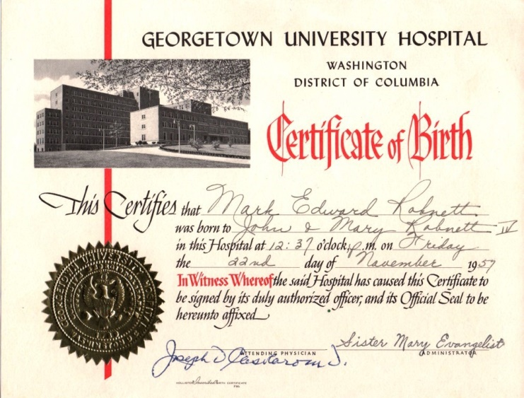

Slide 7
God is central, and you are His child
1 Peter 1:3 God is the central figure in the universe. He has created us for His purposes – once we really understand this, we understand life much better.
In His plan and purpose, He showed mercy to us, allowing us to receive the new birth through the resurrection of Jesus (Ephesians 1:3-6).
Every Christian has a new Father: God Almighty! As a good Father, He:
loves and cares for his child (1 Peter 5:7)
guides and teaches his child (John 14:26)
disciplines his child (Hebrews 12:5-6)
has a plan for his child (2 Timothy 1:9,10)

Slide 8
Eternally Secure !
1 Peter 1:4-5 Amazing and wonderful promises:
God has given us salvation and will not take it away.
It is kept for us by His power, it will never fade away
It is reserved for us in heaven.
John 10:27-29 No one (not even you) can cause you to lose your salvation, because God your Father is GREATER THAN ALL men.
Ephesians 2:8-9 Salvation is by grace through faith, and not by works. No one can lose his salvation because no one earned his salvation.

Slide 9
What can separate you from God’s love?
Romans 8:38-39
A. “Death” – you can’t lose it when you die
B. “Life” – you can’t lose it while you are alive.
C. “Angels” – can’t take it from you.
D. “Demons” – the devil can’t cause you to lose it.
E. “The present” – nothing happening right now can take it away.
F. “The future” – nothing in the future can make you lose it.
G. “any powers” – there is nothing more powerful than God
H. “Height” – nothing above you.
I. “Depth” – nothing below you.
J. “NOR ANYTHING ELSE in all creation, will be able to separate us from the love of God, that is in Christ Jesus our Lord.”

Slide 10
Living in a Broken World
1 Peter 1:6-7 Our life in this broken world is often hard and we “suffer grief.” Remember, this is normal and should be expected (4:12).
If you look around, you'll be distressed. If you look within, you'll be depressed. If you look above, you'll be at rest.
2 Corinthians 4:18 All physical things will eventually disappear, even the purest gold. But there is something more valuable than gold – our faith.
Because our faith is so valuable, God desires to purify it (just like gold is refined). This takes heat and pressure – trials that do not feel good to us at the time. Growth will result when we face trials with faith (James 1:2-4).

Slide 11
Living Joyfully in a Broken World
1 Peter 1:8-9 Jesus will wipe away every tear, remove all pain, and we’ll praise Him forever. We should be filled with a joy that is inexpressible and glorious!
1Peter 1:3 God has given us a “living hope.” Jesus died for us, buy He was resurrected and is now alive. The Christian hope is not wishful thinking, but a confident assurance based on the fact of the resurrection.
How do we live in a broken world? We live by keeping our eyes on Jesus and His amazing promises toward us.

Slide 12
Remember this:
When you put your faith in Jesus, you are given new life. You are born again into God’s family and have a new Father and an eternal hope in heaven.
Your salvation is secure because it is protected by God Himself. You did not earn salvation by your “good works” and cannot lose salvation by “bad works” (or anything else).
Your hope as a Christian should bring you great joy! And as with every good thing, it should bring praise to the great God who has given it to us.

