Slide 1
The Word of God
1 Peter 1:10-12,22-25; 2 Peter 1:16-21

Slide 2
Bold Claims of the Bible
2 Peter 1:20,21 Not just a book written by men, but words spoken by God
Isaiah 40:8 Words are eternally important
Hebrews 4:12 It is a personal message to each of us
Psalm 96:4,5 The God of the Bible is the one and only true God

Slide 3
Some Facts about the Bible
Broadly Accessible. God does not keep His truth hidden in one country or culture (Acts 26:26)
Accurate. Documents are genuine, written by eye-witnesses, and match history.
Reality. Messages match observations; they do not require us to ignore reality
Consistent. God does not change, and His Word does not change.
Provides Answers. God’s messages resolve the most important problems of life.

Slide 4
Most Popular Books in World History
Notes:
The Bible was the very first book printed on the first commercial printing press in Gutenberg, Germany (1450AD). For every year since then, it has been the best selling book globally.

Slide 5
World’s Most Translated Books
Notes:
The global importance of the Bible is clearly shown by the number of languages into which it has been translated. Almost anywhere in the world, people can read the Bible in their own languge.

Slide 6
Original Copies of Ancient Books
Notes:
The Bible is unique among ancient books in that there are so many copies of the original manuscripts in existence. Because of this, we can have confidence that the message is identical to the one that was originally delivered.

Slide 7
Time Gap Between Events and Writing
Notes:
Many ancient stories were only preserved in the memories of storytellers, allowing them to develop into legends over time. But the Bible is unique: Most of the books were written down by eye-witnesses or by first person interviewers. The prevents the story from being changed over time.

Slide 8
Detailed, eye-witness accounts
Eye-witness accounts
  Matthew 14:19-21 > 5000 witnesses to Jesus’ creation of food
  1 Corinthians 15:3-6 > 500 witnesses to Jesus’ resurrection
Detailed reporting of actual events
  John 21:11 > 153 Fish
  Mark 4:37,38 > Jesus sleeping on a cushion
Notes:
Not historical fiction! Until about 1800AD, fiction was written with vague details. Instead, the Bible is written like a news report.

Slide 9
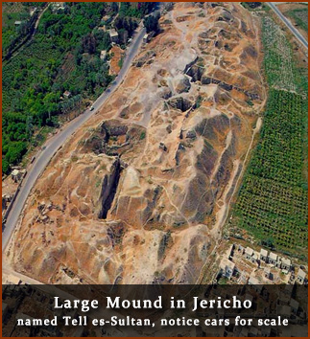
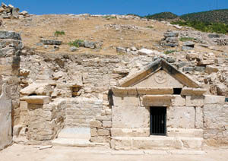
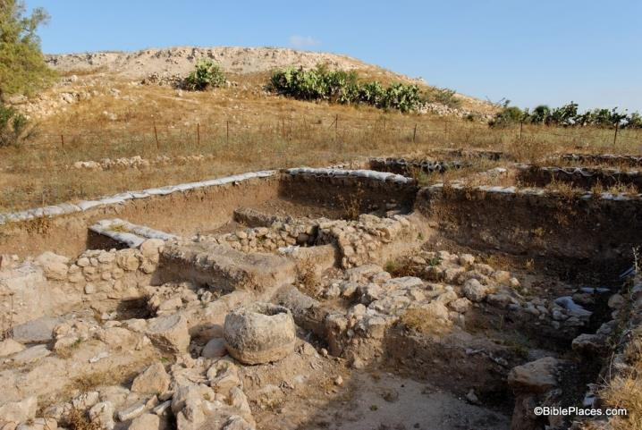
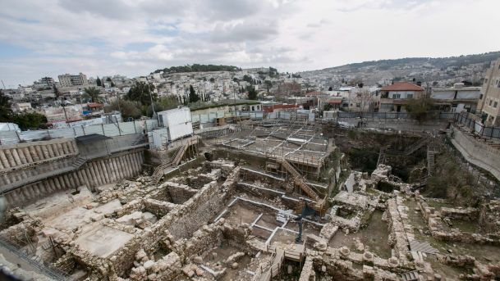
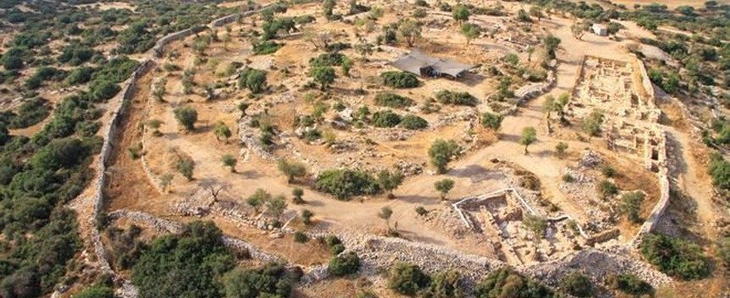
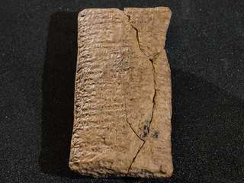
Over 25,000 historical Bible sites have been discovered by Archaeology
Notes:
Archaeology is a relatively new science, only several hundred years old. For many centuries, people questioned the existence of the cities described in the old testament. But now, the Bible is used as an archeological guidebook to help them find what they are looking for.

Slide 10
Real Human Experience
Genesis 12:2,12,13 > Abraham lies
Mark 14:69-71 > Peter denies
Romans 3:23 > Everyone sins

Slide 11
The Problem and the Solution
  Jeremiah 9:23,24; Isaiah 43:7 Why we exist
  Isaiah 59:2; Romans 3:23 The problem of man
  Romans 10:17; John 3:16 The only solution for man

Slide 12
About the Bible
The Mystery (1 Peter 1:10-11). The Old Testament has glorious prophecies about the Savior, but also prophecies about His suffering. Isaiah 53:7-9, 10-12
Revealed (1 Peter 1:12). The mystery revealed in the death and resurrection of Jesus Christ.
Born Again (1 Peter 2:22-23). How? By the living and eternal Word of God.
Eternally True (1 Peter 1:24-25). People come and go, but the Bible does not change.

Slide 13
How to Think About the Bible
Psalm 119:105 – It directs us
2 Timothy 3:16-17 – It equips us for service
Jeremiah 15:16 – It is our spiritual food
Psalm 119:9-11 – It keeps us clean (pure)
2 Peter 1:16-21 – It is completely trustworthy, much more than personal experiences (compare with Matthew 17:1-9). It is our Rock
Deuteronomy 32:47 – It is our Life!

Slide 14
What to do with the Bible
Pray (knees) – Ask God to give you a deep understanding (Psalm 119:33-37).
Hear (mouth) – Read the Bible often, aloud if possible (1 Timothy 4:13)
Memorize (head) – Write a meaningful verse on a notecard and carry it in your pocket, reviewing it regularly. (Psalm 119:9,11)
Meditate (heart) – Be sure that the Word of God is a healthy part of your “information diet.” (Psalm 1:1-3; Joshua 1:8).
Obey (hands) – apply what you learn to your daily life (James 1:22). Don’t just put information into your head and expect your life to change.

Slide 15
What to do with the Bible
Confidence – cultures change, but the Bible does not. Do not trust culture to help you understand the Bible – trust the Bible to help you understand culture.
Research – when you don’t understand something, write it down and seek help from friends and good books. Like mining for gold, the deeper you dig, the more treasure you will find.
Context – do not take verses out of context, but read the entire passage.
Compare – look at parallel passages to understand the full meaning of the message.
Consistent – set aside a regular time to read and guard it from distraction.

Slide 16
What Next?
Do it! Choose a reading method that you enjoy and that works best for you during each season of life. Read it slowly and deeply, not like a school assignment that must be completed (John 5:39).
Focus on Relationship. As a young Christian, focus on the primary places which deal with your new relationship with your Heavenly Father. Start with the Gospel of John and other New Testament books.
Read a chapter carefully and then underline a verse that you find to be particularly meaningful. Think about it throughout the day.
You can also use a devotional guide that points you to a scripture and helps you think deeply about the passage.

