Slide 1
Is the Bible Trustworthy?
Some thoughts…
Notes:
Deep in all of our hearts, we sense that our life has a purpose – a meaning that extends beyond this physical world. Perhaps you have been lying awake at night wondering about this, but eventually, you get discouraged or distracted and try to ignore the biggest questions of life: Where did I come from? Why am I here? What will happen after I die?
I’m glad that you came today as we start a high level study of the Bible. If you come with an open heart, I believe that you will find this book has answers to all of these questions (and much more). It is a big book - a person can spend a lifetime studying this book. Our lessons will only present an overview of some basic things that the Bible teaches. We will study the Bible chronologically and we will only study selected key events. Once you understand the basics of the Bible, the rest of the Bible is easier to understand.
(Remember – apologetics cannot convince a skeptic to believe, but it can remove some barriers to belief for someone who desires to know the truth.)

Slide 2
Faith: trusting something we cannot see
Why do people have faith?
  Deep in our heart, we know that our lives have meaning.
What shapes our beliefs?
  Society, culture, family
  It helps us cope with trouble or feel better
  Truth
But how do I know my belief is true?
Notes:
People all over the world believe that their life has a purpose. If our lives end at the grave, it doesn’t matter whether our life is virtuous or villainous. As Tim Keller says, if you’re on the Titanic as it sinks, it doesn’t matter if you go down hugging or mugging. But deep inside, we all have been created with a greater sense of purpose that continues after we die.
Along the way, people actively choose or passively accept a belief system to live by. Why do people choose one belief system over another? Here are some reasons, but ultimately, what matters most is whether or not their belief system is true.

Slide 3
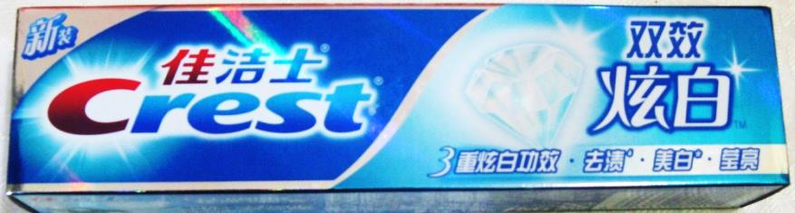



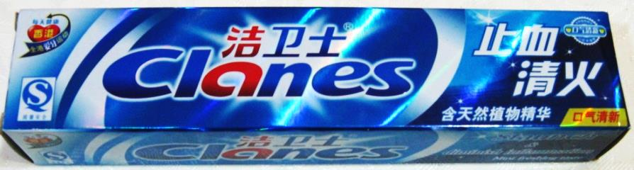



Finding Truth…
…in a world of counterfeits
Notes:
There are many different belief systems, and if you examine them, they are all very different. As such, they cannot all be true. So, how do we identify the one that is true?

Slide 4
Is the Bible trustworthy?
The Bible is Globally Significant
The Bible is Accurate
The Bible makes Important Claims
Notes:
Perhaps you’ve heard some things about the Bible. Many people think that the Bible is just a book of Legends or that it is like many other religious books – filled with rules and philosophy. Tonight, I want to clarify what the Bible really is and why it’s worth studying.

Slide 5
Is the Bible trustworthy?
The Bible is Globally Significant
Notes:
Perhaps you’ve heard some things about the Bible. Many people think that the Bible is just a book of Legends or that it is like many other religious books – filled with rules and philosophy. Tonight, I want to clarify what the Bible really is and why it’s worth studying.

Slide 6
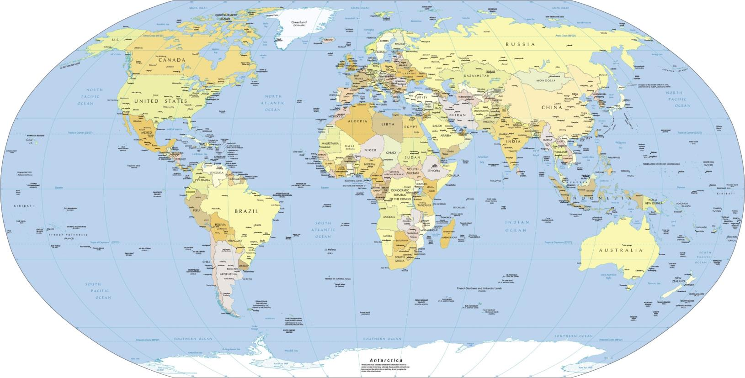
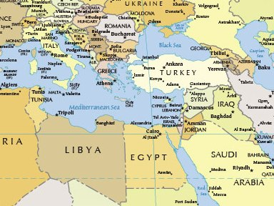
Where Was The Bible Written?
Mostly Israel; other Middle East, Mediterranean and Asian Nations
Notes:
Some people mistakenly assume that the Bible is western, or that it came from America. Actually, it was written thousands of years before America was founded, and it is actually eastern in nature.

Slide 7
Most Popular Books in World History
Notes:
The Bible was the very first book printed on the first commercial printing press in Gutenberg, Germany (1450AD). For every year since then, it has been the best selling book globally.
These numbers are as of January 2000 and are only estimates. But it is clear that the Bible is by far the most printed and read book in world history.

Slide 8
World’s Most Translated Books
Notes:
The global importance of the Bible is clearly shown by the number of languages into which it has been translated. Almost anywhere in the world, people can read the Bible in their own language.

Slide 9
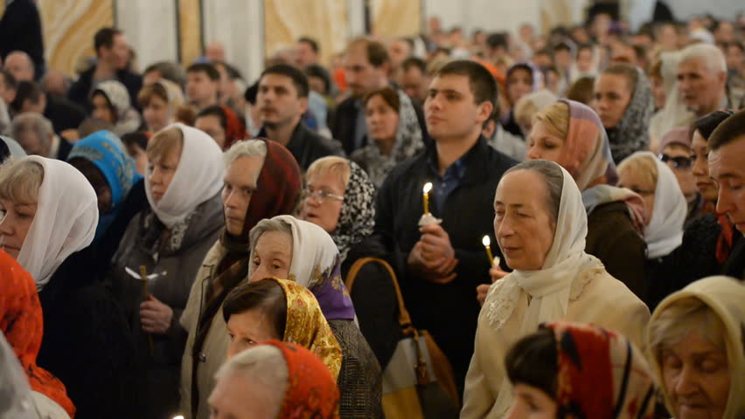
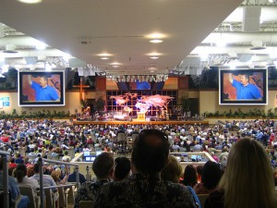

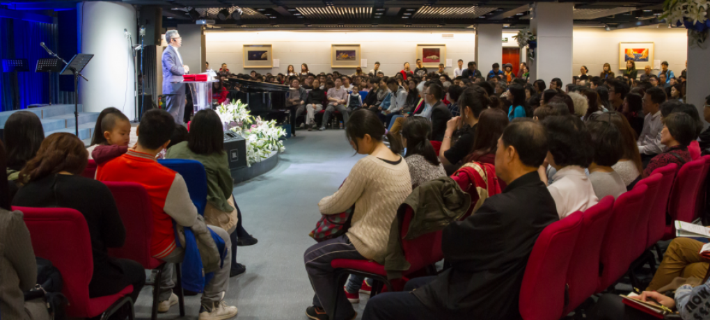
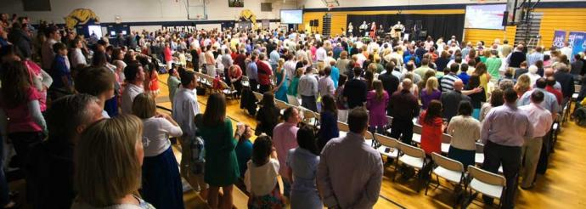
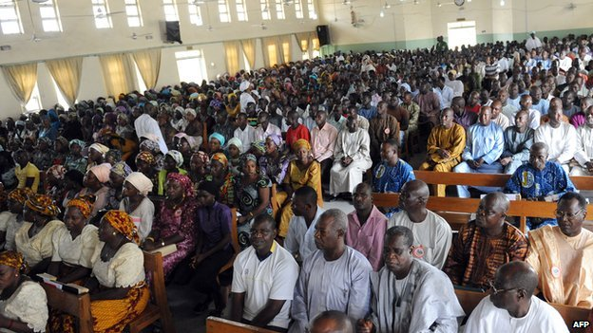
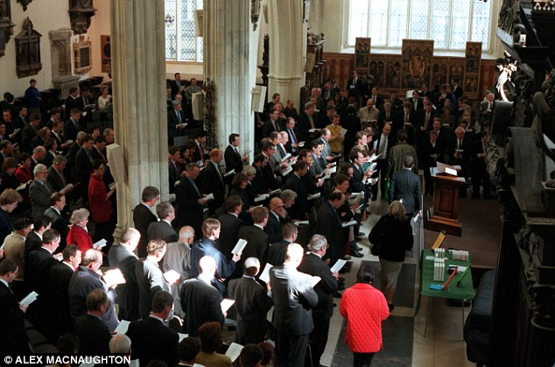
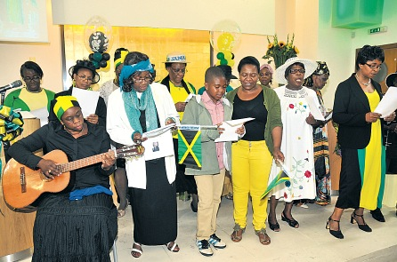
Not Culturally Limited
Notes:
Unlike most religious books, the Bible is not bounded by culture. If a person submits to Islam, they must wear Arabic clothing and read the Quran in Arabic. If a person chooses to be Hindu or Buddhist, they adopt Asian appearance and meditation styles. But when the Bible enters a culture, it doesn’t require people to adopt the clothing or customs of one country – it is a global message for all cultures around the world.

Slide 10
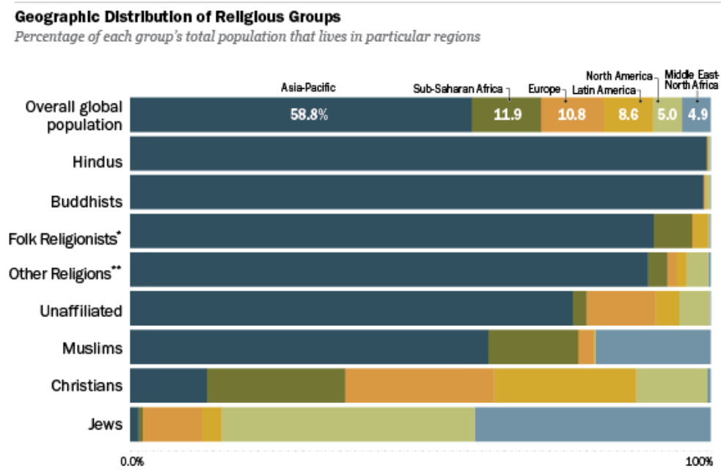

Slide 11
A few famous Bible-believers
Sir Francis Bacon – inventor of scientific method
Johannes Kepler – defined laws of planetary motion
Galileo Galilei – influential physicist, astronomer, scientists
Blaise Pascal – mathematician, developed calculus
Isaac Newton – defined rules of gravity, etc.
Francis Collins – leader of Human Genome Project (first to map DNA)
Andrew Pinsent – Physicist, co-inventor of creation of the Large Electron-Positron Collider at CERN
Copernicus, Boyle, Pascal, Faraday, Maxwell, Kelvin, etc.
Notes:
Some people suggest that the Bible is only accepted by foolish, old, superstitious people. But the fact is, many brilliant scientists and philosophers from the past and the present have studied and accepted the Bible.
Science is useful, but can only study and explain things that observable, measureable, and repeatable.
Creation, meaning, love, morality, destiny, etc. require a different process for understanding.

Slide 12
The Bible is Globally Significant
Written in ancient Middle East
The most popular book in world history
The most widely translated book in the world
Not culturally limited
Trusted by scholars throughout history
It seems reasonable if God spoke to people through a written format, it would be globally accessible.
Notes:
These are just a few things that demonstrate the importance of the Bible.
You may not yet believe that it is the written word of God, but at least you should take some time to understand the message of the most important book in world history.
And it seems reasonable that, if God spoke to people through a written format, it would be globally accessible.

Slide 13
Is the Bible trustworthy?
The Bible is Globally Significant
The Bible is Accurate
Notes:
Perhaps you’ve heard some things about the Bible. Many people think that the Bible is just a book of Legends or that it is like many other religious books – filled with rules and philosophy. Tonight, I want to clarify what the Bible really is and why it’s worth studying.

Slide 14
Early Manuscripts of Ancient Books
Notes:
The Bible is unique among ancient books in that there are so many copies of the original manuscripts in existence. Because of this, we have the ability to compare many original manuscripts to modern translations and assure nothing was lost or added to the original text.
5700 copies of New Testament

Slide 15
Time Gap Between Events and Writing
Notes:
Many ancient stories were only preserved in the memories of storytellers, allowing them to develop into legends over time. But the Bible is unique: Most of the books were written down by eye-witnesses or by first person interviewers. The prevents the story from being changed over time.

Slide 16
Detailed, eye-witness accounts
Eye-witness accounts (1 John 1:1):
“That which was from the beginning, which we have heard, which we have seen with our eyes, which we have looked at and our hands have touched—this we proclaim concerning the Word of life.”
Detailed reports of actual events (John 21:11)
“Simon Peter climbed back into the boat and dragged the net ashore. It was full of large fish, 153, but even with so many the net was not torn.”
Notes:
Not historical fiction! Until about 1800AD, fiction was written with vague details. Instead, the Bible is written like a news report.
Eye-witness accounts
Matthew 14:19-21 > 5000 witnesses to Jesus’ creation of food
1 Corinthians 15:3-6 > 500 witnesses to Jesus’ resurrection
Detailed reporting of actual events
John 21:11 > 153 Fish
Mark 4:37,38 > Jesus sleeping on a cushion

Slide 17
Bible Writers and Timeline
Bible was written:
  Over a period of 1600 years: 1500BC to 100AD
  By 40 separate writers in three languages
  By Kings, fishermen, prophets, a doctor…
Bible written
Old testament (OT)
0
NT
1500BC
100AD
2024AD
Jesus birth, life, death
Amazing consistency and unity from cover to cover!

Slide 18



Imagine this:
40 different people over 1600 years
Each cuts out a different puzzle piece:
How likely that they all fit together?
Impossible!
Unless, they are perfectly guided by the One who is using them to assemble His masterpiece, designed before they started writing anything.

Slide 19
Detailed, Accurate Prophecies
Isaiah 44:24,28 (written about 700BC, before Cyrus’ birth and while the temple was standing):
“This is what the LORD says – your Redeemer, who formed you in the womb: who says of Cyrus, ‘He is my shepherd and will accomplish all that I please; he will say of Jerusalem, “Let it be rebuilt,” and of the temple, “Let its foundations be laid.” ’”
Ezra 1:2 (written ~150 years later in 538BC):
“This is what Cyrus king of Persia says:“ ‘The LORD, the God of heaven, has given me all the kingdoms of the earth and he has appointed me to build a temple for him at Jerusalem in Judah.”
Over 300 specific prophecies about Jesus
Notes:
Isaiah 44:24,28
Written about 700BC before Cyrus was born and while the temple was standing
Ezra 1:1-3 written 150 years later (538BC)
Daniel 9:25,26
Written about 600BC. Predicts that 483 lunar years between decree to rebuild Jerusalem and Messiah
Nehemiah 2:1,6-8 Artaxerxes writes decree in 444BC
Jesus rides into Jerusalem in 33AD.
Over 300 specific prophecies about Jesus

Slide 20
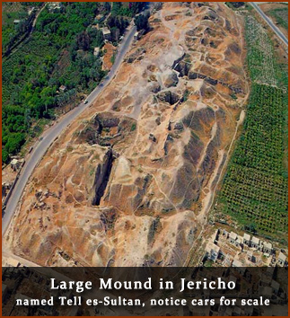
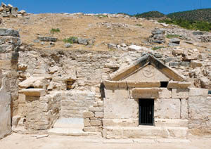
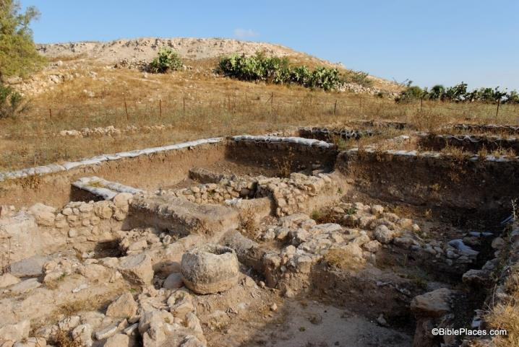
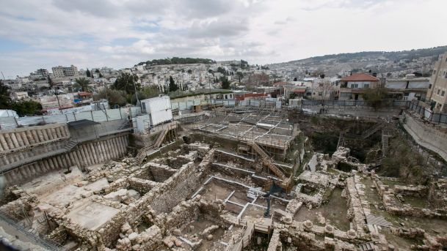
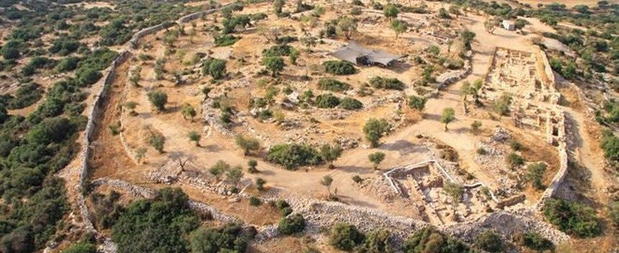
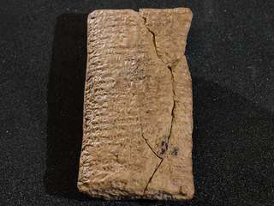
Hundreds of Biblical references have been confirmed by archaeology
Notes:
Archaeology is a relatively new science, only several hundred years old. For many centuries, people questioned the existence of the cities described in the old testament. But now, the Bible is used as an archeological guidebook to help them find what they are looking for.

Slide 21
Real Human Experience
Genesis 12:2,12,13 > Abraham lies
Mark 14:69-71 > Peter denies
John 6:66 > People reject Jesus
Romans 3:23 > Everyone sins
Clearly reflects the beauty and brokenness of our human condition
Notes:
“Principle of Embarrassment” = if the text is embarrassing to the author (or main character?), it is probably true

Slide 22
The Bible is Accurate
Thousands of ancient manuscripts
First-person accounts (not legends)
Detailed reports of actual events (not only rules and philosophy)
Matches archaeology / history
A consistent, unified message
Detailed, accurate prophecies
Matches human experience
Notes:
Unlike many religious books, the Bible does not simply provide a list of rules to obey. It contains true stories of history, showing how God created people, how they broke away from Him, and what He has done to bring them back to Himself. The detailed accounts of the Bible are characteristic of actual historical reporting (not mere fiction). And other than Jesus, the heroes of the Bible are realistically portrayed, including their mistakes and failures.

Slide 23
Is the Bible trustworthy?
The Bible is Globally Significant
The Bible is Accurate
The Bible makes Important Claims
Notes:
Perhaps you’ve heard some things about the Bible. Many people think that the Bible is just a book of Legends or that it is like many other religious books – filled with rules and philosophy. Tonight, I want to clarify what the Bible really is and why it’s worth studying.

Slide 24
The Bible Claims
It Came from God (2 Timothy 3:16)
  “All Scripture is God-breathed and is useful for teaching, rebuking, correcting and training in righteousness,”
Notes:
Also, 2 Peter 1:21

Slide 25
The Bible Claims
It Came from God
It is eternally important (Isaiah 40:8)
“The grass withers and the flowers fall, but the word of our God endures forever.”
Notes:
Also Matthew 24:35

Slide 26
The Bible Claims
It came from God
It is eternally important
It can guide our lives (Psalm 119:105)
“Your word is a lamp to my feet and a light to my path.”
Notes:
(Hebrews 4:12) it is alive: “For the word of God is alive and active. Sharper than any double-edged sword, it penetrates even to dividing soul and spirit, joints and marrow it judges the thoughts and attitudes of the heart.”

Slide 27
The Bible Claims
It came from God
It is eternally important
It can guide our lives
It reveals the truth about God (Ex 34:6,7)
“The LORD, the LORD, the compassionate and gracious God, slow to anger, abounding in love and faithfulness, maintaining love to thousands, and forgiving wickedness, rebellion and sin. Yet he does not leave the guilty unpunished;”
Notes:
Also Jeremiah 9:23,24 and Hebrews 1:1-3

Slide 28
The Bible Claims
It came from God
It is eternally important
It can guide our lives
It reveals the truth about God
It tells the purpose of man (Isaiah 43:6,7)
“Bring my sons from afar and my daughters from the ends of the earth – everyone who is called by my name, whom I created for my glory, whom I formed and made.”
Notes:
Also Psalm 103:11 and John 1:12

Slide 29
The Bible Claims
It came from God
It is eternally important
It can guide our lives
It reveals the truth about God
It tells the purpose of man

Slide 30
Is the Bible Trustworthy?
The Bible is Globally Significant
The Bible is Accurate
The Bible makes Important Claims
Everyone should understand the message of the most popular, widely translated, globally influential book in world history
Notes:
Hebrews 11:6 faith is required
John 1:46 “come and see”

Slide 31
Study Plan
 | Topic
 | Is the Bible Trustworthy?
2 | Did God Really Create the World?
3 | If God is Good, why does Suffering Exist?
4 | Why is Evil so Widespread and Powerful?
5 | What is the Purpose of the Ten Commandments?
6 | Why did Jesus Perform Miracles?
7 | What did Jesus Really Say?
8 | Is Death the End (or the Beginning)?

