Slide 1
A Living Hope
1 Peter 1:1-9
Notes:
Use NIV with this study

Slide 2
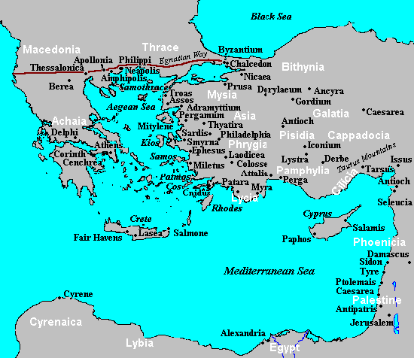
1 Peter - Background
1 Peter 1:1a “Peter, an apostle of Jesus Christ,”
  Probably written from Rome (5:13 – “Babylon”)
  Written in AD 64, the time of Rome’s burning
  Blends Christian blessings with expectations of persecution (because Nero blamed them for burning Rome).
1 Peter 1:1b To “exiles scattered throughout the provinces of Pontus, Galatia, Cappadocia, Asia, and Bithynia,”
  All Christians are temporary residents here, looking forward to our eternal city (Phil 3:20)
Pontus
Notes:
Exiles = παρεπίδημος parepidemos (par-e-piy'-d̮ee-mos) adj. an alien alongside, i.e. a resident foreigner. (KJV: pilgrim, stranger)
Dispersion = διασπορά diaspora (d̮iy-a-spo-ra') n. (concretely) the Israelite resident in Gentile countries.; (specially) the Redeemed Israelite living abroad.

Slide 3
Elect, Chosen, and Saved
1 Peter 1:1-2 “God’s elect, … who have been chosen according to the foreknowledge of God …”
Ephesians 1:3-6 uses the same words: “He chose us in him before the creation of the world … He predestined us for adoption…”
Amazing Truth: God has designed years of history that you might be His child today!
Romans 10:13 “Everyone who calls on the name of the Lord will be saved.”
Matthew 23:37 “I have longed to gather … you were not willing.”
Amazing Truth: Everyone who comes to Jesus will be saved!
Are we chosen by God or do we choose to believe in God? Yes – both are true.
Notes:
“Foreknowledge” means that God planned before, not that he observed before (cf. Ex. 33: 17; Jer. 1: 5; Amos 3: 2; Matt. 7: 23). Thus, God pre-thought and pre-determined or predestined each Christian’s salvation (The ESV MacArthur Study Bible (Kindle Locations 319533-319536). Crossway. Kindle Edition.)
1 Peter opens with two truths that are difficult for is to fully comprehend. First, predestination vs. free-will

Slide 4
Tri – unity : The Trinity
1 Peter 1:2 “the Father” “the Spirit” “Jesus Christ” Notice the roles of each in our salvation:
  The Father has chosen and guided the plan of salvation
  The Spirit “sanctifies” us. This means that He is changing us from our old image into the image of God (2 Corinthians 3:16-18). He helps us to “be obedient to Jesus Christ…”
  Jesus was sacrificed for our cleansing and salvation. A blood sacrifice was required to pay for our sins, and Jesus was the final sacrifice.
Matthew 28:19 Another example of the Trinity at work
Notes:
Now that we’ve resolved the predestination vs. free-will challenge, we consider the trinity…

Slide 5
God is central, worthy of Praise!
1 Peter 1:3 God is the central figure in the universe. He has created us for His purposes – if we really understand this, we understand life much better.
In His plan and for His purpose, He showed “His great mercy” to us, giving us “new birth” through the resurrection of Jesus.
Every Christian has a new Father: God Almighty! Our good Father:
  loves and cares for his children (1 Peter 5:7)
  guides and teaches his children (John 14:26)
  disciplines his children (Hebrews 12:5-6)
  has a plan for his children (2 Timothy 1:9,10)
2 Peter 1:4 As a result of your new birth, you receive God’s “great and precious promises” and “participate in the divine nature” !
Notes:
There are only two kinds of people in the world – those who are God’s children (Matthew 5:14-16) and those who are not (John 8:44).
God’s children are not the same as the people of this world. People of the world have a:
different God (usually themselves)
different morality (“follow your heart”; if it feels good, do it)
different goals (get rich, be famous, and satisfy personal pleasures).

Slide 6
Born Again – in His Image
Genesis 1:26 God created people “In His Image”
Genesis 5:3 After Adam listened to Satan, his children were born “in his own image” – the image of a fallen, sinful man. Every person born on the earth now receives the same image and the same sinful nature (Romans 5:12).
John 1:12-13 But when a person believes in Jesus, they are born again into God’s family. We entered this world by physical birth – we enter God’s family by spiritual birth (John 3:3).
When you were born physically, it was recorded on a birth certificate. When you were born again, a record was made (1 John 5:11-13). Your birth certificate was marked with a seal – the Holy Spirit of God (Ephesians 1:13).

Slide 7
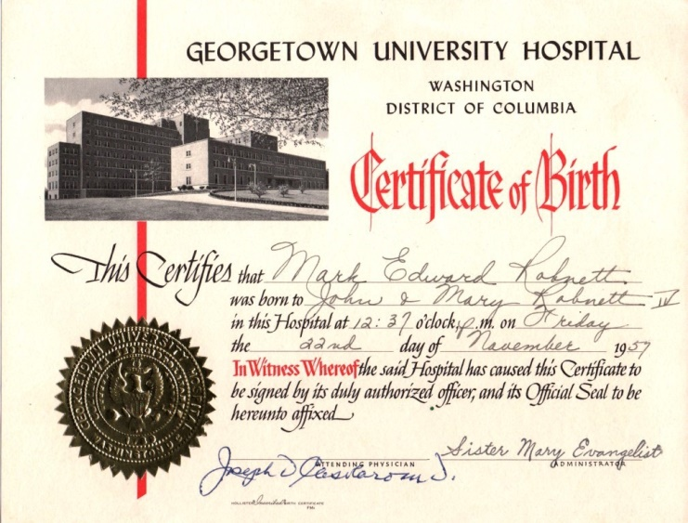

Slide 8
Eternally Secure !
1 Peter 1:4-5 Amazing and wonderful promises:
  God gives us an inheritance that will never perish, spoil, or fade
  It is kept for us by His power (not our strength)
  It is waiting for us, “ready to be revealed” in heaven.
John 10:27-29 No one (not even you) can cause you to lose your salvation, because God your Father is GREATER THAN ALL men.
Ephesians 2:8-9 Salvation is by grace through faith, and not by works. No one can lose his salvation because no one earned his salvation.

Slide 9
What can separate you from God’s love?
Romans 8:38-39
A. “Death” – you can’t lose it when you die
B. “Life” – you can’t lose it while you are alive.
C. “Angels” – can’t take it from you.
D. “Demons” – the devil can’t cause you to lose it.
E. “The present” – nothing happening right now can take it away.
F. “The future” – nothing in the future can make you lose it.
G. “any powers” – there is nothing more powerful than God
H. “Height” – nothing above you.
I. “Depth” – nothing below you.
J. “NOR ANYTHING ELSE in all creation, will be able to separate us from the love of God, that is in Christ Jesus our Lord.”

Slide 10
Living in a Broken World
1 Peter 1:6-7 Life in this broken world will be painful and we “suffer grief.” Remember, this is normal and should be expected (4:12).
“If you look around, you'll be distressed. If you look within, you'll be depressed. If you look above, you'll be at rest.” Corrie TenBoom
2 Corinthians 4:18 All physical things will eventually disappear, even the purest gold. But there is something more valuable than gold – our faith.
Because our faith is so valuable, God desires to purify it (just like gold is refined). This takes heat and pressure – trials that do not feel good to us at the time. Growth will result when we faithfully face trials (James 1:2-4).

Slide 11
Living Joyfully in a Broken World
1 Peter 1:8-9 Jesus will wipe away every tear, remove all pain, and we’ll praise Him forever. When we focus on this, we can be filled with a joy that is inexpressible and glorious!
1 Peter 1:3 God has given us a “living hope.” Jesus died for us, but He was resurrected and is now alive. The Christian hope is not wishful thinking (希望), but a confident assurance (盼望) based on the fact of the resurrection.
How do we live in a broken world? We live by keeping our eyes on Jesus and His amazing promises toward us.
Notes:
盼望 – pànwàng – a confident hope
希望 – Xīwàng – a “hope so” attitude

Slide 12
Take Aways:
When you put your faith in Jesus, you are given new life. You are born anew into God’s forever family.
Your salvation is eternally secure because it is protected by God Himself.
You did not earn salvation by your “good works” and cannot lose salvation by “bad works” (or anything else).
Your hope as a Christian should bring you great joy and praise to the great God who has given it to you.

