Slide 1
A People for
His Own Possession
1 Peter 2:1-10
Notes:
Use NIV with this study

Slide 2
Remember these words from Last Lesson
1 Peter 1:14-15 “As obedient children, do not be conformed to the passions of your former ignorance, but as he who called you is holy, you also be holy in all your conduct,”
1 Peter 1:23-25 “you have been born again, not of perishable seed but of imperishable, through the living and abiding word of God; for ‘All flesh is like grass and all its glory like the flower of grass. The grass withers, and the flower falls, but the word of the Lord remains forever.’ And this word is the good news that was preached to you.”
We are born again to be God’s children, by faith in His grace.
We are born again when we hear and believe His eternal word – the “good news” (gospel).
Notes:
Key words that carry into chapter 2:
We are born again to be God’s children. He is not looking for our religious activities – we become His children by putting out faith in Jesus Christ, who died to pay the full price for all our sin and rose again to give us new life.
We are born again by hearing and believing His word – the “good news” (gospel). The Word of God is eternal and is our source of life and growth.

Slide 3
Growing as a Christian
1 Peter 2:1 “So…” (because you have been born again), we must “put away” deceit, hypocrisy, envy, and slander. To be holy, we must first “put off” these old ways and then “put on” the new self (Ephesians 4:22-24).
1 Peter 1:2-3 Christians must not remain babies – we are called to “grow up into salvation.” How do we do this? We start by longing for “the pure spiritual (“logikos”) milk” of God’s eternal Word (Hebrews 5:12-14), tasting “that the Lord is good.”
A genuine Christian will not be satisfied with the “junk food” of this world – we will hunger to know God through His Word.
We must then move on to maturity – from milk to “solid food.”
Notes:
“Spiritual” comes from Greek logikos, which echoes “word” (logos) of 1:23.
Be sure that they read this verse in Chinese – the words are hard to understand in English.
ESV Bibles. ESV Study Bible (Ebook) (p. 10386). Crossway. Kindle Edition.

Slide 4
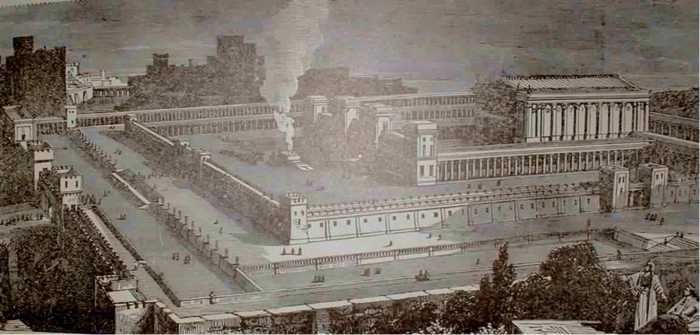
The Old Testament Temple
Constant Sacrifices (sin results in death)
The Temple Veil between the people and “Most Holy Place” (separation from God)
Reading of Old Testament Law (look forward to the promised Savior)
Made from large pieces of local limestone (carefully cut and fit together)
Notes:
To think correctly about the next verses, consider the Old Testament Temple. For the Jews, this was more than just a building – it was the center of Jewish life. The basically worshiped the building and all of the traditions around it.
And if you think about it, the stones were “dead stones” – because limestone is made up from dead organisms.

Slide 5
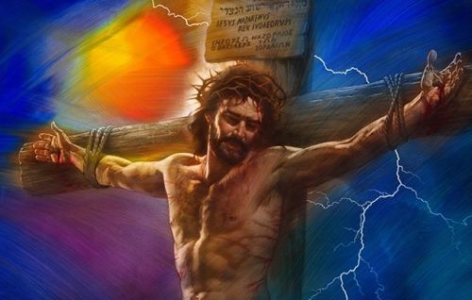
The Cross Changes Everything
Constant Sacrifices (sin results in death)
The Temple Veil between the people and “Most Holy Place” (separation from God)
Reading of Old Testament Law (look forward to the promised Savior)
Made from large pieces of local limestone (carefully cut and fit together)
----------------------------------------------------
The Final Sacrifice (Hebrews 10:10-12)
------------------------------------------------------------------------------------------------------------
The Veil torn, providing a way for anyone to come to God (Matthew 27:50,51)
------------------------------------------------------------------------------------------
The Savior has come and conquered death! (Matthew 28:5,6)
------------------------------------------------------------------------------------------------
Made from “living stones” – Christians in whom God’s Spirit now lives (1 Cor 6:19)
Notes:
But everything changed when Jesus came to fulfill all of the Old Testament prophecies. His final sacrifice paid for all sin: past, present, and future. As God’s children, His Holy Spirit came to live inside all believers. And because the physical temple was no longer needed, it was destroyed by the Romans in 70 AD and never rebuilt.
The new “spiritual house” of God is the universal church. It is not a building (教堂 – jiàotáng) but a group of called out people (教会 - jiàohuì); Greek “ekklesia” = called out ones

Slide 6
A “Spiritual House”
Romans 9:30-32 What was the problem with Israel? They did not pursue righteousness by faith. They tried earn righteousness by the works of the Old Testament Law.
Romans 9:33 Instead of believing in Him, the Stone, (Isaiah 28:16), they stumbled over Him (John 1:11).
1 Peter 2:4 We come (regularly) to Jesus in faith, the precious living “cornerstone” on which every eternal thing is built.
1 Peter 2:5,6 We are God’s living temple and His priests, offering ourselves as acceptable “living sacrifices” (Romans 12:1).
When we believe in Him, we “will not be put to shame.”
1 Peter 2:7,8 There are only two responses to Jesus: receive Him or reject Him. Sadly, those who reject Jesus will stumble and fall.
Notes:
Instead of standing on the Rock (Jesus), they stumbled over Him and His message because it was not what they expected or hoped for (Isaiah 8:14).
Note the dual reality of “those who do not believe” (v.7) and “as they were destined to do.” (v.8)
“to offer spiritual sacrifices.” Spiritual sacrifices mean God-honoring works done because of Christ under the direction of the Holy Spirit and the guidance of the word of God. These would include: 1) offering the strength of one’s body to God (Rom. 12:1– 2); 2) praising God (Heb. 13:15); 3) doing good (Heb. 13:16); 4) sharing one’s resources (Heb.13:16); 5) bringing people to Christ (Rom. 15:16); 6) sacrificing one’s desires for the good of others (Eph. 5:2); and 7) praying (Rev. 8: 3). (The ESV MacArthur Study Bible (Kindle Locations 319754-319761). Crossway. Kindle Edition.)
To every human being, Christ is either the means of salvation if they believe, or the means of judgment if they reject the gospel.

Slide 7
His Chosen People
Exodus 19:5-6 What did God say about Israel if they obeyed His voice? But sadly, they “disobeyed the word,” rejecting the promised Savior, Jesus.
1 Peter 2:9 God has chosen us (His church) to be His holy nation, a royal priesthood!
Our amazing privilege: “proclaim the excellencies of Him who called you out of darkness into His marvelous light.”
“Proclaim” (exaggello – to celebrate something newly discovered) We should seek ways to do that privately and publicly.
1 Peter 2:10 With every breath, remember the mercy that God has shown to you! (Romans 9:25-26)

Slide 8
Take Aways:
As God’s child, “put off” the old ways and “put on” your new self in Christ.
Hunger for God’s Word: “eat it,” chew it,” delight in it, and work to grow into maturity.
Every day, proclaim the excellencies of Him who called you out of darkness into His marvelous light!

