Slide 1
Suffering in a Broken World
1 Peter 3:13-22
Notes:
Use ESV with this study

Slide 2
Living Without Fear
1 Peter 3:13-14a It is unusual for people to mistreat you when you try to do good for them (Proverbs 15:1). But if they do, God will bless you.
Isaiah 8:11-12 When non-believers face bad things, their fear can overwhelm them with dread. Don’t be like them!
Isaiah 8:13 We are children of the LORD of all. He should be “our fear.” Since the greater fear overcomes the lesser fear, every fear of this world becomes small compared to His powerful glory!
Notes:
Fear is an immediate, intense emotional response to a present threat or danger.
Dread is a long-lasting anxiety about a future (usually negative) event.

Slide 3
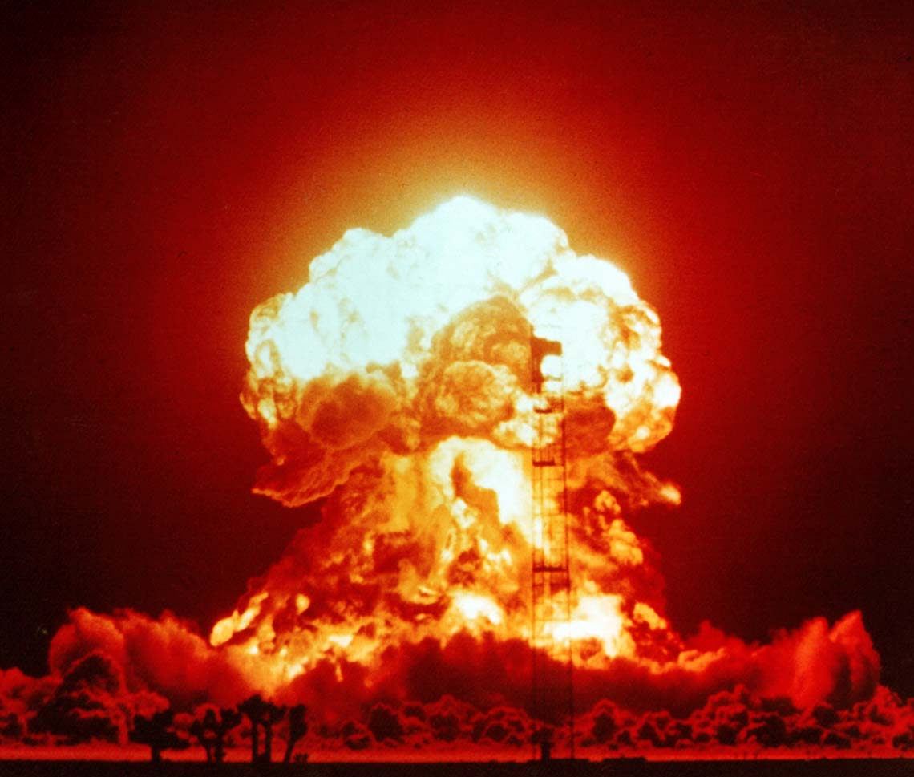
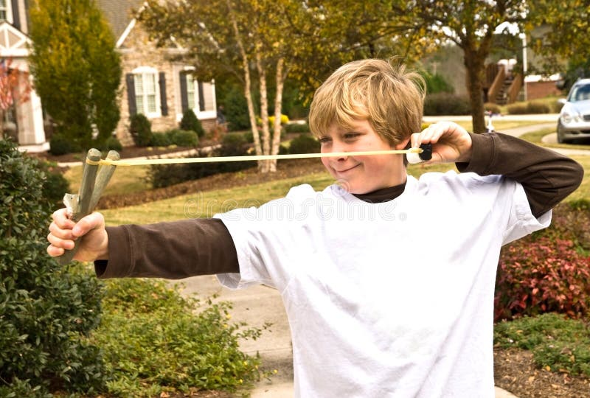
But if my house starts shaking and I look out the window and see this…
I am afraid when I see this guy aiming at me!
…the first fear fades away when faced with the greater fear!

Slide 4
Living Without Fear
1 Peter 3:13-14a It is unusual for people to mistreat you when you try to do good for them (Proverbs 15:1). But if they do, God will bless you.
Isaiah 8:11-12 When non-believers face bad things, their fear can overwhelm them with dread. Don’t be like them!
Isaiah 8:13 We are children of the LORD of all. He should be “our fear.” Since the greater fear overcomes the lesser fear, every fear of this world becomes small compared to His powerful glory!
1 Peter 3:14b-15a “Have no fear of them … but in your hearts honor Christ the Lord as holy.” Live constantly aware of Jesus, walking with Him, loving Him, and obeying Him. Then we can face the fears of this world.
Notes:
Fear is an immediate, intense emotional response to a present threat or danger.
Dread is a long-lasting anxiety about a future (usually negative) event.

Slide 5
Answering Those Who Ask
1 Peter 3:15b “Always being prepared to make a defense…” How to be prepared? Be ready with three things:
  Ask people about their hope. Is it a “hope so” (希望) that can easily go away? Is it in this passing world (Psalm 17:14) or something eternal?
  Understand why you believe that the message of the Bible is true.
  Understand what you believe and be able to explain it clearly and Biblically.
“to anyone who asks you a reason for the hope that is in you;” Because of Jesus’ resurrection, we have a confident hope (盼望). Live in a way that it is obvious to those around, leading them to ask why you can live without fear in an uncertain world.
Notes:
The English word “apologetics” comes from the Greek word here translated “defense.” Peter is using the word in an informal sense (Phil. 1:16–17).
Be sure to remind people to pray that God’s Spirit will guide in what to say and when to say it.

Slide 6
Gentle Confidence
1 Peter 3:15c-16 “with gentleness and respect,…” Christians must always speak with gentle confidence (2 Timothy 2:24-26). It is not our goal to win arguments, but to win people.
“having a good conscience,…” If we argue and get angry, our “conscience” will show us our sin. Others may speak evil about us if we lose control.
“when you are slandered…” Don’t be surprised when people speak evil about you – we live in fallen, sinful world.
1 Peter 3:17-18a Memorize verse 17! When you suffer for doing good, you are following Christ’s example and walking in God’s will (Peter’s experience: Acts 5:40-41).
Notes:
Don’t seek out suffering, but when you suffer, know that Christ did so first.

Slide 7
Suffering and the Gospel
1 Peter 3:18 Beautiful Basic Gospel Truths:
Jesus’ death paid the full price for all sins (Hebrews 10:11-14)
Jesus was perfectly sinless and died for sinners (2 Corinthians 5:15,21)
Only Jesus can bring us to God (John 14:6)
Jesus was put to death, but raised to live again (v.21; Luke 23:46)
1 Peter 3:19-20 After Jesus was crucified (but still “alive in the spirit”), He proclaimed victory (Colossians 2:15) to a terrible group of fallen angels. Some of those “demons” are imprisoned due to disgusting disobedience (Jude 1:6) committed before the flood (Genesis 6:1).
Notes:
v.19-20 may refers to fallen angels (demons), who were permanently bound because of heinous wickedness. (their evil influence may have played a part in the global, unrepentant evil of Noah’s day) The demons who are not so bound resist such a sentence (cf. Luke 8: 31). In the end, they will all be sent to the eternal lake of fire (Matt. 25:41; Rev. 20:10). The ESV MacArthur Study Bible (Kindle Locations 320027-320030). Crossway. Kindle Edition.
I also wonder if this passage could refer to the pre-incarnate Jesus who, in the spirit, could have preached the gospel to rebellious sinners during the days of Noah.

Slide 8
Suffering and the Gospel
1 Peter 3:20 What saved the people from death? (hint: not the water)
1 Peter 3:21 “Baptism, which corresponds to this, now saves you,” What does Baptism correspond to? (hint: not the water)
Baptism corresponds to the Ark. Noah built the ark by faith, entered by faith, was shut into the ark by God and was saved (Hebrews 11:7).
“as an appeal to God for a good conscience, through the resurrection of Jesus Christ,…” We are put into Christ, the “ark of safety,” by faith in His death and resurrection. (“appeal” = agree to conditions of a covenant)
1 Peter 3:22 The suffering of Jesus led to the greatest victory in history! And when you suffer, know that you are following Him.
Notes:
v.21 “corresponds to” = Greek antitupon. It means "copy," "type," corresponding to," "a thing resembling another," "its counterpart," etc. Obviously, it was the Ark. Noah built and entered the ark by faith, was shut inside by God, and was saved (Heb. 11:7). The flood waters destroyed the ungodly. Peter, when referring to the flood waters, refers to them as the means of destruction of the ungodly (2 Pet. 2:5; 3:6). It was the Ark that saved, not the water.
Unfortunately, the word in the Chinese text says that water saves a person. Perhaps a better translation for baptism would be the one used in Mark 1:8 施洗???
The resurrection and ascension of Christ demonstrates God’s acceptance of Christ’s substitutionary death for our sins.

Slide 9
Take Aways:
A proper fear of God helps overcome the fears of this world.
Live with a confident hope in the promises of God and expect others to ask you the reason for your hope.
Understand what you believe and why you are a Christian. Be ready to respectfully share truth whenever someone asks.
It may be God’s will for you to suffer for doing good. When suffering, remember Jesus and His final victory (and yours)!

