Slide 1
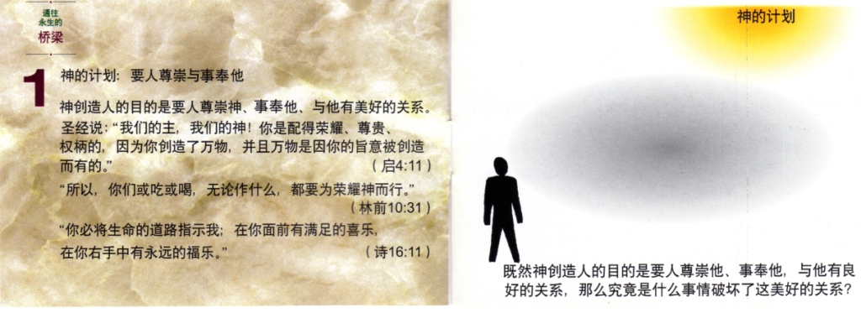

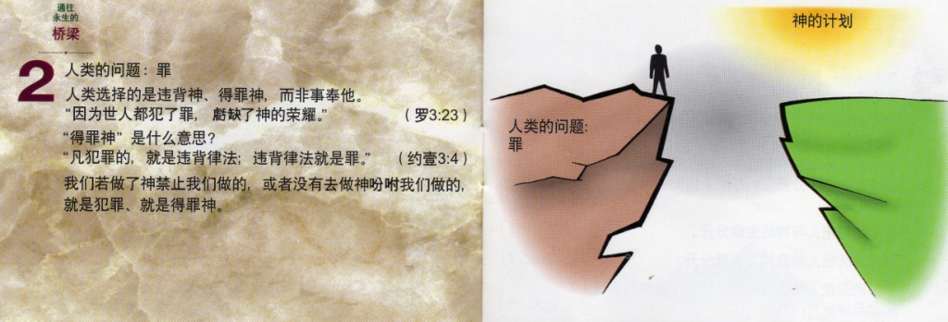
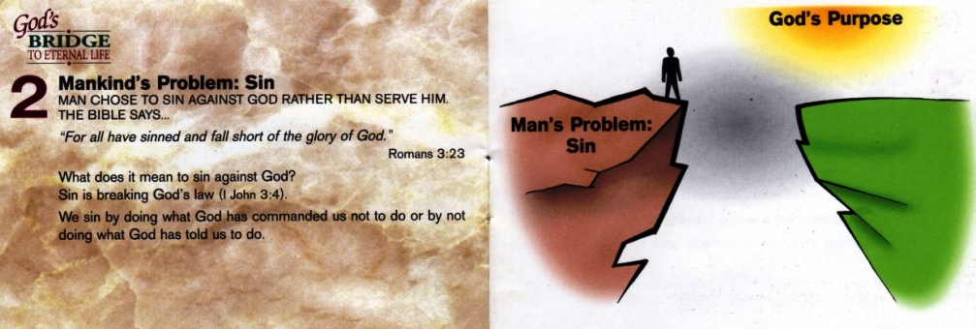

Slide 2
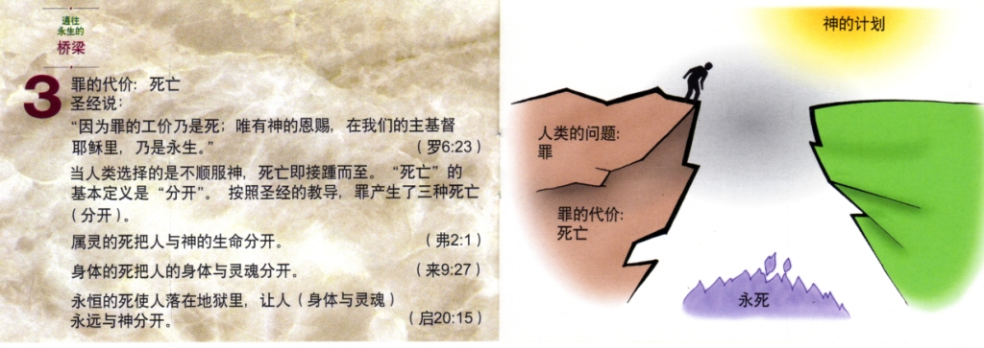
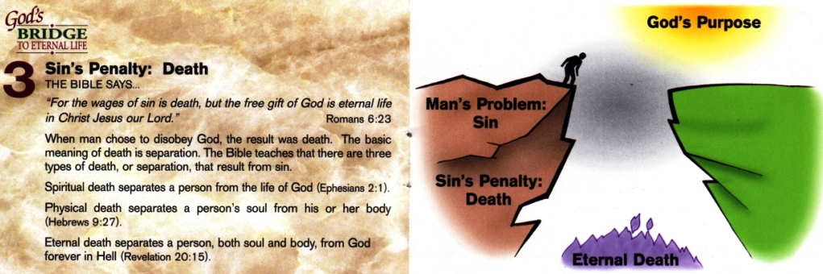
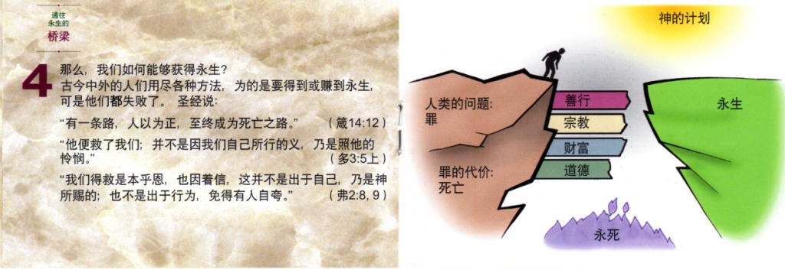


Slide 3
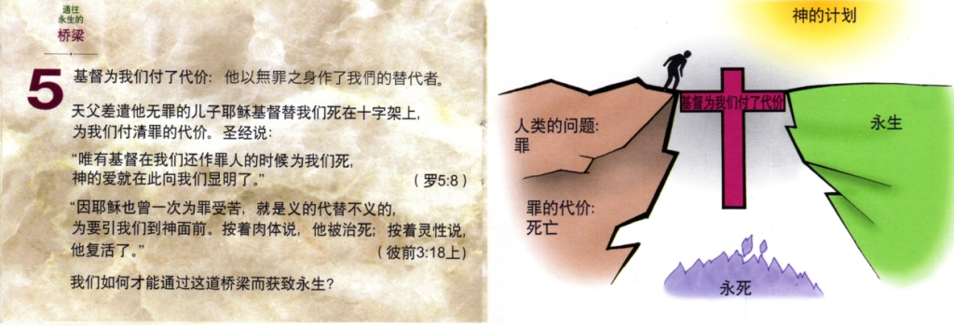

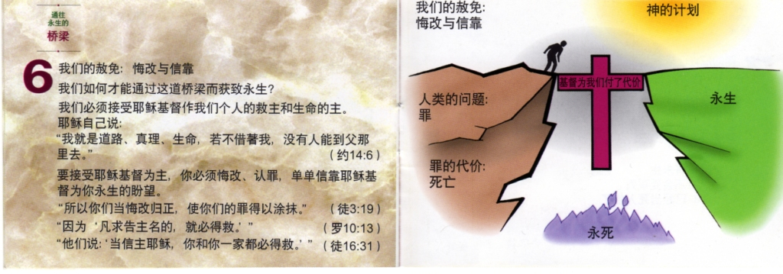
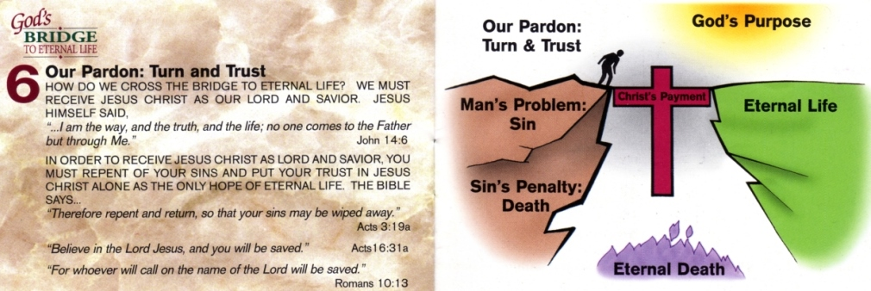

Slide 4
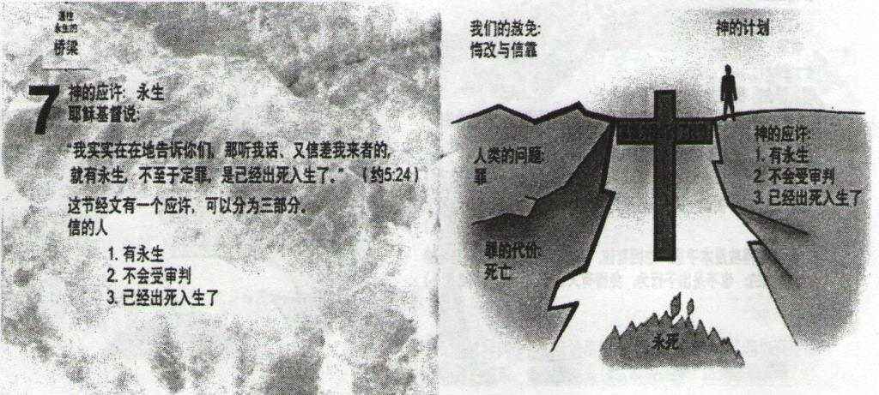
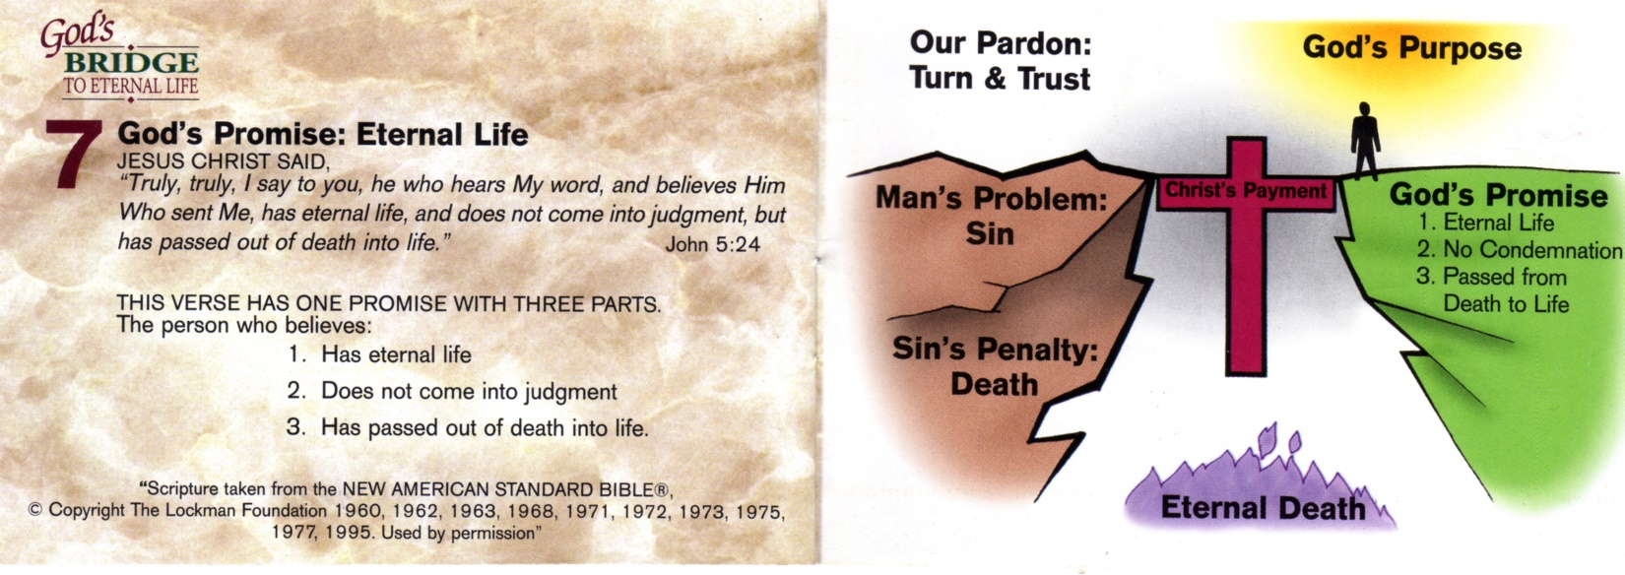
罗马书10：9，10，13
你若口里认耶稣为主，心里信神叫他从死里复活，就必得救。因为人心里相信，就可以称义；口里承认，就可以得救。因为“凡求告主名的，就必得救。”
祷告者求告主名的范例：
主啊，我认识到我的罪使我和你分离了，我想转离我的罪来归向你！谢谢你差遣你的独生子耶稣来到这个世界上，为我的罪钉死、埋葬并复活。我相信耶稣为我的救主，也相信他流的宝血为我的罪付上的代价。所以，就在今天，来拯救我，让我成为你的孩子。阿门！
Romans 10:9,10,13 says:
If you declare with your mouth, “Jesus is Lord,” and believe in your heart that God raised him from the dead, you will be saved. For it is with your heart that you believe and are justified, and it is with your mouth that you profess your faith and are saved… for, “Everyone who calls on the name of the Lord will be saved.”
An example prayer to call upon the Lord:
Lord, I know that my sins separate me from You, and I want to turn from my sins and turn to You! Thank You for sending Your Son Jesus to this earth to die for my sins, to be buried, and to rise from the dead. I want to trust Jesus as my Savior, and I want to trust His blood that He gave to pay for my sins. So today, please save me and make me your child. Amen!

