Slide 1
John 5 and 9
Two Needy Men

Slide 2
Two Needy Men
Both have problems that are impossible to solve
Both experience amazing miracles from Jesus
Both face powerful pressure of culture
Both make important decisions
But first, a story about a goat…

Slide 3
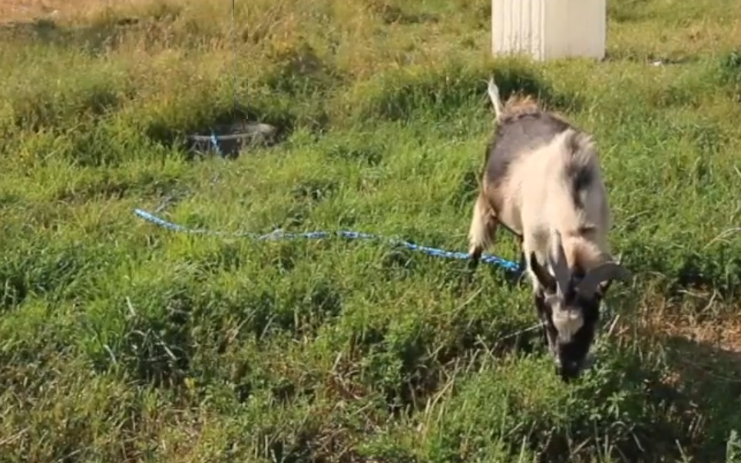
Harold’s Goat (with tire)
Notes:
Before we start, I want to tell you a story about Harold, an old friend of mine. Harold and I were co-workers at a factory in Virginia, but Harold didn’t really want to work at a factory – he wanted to be a farmer. As he got older, he began to prepare for the day when he would retire and buy a farm. Among other things, he bought a goat. Since he still didn’t have a large piece of property, he tied an old automobile tire to a rope and put the rope around the neck of the goat. This way, the goat could drag the tire a short distance and eat grass, but he couldn’t go very far (or very fast).
A few years later, Harold retired and bought a large piece of property. He put up a fence around a section of the property. And finally, with a sense of joy, Harold put his goat into the fenced area and untied the old tire. After years of being tied up, his goat was finally free to run around and eat grass anywhere he desired. I’ll finish the story later…

Slide 4
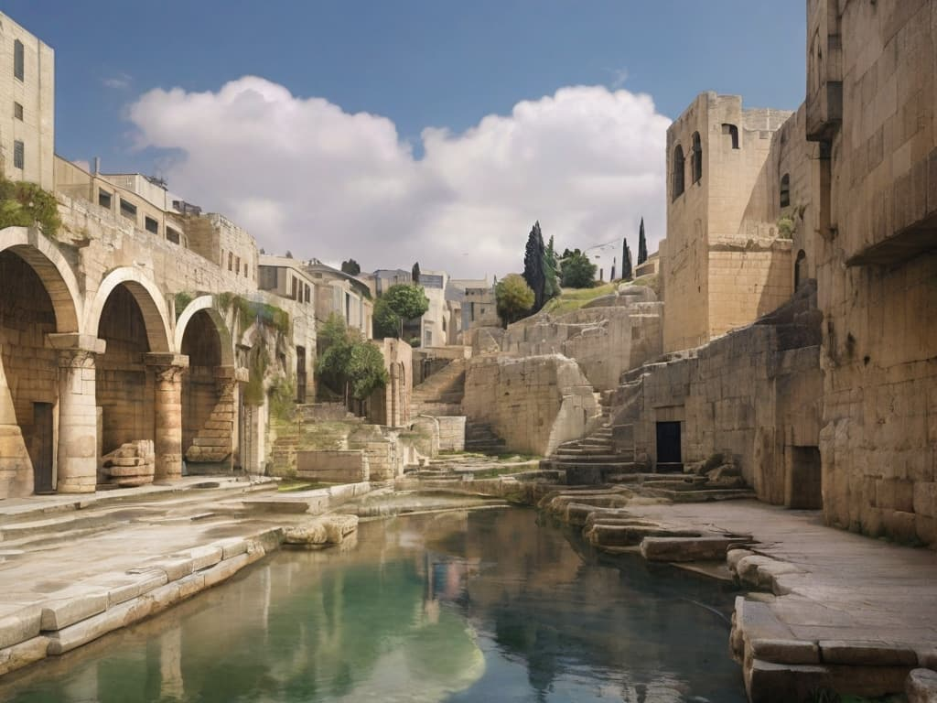
John 5:1-9 : The Pool of Bethesda
vs.1-3 Jesus goes to the needy people
vs.5 An incurable disease: invalid for 38 years
vs.6 A good question
vs.7 A vague answer without any expectation or faith
vs.8,9 A powerful miracle
Notes:
Now, let’s look at John 5. Jesus enters the city of Jerusalem and goes to a place filled with sick people (verses 1-3). This is what Jesus does – He shows kindness to some of the weakest people in the world, people that everyone else has forgotten. Among all of the people gathered around this pool, Jesus seeks out a certain man, one who had been paralyzed for 38 years (John 5:5-6). This man did not know Jesus or have any particular faith in Jesus, and he didn’t cry out for Jesus to heal him. Why did Jesus choose to reach out to Him? I don’t know. But remember, Jesus is the mighty God and has the authority to do whatever He pleases.
Jesus asks the man a very interesting question: “Do you want to get well?” As first, it might seem like a silly question – of course, who wouldn’t want to get well? But after you think about it for a while, it doesn’t seem so strange after all. Even when people are in a bad situation, they often get used to their normal way of life and become unwilling to change. This man doesn’t give Jesus a clear answer (John 5:7). He just gives some excuses about why he’s been there so long. It has been a very long time and he is still sitting and begging.
So Jesus powerfully gives him three commands (John 5:8,9): get up, pick up your mat, and walk. Immediately, the man was cured. Not only could he stand and walk, his new legs were strong enough to carry his bedding. Jesus is the Creator, and in the presence of all, He creates new legs for the man and gives him instant power to use them!
When Jesus found this man, he was sitting without any hope of walking. But Jesus heals his incurable disease. Jesus does this without any help from the man – he didn’t even have to have faith in Christ. Faith was not necessary.

Slide 5
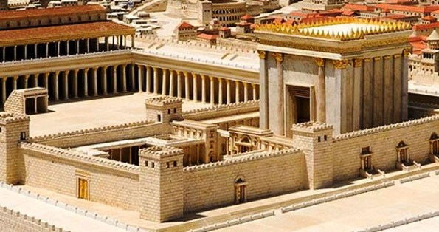
John 9:1-7 : The Doorway of the Temple
vs.1 An incurable disease: blind from birth
vs.2 The wrong question
vs.6,7 A powerful miracle
vs.32 The first in history
Matthew 4:23,24 The power of Jesus
Notes:
Now that you’ve seen the creative work of Jesus in the life of this man, turn to John 9 and read verses 1-3. Jesus and His disciples meet a man who has been blind from birth, begging near the gate of the temple. In their culture, they were taught that everyone’s sickness is a direct result of their personal sin. But since this man was born with an incurable disease, the disciples are confused about who was at fault.
But Jesus has a different answer to their question. In verses 6 and 7 Jesus makes some mud, puts it into the man’s eyes, and tells him to go and wash it away. He comes back seeing – another amazing act of creation (new eyes, new optic nerve, and new brain processor). This was amazing – a first in history based on verse 32. Once again, Jesus just picked this man out of those who were nearby – Faith was not necessary.
If you watch Jesus’ behavior in the gospels, you see that He came to earth with amazing power to heal diseases. Matthew 4:23,24 make it clear that He could heal every disease – this is the power of Jesus.

Slide 6
The Sabbath Day
Exodus 20:8-11 God’s command – a blessing to His people of rest and worship
The rabbis defined 39 types of work and hundreds of rules to follow. Instead of a blessing, the Sabbath became a burden.
John 9:14 and 5:9 When did Jesus heal these men? Why do you think He chose to do this?
5:10 How did the Jews respond to this amazing miracle? How should they have responded?
9:16,24 How did they view Jesus, the miracle worker?
The Pride of Men: So focused on their religious tradition that they are blinded to God
Notes:
Before we read further, you need to know something about Jewish religious culture. One of God’s original commandments is described in Exodus 20:8-11. To provide people with a day of rest and worship, God gave them a rule: work for six days, but on the last day of the week, close up your businesses and take the day off. Our Creator and he knows what’s good for us, so He gave this command as a blessing.
Sadly, as time when on, the Jewish religious leaders changed the purpose of this special day and wrote many extra rules to govern what people could and could not do. Instead of the Sabbath day being a blessing, it became a burden. On the day that God set aside for worshiping (spiritually, emotionally, intellectually, and physically), it became a day where the proud and powerful religious leaders showed everyone their own self-righteousness.
Now that you know how the Jewish leaders felt about the Sabbath day, notice John 9:14 and John 5:9. What day did Jesus heal each of these men – the Sabbath. Why do you think that Jesus might have chosen that specific day to do these miracles? Although the healing of the man should have been a moment of great joy and worship (the purpose of the Sabbath), the Jews had a different reaction (John 5:10). Instead of praising God, the religious leaders criticized the man for carrying his bed on the Sabbath, violating their special rule. Instead of marveling at this dramatic healing, they demand to know why the man is carrying his mat (John 5:11,12).
When the man tells the Jewish leaders about his Healer, they are angry that someone has broken their custom. Look at John 9:16,24. Standing before them is a man who was born blind but now has perfect sight. And what are they saying about his Healer? This is the pride of men, so focused on their religion that they fail to see the power of God.

Slide 7
The Pressure of Culture
9:18-23 They should have rejoiced, but the parents remain quiet
5:11-13 The man doesn’t even know Jesus’ name.
5:14 Jesus comes back to the man – an opportunity to believe.
5:15 Instead of trusting Jesus, the man returns to the Jews
9:24,25 The formerly blind man states the facts (Isaiah 35:5)
9:34 The formerly blind man suffers for speaking the truth
9:35-37 Jesus comes back to the man – an opportunity to believe
9:38 The man trusts Jesus and worships Him
Notes:
Imagine what it must be like to have your child born blind. Perhaps you spent 9 months dreaming of having a healthy, happy son. But then, you experience overwhelming shock and sadness at his birth, realizing that he will eventually become a poor beggar. But then one day, your son comes home with perfect eyesight! You would be absolutely joyful! But listen to their report to the religious leaders in John 9:18-23. Even though they had received such an amazing blessing from Christ, they are afraid to say His name. Their answer illustrates the overwhelming pressure of culture.
Look back at John 5:11-13. Just like the blind man, the religious leaders question the man who could now walk. But the man doesn’t even know who healed him. And he would never even know who Jesus was, unless Jesus came back looking for him. Which is exactly what Jesus does. Now that Jesus has changed the man’s physical life, He returns to give him a wonderful opportunity – the opportunity to believe and have eternal life (John 5:14).
We don’t know the entire discussion between Jesus and the man, but we hear an important conclusion: “stop sinning or something worse may happen to you.” What could be worse than sitting as a paralyzed beggar for 38 years!? There is something far worse – spending eternity separated from God. This is the future for anyone who is trapped in sin without Jesus to save them.
The man had a choice to make: do I follow Jesus, or do I remain stuck in my false religious culture. We see his unfortunate response in John 5:15 – he chose to stay in his “comfort zone” and report back to the Jews. Even though he has had an amazing experience with Jesus, he bends to the overwhelming pressure of culture.
The blind man in John 9 also had to make a choice. In John 9:24,25, the man gives a very simple testimony of his personal experience with Jesus. Interestingly, only Jesus fulfilled the prophecy of Isaiah 35:5 – the Bible shows no other recorded miracles of someone giving sight to the blind. The Jewish leaders get angy at him, and finally throw him out of their presence and their religion (John 9:34).
Remember that this man had never seen Jesus. When he washed away the mud in the pool of Siloam, Jesus was gone. There was no hope that he could find Jesus. Unless… unless Jesus comes to look for him. Which is exactly what He did. (John 9:35‑37). And when He found him, He gave him something much more than physical sight – He gave him the gospel: “believe in Me.”
This man had a very different response than the lame man: with his mouth, he confesses his belief in Jesus (vs. 38). And even though the Jewish leaders are watching, he chooses to worship his new Savior. Not only were his physical eyes opened, he now receives something much greater – spiritual sight. Something much more valuable than the religious leaders had (vs. 40,41).

Slide 8
The rest of the story…
Harold’s goat: Finally free to go wherever he wanted and eat fresh grass, but he stood still, grew weak and sick.
Finally, Harold tied the tire back around the goat’s neck. He started to eat and regain strength.
He had grown so familiar with bondage that he didn’t know how to accept freedom.
Many of us are like Harold’s goat: comfortable in our sin and frozen in our cultural expectations.
Will we accept the freedom Christ offers? Do you want to get well?
Notes:
Remember my friend Harold? He graciously untied his goat, allowing him to run around the pasture and enjoy freedom to graze and rest. But for some reason, the goat stood sadly still. For days, he wouldn’t eat. He grew weak and sick. Harold wasn’t sure what to do. Finally, he brought back the old tire and tied it around the goat, and the goat began to eat and regain his strength. Apparently, he had grown so familiar to being in bondage that he didn’t know how to live with freedom.
Sadly, many of us are just like Harold’s goat. We are in bondage to our trouble; we feel the limitations of our society, and we carry the burden of our sin. But after a long time, we grow familiar with our situation and stop looking for a solution. And then, the Savior arrives with an amazing offer of freedom. He asks us: “do you want to get well?” We pause for a moment, take a deep breath, then start to talk about our history and culture. Before we know it, we have convinced ourselves that it is probably better to just remain enslaved to sin instead of taking the risk of following Jesus.
Many things have changed since the days of Jesus, but we still face many of the same challenges. We experience pain, suffering, and hopelessness. And here in China, you are part of an ancient culture, one that puts pressure on each of you to do what is “normal” and “expected.” We are constantly encouraged to have the “China Dream,” one that fits solidly into the culture.
As we study the Bible together, I hope that you are beginning to see Jesus. You may not have the same physical problems of the blind man and the lame man, but Jesus has come here to seek for you. He is the One who created you in the beginning and the One who has the power to re-create legs, re-create eyes, and give life to our old, dead spirits. And like the lame man and the blind man, you find yourselves with a choice: are you willing to believe in this amazing Savior?

