Slide 1
The Gospel of Mark
Chapter 1bc

Slide 2
Empowered by the Holy Spirit
Philippians 2:5-7 Jesus was “incarnated” – He emptied Himself of heavenly glory and became a human being. He was completely God and He was completely human.
Mark 1:10-11 Throughout the New Testament, Jesus submits to the Father’s direction and is filled with the Holy Spirit.
Mark 1:12 The Holy Spirit is in control, driving Jesus out into the wilderness (a place of testing).
Mark 1:13 Unlike Adam who fell into temptation in the garden, Jesus the King overcomes the temptation of Satan in the wilderness (Romans 5:18-21).
Notes:
Notice the frequency of the word “immediately.”
An interesting parallel of OT and NT:
OT: at creation, the voice of the Father speaks, the Spirit hovers over the water, earth and humanity are created, history is launched, then Satan tempts Adam.
NT: at baptism, the voice of the Father speaks, The Spirit comes down to Jesus in the water, history is altered, and Satan tempts Jesus

Slide 3
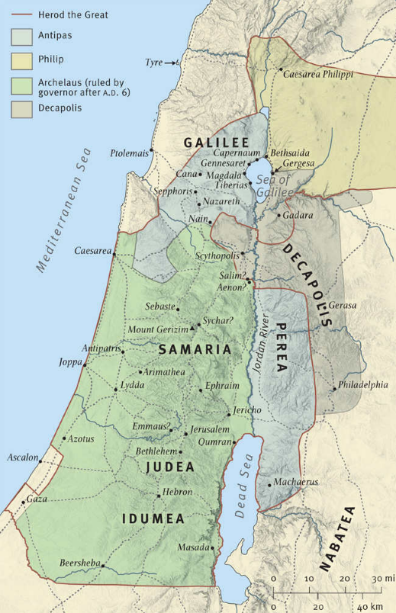
Preaching the Gospel
Mark 1:14-15 Jesus preached the gospel of God:
  in Galilee (as predicted in Isaiah 9:1,2)
  the time is fulfilled (Galatians 4:4 – God’s perfect plan)
  the kingdom of God is near (spiritual now, physical soon)
  repent and believe (the two parts of the gospel)
Notes:
Galilee, not Judea (to the common people, not the religious elite)
The time (Kairos = event time, not Chronos = clock time) – the most significant moment in history
God’s kingdom is spiritual in the hearts of those who believe, then millennial at Christ’s second coming (Rev 20:1-6), then eternal with a new heaven and a new earth.

Slide 4
Calling His First Apostles
John 1:35-42 Andrew and Simon (Peter) already knew Jesus. After John went to prison, they returned to their successful fishing business in Capernaum.
Mark 1:16-18 Jesus gives a strong command to follow Him, leaving their business behind. The power of Jesus is evident – they immediately obey.
Notice that He will make them become fishers of men.
Mark 1:19-20 When James and John are called, they leave everything and everyone behind.
When Jesus came to earth, what did Jesus leave behind?
Mark 8:34 As a Christian, have you left anything behind?
As Christians, we don’t follow religion, we follow the King.
Notes:
Apostles = 12 men called by Jesus and “sent out” to preach the Gospel.
Peter and Andrew were partners with James and John (Luke 5:10). The business must have been pretty good, since Peter owned a sizeable house and John was well-known to the high priest (John 18:15).
Jesus chose His apostles (John 15:16), not the other way around.

Slide 5
Teaching with Power and Authority
Mark 1:21-22 The scribes always quoted other teachers as a basis for authority. Jesus spoke directly by the power of the Holy Spirit.
Mark 1:23-24 Demons (fallen angels) tremble at the power of Jesus’ words (1 John 3:8).
The demons believed in Jesus but could not be saved; the crowds refused to believe and would not be saved.
The OT does not include stories about demon possession but the gospels show many cases. Demon possession was/is always present but was exposed during Jesus’ ministry.
We are called to evangelism, not exorcism (casting out demons). When the Holy Spirit comes into a person, the demons go out.
Notes:
Define demon possession (where are demon enters a person and controls them).
There are only two cases of demon possession in the book of Acts (16:16-18; 19:13-16).
The people struggled to believe that Jesus was the Christ, but the demon knew very clearly (and trembled – James 2:19).

Slide 6
Teaching with Power and Authority
Mark 1:25-26 Religious leaders accused Jesus of working by the power of Satan (Matthew 12:24). He didn’t need the testimony of demons and commanded their silence.
Mark 1:27-28 They were amazed at the authority of His teaching – now they are amazed at His power over spirits.
Mark 1:29-31 The mother-in-law was instantly healed and immediately began serving (didn’t need time to rest).
Mark 1:32-34 The Sabbath ended at sundown, so people could now legally carry sick people to Jesus.
Matthew 8:17 Jesus took the sickness and diseases upon Himself, eventually conquering the root cause (sin).

Slide 7
Focused on His Purpose
Mark 1:35 Jesus needed more strength than sleep could provide, so He spent time with His Father.
Jesus’ power came from submission to the Father and dependence upon the Holy Spirit (prayer was essential).
Mark 1:36-37 Most of the crowd was looking for a healer, not a Savior.
Mark 1:38 The time was right for the gospel to be preached. Miracles prove that His message was true, but salvation only comes through repentance and faith.
Mark 1:39 A short verse to describe months of traveling, preaching, and overpowering Satan’s demons.

Slide 8
Trading Places
Leviticus 13:45-46 People with leprosy were required to stay outside of town and away from healthy people.
Mark 1:40-42 A leprous man, desperate and humble, bows before Jesus with respect and worship. Jesus touches the “untouchable” man and heals him.
Mark 1:43-44 To prevent giant crowds seeking healing, Jesus “sternly charged him” to leave quickly and quietly.
Mark 1:45 The man (like us) thought that he knew better.
Jesus traded places with the leper, moving outside of town into the desolate places (where the leper had lived).
Notes:
According to the Talmud, lepers were required to stay at least 2 meters away from healthy people.
Jesus trading places with the leper is a picture of salvation. He took our sin upon Himself so that we could receive His righteousness.
He must have been perfectly healed to walk 160km to Jerusalem (if priests are only in Jerusalem).

Slide 9
Some “Take Aways”
In His humanity, Jesus shows us the power of a surrendered, Spirit-filled life.
Is there anything that would hold you back from following Jesus wherever He calls?
Never think that you know better than Jesus!
When we cry out to Jesus for forgiveness from sin, He will always answer: “I am willing, be cleansed.”
When Jesus healed Peter’s Mother-in-law, she immediately began serving Him. How am I serving Him?

