Slide 1
The Gospel of Mark
Chapter 4a
Parables and Power
Notes:
In Chapter 4, we see examples of Jesus teaching in Parables. Mark’s gospel only gives us a sample here in chapter 4 (with two others in chapter 7 and chapter 12).

Slide 2
What are “parables”?
The Bible is full of detailed true stories of actual historical events.
Mark 4:1,2 – Parables are different:
Short stories told by Jesus
Designed to teach one or two important truths
To understand well:
Pay attention to the context
Try to “enter” the culture
Notes:
When you read the Bible, you will see many true stories of actual, historic events. But parables are different: they are short stories that Jesus made up to help us understand one or two important truths. The details of each story are interesting, but they are not as important as the central truth Jesus is trying to teach. So we need to be careful not to spend too much time guessing about the details.
Also, keep in mind that we live in a modern world and different culture than middle-eastern Israel 2000 years ago. We will understand these parables better if we try to enter into their world and culture. Finally, when Jesus tells a parable, it’s not usually isolated from a particular situation. So we need to be careful to read the parable in the context of the question or issue that He’s facing at the moment.

Slide 3
#1: The Sower, Seed, and Soil
Three parts to this parable:
A sower: important, but even inexperienced farmers can toss good seed into good soil (Mark 4:3)
The seed: contains everything needed to produce a living plant: DNA, biological machines, protection, etc. (Mark 4:14)
The soil: to receive the seed and grow crops
The Seed is the Word of God
The Soil are people
Notes:
(Taught this parable on Sunday 7/25/2021).
Note that there are only three parts in this story: a sower, the seed, and the soil. Very little is said about the sower. In fact, it really doesn’t matter if the seed is scattered by an experienced farmer or his little child. When good seed is thrown onto good soil, it will grow.
Seed is an amazing thing: inside of each seed is everything needed to produce a living plant. The seed contains DNA and biological machines to build roots and stems, branches and leaves, and flowers and fruit. It also has enough moisture and nutrients to begin the growing process. Even if an experienced farmer carefully spreads small rocks in his field, nothing will grow. He must use seed.
The seed is the message of the kingdom and the soil is a picture of the people who hear the message. The same parable is explained in Luke 8:11, showing that the seed is a picture of the Word of God. The power for life is in the seed, and in this story, the seed is the Word of God.
But the focus of this story is not on the sower or on the seed – it is on the dirt, the soil that receives the seed. Just as there are four kinds of soil that can receive physical seed, so also are there four kinds of people who can hear the Word of God.

Slide 4
#1: The Sower, Seed, and Soil
Focus of this Parable - Listening:
v.9 Listen with an open, trusting heart
v.10 These people asked Him for more
v.11-12 Those who seek truth will find it
v.13 This parable is important! If we understand this, we will understand the other parables.

Slide 5
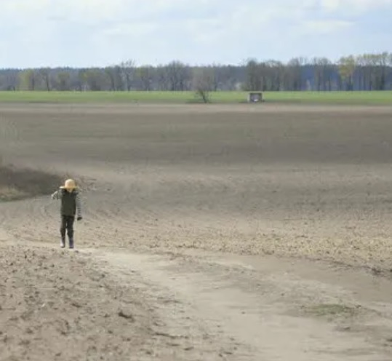
Along the path – Mark 4:4,15
People walked between fields on paths, packed down hard by years of use and hot sunshine
Seeds that fell here could not break through the surface of the soil
Birds would gather here and get a free lunch
A Hard Heart
Our hearts can become hard if we continue to ignore the truth
Receive the message while it is still fresh (Matthew 18:2-4), ready to trust God (even when you don’t understand everything).
Even a Christian’s heart can be hard sometimes, not listening or doing
Notes:
First, there are people who hear the message with a hard heart (verse 19). Notice the word “heart.” Just like soil can be packed down through years of walking, our hearts can be hardened over many years of ignoring the truth about God. Romans 1:21-23 describes people that knew God, but chose to ignore him. Even though they claim to be wise, their hearts become dark and hard.
Turn to Matthew 18:2-4. Jesus says that, if a person wants to enter the kingdom of heaven, he must humble himself and become like a little child. Two things about little children: they trust their father, knowing that he loves them and will take care of them. They also ask a million questions a day, collecting answers with a very open mind. Their “soil has not been packed down” and they are always ready to listen and receive truth.
But as people get older, their pride begins to grow and their ears become closed to new things. Their hearts become hard and they proudly proclaim that “there is no God.” There is no fear of God in their eyes and there is no hunger for truth in their hearts. Even though the good seed is sown in their direction, it just bounces off. Their mind is filled with pride, stubbornness, fear of man, doubt, prejudice, and love of sin.

Slide 6
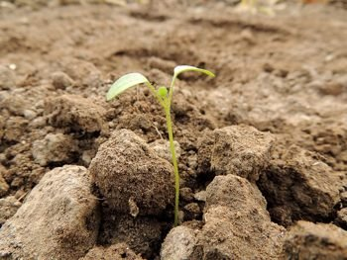
Rocky Places – Mark 4:5-6, 16-17
Before planting, the farmer would try to remove all of the stones
Some rocks are too big or too many to easily remove
Seed would only enter shallow soil and quickly spring up with shallow roots
Hot sun would soon dry out the soil and the plant would die
A Shallow Heart
Not seeking to be saved from sin – looking for a healer, counselor, or grandfather to fix their problems. Expecting prosperity, not suffering
Asking God to bless our kingdom instead of receiving His kingdom
Notes:
Second, there are people who hear the message with a shallow heart. Maybe they are struggling with a personal problem and then hear the message. They are excited to hear of a solution to their problem and quickly jump at the chance to believe in Jesus. But here is the problem: they are not entering into Christ’s kingdom – they are asking Jesus to enter into theirs. They are not looking for a Savior; they are looking for a counsellor – someone to make a few improvements to their sinful world.
But their happiness does not last. They never came with a true devotion to the King. What appeared to be true faith was just a brief, shallow spurt. But they never counted the cost and expected suffering. They assume that being a Christian will give them a happier life with ease and comfort, but fail to remember the reality of what Jesus said about suffering (2 Timothy 3:12).
Perhaps you remember the story of how Jesus fed 20,000 people with just five loaves and two fish (John 6:8-11). Afterwards, the people were so excited to be His followers and wanted to make Him their king (verse 14-15). The next day, they were hoping that He would feed them breakfast (verse 26). But Jesus did not come to feed them – He came to give them eternal life (verse 35). When the words of Jesus were different than their expectations, they quickly turned and walked away (verse 66). But those who had a deep faith based on truth (not just experience) stayed (verses 67-69).

Slide 7
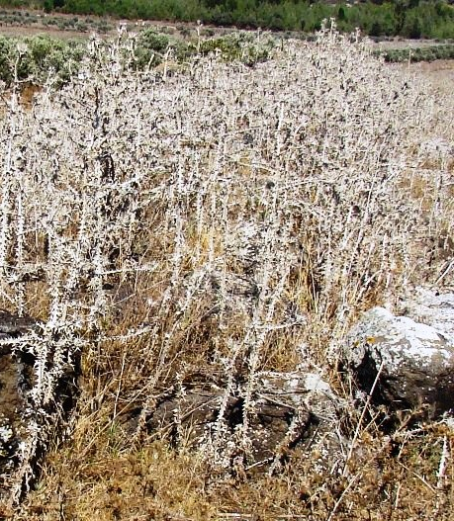
Among Thorns – Mark 4:7, 18-19
Farmer would also try to remove weeds, but some roots go very deep
Weeds and thorns grow naturally, quickly and strong
Weeds use up all of the water and nutrients in soil, crowding out the good seed, leaving it weak and fruitless
A Distracted and Divided Heart
Understand the truth of the Bible, but still trapped by worldly things.
Weeds are strong: we must work hard to kill them (Colossians 3:5,12)
Good things are bad when they become the most important thing.
Notes:
The third kind of soil (thorny ground), is a picture of someone who believes in Jesus with a divided heart. This is a person who is convinced of the truth of the good news, but he’s still totally focused on his career and his stuff. When anyone comes to God, they must understand that their human life isn’t instantly perfectly sinless.
Remember that good seed is not native to our soil – weeds are. Weeds grow fast and strong while the good seed must be actively protected. As long as weeds are alive, they will grow. It’s not enough to just pull off the top and leave the roots in the ground. Like those weeds in the farmer’s soil, we must work hard to kill them (Colossians 3:5). We must take clear and definite steps to dig out the root. Even then, we will continue to find that sin grows back and must regularly be confessed and cleaned out. If we don’t do it, they will steal away our heart, crowd out the truth, and prevent us from living fruitful lives, especially worry and a strong desire for wealth.
Wealth is especially deceitful, grabbing our heart and dragging us back into our old, sinful lifestyles. God has given us all things richly to enjoy (1 Timothy 6:17), but they should not be pursued as the god of our life. Money is a good servant, but a bad master.

Slide 8
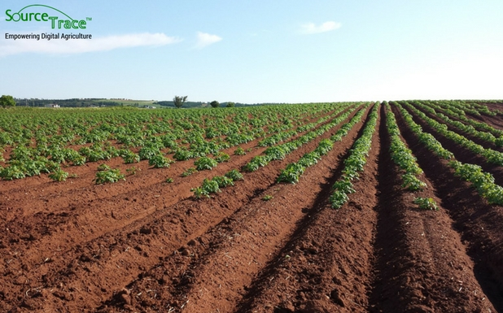
In Good Soil – Mark 4:8,20
Without good soil, farming is a waste of time
Good soil is plowed deep and nutrient-rich, ready to receive seed
Healthy plants grow and produce a good crop of fruit
In those days, a yield of 8 fold was good
A Prepared Heart
A person hungry for truth, ready to receive and obey it
All true Christians will produce good fruit (John 15:8)
Good fruit is shown by attitude (Gal 5:22,23) and actions (Col 1:10)
Notes:
The fourth and final type of soil represents those who HEAR the word and understands it. Remember, this is a story about how we hear. And I pray that God will make us all good hearers. Good soil is prepared to receive the truth. Not every Christian produces the same fruit, but all true believers bear fruit (John 15:8). The fruit of a true Christian is shown by their attitude (Galatians 5:22,23) and their actions (Colossians 1:10; Hebrews 13:15).

Slide 9
Some “Take Aways”
Always come to the Bible with an open heart, ready to receive and apply His truth.
Ask God to help you “put off” sin and “put on” new, holy ways of living for His glory

Slide 10
The Gospel of Mark
Chapter 4b
Parables and Power

Slide 11
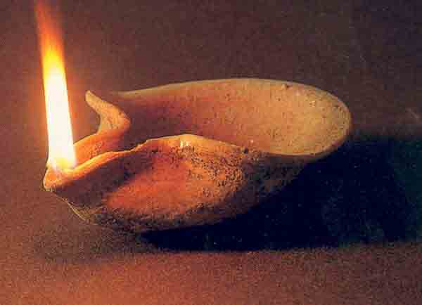
#2: The Lamp Under a Basket
vs.21 Small lamps were used to light common houses
John 1:4-5,9; Matt 5:14-16 Jesus is the light, and if He’s in you, you will shine for His glory.
vs.22 Do not hide the truth from others, especially family members (Psalm 78:4-7)
vs.23-24 If we want to harvest more fruit, we need to sow more seeds of truth
vs.25 The more we seek Him in His Word, the more truth He will reveal to us
Notes:
These little lamps from that time required oil and a wick. The oil is a picture of the Holy Spirit and the wick is you. In order to burn brightly, we must be saturated with the Spirit (not dry). What does it look like for you to shine?
What does it look like for a Christian to shine and provide light for those around us? Love is the greatest apologetic, but it is not easy. By the power of God, true love takes the initiative and meets a real need. It acts with intentionality and is willing to spend time (1 John 4:10). Love is not just seen in how we act, but in how we react.
Some people don’t like the light: John 3:20 “Everyone who does evil hates the light, and will not come into the light for fear that their deeds will be exposed.”

Slide 12
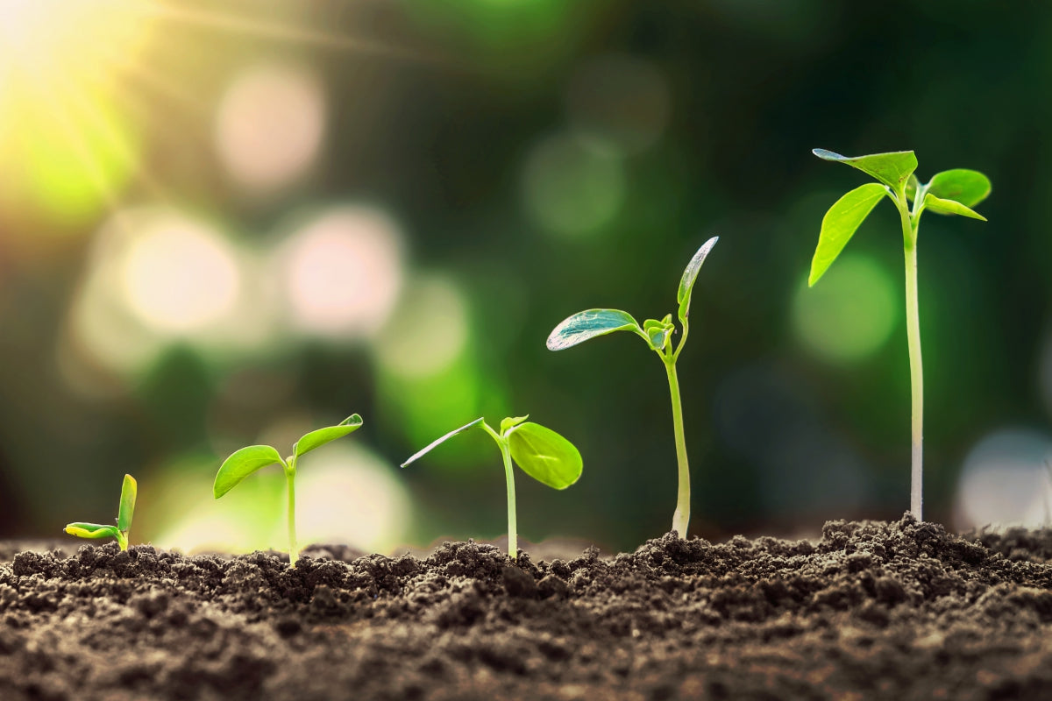
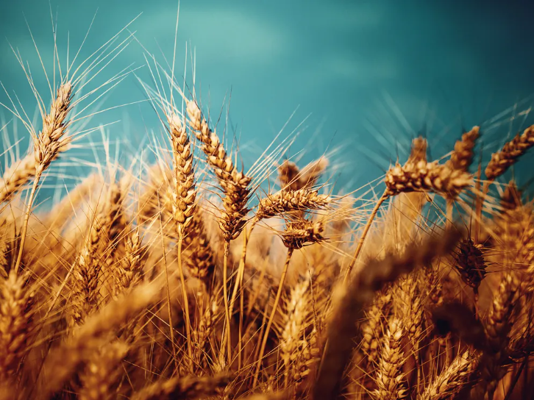
#3: The Seed Growing
vs.26 Our job: spread seed on the ground (speak His gospel message to others)
vs.27 Trust that God will do what He says (what we cannot)
vs.28 Stay involved: watering, weeding, feeding (1 Cor 3:6-7)
vs.29 Our job: when it’s time, reap the harvest (help people understand how to be saved)
Notes:
God’s sovereignty is often mysterious to us. We know from Isaiah 55:8-9 that His word always goes forth and accomplishes what He desires, but we also know that Isaiah’s commission (Isaiah 6:8-12) gave him the lifetime job of preaching the Word without any positive response.

Slide 13
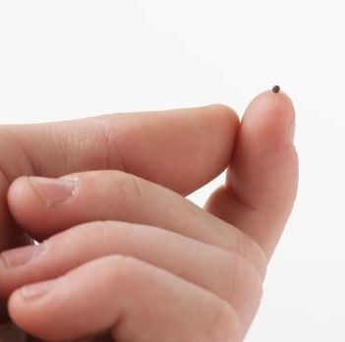
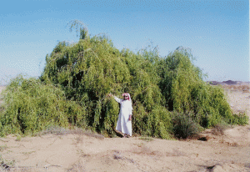
#4: The Mustard Seed
vs.30 Jesus is testing people’s expectations about God’s kingdom
vs.31 Jesus’ ministry was in a small country. When He was crucified, only a few people believed.
vs.32 But now, the gospel has spread worldwide and given life and hope to millions of people
vs.33 More information is not always better. Jesus only gave as much as they understood each time.
Notes:
Mustard trees in Palestine/Israel are actually huge tree-like bushes that can grow up to 15 feet tall. A bush that size can hold a bunch of birds. Jesus isn’t talking about birds. He’s talking about people. The meaning here is that if the kingdom of heaven is like an enormous plant with room enough for entire flocks of birds, then heaven has enough room for God’s children.
Small Start: Gen 12:1-2 Just Abraham; Numb 12:3 Moses was the meekest guy; Deut 7:7-9 Israel was the smallest nation; John 20:19 11 Apostles ; 1 Corinthians 1:26 us;
Big Finish: Acts 2:41 3000 believers; Acts 17:6 Turned the world upside down; Rev 7:9-10 Innumerable saints!

Slide 14
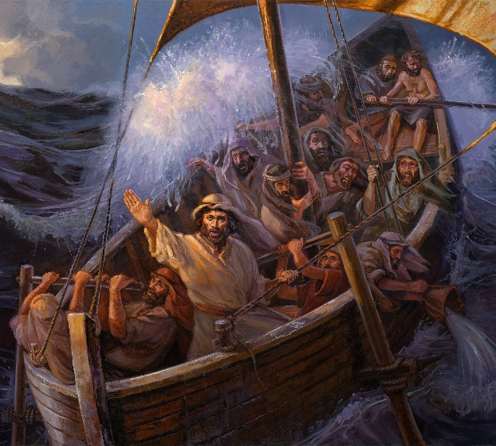
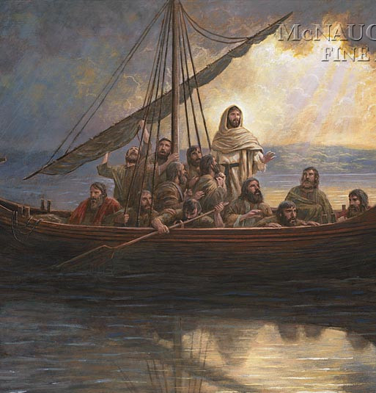
True Story: The Great Storm
vs. 35-36: a group of boats crossing the lake
vs. 37-38: the fishermen are afraid of the storm outside of the boat
Remember: Jesus loves you and will allow you to go through storms
vs. 39: Jesus speaks to the wind and waves
vs. 40-41: the disciples are now afraid of the One inside the boat
Notes:
We now move to a true story, showing Jesus’ power as the God over nature. This time, Jesus is in the boats with experienced fishermen. There were also other boats around (eyewitnesses).
Sometimes, when life seems crazy, it can feel like Jesus is asleep and doesn’t care. But don’t worry – He knows exactly what is happening now and what will happen next. You can rest!
At first, they are afraid of the terrible storm outside of the boat, but afterwards, they are terrified by the One inside of the boat, asking “Who is this?”

Slide 15
Two True Stories: Jonah and Jesus
Some interesting parallels between two stories:
Experienced sailors were facing powerful storms, trying unsuccessfully to save themselves from death
Jonah and Jesus were awakened from sleep and asked to help
Both stories end with miraculously calmed seas, the sailors amazed, and worshiping God
Jonah said: Kill me – I will die so that you can live
Jesus said: You will kill Me – I will die so that you can live (Matthew 12:38-41)
When you are tempted to say, ‘God, don’t you care?’, remember Jesus on the cross.
Notes:
Jonah 1:1-6, 12,15-16
Although Jonah was in the storm because of disobedience (while the apostles were there because of obedience, both stories have many parallels Both stories:
were in boats during deadly storms
J&J were asleep while the experienced sailors were panicking
end with miraculous intervention of calm seas
end with sailors amazed and (and worshiping) God
Jonah saved the people when thrown into the stormy sea
Jesus saved the people when thrown into the fierce, stormy wrath of God against sin

Slide 16
Some “Take Aways”
If you are His child, share some “seeds” of His Word and trust Him to make it grow!
Be serious about studying His Word and He will multiply your knowledge (of Him)!
Sometimes when we obey God we may face a “storm,” but He will always be with us.
When you face troubles, remember Jesus suffered on the cross for you, taking “the storm” of God’s wrath.

