Slide 1
The Gospel of Mark
Chapter 7
Truly Clean

Slide 2
Some Background:
The Old Testament Law made the Jews special among all nations: Exodus 19:5
Some OT unclean/clean laws: Leviticus 11:24ff
Some OT washing laws: Exodus 30:20-21
The Jewish leaders added man-made laws and traditions, raising them above the Law of God.
Jesus didn’t follow these traditions, so the leaders hated Him and tried to silence Him.
Jesus came to fulfill all of the OT law (Matt 5:17).

Slide 3
Pharisees challenge Jesus
Mark 7:1,2 – The leaders were always looking for reasons to accuse Jesus of bad behavior
vs.3,4 – To “wash properly” was to follow a traditional procedure for “spiritual cleansing”
vs.5 – The disciples were not breaking the OT law. The leaders were accusing Jesus of bad teaching.
“defiled” = spiritually unclean
vs.6-7 – True worship is about the heart. Jesus accuses them of heartless, external worship.
The heart = center of mind, will, and emotions
Notes:
Traditional hand washing required water to be poured through uplifted fingers and draining off below the wrist, then with the fingers pointing down. Then each hand was to be rubbed with the opposite fist. {these rules are not Biblical – they are traditional}

Slide 4
Tradition instead of obedience
vs.8 – Tradition can easily blind us to the truth about God and proper worship. For example:
vs.9,10 – The 5th commandment is clear: to honor parents.
vs.11 – To declare something as “Corban” meant to devote it to God for use in the temple (some Jewish leaders did this to reserve their wealth for their own use).
vs.12,13 – By following this tradition, their money was not available to help care for elderly parents.

Slide 5
What is the source of “unclean”?
vs.14,15 – Physical things and external activities are not the source of a person’s uncleanness.
Man-made religions invent rules to balance sin with good works and try to achieve godliness.
vs.17 – Genuine followers of Jesus ask for Him to help them understand truth.
vs.18,19 – Food does not make a person unclean because it does not come out of the heart.
By His authority, He now declares all foods clean.
Notes:
Jesus did not simply say “all foods are clean.” That would imply that the OT law was wrong. His declaration was based on His authoritative fulfilment of the law – Now, all foods are clean.
Perhaps Peter, who gave this gospel to Mark, we recalling how he finally understood this based on his experience in Acts 10 with Cornelius

Slide 6
How to fix the “unclean” problem?
vs.20,21 – Our problem is deeper than our actions – it comes from our very heart.
vs.21-23 – These evil realities rise out of sinful, self-centered, broken hearts.
Mark 9:43-48 – “Unclean” sinful behaviors (hand and foot) and sinful desires (eye) are very serious.
But the problem cannot be fixed on the outside by religion, social change, education, science (or even amputation).
The problem can only be solved from the inside by Jesus
Notes:
Even amputation cannot fix the problem – we cannot cut out our heart.

Slide 7
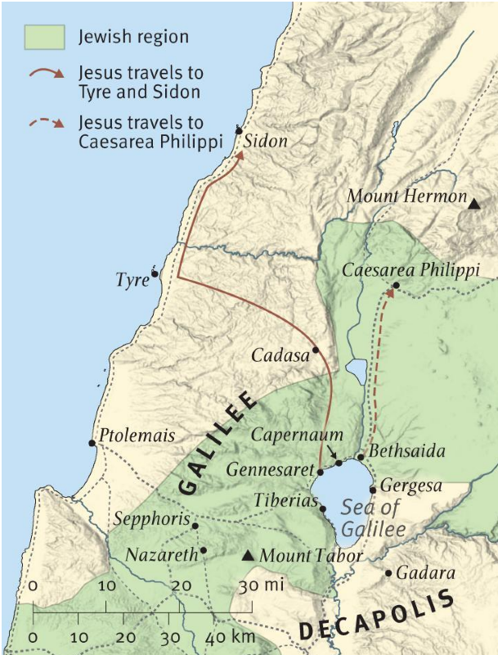
Mark 7:24-25
“And from there he arose and went away to the region of Tyre and Sidon. And he entered a house and did not want anyone to know, yet he could not be hidden.”
Jesus leaves the Jewish provinces to get some rest and prepare for His upcoming crucifixion.
But there are needy people everywhere…

Slide 8
Seeking the One who cleans inside
vs.25,26 – An unclean Gentile woman whose daughter has an unclean spirit comes to the perfectly clean Jewish Rabbi.
vs.27 – The Jews called the Gentiles “dogs”: dirty stray dogs (kuon). But here Jesus uses a different word (kunarion), meaning pet puppy.
Jesus’ describes the order of His plan: He will preach to Israel first, and after His resurrection, the message will go out into the whole world (Matthew 28:19).
vs.28 – The woman humbly admits her unworthiness and calls Jesus “Lord,” requesting His grace.
vs.29,30 – A compassionate Savior cleans the daughter of the humble Gentile woman.
Notes:
This woman is unclean and therefore unqualified to approach any devout Jew, let alone a rabbi.
The woman understands Jesus’ mission and her unworthiness, but humbly requests His grace.

Slide 9
Unlocking ears and tongues
vs.31,32 – A deaf and mute man is brought to Jesus by faithful friends.
vs.33 – Jesus enters the man’s silent world with sign language and compassionate touch.
vs.34 – Jesus speaks a single Greek word used only here and in Isaiah 35:4-6. Two connections:
“your God will come” – Jesus is God, the Savior
“with divine retribution” – Jesus didn’t come to bring judgment, He came to take it on Himself.
vs.36,37 – Do we think we know better than God?
Notes:
Jesus’ “deep sigh” expresses the pain He feels when taking our suffering upon Himself – our substitute.
“with divine retribution” – Jesus didn’t come to bring judgment, He came to bear it.
Put another way, the Child had to become a dog so that we could become sons and daughters at God’s table.

Slide 10
Some “Take Aways”
True worship comes from the heart.
Evil comes from sinful hearts and can only be fixed by Jesus, the compassionate Savior.
To receive His grace, we must humbly admit our unworthiness and His Lordship.
The Son became a dog so that we could become children at His Father’s table.

