Slide 1
The Gospel of Mark
Chapter 8
“If anyone would come after me, let him deny himself and take up his cross and follow me.” Mark 8:34

Slide 2
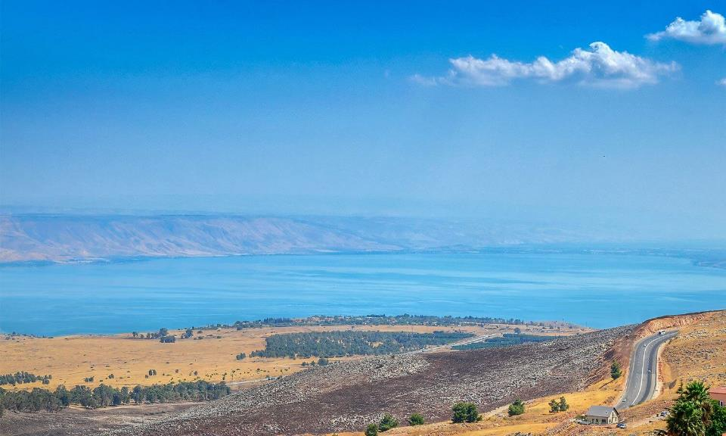
Sea of Galilee
Notes:
Much of Jesus’ ministry happened around the “Sea of Galilee”.
It is about 21 km long and 11 km wide.
Dianchi Lake is about 39 km long and 13 km wide.

Slide 3
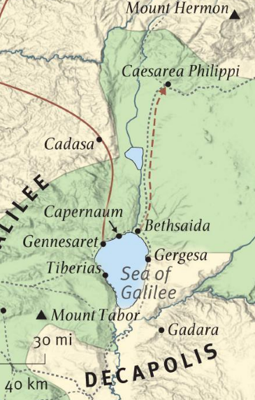
Mark 8
Teaching and Traveling
Begins in the Gentile region of Decapolis
Across the Sea of Galilee to Dalmanutha
Another boat ride to Bethsaida
Over land (~40km) to Caesarea Philippi
Begins His final journey to Jerusalem
Dalmanutha
To Jerusalem

Slide 4
Feeding the Gentiles
Mark 7:35-37 – Jesus did not come to be just a miracle worker – He came to be the Savior. But, against His command, the people advertised His miracles.
Mark 8:1 – To experience His miracle power, great crowds of Gentiles gathered for three days.
vs.2,3 – Even though people came for the wrong reasons, Jesus still had compassion for the physical needs of the people.
vs.4-5 – The apostles, like us, were quick to forget (and doubt?) the power and goodness of Jesus.
vs.6-7 – Jesus often “breaks” those that He uses
vs.8-9 – Big baskets (Gk: “spuris”) not smaller ones (“kophinos”) like in 6:43
Notes:
There are only two places in the NT where Jesus speaks of His compassion for the people: in verse 2 where He speaks of their physical needs and in the parallel passage in Matthew15:32 where He speaks of their spiritual needs.
Interestingly, the Gentiles stayed with Jesus while the Jews only stayed for one day…

Slide 5
Facing the Pharisees
Vs.10,11 – The Pharisees usually challenge and test Jesus, demanding increasingly greater signs and more proofs of His claims.
Sadly, we are often like them: always wanting more.
vs.12 – In 7:34, Jesus sighed (“stenazo”), but here, He sighs deeply (“anastenazo”) in His spirit. He is deeply grieved at their hardness of heart and unbelief.
“No sign will be given” – only the greatest sign of all will convince many: His resurrection (John 2:18,19)
vs.13 – When people reject Jesus, there is no other hope for their salvation
Notes:
In 7:34, Jesus sighed (stenazo), but here, He sighs deeply (anastenazo) in His spirit.

Slide 6
The Forgetful Apostles
Vs.14 – They forgot to bring any food and Jesus uses their hunger as a teaching opportunity
vs.15 – Yeast is often used in the Bible to describe something evil that spreads to many people
  “yeast of the Pharisees” – the risk of false teaching and self-righteous religious effort
  “yeast of Herod” – the immoral, corrupt ways of the world
vs.16,21 – The apostles were still focused on physical issues and were spiritually insensitive to Jesus’ teaching (like us…)
vs.17-20 – Jesus continues to remind them of Who He is and what He can do

Slide 7
Fixing Eyes and Understanding
vs.22,23 – Jesus uses compassionate touch to reassure the blind man. He ask questions to illustrate two things:
vs.24 – Step 1: the man’s eyes work, but his neural system is still not completely restored.
vs.25 – Step 2: his mental processing ability is enabled, converting the images clearly.
Without fixing the brain, you cannot process what your eyes see. And without the Spirit’s enlightenment, Jesus’ miracles and teaching cannot enter hard hearts.
vs.26 – Jesus took the man out of the village (and asks him to stay out) to keep the crowd from focusing only on His healing powers.

Slide 8
Who is Jesus?
vs.27,28 – Jesus gives His apostles the opportunity to share the words of others and their own thoughts
vs.29 – The answer every person gives to this question will determine their eternal destiny. Peter responds with clear truth and Jesus accepts it: He is Messiah.
vs.30 – Jesus’ mission could not be understood apart from the cross, and even the apostles didn’t get it yet…
vs.31 – Jesus must suffer many things and be killed, then rise again. His suffering was not accidental – this is why He came: to suffer and die for us!
Notes:
True forgiveness always requires suffering. Sin always carries a penalty. Guilt can’t be dealt with unless someone pays. The only way that God can pardon us and not judge us is to go to the cross and absorb it into Himself.

Slide 9
Correcting Confusion
vs.32 – All of his life, Peter was told the Messiah would come, defeat evil, and take His throne of power. But now, why is Jesus predicting His suffering and death…?
Peter condemns Jesus statement with very strong words! This does not match Peter’s expectation!
vs.33 – Jesus speaks to Peter and the other apostles (who may have been thinking the same thing): you are focused on the things of this world, not God’s kingdom! (Satan’s temptation of everyone)
Jesus came to be a king and defeat evil, not with a sword, but with a cross.
Jesus is the King of Kings and Lord of Lords. You don’t approach a king negotiating – you lay your sword at his feet and say, “command me.”

Slide 10
The Way of the Cross
Jesus took up his cross and died for us. Therefore we can submit to Him out of love and trust.
vs.34 – What does it mean to “take up our cross”?
vs.35-37 – Every culture points to achievements that define success: respect, children, position, money, possessions, etc. Life = “psyche” = identity.
When we follow Jesus, we receive a new identity with new purposes. Since we are choosing a direction different than this world, it will involve suffering.
vs.38 – If people are ashamed of Jesus, they show that their true loyalty is to this passing world.
Notes:
The word for life in v.35 is “psyche” – the things that define our identity. He is not saying that we should lose our individual self (that’s eastern mythology). He is saying that our identity must change from the things of this world to the things of God.

Slide 11
Some “Take Aways”
We often demand more signs from Jesus, but He has already given all we need.
Jesus is the King who defeats evil with a cross, not a sword.
Do not come to Jesus with your plan – ask Him for grace to surrender to His plan.
What is your identity?

