Slide 1
The Glory of Jesus
(and weakness of men)
Chapter 9a

Slide 2
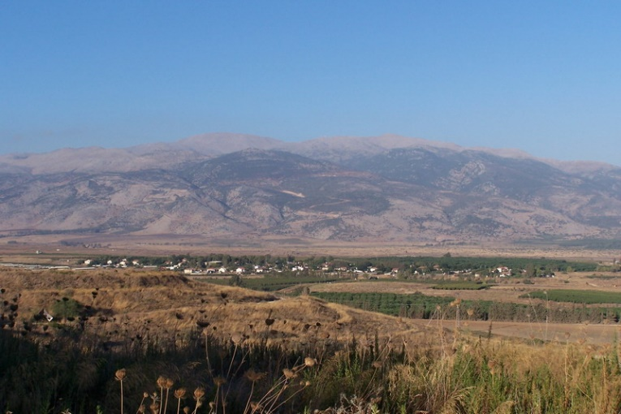
Mount Hermon
Notes:
Today’s story begins on “a very high mountain” near Jerusalem, traditionally Mt. Hermon (2814 meters above sea level). As you can imagine, it took time to walk up and down, giving opportunity for thoughtful conversation.

Slide 3
Seeing the Kingdom of God
Mark 9:1 – To understand this, look back to preceding verses in chapter 8…
Mark 8:31 – Jesus tells of His death and resurrection, resulting in surprise among the apostles (vs. 32,33).
Mark 9:1 – “And he said to them” – connects to the previous words.
“the kingdom of God after it has come with power.” Two possible views about this: the transfiguration (one week away) or the resurrection (several months away).
Matthew and Luke also include the transfiguration immediately after this statement (a sample of Jesus’ glory when He returns)
The resurrection: the ultimate picture of the power of God

Slide 4
The Transfiguration
Transfiguration (Greek: “To be transformed”)
vs.2 – up on a high mountain. Some encounters with God happen on mountains:
Exodus 34:4-6 Moses is given a small taste of God’s glory
1 Kings 19:11-13 Elijah experiences God’s power and quiet voice
vs.2,3 – The glory of God in Jesus shines out from Him. He does not point to God’s glory like the prophets – He is the glory of God!
vs.4 – Elijah and Moses appear and talk with Jesus about His departure (Luke 9:31)
Notes:
No one could see the face of God and live, but the apostles are given a glimpse of God’s glory, and yet they do not die. Jesus is the intercessor to bring people into the presence of God.

Slide 5
Listen to Jesus!
After meeting with God on Mt. Sinai, Moses built a “tabernacle” – a tent to meet with God (a portable temple)
vs.5,6 – Peter suggests they build three tents (Greek word for “tabernacle”). When people experience God, they want to preserve the experience with a temple.
Jesus is the ultimate temple, the ultimate priest, and the ultimate sacrifice! We no longer need a physical temple…
vs.7 – The Father again proclaims Jesus’ identity (as He did at Jesus’ baptism, Mark 1:11).
vs.7,8 – Moses and Elijah disappear: the law and the prophets are fulfilled in Jesus. Give Him your full attention!
The three apostles have now actually seen the glory of Jesus, a personal experience of worship.
Notes:
Tabernacles and temples are no longer needed – Jesus completes the law and the prophets!
Peter’s rebuke of Jesus did not cancel his role of service to Jesus. Thankfully, God is gracious to sinners…
It is one thing to be told the truth about Jesus, but an entirely better thing to experience true worship! This is what we were created for!

Slide 6
Talking and Learning with Jesus
vs.9 – Jesus has just given the three apostles a preview of His resurrection power. They are not to talk about it until after the actual resurrection.
Until the people see Him die and rise again, they may develop false expectations about His true mission.
vs.10 – The apostles still don’t get it (Jewish people only expected a resurrection at the end of time).
vs.11 – The apostles have just seen Elijah. They are wondering if Malachi 3:1,4:5 is about to be fulfilled.
vs.12,13 – Jesus clarifies: the prophecy was fulfilled in John the Baptist. He was rejected and killed, and so also, Jesus will also be rejected and killed.

Slide 7
The weakness of men
vs.14-18 – Jesus returns to find his apostles struggling to cast out a demon. It appears that they were trying to do it in their own strength, not with prayer and dependence upon God (v.28,29).
They underestimated the power of evil in the world and in themselves.
vs.20-23 – The doubts of the man are exposed. Jesus often healed apart from the faith of those involved, but here, He chooses to emphasize the power of faith.
vs.24 – The man admits his weak faith. He is willing to lose face and completely ask Jesus to help his faith and his son.
True “saving faith” is faith in Jesus instead of oneself. If we wait for perfect faith, you will never enter God’s presence!
Notes:
Jesus healed many people apart from their faith (raising the dead, healing a man born blind, the lame man at Bethesda, etc).
Some people have faith in their faith (not the right kind of faith).

Slide 8
The Power of Jesus
vs.25 – Jesus did not perform miracles to impress thrill seekers.
vs.26,27 – The powerful evil spirit is overcome by the powerful Jesus. New life is given to the boy and his father.
Luke 4:13 – Jesus was already tempted by the devil, and would soon face His greatest temptation yet.
On the mountain, Jesus talked with Moses and Elijah about His “departure,” preparing for the cross.
Colossians 2:13-15 – Jesus came to completely save us by enduring a shameful death on the cross to completely conquer our evil enemy.

Slide 9
Some “Take Aways”
Evil is powerful (around and inside) so we need to completely trust the power of Jesus
Don’t put your faith in your faith – put your faith in Jesus.
Don’t wait for perfect faith – trust Jesus to help you serve Him even with weak faith.
Jesus was willing to lose face to save us – are we willing to lose face to serve Him?

