Slide 1
The Gospel of Mark
Chapter 10
How do You come to Jesus?

Slide 2
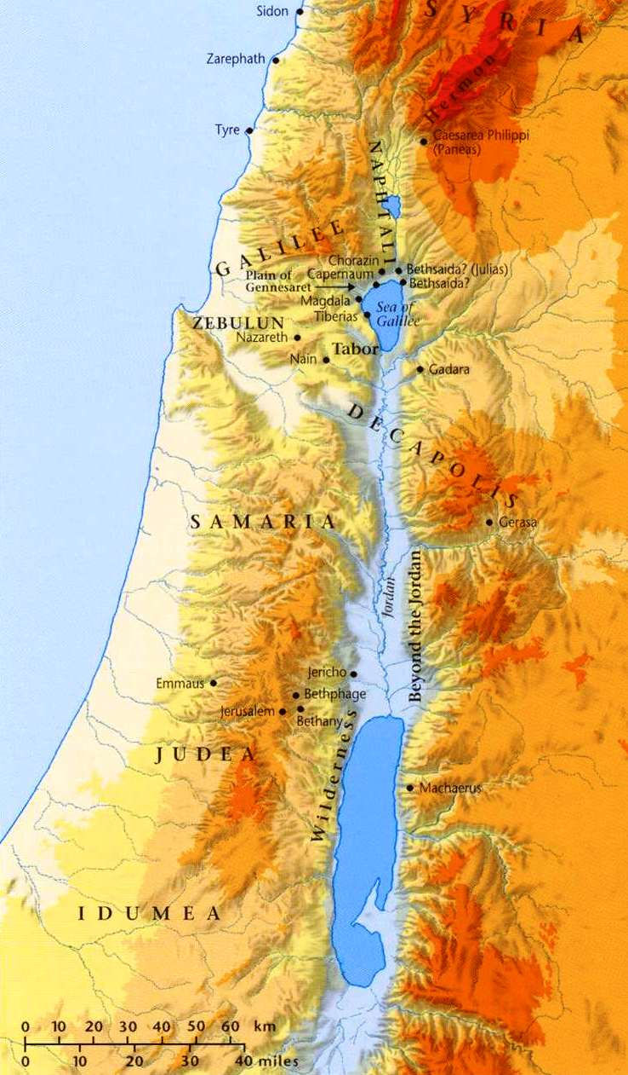
Mark 10
Journey to Jerusalem
Capernaum Mark 9:33
Judea and beyond the Jordan Mark 10:1

Slide 3
Different People Coming to Jesus
vs.2 – Pharisees came up to Him
vs.14 – Let the children come to Me
vs.17 – a rich young man ran up to Jesus
vs.35 – James and John came up to Him
vs.50 – Bartimaeus came to Jesus
They each come for different reasons and get different responses from Jesus.
Which person is most like you?

Slide 4
The Pharisees come to Him
vs.2 – Why did they come? (to test Him)
vs.3 – How does Jesus respond? (with a question)
vs.4,5 – What is their problem? (hard hearts)
vs.6 – How long has marriage existed?
vs.7-9 – Who determines if divorce is right?
It doesn’t appear that these hard-hearted Pharisees got closer to Jesus

Slide 5
Children are brought to Him
vs.13 – Why did they come? (that He might touch them)
vs.13 – Who tried to stop them? Why?
vs.14 – How does Jesus respond? (Mark 9:35-37)
vs.15 – How does someone come like a child?
vs.16 – What does Jesus do?
The tenderness of Jesus is amazing (Matt 11:29)
Notes:
Maybe the disciples considered the children unimportant (an annoying distraction) – too insignificant to take up Jesus’ time.
But Jesus reminds us that every human being is made in God’s image and has great value.
Never stop children from coming to Jesus!

Slide 6
The Rich Young Man Comes
vs.17 – Why did he come to Jesus? (he wondered what else he needed to do to earn heaven)
vs.18 – What was Jesus’ response? (good teacher?)
vs.19 – Jesus gives him a short test
vs.20 – How does the man respond? Did he really do everything perfectly?
Jesus doesn’t call the man a “liar.” He reminds him of another commandment in Leviticus 19:18
vs.21 – Jesus exposes the idol of the man’s heart.
Notes:
He does not come like a child – he comes with his wealth, accomplishments, and self-righteousness.
Jesus questions why the man would assume that an unknown wandering teacher would be good.
This was a businessman, so Jesus combines the 8th and 9th commandment (stealing and lying) to question if his business dealings were always fair and true (do not defraud)
When compared to other people, the man assumed he was OK. But compared to God’s perfect righteousness, we all are left silent (Romans 3:20)

Slide 7
The Rich Young Man Goes
vs.22 – How did the man respond? Why?
The man had put his faith in his wealth and accomplishments, instead of knowing God.
His money and position was the center of his identity.
Jesus asked the man to trade his earthly identity for a new identity, but he was not willing.
How about you? What do you love the most?
Notes:
The man followed his god instead of following Jesus (breaking the 1st commandment)
God may not call each of us to sell everything and give it away, but we must yield everything to God and steward it for His eternal purposes.
Jeremiah 4:22 – “For my people are foolish; they know me not; they are stupid children; they have no understanding. They are ‘wise’—in doing evil! But how to do good they know not.”

Slide 8
The Disciples are Confused
Jewish culture taught that wealth was a reward for good moral behavior.
vs.23,24 – Why were the disciples amazed?
vs.25,26 – If a rich man can’t be saved, then who can?
vs.27 – How hard is it for a man to save himself?
vs.27 – Who makes salvation possible?
vs.21 – “Jesus loved him” – What did Jesus do to demonstrate His love? (exactly what He asked the man to do). When we know this, it changes our values.
Notes:
Jesus is the true Rich Young Ruler. When we see how He gave up His riches and position to come and save us, it should give us a new perspective on how loosely we hold our possessions.

Slide 9
Mark 10
Journey to Jerusalem
Capernaum Mark 9:33
Judea and beyond the Jordan Mark 10:1
Going up to Jerusalem Mark 10:32

Slide 10
James and John come to Jesus
vs.32-34 – Jesus reminds them of what will happen in Jerusalem (with more details)
vs.35-37 – When you pray, don’t tell Jesus exactly what to do.
vs.38 – The guys didn’t know what they were asking for. When we Jesus’ greatest moment of glory?
On the cross – the most amazing display of God’s love. Who was prepared to be on His right and left sides?
Jesus (and His disciples) would be “baptized” (immersed) in suffering because of our sinful world.
vs.42-44 – Jesus redefines greatness
vs.45 – Why did Jesus come to earth?
Notes:
Jesus was determined as He went to Jerusalem. His followers must be wondering what conflict awaited them upon arrival…
John 17:1 – Jesus was glorified on the cross
“To give His life as a ransom for many.”
For (Gk. “anti”) = in place of
Ransom (Gk. “lutron”) = to buy freedom for a slave or prisoner

Slide 11
Mark 10
Journey to Jerusalem
Capernaum Mark 9:33
Judea and beyond the Jordan Mark 10:1
Going up to Jerusalem Mark 10:32
Came to Jericho
Mark 10:46

Slide 12
Bartimaeus comes to Jesus
vs.46 – Who was Bartimaeus? What valuable thing to could he offer to Jesus?
vs.47 – What truth did Bartimaeus proclaim about Jesus?
vs.48 – How do people treat “worthless” people?
vs.49 – How does Jesus people treat “worthless” people?
vs.50 – He leaves behind the only valuable thing that he has to respond to Jesus’ call.
vs. 51,52 – What way does Bartimaeus go?

Slide 13
Some “Take Aways”
Which of these people is most like you?
the Pharisees the Children the rich man
James and John Blind Bartimaeus
Wealth and position can blind us to our sinful need and God’s offer of grace.
Come to Jesus as a blind beggar – we are all desperate for His grace.

