Slide 1
The Gospel of Mark
Chapter 11
Entering the Temple

Slide 2
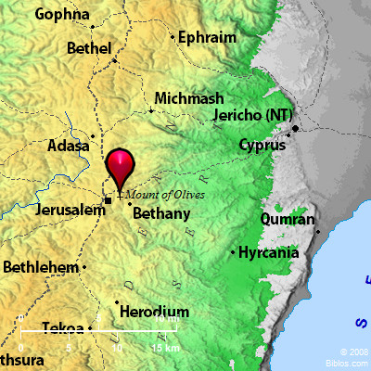
Mark 11
Entering Jerusalem
Now when they drew near to Jerusalem, to Bethphage and Bethany, at the Mount of Olives, Jesus sent two of his disciples…
Mark 11:1

Slide 3
God’s Perfect Plan
vs.2 – The right animal will be in the right place at the right time
vs.3 – The answer before the question is asked
vs.4-6 – Everything is exactly as Jesus said
vs.7 – Jesus rides an untrained donkey
vs.8-10 – People welcome the triumphant King as He rides into Jerusalem
Hosanna – (from Hebrew “Yasha”) “Save us!” The people wanted salvation from Rome, failing to see their biggest enemy, sin.

Slide 4
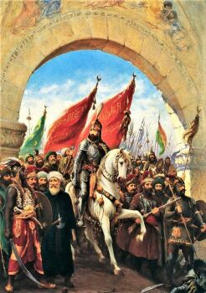
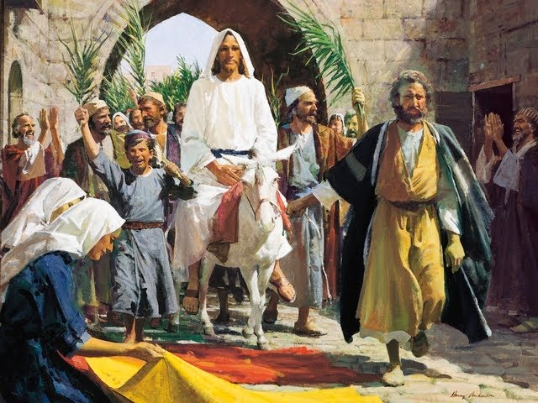
A Different Kind of King

Slide 5
A Different Kind of King
Zechariah 9:9 – How would the true king enter Jerusalem? What are some of His attributes?
Righteous Humble Having Salvation
Revelation 5:5,6 – John is told to look for a lion, but sees a lamb “as though it had been slain,”
Lion = strength, majesty, authority
Lamb = gentle, meek, patient, sacrifice
Jesus – the King who doesn’t conquer with a sword but with a cross

Slide 6
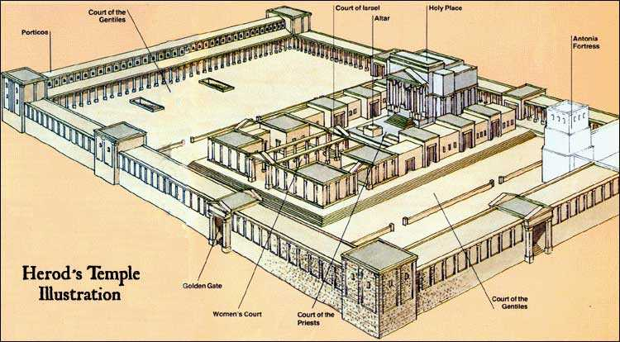
Jesus in the Temple
vs.11 – He enters the temple, looks around, and leaves
Isaiah 56:6,7 – the Gentiles will come, find joyful prayer, and love the Lord

Slide 7
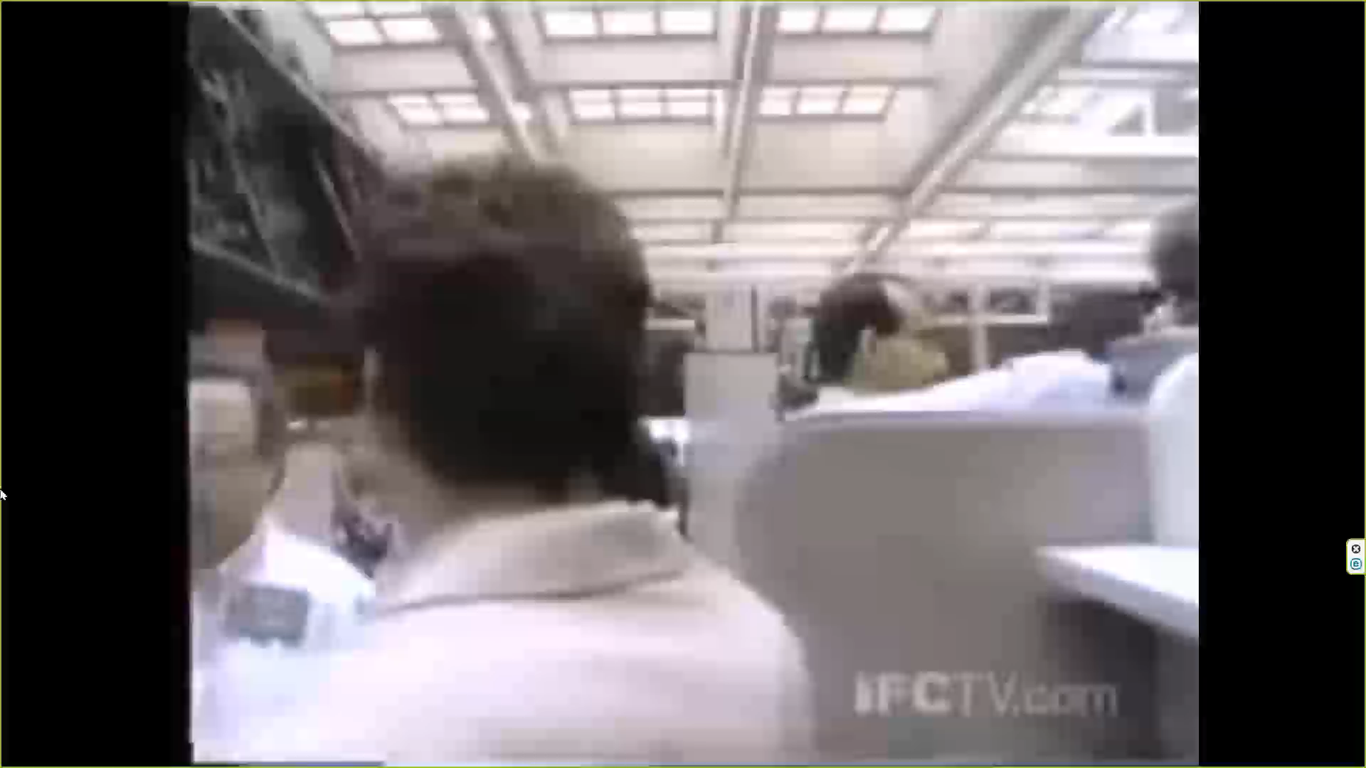
New York Mercantile Exchange
Is this a peaceful place for prayer and worship?
Isaiah 56:6,7 – the Gentiles will come to the temple, find joyful prayer, and love the Lord

Slide 8
Jesus in His Temple
255,000 Lambs – Ancient historian Josephus reported this many sacrificed during Passover
vs.15,16 – How does Jesus feel about the crazy business culture in the temple?
The Jews expected that the Messiah would come and cleanse the temple of foreigners
vs.17 – Instead, Jesus came to cleanse the temple for foreigners (like us)
vs.18,19 – Jesus didn’t just overturn the tables, He overturned the broken sacrificial system
Mark 15:37,38 – When Jesus died, the temple was no longer necessary (1 Corinthians 6:19,20)
Notes:
God hates empty worship!
Isaiah 1:10-14; Malachi 1:10

Slide 9
A Fruitless Fig Tree
vs.12 – Remember, Jesus was fully God and fully man
vs.13 – Middle Eastern fig trees have two kinds of fruit. In the spring, before the figs develop, small sweet nodules, good to eat, emerge with the leaves
vs.14 – From a distance, the tree looked healthy, but up close, it had no fruit
vs.20 – Israel was like the fig tree: a lot of activity but no spiritual fruit
vs.21 – Jesus had just cleared the temple of fruitless activity
“Jesus is the rest and the storm … either you have to kill Him or crown Him … you can’t just say, ‘What an interesting guy.’” (Tim Keller, Jesus the King)

Slide 10
Serving in His Power
vs.22 – We can only serve effectively by faith
vs.23,24 – Peter and the apostles were uneducated fishermen, facing the powerful thousand-year-old Jewish system (Acts 4:13).
vs.25 – Even when treated badly, remember how much you’ve been forgiven.
vs.27-30 – Jesus responds to tests with questions
vs.31-33 – Even if they are given a clear answer, skeptics will often not believe

Slide 11
Some “Take Aways”
God’s plans and timing are always perfect – trust Him and rest in His love!
Imitate Jesus: humble, meek, and patient
Be on guard for fruitless worship – He wants your heart, not just your words and activity.
Trust Him to use you, even in your weakness, to accomplish His eternal kingdom work.

