Slide 1
The Gospel of Mark
Chapter 13
The End is coming, but when?

Slide 2
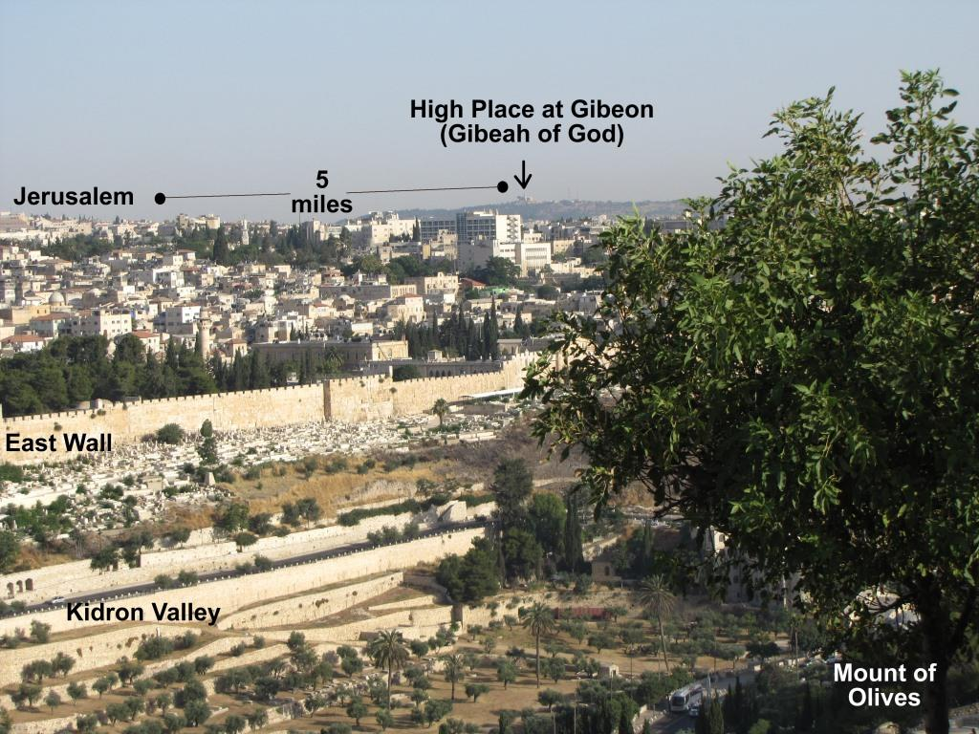
Mark 13:3-4 – Expecting Change
vs.3 – It is 2 days before Passover, as Jesus climbs the Mount of Olives with four apostles. They sit together and look across the valley at Jerusalem.
vs.4 On Passover, the apostles may be expecting Jesus to take control and set the people free from Roman rule.
But Jesus gives a much bigger answer to their question…
Notes:
Jesus has just predicted the absolute destruction of the temple (and radical change of the religious system). Since Passover was the time when God radically acted to set the Israelites free from Egypt, they might have been expecting Jesus to do something similar this week.

Slide 3
Mark 13:5-8 – Global Pains
vs.5 – “See that” = “keep your eyes open.” Be very careful that no one leads you away from the truth.
vs.6 – “Many will come” and claim to be the “savior” – any leader saying that they can solve the problems of the world. Be careful who you follow… (1 Thessalonians 5:3)
vs.7,8 – A woman’s birth pains start slowly and speed up as the time approaches. These painful troubles will increase before Christ returns.

Slide 4
Mark 13:9-13 – Personal Pains
vs.9 – “be on your guard” – you may have to speak the truth before leaders (and suffer)
vs.10 – These apostles will begin the process of bringing the gospel to the nations. All people will have the opportunity to hear!
vs.11 – Don’t worry – trust the Holy Spirit
vs.12 – A very difficult challenge: what is most important: Jesus or your family? (Matt 10:34-37)
vs.13 – True followers of Jesus will endure.

Slide 5
Before Mark 13:14-23, a Little History
Many OT prophecies have a near and a far fulfillment
Daniel 11:31 – “the abomination that makes desolate”
  Abomination: “something that causes disgust or hatred”
  Desolation: “a state of complete emptiness/destruction.”
Daniel 11:32,37 – a terrible ruler will lift himself above God and set up an abomination in the temple.
Near fulfilment: Antiochus Epiphanes in 170BC
Far: “Antichrist” at the end of the end times (Dan 12:9-11)
Notes:
Mark 14:14 will describe the “Abomination of Desolation” which has a near and far fulfilment.
The near fulfilment occurred in 175-165BC:
Antiochus IV, the Seleucid king who controlled Israel called himself “Antiochus Epiphanes” (“manifest god”). He desecrated the temple by sacrificing a pig on the altar, forcing the priests to eat pig meat, and setting up and idol of Zeus in the temple.
The far fulfilment will come at the end of the age when antichrist sets up something terrible in the temple and does evil things at the mid-point of the tribulation.

Slide 6
Mark 13:14-23 – The Coming Tribulation
vs.14 – the Jews knew about the historical “abomination that makes desolate.” Now Jesus is talking about another, worse one in the future.
vs.15-18 – When this terrible thing happens in the near future at Jerusalem, Jews in Judea should be ready to quickly flee to safety!
vs.19 – There will also be a bigger, future event.
vs.20 – Who is in control?
vs.21 – False teachers will try to deceive believers
vs.22,23 – “Be on guard” against false teachers, even those who do signs and wonders! Don’t be surprised – Jesus has already told us to expect it (Rev 13:13,14).
Notes:
The parenthetical statement (let the reader understand) shows that Jesus was not speaking this as an immediate warning, but one for future readers of this passage.
The urgent warning to flee shows that the terrible tribulation will come quickly and be very destructive!
Winter in Israel is a time of seasonal flooding that blocks escape routes.

Slide 7
Mark 13:24-27 – The Coming of Jesus
Hebrews 1:3 – Who keeps the universe in order?
vs.24,25 – After the great tribulation, the sun and moon will change and the universe will be shaken.
vs.26 – Jesus will come back to Earth with great power and glory – everyone will know about it! Don’t believe in a hidden, smaller false savior.
vs.27 – God’s angels will gather His children from every nation on the Earth (Revelation 7:9).

Slide 8
Mark 13:28-32 – The Question Answered
vs.4 – the question: “what will be the sign when all these things are about to be accomplished?”
vs.28,29 – the answer: “when you see these things…you know that He is near,”
vs.30,31 – Everything (start to finish) will happen within a “generation” (~30 years).
vs.32 – the other answer: Do not believe anyone who thinks that they know the exact day!

Slide 9
Mark 13 – Our Response
vs.9 – Be on Your Guard
vs.23 – Be on Your Guard
vs.33 – Be on Your Guard
vs.5 – Stay Awake
vs.33 – Stay Awake
vs.34 – Stay Awake
vs.35 – Stay Awake
vs.37 – Stay Awake
“So then let us not sleep, as others do, but let us keep awake and be sober. For those who sleep, sleep at night, and those who get drunk, are drunk at night. But since we belong to the day, let us be sober, having put on the breastplate of faith and love, and for a helmet the hope of salvation.” 1Thessalonians 5:6-8

