Slide 1
The Gospel of Mark
Chapter 14a
A New Passover

Slide 2
Mark 14:1,2,10,11 – The Hour has come
Exodus 12:5-8 – God’s instructions for a substitute sacrifice, protecting from divine justice.
Exodus 12:12-14 – The blood on the door was a sign of faith in God’s promise. In every house there would be either a dead lamb or a dead firstborn person.
Every year, Jewish people would celebrate the “Passover.”
Mark 14:1,2 – The chief priests were looking for a secret way to catch and kill Jesus. They didn’t want to arrest Jesus this week, but they were never in control…
vs.10,11 – Judas may have been following Jesus to gain power when He became king. But now, with Jesus predicting His death, Judas tries to get whatever he can.
Notes:
Judas agreed to 30 pieces of silver, the price of a slave accidentally gored to death by an ox (Ex 21:32). The predicted amount of Jesus’ betrayal (Zechariah 11:12)

Slide 3
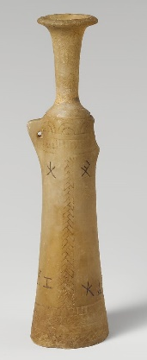
Mark 14:3-9 – Pure Worship
vs.3 – Since lepers were outcast by Jewish society, Simon had probably been healed by Jesus.
Mary broke the neck off the alabaster flask to quickly pour the expensive perfume on Jesus. She doesn’t care about the cost, the cultural taboos, or the opinions of others. She only focuses on worshiping Jesus!
vs.4,5 – The people watching (including the disciples) are poor judges of Mary’s true sacrificial worship (Romans 14:4).
vs.6,7 – There will always be opportunities to serve people, but the most beautiful and important thing is pure worship of God.
vs.8,9 – “She has done what she could.” (Susan’s life verse)
Traditionally, kings were “anointed” by an important man before taking power (e.g. 1 Samuel 10:1,2). Jesus was about to be glorified, and was “anointed” by a simple woman.
Wherever the gospel goes in the world, the Bible records this story!
Notes:
“the woman” is identified as Mary by John 12:1-8.
300 denarii is about a years’ wages for a laborer.
Romans 14:4 – “Who are you to pass judgment on the servant of another? It is before his own master that he stands or falls. And he will be upheld, for the Lord is able to make him stand.”
Jesus was about to be glorified (John 17:1)

Slide 4
Mark 14:12-16 – Preparing the Passover
vs.12 – Jesus may have kept the location secret to prevent Judas from bringing the chief priests here at the wrong time.
vs.13 – Water jars were typically carried by women, so this man would stand out in the crowd.
Peter and John were sent (Luke 2:7). Only two people were allowed to accompany a lamb for the sacrifice.
vs.14,15 – An upper room would be on a rooftop, and this one was prepared exactly as needed…
vs.16 – they “found it just as He had told them.” Jesus guides and directs perfectly.
Notes:
The upper room arrangements were either made in advance by Jesus or by a miraculous work of God.

Slide 5
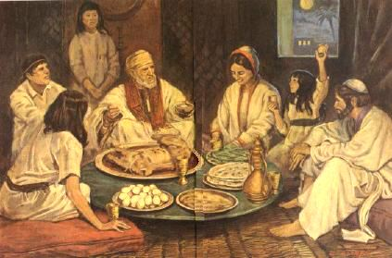
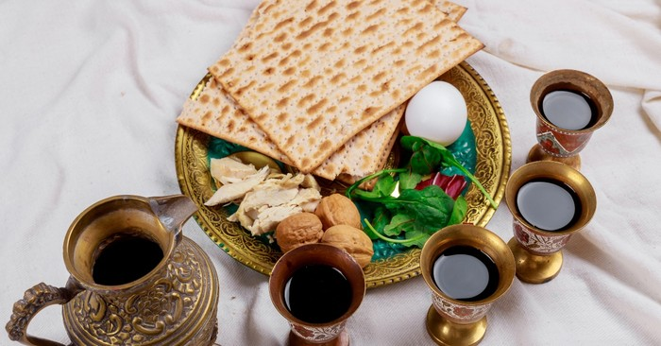
A Typical Passover Meal
The family would eat together, and four times during the meal the leader (dad) would pick up a cup of wine and explain the meaning of something:
Red wine: symbolize freedom and blessing
Unleavened bread: bread of affliction, quickly made
Salty vegetables: bitter tears in slavery
Mixed chopped nuts, fruits, and wine: the mortar used to build as slaves
The lamb: sacrificed, blood put on doorpost
Every year, the Jews would do this and look back at how God set them free from Egypt
Notes:
Four cups of wine, symbolize God’s four-fold promise of redemption found in Exodus 6:6,7:
I will take you out: salvation from harsh labor (as soon as the plagues were introduced)
I will save you: salvation from servitude (when the Jews left Egypt)
I will redeem you: the splitting of the sea (removing the fear of being recaptured by Egypt)
I will take you as my nation: arrival at Mt. Sinai (receiving the covenant of God)

Slide 6
Mark 14:17-21 – A Sad Announcement
vs.17,18 – While all 12 eat the Passover meal with Jesus, He tells them that one of their group will betray Him.
vs.19 – “Is it I?” shows that each man knew the depth of his own sin and possibility that he could be the betrayer. It also shows how well Judas covered up his real intentions.
vs.20 – There were probably several dishes around the table for dipping bread – Judas must have been using the same one as Jesus.
vs.21 – Jesus was not a “victim” – it was God’s plan for Jesus to die (Acts 2:23).
This is a strong reminder that people are responsible for rejecting Jesus, especially when informed (Hebrews 10:29)
Notes:
It is possible to betray someone accidentally (slip of the tongue) or while under torture to speak the name of your pastor.

Slide 7
Mark 14:22-25 – The New Covenant
Imagine the shocked disciples when Jesus changed the “script” they had heard for generations!
vs.22 – The broken bread is My body, the bread of my affliction. Surrender to Him – “take and eat.”
vs.23,24 – The wine is My blood, poured out for all to have a new covenant of grace
vs.25 – An amazing promise: I will bring you into My new kingdom before I feast again (Matt 26:29)!
Notes:
“Take and eat” is the fulfilment of Jesus’ dialogue in John 6:52-59

Slide 8
Christ, our Passover Lamb
The first Passover was the on the night before God redeemed the Israelites with lambs’ blood
The final Passover was on the night before God redeemed the world through Jesus’ blood
Jews were passed over – no physical death on that night
Christians are passed over – no spiritual death forever
Killing the Passover Lamb provided freedom from Egypt
The Death of Jesus provided freedom from sin
Jews celebrate Passover with their physical family
Christians celebrate Passover (“the Lord’s Supper”) with their spiritual family (the church – Luke 22:19; 1 Corinthians 11:23-26)
Christians look forward to celebrating forever in Jesus’ kingdom
Notes:
1 Corinthians 5:7 “Cleanse out the old leaven that you may be a new lump, as you really are unleavened. For Christ, our Passover lamb, has been sacrificed.”

Slide 9
Some “Take Aways”
Focus only on Jesus when you worship: not culture, opinions of others, or yourself.
Without the grace of Jesus, we could have been the one who betrayed Him (“Is it I?”)
We must each repent and believe in Jesus (“take and eat”) for Him to save us
Celebrate the “Lord’s supper” with other Christians and remember Him.

