Slide 1
Jesus in Exodus
Our Great Deliverer, Perfect High Priest and Final Sacrifice

Slide 2
Exodus: Many Symbols and Types of Jesus
Moses – Deuteronomy 18:15; John 1:21
The Passover – 1 Corinthians 5:7
The Tabernacle – Hebrews 9:2,11-12
In the Wilderness – 1 Corinthians 10:6
Notes:
We know that these things serve as “types” because they are specifically referred to as such in the New Testament.

Slide 3
Jesus: our Mediator and Leader
Moses | About Moses
Ex 2:1-2, 10 | A good, chosen child
Ex 2:13-14 | Rejected by his own people
Ex 2:10; 3:1 | Son of a king, humbled as a servant
Ex 4:29-31 | Received by his people at 2nd coming
Ex 12:31-32 | Led God’s people out of captivity in Egypt
Ex 16:15,35 | Performed miracles; fed the people bread
About Jesus | Jesus
A great, chosen child | Luke 1:31-32
Rejected by His own people | John 1:11
Son of The King, humbled as a servant | Phil 2:5-7
Will be received by His people at 2nd coming | 1 Thess 1:9-10
Led God’s people out of captivity to Satan | Luke 4:18
Performed miracles; fed the people bread | John 6:1-13
Notes:
“The Lord your God will raise up for you a prophet like me from among you, from your fellow Israelites. You must listen to him” (Deuteronomy 18:15).

Slide 4
Jesus: our Mediator and Leader
Moses | About Moses
Ex 24:3-4 | Delivered the Word of God
Ex 33:11 | Had personal conversations with God
Ex 32:11-14 | Interceded for his people
Ex 32:32 | Offered his life for sinful people
Ex 34:27 | Mediated the Old Covenant
Ex 34:29-35 | God caused his face to shine with glory
About Jesus | Jesus
Is the Word of God | John 1:1,14
Had personal conversations with God | Matt 11:27
Intercedes for His people | Hebrews 7:25
Gave His life for sinful people | 1 John 3:16
Mediated the New Covenant | Luke 22:20
God caused his face to shine with glory | Matt 17:2

Slide 5
Jesus: Salvation through His Blood
Passover | About Passover
Ex 12:3 | A lamb will be sacrificed as a sustitute
Ex 12:5 | The lamb must be spotless
Ex 12:46 | The lamb must not have broken bones
Ex 12:7 | The blood of the lamb will be applied as a cross
Ex 12:8 | The family will feast on the lamb
Ex 12:13 | The blood of the lamb saves from death
Ex 12:14 | This memorial feast will be done each year
About Jesus | Jesus
Jesus is the lamb of sacrifice | John 1:29
Jesus was sinless, a "spotless lamb" | Heb 4:15; 1 Pet 1:19
Jesus' bones were not broken | John 19:36
The blood of Jesus was shed on the cross | John 19:33-34
Christians eat a symbol of Jesus' body | Luke 22:19
The blood of Jesus saves from eternal death | John 5:24
This memorial feast will be done often | 1 Cor 11:25-26

Slide 6
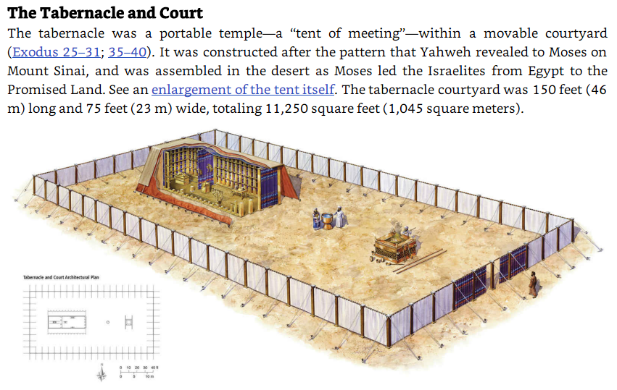
Ex 25:8 | A place where God's presence dwells
Notes:
These images and notes are from the ESV Study Bible.

Slide 7
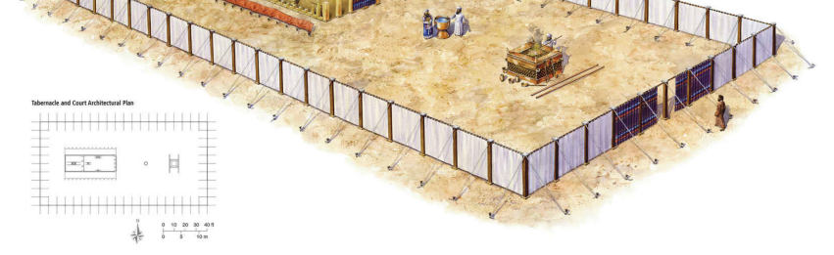
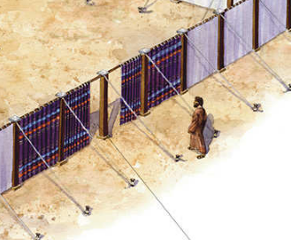
The Only Entrance
Ex 27:16 | One entrance with blue, purple, and scarlet

Slide 8
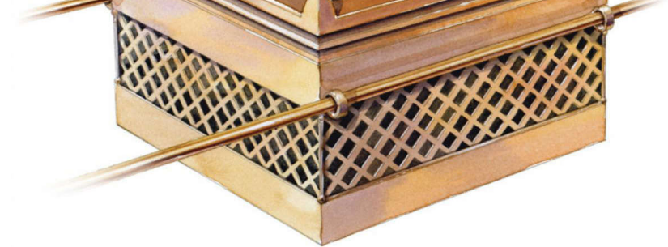
The Bronze Altar
(a sacrifice was required before approaching God)
Ex 27:1,2 | The bronze altar: to offer sacrifices

Slide 9
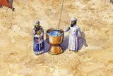
The Bronze Basin (the priests must wash before entering the tent of meeting)
Ex 30:17-18 | The Bronze Basin: to wash before entering

Slide 10
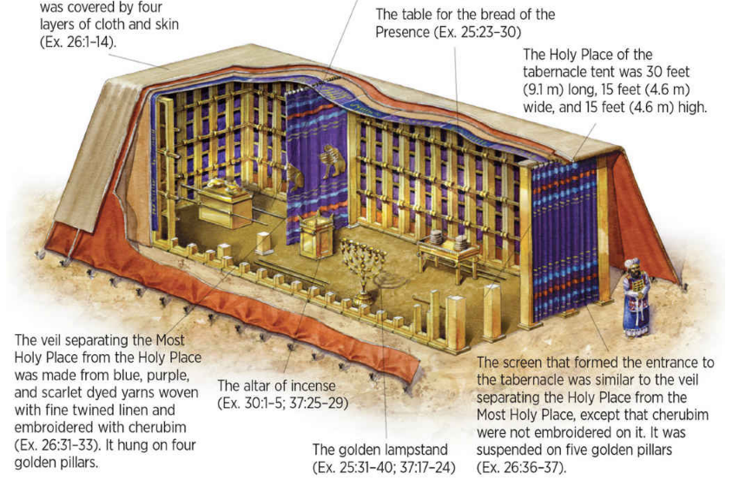
The Tabernacle Tent
The entire tent was 45 feet (13.7 m) long, 15 feet (4.6 m) wide, and 15 feet (4.6 m) high. It was a wooden skeletal structure, overlaid with gold, with no solid roof or front wall (Ex. 26: 15– 29). Five wooden bars (overlaid with gold) passed through rings attached to each frame (Ex. 26: 26– 30).
ESV Bibles. ESV Study Bible (Ebook) (p. 1121). Crossway. Kindle Edition.

Slide 11
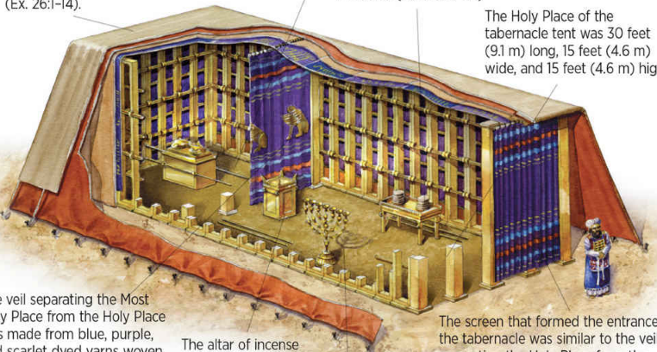
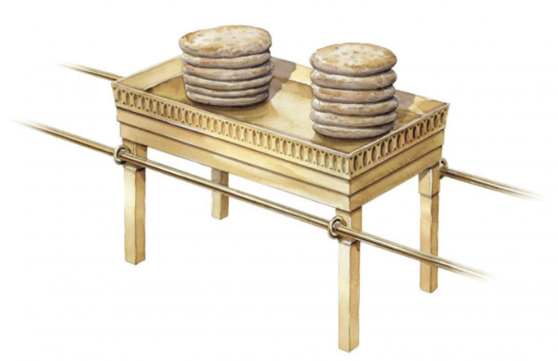
The Table for the Bread of the Presence
Ex 25:23,30 | A golden table: for bread of the Presence

Slide 12
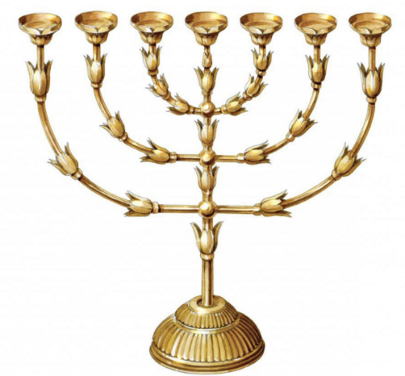
The Golden Lampstand
Ex 25:31 | The golden lampstand: to light the room

Slide 13
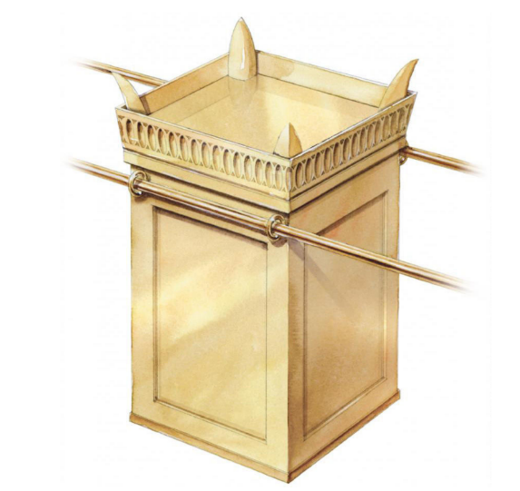
The Altar of Incense
Ex 30:1-2 | The Incense Altar: as a fragrant offering

Slide 14

The Temple Veil (curtain)
Ex 26:31,33 | The Veil: to protect the Most Holy Place

Slide 15
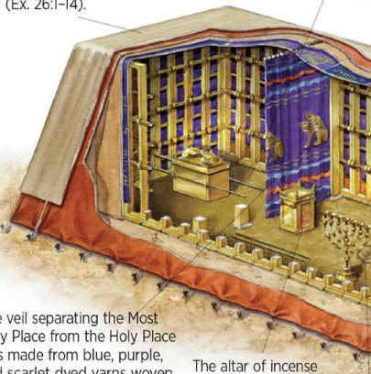
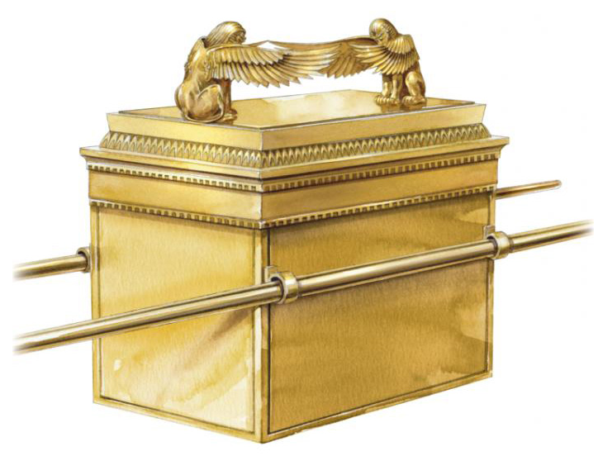
The Ark of the Covenant
Ex 25:10-11 | Acacia wood covered in pure gold
Ex 25:10,16-18,22 | Blood sprinkled on the mercy seat to cover the broken law of God

Slide 16
Jesus: the Way to Heaven from Earth
Tabernacle | About the Tabernacle
Ex 25:8 | A place where God's presence dwells
Ex 25:10-11 | Acacia wood covered in pure gold
Ex 25:10,16-18,22 | Blood sprinkled on the mercy seat to cover the broken law of God
Ex 25:23,30 | A golden table: for bread of the Presence
Ex 25:31 | The golden lampstand: to light the room
Ex 26:31,33 | The Veil: to protect the Most Holy Place
Ex 27:16 | One entrance with blue, purple, and scarlet
Ex 27:1,2 | The bronze altar: to offer sacrifices
Ex 30:1-2 | The Incense Altar: as a fragrant offering
Ex 30:17-18 | The Bronze Basin: to wash before entering
About Jesus | Jesus
Jesus entered heaven itself | Hebrews 9:24
Jesus was both human and God | Phil 2:8,9
Jesus’ blood, shed once to satisfy the law | Hebrews 10:11,12
Jesus: the holy bread of life | John 6:35
Jesus: the light of the world | John 8:12
The body of Jesus, torn open for us | Matt 27:51; Hebrews 10:19-20
Jesus: the only way to God | John 14:6
Jesus: the final sacrifice for all | Hebrews 10:14
Jesus always makes intercession for us | Hebrews 7:25
Jesus’ sacrifice cleanses us from all sin | Hebrews 10:22
Notes:
“And let them make me a sanctuary, that I may dwell in their midst. Exactly as I show you concerning the pattern of the tabernacle, and of all its furniture, so you shall make it.” Exodus 25:8-9

Slide 17
Jesus: Realities of the Way
OT | In the Wilderness
Ex 3:2-6 | “I Am” burns the thorn bush (fire=judgment)
Ex 16:15 | God gave them manna to eat
Ex 17:6 | God gave them water from a rock
Ex 32:4-6,28,35 | Punishment for idolatry
Numbers 21:9 | The serpent lifted up to save lives of sinners
About the Reality | NT
Jesus (the “I Am”) conquers sin with a crown of thorns | John 8:58; Matthew 27:29
Jesus is the Bread of Life | 1 Corinthians 10:4; John 6:32-35
Jesus is the Living Water | John 7:37-38
Warning against sin and self-confidence | 1 Cor 10:5-6
Jesus was lifted up for our sin and forgiveness | 1 Corinthians 10:9; John 3:14-15
Notes:
These examples remind us of the dangers of loving our sin more than loving God (especially idolatry, sexual immorality, testing God, and complaining). Sadly, most of the Israelites were disqualified from entering the promised land because of these sins.

Slide 18
Things to Remember:
We have a perfect Deliverer, One who provides eternal freedom from the sin within.
We have a perfect Sacrifice, not like perishable things such as silver, gold, or a lamb.
We have a perfect High Priest, One who gave Himself that we can enter the Holy presence of God.

