Slide 1
Jesus in Genesis
The First and Final Priest
Notes:
As we’ve said before, God planned the entire story of redemption before He created the world. As such, we see elements of His redemptive story woven throughout the entire Bible. Sometimes, an OT story comes back in a surprising way! But first, important some clarifications…

Slide 2
Important words to understand
Pastor (牧师 Mùshī): The person responsible for leading and teaching in a true New Testament church. Bible words for this are elder (长老 zhǎnglǎo) or shepherd (牧养 Mùyǎng). (1 Peter 5:1-3)
Priest (祭司 Jìsī): The Jewish person who offered sacrifices for the forgiveness of sins. Catholic and Orthodox churches have priests who claim to offer the body and blood of Jesus every week.
Notes:
Remember, not everyone who goes to church is truly a Christian!
The Pope is not the leader of the true church. Do not be confused to think that he speaks for real Christians.

Slide 3
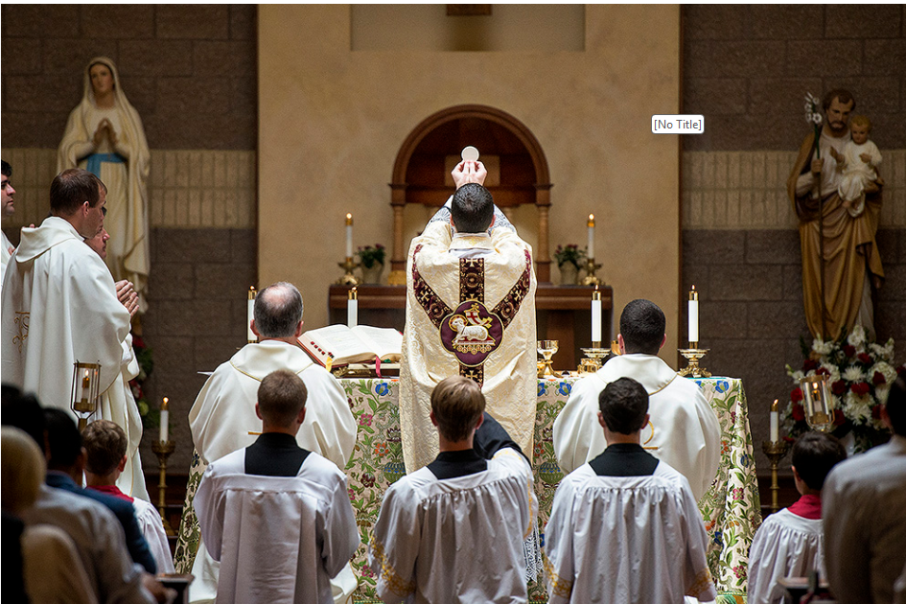

Slide 4
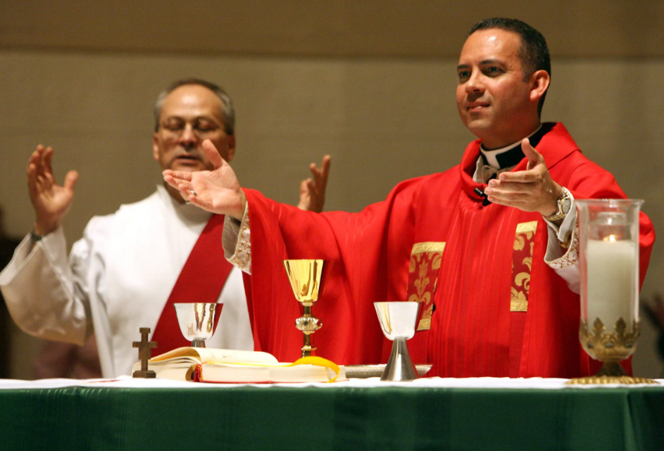

Slide 5
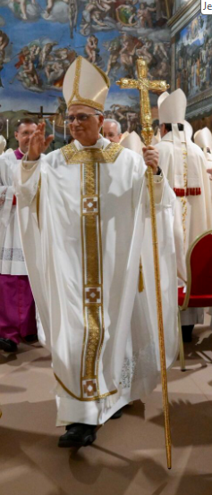
Important words to understand
Pastor (牧师 Mùshī): The person responsible for leading and teaching in a true New Testament church. Bible words for this are elder (长老 zhǎnglǎo) or shepherd (牧养 Mùyǎng). (1 Peter 5:1-3)
Priest (祭司 Jìsī): The Jewish person who offered sacrifices for the forgiveness of sins. Catholic and Orthodox churches have priests who claim to offer the body and blood of Jesus every week.
Pope: The “highest priest” in the Roman Catholic church, considered by Catholics to speak the words from God.
Pope Leo XIV
Notes:
Remember, not everyone who goes to church is truly a Christian!
The Pope is not the leader of the true church. Do not be confused to think that he speaks for real Christians.

Slide 6
Genesis 14:8-20 Abram Rescues Lot
v.8-12 > Abram’s nephew Lot is captured in a war
v.13-16 > Abram, with a group of 318 trained men defeats the enemy armies (by God’s help) and brings Lot back home.
v.17,21-23 > The king of Sodom meets Abram
V.18-20 > Melchizedek meets Abram
He was the “king of Salem,” and old form of the name Jerusalem
Came with bread and wine
Priest of “God Most High”
Notes:
In Genesis 12, we see God’s plan of redemption starting to take place. He calls Abram, sends him out, and then Abram goes to Egypt. In Chapter 13, Abram’s nephew (Lot) moves to the city of Sodom.
And then in chapter 14, we see this strange story about Abram meeting a person named Melchizedek, a mysterious king/priest. It is interesting that this meeting occurs very early, almost at the beginning of the redemption story.

Slide 7
Genesis 14:18-20 A Mysterious Priest
We know nothing about Melchizedek’s family
We don’t know when he became a priest and when he stopped being a priest of God Most High
He had special knowledge about Abram, blessed him, and proclaimed the truth about God’s promises to him
Abram respected Melchizedek as a priest and gave him a “tithe” – 10% of the spoils of the battle.
Psalm 110:1,4 > 1000 years later, we see that this meeting will have a future meaning
Notes:
When God made His covenant with the people of Israel, He used a special covenant name for Himself: Jehovah (or Yahweh). This is often printed as LORD in the Bible. But when we read about Melchizedek, we see that he is a priest of the “God Most High.” This is the English translation of the name “El Elyon,” which is a global name for God that shows He is the possessor of heaven and earth, not just limited to Israel.
(Interestingly, immediately after his encounter with Melchizedek, Abram refers to God as “Yahweh El Elyon” in his interaction with the king of Sodom in Genesis 14:22).

Slide 8
Hebrews 7 – Some facts about Melchizedek
v.1 > he is the king of peace and a global priest
v.2 > his name means righteousness and his city means peace
v.3 > he has no beginning or end (figuratively)
v.4-5 > he received honor from Abraham (the father of faith)
v.6-7 > he blessed Abraham and is superior to him
v.8-10 > he was superior to the Jewish priests
Notes:
All Jewish priests descended from Aaron, descended from Levi. They could only serve to age 50 and could not hold political office (King).
Abraham had no obligation to pay tithes to Melchizedek, but willingly chose to give honorably. And since Levi was still “in the loins” of Abraham, it is as though Levi gave tithes to the greater priest.

Slide 9
Hebrews 7 – Some facts about Jesus
v.1 > He is the king of peace and the global priest
v.2 > He brings righteousness and then peace (Rom 5:1)
v.3 > He has no beginning or end (literally)
v.4-5 > He receives honor from Abraham and everyone
v.6-7 > He blesses every person who comes to Him by faith
v.8-10 > He is superior to all priests

Slide 10
Hebrews 7 – More facts about Jesus’ ministry
v.11 > no other priest, Jewish or Catholic, can ever make people righteous
v.12 > Christianity did not “enhance” Judaism – it replaced it
v.15-16 > Jesus is the better Priest, proven by His resurrection power
v.17 > The Father has declared that Jesus will be the Priest forever
v.18-19 > the work of Christ allows us to draw near to God
v.23-26 > Our holy Savior can save us completely because He lives and intercedes for us forever
Notes:
v.12 “Changed” means to put one thing into the place of another. Christianity, in a sense, comes from Judaism. But Christianity not merely enhanced Judaism – it replaces Judaism. Because, in Christ, the old priesthood has been replaced, so is all of the law that pertains to it. This was a problem in the early church: some believing Jews told new Christians that they would have to be circumcised and begin following Jewish ceremonial laws. This brought a strong rebuke from Paul in Galatians 3:1,3; 4:9; 5:6.
v.15 The Greek language has two words for “another: “allos” refers to an additional one of the same kind, but “heteros” means another one of a different kind. You can guess that this verse uses “heteros” to describe the new priest in the likeness of Melchizedek.
v.18 The old system was weak: although it could reveal sin, and in a way, temporarily cover sin, it could never take away sin. As we see in Romans 8:1-3, God “set aside” (did away with) the old system and replaced it with something much better in Jesus.
V.19 contains a key phrase: “through which we draw near to God.” This is God’s desire for every person and should be our desire – that we continually draw near to Him. We should not view salvation as just a means to personal happiness or fulfilment. Our passion should be to be “filled with all the fullness of God.” (Ephesians 3:17-19)
v.20-22 The Old Covenant was not bad – it helped restrain sin and point to the Savior. But it was imperfect and temporary, so God never intended or promised that the Levitical priesthood would last forever. But the new priesthood of Jesus, the superior priest, receives a promise for eternal continuation. And since Jesus is the Mediator of the New Covenant, He has become the guarantor of it. He guarantees to pay all of the debts that our sins have incurred, or ever will incur against us.

Slide 11
Things to Remember:
From beginning to end, the entire Bible is God’s perfect story of redemption
The first priest in the Bible is a picture of the final Priest
In a world of darkness and suffering, Jesus is the only hope for righteousness and peace
Jesus can save and keep us forever because He is our resurrected Savior

