Slide 1
The Revelation of Jesus Christ
Part 4 – “Judgment on Our People and Our Planet”
“The nations raged, but your wrath came, and the time for the dead to be judged, and for rewarding your servants, the prophets and saints…” (11:18)
Notes:
Today, we will take a high-level overview of the next six chapters of Revelation (6-11). I don’t want you to get stuck in the details, but I want you to look for two major things: God’s Absolute Control AND God’s Judgment against sin.

Slide 2
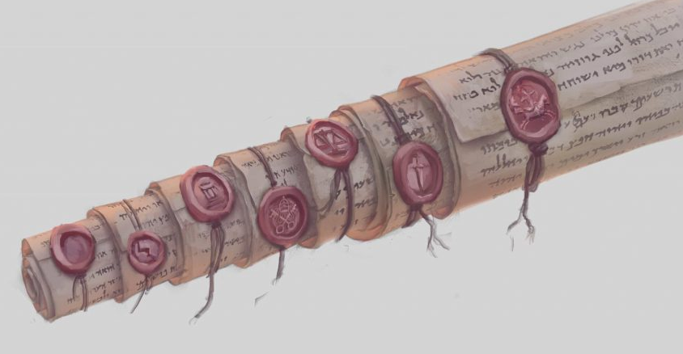
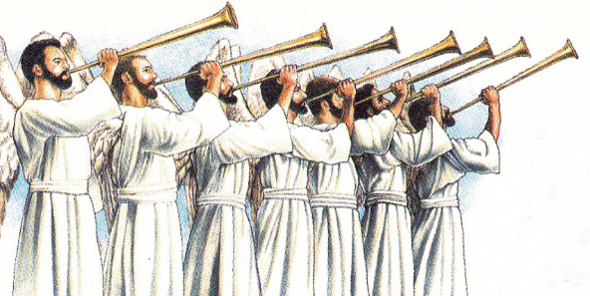
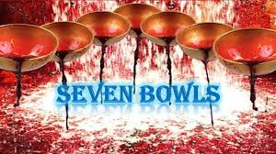
Judgment: 7 Seals 7 Trumpets 7 Bowls
Rev 5:1,6,7 Like a “title deed” that shows ownership, Jesus takes a scroll with seven seals. Judgment on people.
With the sounding of each trumpet, God judges the physical planet earth.
Bowls of God’s judgment, like plagues poured out on the people of earth and its rebellious king.
Notes:
As we read these chapters, there will be three sets of judgment from God: 7 seals on the scroll, 7 trumpets, and 7 bowls. Even though they are described in order here, they may actually overlap with one another. Today, we will look at the first two sets of judgments: the seals and the trumpets.

Slide 3
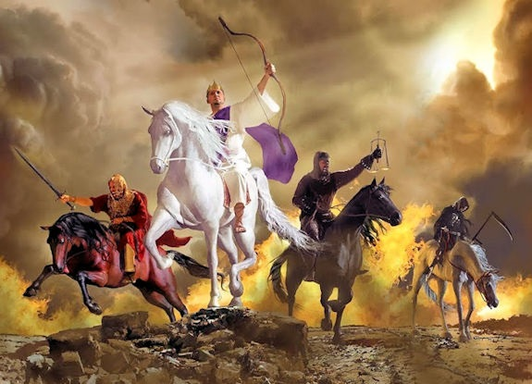
Four Horses: Revelation 6
6:1,2 The white horse: an earthly
ruler with a bow (no arrows)
peacefully conquers the earth.
6:3,4 The red horse: power is given to one who makes war, taking peace from the earth (false peace is now removed – 1 Thess 5:3).
6:5,6 The black horse: famine. After worldwide war comes worldwide famine.
6:7,8 The pale horse: with famine and war comes death, followed by hell. Death is physical and spiritual.
Notes:
Chapter six opens as Jesus begins to unroll the sealed scroll that He received from the One seated on the throne. With each seal that He breaks in heaven, judgment breaks out on earth. Here is a quick summary of what happens when each seal is broken:
(6:1,2) On a white horse, an earthly ruler (crown) goes forth with a bow (but no arrows) to peacefully conquer the earth.
(6:3,4) On a red horse, power is given to one who makes war, taking peace from the earth. The false peace that was described earlier is now removed (1 Thessalonians 5:3).
(6:5,6) A black horse comes, illustrating famine, announcing a very high price for basic food (only enough food for one person for an entire day’s wage). After worldwide war comes worldwide famine.
(6:7,8) Along with famine and war comes death (pale horse), followed by hell. Death is physical and spiritual. A fourth of mankind will die during this time, a period that is cut short for the sake of the remaining saints (Matthew 24:21,22).

Slide 4
Three More Seals…
6:9-11 God is in control and Christians are still being killed by the enemy (don’t be deceived about Who is in control).
(6:12-14) A terrible earthquake, destruction and terror among the men on earth. John had never seen a nuclear weapon, but his description sounds like one. Even the most powerful people are powerless (6:15-17).
(7:4) God’s long term plan to use Israel is completed.
(7:9,10,12) Heaven is a place of worship!
8:1 The seventh and final seal leads to silence in heaven (“the calm before the storm”).
Notes:
(6:9-11) We then see prayers being offered up by martyred saints in heaven.
(6:12-14) The sixth seal is broken and there is a terrible earthquake, bringing about destruction and terror among the men on earth. It sounds a lot like nuclear war, something that John had never seen (but accurately describes). Even the most powerful people are powerless (6:15-17).
Between the 6th and 7th things, an interlude of heaven helps us stop and look to God’s sovereign control. The sealing of the 144k Jewish evangelists reminds us that God is fulfilling his plan to redeem Israelites for His glory. Though Israel failed in their mission to be a witness nation in the Old Testament, that will not be the case in the future.
When the seventh and final seal is broken in 8:1, everything goes silent in heaven (“the calm before the storm”).

Slide 5
Seven Trumpets
8:7 the first trumpet: destruction of plants. Hail and fire mixed with blood fall upon the earth and burn up a third of the vegetation (and oxygenation).
8:8,9 the second trumpet: destruction of sea and creatures. Something like a comet falls into the sea, killing a third of the sea creatures and destroying ships.
8:10,11 the third trumpet: pollution of fresh water. Similar to the sea, now fresh water is poisoned.
8:12 the fourth trumpet: destruction beyond earth. Luke 21:25,26 is fulfilled, shaking the heavens and reducing the light.
Notes:
While the seal judgments focus mostly on the people on earth, the trumpet judgments seem to focus most of their destruction on the planet. The One who created this world now systematically destroys parts of it (almost in the order of creation), reminding us of His authority and completed plan:
(8:7) As the first trumpet sounds, hail and fire mixed with blood fall upon the earth and burn up a third of the vegetation (and oxygenation).
(8:8,9) The second trumpet brings something like a comet falling into the sea, killing a third of the sea creatures and destroying ships.
(8:10,11) With the third trumpet comes a similar judgment on fresh water, poisoning those who drink it.
(8:12) The prophecy from Luke 21:25,26 is fulfilled when the fourth trumpet sounds, bringing destruction of heavenly bodies, extending the destruction of this time beyond the boundaries of our planet.

Slide 6
Seven Trumpets (continued)
8:13 a warning – things are about to get even worse!
9:1-6 the fifth trumpet: creatures are released that punish unsaved people upon the earth for five months.
9:13-18 the sixth trumpet: an army of 200 million kill a third of the remaining people upon the earth.
11:15-19 the seventh trumpet: the kingdom of earth has now become the kingdom of Jesus Christ. An earthquake and hailstorm upon the earth.
Notes:
(9:5,6) The fifth trumpet sounds, releasing creatures that punish unsaved men upon the earth for five months.
(9:13-16,18) With the sixth trumpet comes an army of 200 million, killing a third of the remaining people upon the earth.
(11:15) The seventh trumpet brings leads to proclamation of God’s glory in heaven and an earthquake and hailstorm upon the earth.

Slide 7
God has Absolute Control
While it looks like chaos on the earth, everything that happens begins in heaven when Jesus breaks a seal or the angels blow a trumpet.
Power does not exist in the hands of men – it is only given by God from above. Even when Christians are killed, it is a part of His great plan (6:11; John 19:10,11).
God has planned that someone from every people group in the world shall be saved (7:9).
The devil doesn’t even have control of his demons – the key has to be given him by the One who holds it (1:18). Even though the “destroyer” is their “king,” God sets their boundaries (9:4).
Notes:
That’s the high-level overview of these six chapters. When you step back and look at the chapters in their entirety, some major things stand out:
Regardless of how bad things appear on the earth, God is in absolute control.
While it looks like chaos on the earth, everything that happens begins in heaven when Jesus breaks a seal or the angels blow a trumpet.
Power does not exist in the hands of men – it is only given by God from above. Even when Christians are killed, it is a part of His great plan (6:11).
God has planned that someone from every people group in the world shall be saved (7:9).
The devil doesn’t even have control of his demons – the key has to be given him by the One who holds it (Revelation 1:18). Even though the “destroyer” is their “king,” God defines their boundaries (9:4).

Slide 8
God has Absolute Control
The four angels are only released by the command of God, the One who prepared them specifically for this moment in history (9:15).
God controls what will be revealed and what will be concealed (10:4). His covenant is unfailing (11:19).
God is the only One Who can cause an earthquake and decide the exact amount of destruction (11:13).
And finally, only God is the One who will reign over the world forever and ever (11:15), answering the prayers of Christians (8:4) taught long ago (Matthew 6:10).
Notes:
The four angels are only released by the command of God, the One who prepared them specifically for this moment in history (9:15).
God controls what will be revealed and what will be concealed (10:4).
God is the only One Who can cause an earthquake and decide the exact amount of resulting destruction (11:13).
And finally, only God is the One who will reign over the world forever and ever (11:15), answering the prayers of saints taught long ago (Matthew 6:10).

Slide 9
Sin is Very Serious
People will reach the limit of God’s patience and grace (10:10,11; 2Peter 3:12,15).
God is holy and true, and by His justice, must punish sin (Hebrews 10:29-31), and will answer the prayers of Christians (6:10).
The suffering of those days is a picture of the pain of hell, in which men seek death but cannot find it (9:6).
Even when God calls people to repent (Acts 17:30,31), they often refuse with a rebellious heart.
Even in the midst of such intense judgment, men cling to their own works (9:20) and their murders, drugs, immorality, and theft (9:21).
Notes:
Regardless of what people may want to believe, the God of the universe is also a mighty God who does not treat sin lightly. We are now in a time of patience and grace, but that will soon come to an end (2 Peter 3:12,15):
God is holy and true, and by His justice, must punish sin (6:10). The prayers of the saints remind us of the promise of God in Hebrews 10:29-31.
The suffering of those days is a picture of the pain of hell, in which men seek death but cannot find it (9:6).
What did God preach to and through His prophets? That sin leads to judgment. At this time in our world, it hasn’t been completely revealed. But that time is coming (10:7).
We often hear people complain that there is not enough evidence to believe in God. This book makes it clear that such a complaint is just an excuse to cover a rebellious heart. Even when God calls people to repent (Acts 17:30,31), they often refuse. Even in the midst of such intense judgment, men cling to their own works (9:20) and their murders, drugs, immorality, and theft (9:21).

Slide 10
Salvation has a Very High Cost
Even though Jesus is the Judge, He is constantly pictured as “the Lamb” (6:1,7,16). Remember that He Himself bore this same pain for mankind.
And not just Jesus, but many of the Christians also shed blood for the sake of their testimony (6:9). Salvation is free, but the price was not (and is not) cheap.
Salvation comes only through the blood of the Lamb (7:14).
Let there be no mistake: the crucifixion of Jesus is not forgotten in heaven (11:8).
In the midst of earthly chaos, don’t be afraid (Psalm 46:1-7)
Notes:
Finally, recognize that because of the intense wrath of God against sin and sinful men, salvation has a very high cost:
Even though Jesus is the agent of judgment in this passage, it amazes me that He is constantly pictured as “the Lamb,” reminding us that He Himself bore this same pain for mankind (6:1,7,9).
And not just Jesus, but many of the saints also shed blood for the sake of their testimony. Salvation is free, but the price was not (and is not) cheap (6:9).
Salvation comes only through the blood of the Lamb (7:14).
Let there be no mistake: the crucifixion of Jesus is not forgotten in heaven (11:8).
If you’re still waiting for some kind of sign to bring you to repentance, today’s Bible study is it. If you have come to repentance and faith in Christ, use this study to appreciate the power of God and His great wrath against sin. Every time that you think about this, remember His love which placed the full force of our just judgment on Jesus on the cross (Isaiah 53:5).

Slide 11
“The Revelation of Jesus Christ”
Today, what did you see revealed about Jesus Christ?

