Slide 1
Romans 1b
Unrighteousness Revealed

Slide 2
From Last Lesson
1 Corinthians 1:18 “For the message of the cross is foolishness to those who are perishing, but to us who are being saved it is the power of God.”
Romans 1:16 “For I am not ashamed of the gospel, because it is the power of God that brings salvation to everyone who believes…”
Nothing else can rescue people from their sinful nature and give them new life!
Romans 1:17 Our only hope is to receive God’s righteousness by faith in the gospel. It has always been “from faith to faith…” Starting with Abraham (Gen 15:6) until now.
What do we need to be saved from?
Notes:
Why would Paul preach the gospel to people who were already Christians? For Paul “the gospel” is not just a call to initial saving faith but also a call to continue in a daily walk of faith
The gospel is the power of God to save, but it must be shared! (Romans 10:14)
The Righteousness of God is revealed. People assume that they are good enough by comparing with other sinful people, but the gospel of the Bible reveals our sinfulness and need of a Savior.
Righteousness is a major theme of Romans, appearing in one form or another over 30 times in Romans.
“righteousness from God,” so that it denotes right standing before God (a legal reality) that is given to people by God. (Hebrews 12:14; 2 Corinthians 5:21)

Slide 3
God’s Wrath Revealed
1:18 Wrath – the right response of a holy God to evil and wickedness (true justice, not an angry outburst). It is revealed in several ways:
Directly, through judgments like the flood and Sodom
Naturally, “reaping what we sow” (Galatians 6:7)
Abandonment, letting people do whatever they choose
Eternally, punishment in hell
Why? Because people suppress the truth in wickedness. Instead of seeking the light of truth, people choose to stay in darkness (John 3:19-20)
Notes:
Picture a perfect judge in a courtroom. He doesn’t need to get angry and shout – he wisely and consistently gives the proper judgment to those who have disobeyed the law.
In this chapter, we will see God’s wrath of abandonment…
The most graphic revelation of God’s holy wrath and hatred against sin was when he poured out divine judgment on his Son on the cross.

Slide 4
God’s Glory Revealed
1:19-20 How can God’s “invisible qualities” of eternal power and divine nature be “clearly seen”?
Creation – we see His eternal power from the massive universe to a colony of tiny ants, the variety of creatures in sky, sea, and land, the design of a human body, etc.
Notes:
The creation delivers a clear, unmistakable message about God’s person (cf. Ps. 19: 1– 8; 94: 9; Acts 14: 15– 17; 17: 23– 28).
They are without excuse. God holds all men responsible for their refusal to acknowledge what he has shown them of himself in his creation.

Slide 5
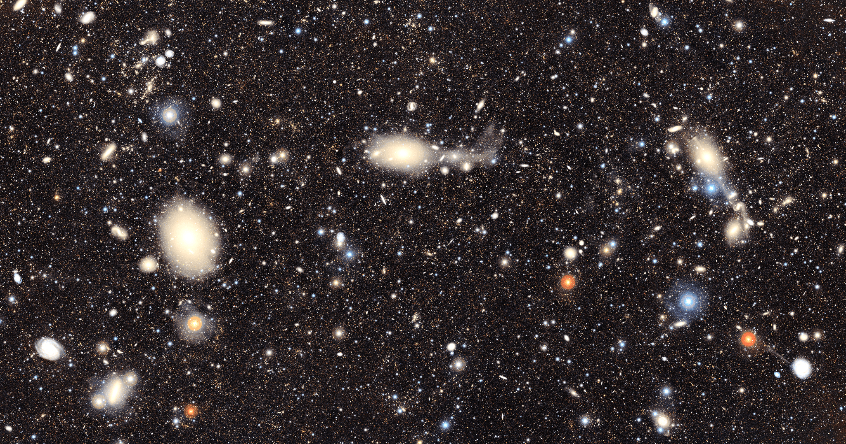
June-2025, from the NSF-DOE Vera C. Rubin Observatory in Chile. This image includes about 10 million galaxies, roughly .05% of the approximately 20 billion galaxies Rubin Observatory will capture over the next decade.
Notes:
We can’t even begin to imagine 20 billion galaxies. The universe declares the “eternal power” of God.

Slide 6

Notes:
Simply looking at a variety of insects shows the amazing creativity of God. He loves beauty and functional design – many specific creatures made for a very important purpose.
By the way, the title of this picture is “Works of Art of Evolution.” What kind of blindness is required to think such foolishness?

Slide 7
God’s Glory Revealed
1:19-20 How can God’s “invisible qualities” of eternal power and divine nature be “clearly seen”?
Creation – we see His eternal power from the massive universe to a colony of tiny ants, the variety of creatures in sky, sea, and land, the design of a human body, etc.
Conscience – in our heart, knowledge of good / evil, desire for meaning, longing for eternal (better) life, etc.
His Word – God has given us the Bible and sent Jesus to answer life’s most important questions
If a person responds to the “General Revelation” they have been given, God will bring “Special Revelation” to them.
Notes:
The creation delivers a clear, unmistakable message about God’s person (cf. Ps. 19: 1– 8; 94: 9; Acts 14: 15– 17; 17: 23– 28).
They are without excuse. God holds all men responsible for their refusal to acknowledge what he has shown them of himself in his creation.

Slide 8
Man’s Foolishness Revealed
God created everything (including us) to give Him glory.
1:21 Even though people know God, they do not do what they were created for (give Him glory or praise)
If we abandon our main purpose, our life becomes futile (meaningless) and our heart grows dark.
1:22-23 When people ignore God, all their ideas are foolish (even if they have a PhD – Psalms 14:1)
People were created to worship. When they don’t worship the true God, they substitute small, weak gods made in the image of created things.
Notes:
Man’s chief end is to glorify God (Lev. 10: 3; 1 Chron. 16: 24– 29; Ps. 148; Rom. 15: 5– 6), and Scripture constantly demands it (Ps. 29: 1– 2; 1 Cor. 10: 31; Rev. 4: 11). To glorify him is to honor him, to acknowledge his attributes, and to praise him for his perfections (cf. Ex. 34: 5– 7).
People attempt to define new purposes for their lives, usually based on their own fallen morality of temporal goals.
People (“scientists”) have spent many years and billions of dollars trying to prove evolution. Imagine what wonderful results would have come if they invested this much in studying the glory of God in His creation!

Slide 9
A Dangerous Downward Spiral
1:25,24 Because people exchange the truth about God for a lie, placing highest value in created things, and teaching others to do so…
God “gave them over” – this is a Greek legal term for sending prisoner for punishment. When men abandon God, He will let them follow their destructive desires.
1:26-27 When people get further away from God, what sin shows their moral collapse?
What does the Bible say about homosexuality? What are some of the results (“due penalty”) of this error?
Notes:
Worship = to place the highest value (ultimate value) in something.
What does the Bible say about homosexuality?
v.24 – sinful desires, sexual impurity, degrading
v.26 – shameful lusts, unnatural
v.27 – unnatural, shameful acts, inflamed with lust, error
What are some of the results (“due penalty”) of this error?
STDs, AIDS, shame, broken relationships, self-destruction

Slide 10
A Dangerous Downward Spiral
1:28 As people go further away from God, they don’t just “degrade their bodies” (v.24), they also receive a “depraved mind.”
1:29-31 People go their own way, hoping to find freedom. Instead, it leads to a broken, evil culture.
1:32 Conscience = “with knowledge.” God has put knowledge of His law within the heart of each man. Repeatedly ignoring your conscience makes it less sensitive, and eventually, dead.
Warnings are given in love. “Deserve death” for those who approve of (and celebrate) sinful things – a timely warning during “Pride Month.” (Proverbs 16:18)
Notes:
Depraved or Debased – a mind that is so contaminated with garbage that it is useless to God. The Greek word for “depraved mind” describes metal ore that is so filled with impurities that it is useless, not worth refining.
When people do what is right in their own eyes, they repeat the very ugly history of Israel’s judges (Judges 21:25)
Pride goes before destruction… (Proverbs 16:18)
An alternative to “Pride Month” is “Fidelity Month,” celebrating values that used to unite our community (patriotism, religion, family, community) in spite of differences.

Slide 11
Some “Take Aways”
Never be ashamed of the gospel – it is the only hope for salvation for sinful people!
God’s wrath is real – knowing this can put a person on the path to fear the Lord (Proverbs 9:10).
Wise people worship God – fools glorify themselves.
Satan leads people to exchange the truth about God for a lie, worshiping creation rather than the Creator.
People can escape the sinful spiral if they repent and surrender to Jesus (1 Corinthians 6:9-11)

