Slide 1
Romans 3b
“But now…”

Slide 2
Hope in a Hopeless Situation
What have we seen so far:
Romans 1:18,21,24,28-29 Wicked people who reject God and follow their lustful hearts.
Romans 2:1,4 Moral people who know the truth, but don’t do it, presuming that God will not judge them.
Romans 2:17-21 Jewish people who were born into “God’s family” and confident of His approval.
Romans 3:1-20 All people are absolutely sinful, separated from God, and stand silent before the Judge of the universe.
“But now…”
Notes:
Everyone stands without hope, ready for eternal condemnation before the perfectly righteous judge of all. Is there any hope for lost sinners?
Two words crack open the door of hope: “But now…”

Slide 3
“But now…”
We all need two things: forgiveness and God’s righteousness
If we can’t gain righteousness by keeping God’s law, then how can we have it?
3:21 The Old Testament “Law and the Prophets” always said: it is “apart from the law…”
3:22,23 Some important words:
  righteousness is given – it is not earned, it is a gift
  through faith – trusting in Jesus’ work, not mine
  all who believe – everyone can receive it
  all have sinned – everyone needs it
  fall short of the glory of God – we were created to give God glory, but because of sin, we cannot do it
Notes:
Now is a special time when Jesus has come and died for sinners. Perhaps it fulfils Jeremiah 31:33 – “This is the covenant I will make with the people of Israel after that time,” declares the LORD. “I will put my law in their minds and write it on their hearts. I will be their God, and they will be my people.”
God can bestow his righteousness on all who believe, Jew or Gentile, because all people (“no difference”) fail miserably to live up to the divine standard.

Slide 4
“Justified Freely…”
3:24 Some more important words:
  justified – pardoned from sin and given righteousness
  freely – this gift is based totally on Christ’s work for us
  by His grace – only because of God’s goodness to sinners
  the redemption – to pay the ransom for a prisoner*
  by Christ Jesus – only Jesus could pay the necessary price to set us free
* Redemption: In the OT story of Passover, a lamb was sacrificed to set the people free from temporary, physical slavery. In Christ’s sacrifice, we can be set free from eternal, spiritual slavery.
Notes:
Justified: a legal term from the Greek word for “righteous” and means “to declare righteous.” This verdict includes: pardon from the guilt and penalty of sin, and the transfer of Christ’s righteousness to the believer’s account. (2 Corinthians 5:21).
by his grace – justification is a gracious gift God extends to the repentant, believing sinner, wholly apart from human merit or work.
redemption. The word redemption reaches back to the OT exodus and the blood of the Passover lamb (see Exodus 12– 15), by which the Lord liberated Israel from Egypt; the exodus likewise points forward to the greater redemption Jesus won for his people through his blood by forgiving them their sins through his death on the cross

Slide 5
“a sacrifice of atonement…”
3:25 “God presented Christ as a sacrifice of atonement…”, not done in secret, but lifted up for all to see
Leviticus 16:15 – on the “Day of Atonement,” a goat was sacrificed and blood sprinkled on the “mercy seat” of the Ark of the Covenant.” “Through the shedding of His blood,” Jesus fulfilled the Law and satisfied the wrath of God!
Notes:
The day of atonement: Leviticus 16:15 and 1 John 2:2
God’s justice was called into question because in his patience he had overlooked former sins. In other words, how could God as the utterly Holy One tolerate human sin without inflicting full punishment on human beings immediately? Paul’s answer is that God looked forward to the cross of Christ where the full payment for the guilt of sin would be made, where Christ would die in the place of sinners.

Slide 6
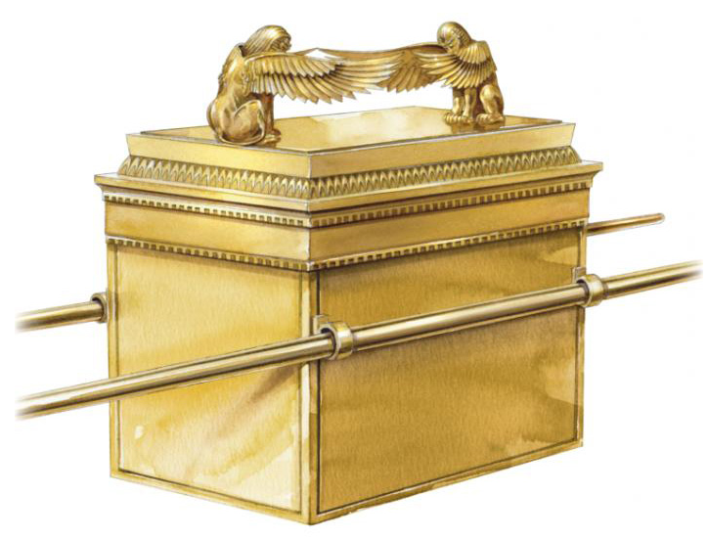
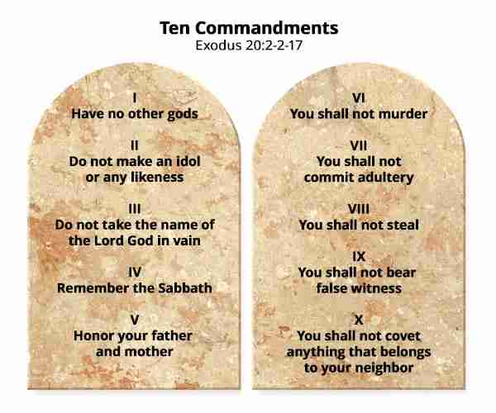
The Ark of the Covenant
God’s Presence
Blood of Goat Sprinkled
10 Commandments

Slide 7
“a sacrifice of atonement…”
3:25 “God presented Christ as a sacrifice of atonement…”, not done in secret, but lifted up for all to see
Leviticus 16:15 – on the “Day of Atonement,” a goat was sacrificed and blood sprinkled on the “mercy seat” of the Ark of the Covenant.” “Through the shedding of His blood,” Jesus fulfilled the Law and satisfied the wrath of God!
“to demonstrate His righteousness” – How could God leave guilty people unpunished? He didn’t…
“in His forbearance He had left the sins committed beforehand unpunished…” God could have destroyed all sinners immediately, but He patiently waited for Jesus to take our place and receive our punishment!
3:26 “He might be just and the justifier…” Our judge also became the One who paid the price for our sin!
Notes:
The day of atonement: Leviticus 16:15 and 1 John 2:2
God’s justice was called into question because in his patience he had overlooked former sins. In other words, how could God as the utterly Holy One tolerate human sin without inflicting full punishment on human beings immediately? Paul’s answer is that God looked forward to the cross of Christ where the full payment for the guilt of sin would be made, where Christ would die in the place of sinners.

Slide 8
Salvation by Faith for All
3:27 Since salvation is accomplished through Christ’s atoning death, all human boasting … is excluded.
3:28 Justification is by faith alone, not at all on our effort to do any works of the law (Proverbs 16:25).
3:29-30 Since God is the Lord of all (Jews and Gentiles), there can only be one way of justification – by faith.
3:31 “we uphold the law” The gospel doesn’t ignore the law – God’s law is perfectly righteous for judgment.
But Christ perfectly fulfilled God’s law and offers salvation to all who believe.
Notes:
Justification by faith does not nullify the law but establishes it. That is, the law itself points to the fact that human obedience to the law cannot save and that righteousness can be achieved only through faith in Christ; Christ has achieved this righteousness on behalf of all who believe in him, through his perfect fulfillment of the law and his atoning death on the cross for the salvation of all who believe. When Paul says, “we uphold the law,” he also affirms the abiding moral norms of the law and thus anticipates the charge of antinomianism, to which he responds more fully in chapters 6 and 7.
Christ fulfilled the law’s original purpose, which is to serve as a tutor to show mankind’s utter inability to obey God’s righteous demands and to drive people to Christ (Gal. 3:24).

Slide 9
The Wonderful Grace of God
Romans 3: ²¹ But now apart from the law the righteousness of God has been made known, to which the Law and the Prophets testify. ²² This righteousness is given through faith in Jesus Christ to all who believe. There is no difference between Jew and Gentile, ²³ for all have sinned and fall short of the glory of God, ²⁴ and all are justified freely by his grace through the redemption that came by Christ Jesus. ²⁵ God presented Christ as a sacrifice of atonement, through the shedding of his blood—to be received by faith. He did this to demonstrate his righteousness, because in his forbearance he had left the sins committed beforehand unpunished— ²⁶ he did it to demonstrate his righteousness at the present time, so as to be just and the one who justifies those who have faith in Jesus.

Slide 10
A Gift to be Received by Faith
Romans 3: ²¹ But now apart from the law the righteousness of God has been made known, to which the Law and the Prophets testify. ²² This righteousness is given through faith in Jesus Christ to all who believe. There is no difference between Jew and Gentile, ²³ for all have sinned and fall short of the glory of God, ²⁴ and all are justified freely by his grace through the redemption that came by Christ Jesus. ²⁵ God presented Christ as a sacrifice of atonement, through the shedding of his blood—to be received by faith. He did this to demonstrate his righteousness, because in his forbearance he had left the sins committed beforehand unpunished— ²⁶ he did it to demonstrate his righteousness at the present time, so as to be just and the one who justifies those who have faith in Jesus.
Notes:
The story is wonderfully amazing! But we cannot just view it from a distance – we need to take action and put our faith in Jesus!

Slide 11
Some “Take Aways”
Because of sin, every person cannot do what they were designed to do: glorify God.
The entire Old Testament pointed to Christ: He is the perfect law-keeper and sacrifice of atonement for us.
Salvation is a free gift of God’s grace, but it must be received by faith.
If you have received Christ’s righteousness – live in it this week!

