Slide 1
Romans 4
Faith, not Works
Notes:
In the second half of chapter 3, Paul introduced the fact that righteousness cannot be attained by keeping the law – only by God’s grace through faith. He now expounds on that truth and drives it home!

Slide 2
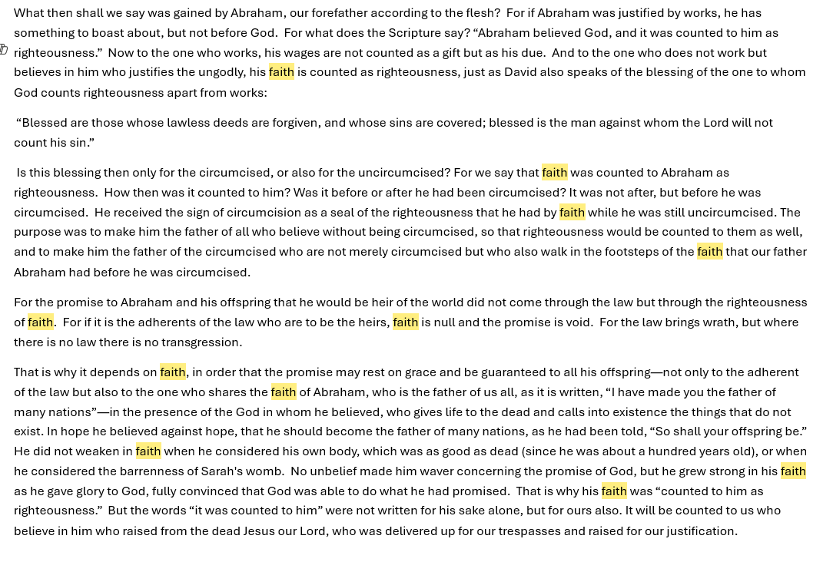
Key Words in Romans 4: Faith (11) and Counted (9)
Faith: a deep level of trust, commitment, and action in the absence of complete proof (Hebrew 11:1)
Counted: to take something that belongs to someone and credit it to another’s account
Notes:
While the terms "faith" and "belief" are often used interchangeably, they have distinct nuances. Belief is generally understood as an intellectual acceptance of something as true, while faith involves a deeper level of trust, commitment, and action, often in the absence of complete proof. Essentially, belief is a state of mind, while faith is a state of action and commitment.

Slide 3
Abraham and David
4:1-3 The Jews saw Abraham as a very righteousness man (John 8:39). How did he become righteous?
Ephesians 2:8-9 Faith does not earn righteousness – it is a gift from God through which His saving grace flows.
4:4-5 If our work could make us righteous, God would owe some salvation to us. We must stop trying to earn God’s favor and completely trust Him for salvation.
Who does God justify? The ungodly. Unless people see their sin and repent, they will not receive God’s grace.
4:6-8 After committing adultery and murder, David wrote Psalm 32:1-2, admitting his only hope for forgiveness is God’s mercy and grace to unworthy sinners like himself.
Notes:
Faith is never the means of justification— it is simply the channel through which it is received and it, too, is a gift.
God “delights” to forgive when we repent (Micah7:18-19)! But sadly, there are a lot of people who don’t want forgiveness:
* Some choose to deny the concept of sinfulness, except when accusing those who point out “sinful” behavior or blaming someone else for the bad consequences of their choices.
* Some are well aware of how messed up they are, but just don’t care about the damage done to themselves or others.

Slide 4
Faith first … Circumcision next
Many Jews thought that the act of circumcision guaranteed their salvation.
Many other religions believe some ceremony or activity (ritual) will make them righteous. Any examples?
4:9-10 Israel’s history proves circumcision does not save. Abraham righteousness came before his circumcision:
Genesis 15:6 “[Abraham] believed the LORD, and He counted it to him as righteousness.”
Genesis 16:15-16 “And Hagar bore Abram a son, and Abram called the name of his son, whom Hagar bore, Ishmael. Abram was eighty-six years old when Hagar bore Ishmael to Abram.”
Genesis 17:1,10 “When Abram was ninety-nine years old the LORD appeared to Abram and said to him, “I am God Almighty;1 walk before me, and be blameless,…, This is my covenant, which you shall keep, between me and you and your offspring after you: Every male among you shall be circumcised.”
Notes:
Abraham was 86 when Ishmael was born (Gen. 16:16), and Abraham was 99 when he was circumcised. But God declared him righteous before Ishmael had even been conceived, at least 14 years before Abraham’s circumcision.

Slide 5
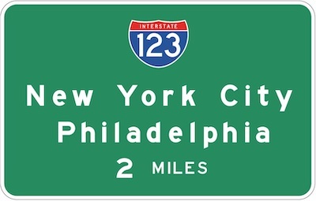
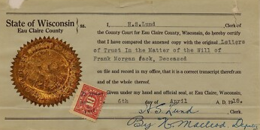
True Circumcision
4:11a Abraham “received the sign of circumcision as a seal of the righteousness that he had by faith while he was still uncircumcised.”
Sign: points to something existing
(but the sign is not the thing)
Seal: proves something is genuine
True Circumcision: Deuteronomy 10:16 – Circumcise your heart!
NT Sign: Christian baptism points to existing salvation
NT Seal: The Holy Spirit in a believer’s life (Eph 1:13)
Notes:
A sign might point your way to a city, but it is not the city.
Deut 10:16 Circumcise your heart! (also Jer 4:4)
A true seal of circumcision is done on the heart, not the foreskin!

Slide 6
Righteousness by Faith
4:11b-12 Abraham is “father” of two kinds of righteous believers:
Gentiles, “all who believe without being circumcised” (Gal 3:29)
Jews, “who are not merely circumcised but who also walk in the footsteps of the faith that our father Abraham had before he was circumcised”
4:13 God’s promise of salvation through Abraham’s offspring came through faith, not obedience to the Jewish law
4:14 “faith is null and the promise is void.” Since no one can keep the whole law to be saved, such an “impossible contract” becomes legally invalid
4:15 Without the law, we remain ignorant of our sinful nature. The law helps us see that we have violated God’s command.
Notes:
Null and void are legal terms, in this case, describing an impossible contract that would be judged as legally invalid by a law court

Slide 7
iniquity, transgression, and sin
Psalm 32:5 “I acknowledged my sin to you and did not cover up my iniquity. I said, ‘I will confess my transgressions to the LORD.’”
Sin: a general term for any action, thought, or attitude that fails to meet God's moral standards (“to miss the target”)
Transgression: specifically refers to breaking a known law or boundary – a deliberate choice to disobey (“rebellion”)
Iniquity: describes personal corruption (inside our heart) resulting from repeated sin and transgressions (“wickedness”)
Exodus 34:6,7 “The LORD, the LORD, a God merciful and gracious, slow to anger, and abounding in steadfast love and faithfulness, keeping steadfast love for thousands, forgiving iniquity and transgression and sin, but who will by no means clear the guilty, …”
Notes:
Psalm 32 – more of David’s penitent psalm after sinning with Bathsheba and Uriah.
In essence, sin is a general term for any action, thought, or attitude that violates God's law or moral standards. Transgression specifically refers to the act of violating a known law or boundary, often implying a deliberate choice to disobey. Iniquity denotes a deeper, ingrained corruption or perversion, often resulting from repeated sin and transgressions.
Here's a more detailed breakdown:
Sin: This is a broad term encompassing any act, word, thought, or motivation that falls short of God's standard or violates His law. It's often described as missing the mark, or falling short of perfection.
Transgression: This term specifically highlights the act of crossing a boundary or line that one knows is wrong. It implies a deliberate choice to disobey, often involving a breach of trust or a rebellion against authority.
Iniquity: This term suggests a deeper, ingrained corruption or wickedness. It's often associated with a pattern of sin and transgression, leading to a twisted or perverted state of being. It can also refer to the guilt or consequences associated with sin.
Examples:
Sin: Telling a lie (even unintentionally).
Transgression: Knowing that stealing is wrong but doing it anyway.
Iniquity: A person who habitually steals and justifies their actions.
Rational: to operate according to logic or reason
Rationalize: to justify an action based of a set of reasons (“rationale”), even when we know the action is wrong
“We are not rational people – we are rationalizing people.”

Slide 8
Righteousness by Faith
4:16 Why does God continue to repeat that salvation is by grace through faith?
Proverbs 16:25 > Because it is not our normal way of thinking. Consider these ways to become righteous:
Hinduism: practice disciplined meditation
Buddhism: follow the “Eightfold Path”
Islam: obey the “Five Pillars”
Judaism: obey all commandments
Biblical Christianity: receive the gift of forgiveness from God
4:17,18 We can all be children of Abraham (Gen 17:5)!
4:20-25 Why does God continue to repeat that salvation is by grace through faith?
Notes:
4:17 Because God is the all-powerful Creator, operating outside of space-time, He can declare believing sinners to be righteous even though they are not (by transferring His righteousness to them), just as He made or declared Jesus “sin” and punished him, though he was not a sinner.

Slide 9
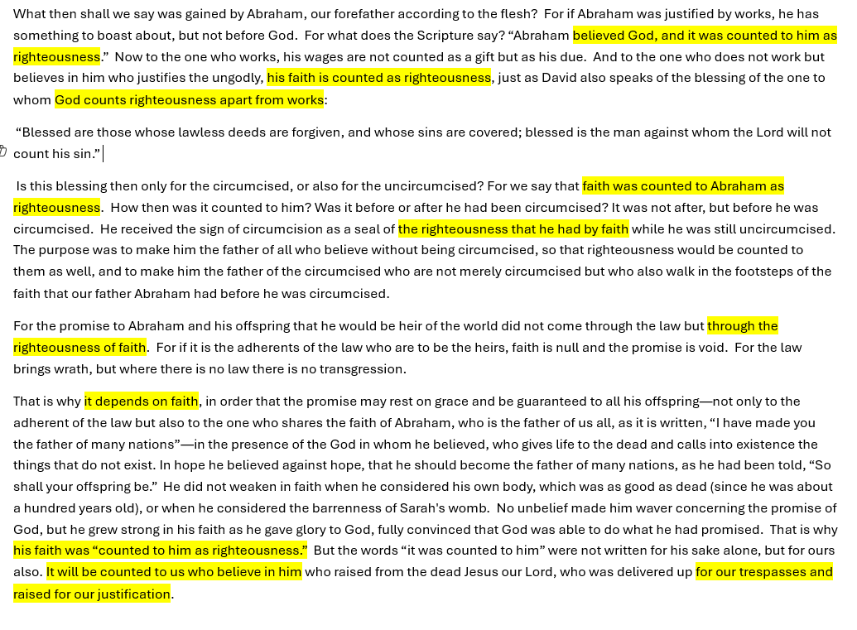
Some “Take Aways”
Salvation is by grace alone through faith alone.
Salvation is by grace alone through faith alone.
Salvation is by grace alone through faith alone.
Salvation is by grace alone through faith alone.
Salvation is by grace alone through faith alone.
Notes:
This point is made at least 10 times in this chapter alone!

