Slide 1
Romans 9 to 11
Part 1: The Story of Israel

Slide 2
The Book of Romans
1:18 to 3:18 - Everyone is Very Sinful: those who reject God, moral people, Jewish people, you and me…
3:21 to 5:21 - Salvation is Only by Grace: no one can keep the law (except Jesus, the One who saves)
6:1 to 7:25 - No Longer a Slave to Sin: following God with a new spirit in an old body
8:1 to 8:39 - Our Hope of Glory: groaning now, but with confidence in God’s perfect love and promises
9:1 to 11:36 - God’s plan for Israel (and us): hard hearts now but a future of salvation

Slide 3
Manage your Expectations!
Romans 11:33 “Oh, the depth of the riches of the wisdom and knowledge of God! How unsearchable his judgments, and his paths beyond tracing out!”
Romans 11:34-35 “Who has known the mind of the Lord? Or who has been his counselor? Who has ever given to God, that God should repay them?”
Romans 11:36 “For from Him and through Him and for Him are all things. To him be the glory forever! Amen.”
Today’s objective: review the parts of the passage about Israel.
Next time: dig into the amazing theology passages.
Notes:
Starting with the end of this section, get ready to not understand everything! God’s wisdom is beyond our understanding, and our tiny brains, limited by space and time cannot comprehend His perfect plans.

Slide 4
Not all Israelites are Saved
9:1-4a “I speak the truth in Christ—I am not lying, my conscience confirms it through the Holy Spirit—I have great sorrow and unceasing anguish in my heart. For I could wish that I myself were cursed and cut off from Christ for the sake of my people, those of my own race, the people of Israel.”
9:4b-5 “Theirs is the adoption to sonship; theirs the divine glory, the covenants, the receiving of the law, the temple worship and the promises. Theirs are the patriarchs, and from them is traced the human ancestry of the Messiah, who is God over all, forever praised! Amen.”
9:6-8 “It is not as though God’s word had failed. For not all who are descended from Israel are Israel. Nor because they are his descendants are they all Abraham’s children. On the contrary, ‘It is through Isaac that your offspring will be reckoned.’ In other words, it is not the children by physical descent who are God’s children, but it is the children of the promise who are regarded as Abraham’s offspring.”
Notes:
Paul has great sorrow and unceasing anguish – don’t think that it is ungodly to experience sorrow (for the right reasons).
What are some of the blessings given to the Israelites?
Not all who are physically descended from Abraham are “children of the promise.” Galatians 4:22-23, 28-29

Slide 5
Prophecies of God’s Plan
9:24-26 “even us, whom he also called, not only from the Jews but also from the Gentiles? As he says in Hosea: ‘I will call them ‘my people’ who are not my people; and I will call her ‘my loved one’ who is not my loved one,’ and, ‘In the very place where it was said to them, ‘You are not my people,’ there they will be called ‘children of the living God.’”
9:27-29 “Isaiah cries out concerning Israel: ‘Though the number of the Israelites be like the sand by the sea, only the remnant will be saved. For the Lord will carry out his sentence on earth with speed and finality.’ It is just as Isaiah said previously: ‘Unless the Lord Almighty had left us descendants, we would have become like Sodom, we would have been like Gomorrah.’”
Notes:
God’s big plan was to save people from the whole world, not just Israel. Speaking through the prophet Hosea, who was instructed to take an unfaithful prostitute for his wife, He promises that non-Israelite people with become His children!
Isaiah uses that example of Sodom and Gomorrah, showing that God has absolute power and authority to wipe out the entire nation of Israel for their sin. But He didn’t…

Slide 6
Israel’s Big Problem
9:30-32a “What then shall we say? That the Gentiles, who did not pursue righteousness, have obtained it, a righteousness that is by faith; but the people of Israel, who pursued the law as the way of righteousness, have not attained their goal. Why not? Because they pursued it not by faith but as if it were by works.”
9:32b-33 “They stumbled over the stumbling stone. As it is written: ‘See, I lay in Zion a stone that causes people to stumble and a rock that makes them fall, and the one who believes in him will never be put to shame.’”
10:1-4 “Brothers and sisters, my heart’s desire and prayer to God for the Israelites is that they may be saved. For I can testify about them that they are zealous for God, but their zeal is not based on knowledge. Since they did not know the righteousness of God and sought to establish their own, they did not submit to God’s righteousness. Christ is the end of the law so that there may be righteousness for everyone who believes.”
10:21 “But of Israel he says, ‘All day long I have held out my hands to a disobedient and contrary people.’”
Notes:
What was Israel’s big problem? They tried to achieve righteousness by works, not faith
Instead of standing on the Rock (Jesus), they stumbled over Him and His message because it was not what they expected or hoped for.
Their zeal is not based on knowledge of the truth.- they did not know the absolute, glorious righteousness of God, and assumed that they could achieve an equivalent degree of righteousness on their own merit. But Jesus is the “end of the law” for everyone who believes. Matthew 5:17 – Jesus didn’t come to abolish the law but to fulfill it!

Slide 7
Has God Rejected Israel?
11:1-2a “I ask, then, has God rejected his people? By no means! For I myself am an Israelite, a descendant of Abraham, a member of the tribe of Benjamin. God has not rejected his people whom he foreknew.”
11:2b-4 “Do you not know what the Scripture says of Elijah, how he appeals to God against Israel? ‘Lord, they have killed your prophets, they have demolished your altars, and I alone am left, and they seek my life.’ But what is God's reply to him? ‘I have kept for myself seven thousand men who have not bowed the knee to Baal.’”
11:5-7 “So too at the present time there is a remnant, chosen by grace. But if it is by grace, it is no longer on the basis of works; otherwise grace would no longer be grace. What then? Israel failed to obtain what it was seeking. The elect obtained it, but the rest were hardened,…”
Notes:
God has not rejected Israel! He started a plan with them and He will finish it.
In 1 Kings 19:14-18, Elijah complains to God that he is the only true follower of God left among all of Israel. But God reminds him of his short-sightedness, saying that His sovereign choice has “kept for myself” 7,000 people for His name.
He continues to demonstrate that His sovereign choice will accomplish His eternal purpose, saving the “elect” but hardening others (more about this next week…)

Slide 8
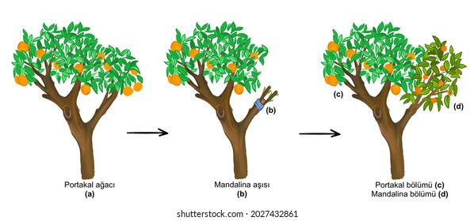
Good News for Us!
11:11,13-14 “So I ask, did they stumble in order that they might fall? By no means! Rather through their trespass salvation has come to the Gentiles, so as to make Israel jealous. Now I am speaking to you Gentiles. Inasmuch then as I am an apostle to the Gentiles, I magnify my ministry in order somehow to make my fellow Jews jealous, and thus save some of them.”
11:17-20a “But if some of the branches were broken off, and you, although a wild olive shoot, were grafted in among the others and now share in the nourishing root of the olive tree, do not be arrogant toward the branches. If you are, remember it is not you who support the root, but the root that supports you. Then you will say, “Branches were broken off so that I might be grafted in.” That is true. They were broken off because of their unbelief, but you stand fast through faith.”
Notes:
In God’s sovereign plan, He selected this time for the gospel to come to the Gentiles.
God uses the metaphor of grafting wild olive branches into a cultivated olive tree, describing how He has brought Gentiles into the family which originally began with Abraham.

Slide 9
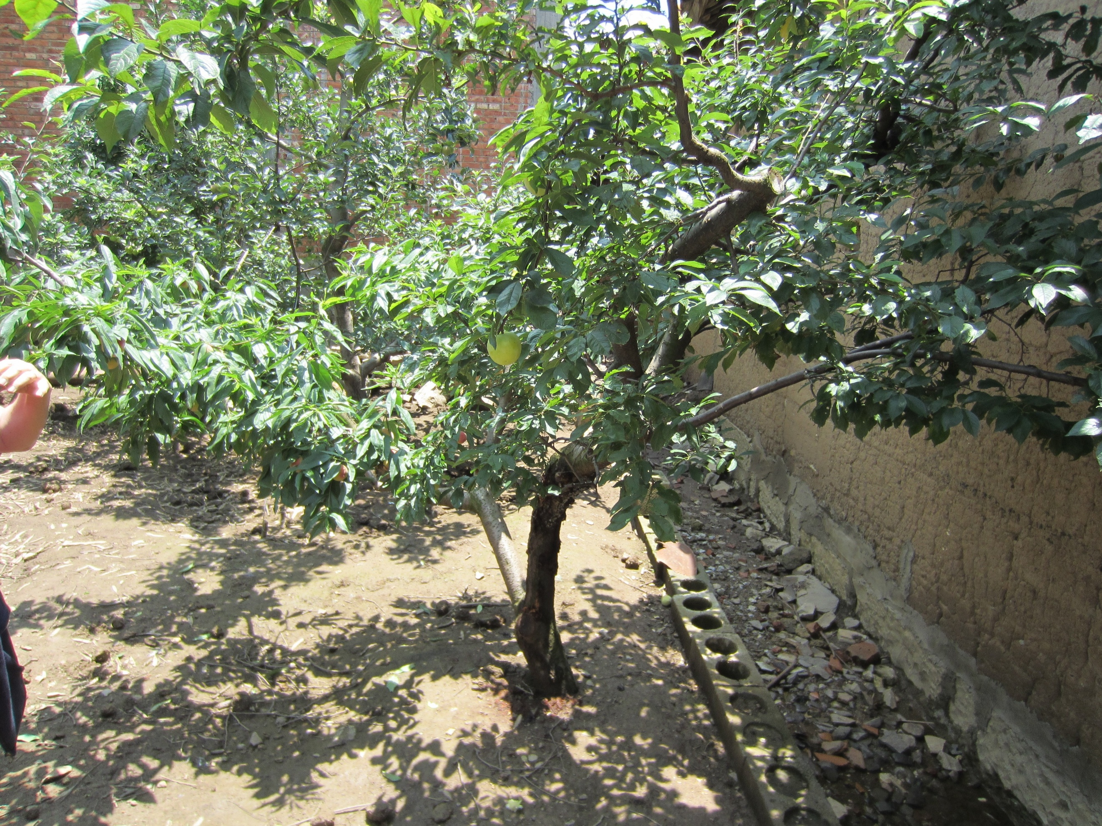
Apple Tree with Peach Grafted In
Notes:
Here is an apple tree with a peach branch grafted in (at our friend’s father’s farm in Zhaotang)

Slide 10
Israel’s Future
11:25-27 “Lest you be wise in your own sight, I do not want you to be unaware of this mystery, brothers: a partial hardening has come upon Israel, until the fullness of the Gentiles has come in. And in this way all Israel will be saved, as it is written, ‘The Deliverer will come from Zion, he will banish ungodliness from Jacob’; ‘and this will be my covenant with them when I take away their sins.’”
11:28-29 “As regards the gospel, they are enemies for your sake. But as regards election, they are beloved for the sake of their forefathers. For the gifts and the calling of God are irrevocable.”
11:30-32 “For just as you were at one time disobedient to God but now have received mercy because of their disobedience, so they too have now been disobedient in order that by the mercy shown to you they also may now receive mercy. For God has consigned all to disobedience, that he may have mercy on all.”
Notes:
A “partial hardening” has come upon Israel, perhaps in response to their request in Matthew 27:24-25, the Jesus’ blood be on them and their children. But the hardening was only partial – remember that the early church was made up of thousands of Jews.
“All Israel will be saved” – At the end of the tribulation, the remaining people in the nation of Israel will put their faith in Jesus.
The Jewish zealots were enemies of the Christians. But they were still beloved by God, not because of their terrible behavior, but because God had made an unbreakable promise to “their forefathers,” Abraham, Isaac, and Jacob. True love keeps its promises…
Just like the Jews, we all deserve to be punished for our disobedience. But in His amazing grace, God offers mercy to all of us!

Slide 11
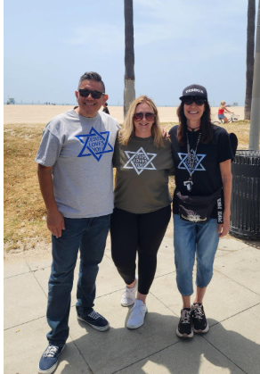
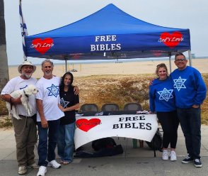
“Messianic Jews”

Slide 12
Some “Take Aways”
Our limited understanding of God’s eternal plan should not cause doubt – it should lead to worship!
Like Paul, it is normal to experience sorrow for our unsaved relatives.
Stand firm on Jesus, the Rock of our salvation!
Never doubt God’s ability to accomplish His perfect plans!

Slide 13
Behold Our God (verse 1)
C Em
Who has held the oceans in His hand?
C Em
Who has numbered every grain of sand?
F G
Kings and nations tremble at His voice
Am Em7 G
All creation rises to rejoice

Slide 14
Behold Our God (chorus)
C G/B Am F
Behold our God seated on His throne
C G
Come let us adore Him
C G/B Am F
Behold our King, nothing can compare
C G C Em C Em
Come let us adore Him!

Slide 15
Behold Our God (verse 2)
C Em
Who has given counsel to the Lord?
C Em
Who can question any of His words?
F G
Who can teach the one who knows all things?
Am Em7 G
Who can fathom all his wondrous deeds?

Slide 16
Behold Our God (chorus)
C G/B Am F
Behold our God seated on His throne
C G
Come let us adore Him
C G/B Am F
Behold our King, nothing can compare
C G C Em C Em
Come let us adore Him!

Slide 17
Behold Our God (verse 3)
C Em
Who has felt the nails upon His hands
C Em
Bearing all the guilt of sinful man?
F G
God eternal, humbled to the grave
Am Em7 G
Jesus, Savior, risen now to reign

Slide 18
Behold Our God (chorus)
C G/B Am F
Behold our God seated on His throne
C G
Come let us adore Him
C G/B Am F
Behold our King, nothing can compare
C G C Em C Em
Come let us adore Him!

Slide 19
Behold Our God (bridge)
C F/C
You will reign forever!
(Let Your glory fill the earth)
C F/C
You will reign forever!
(Let your glory fill the earth)
Am7 F/C
You will reign forever!
(Let your glory fill the earth)
Am7 F/C
You will reign forever!
(Let your glory fill)

Slide 20
Behold Our God (chorus)
C G/B Am F
Behold our God seated on His throne
C G
Come let us adore Him
C G/B Am F
Behold our King, nothing can compare
C G C
Come let us adore Him!

