Slide 1
Romans 15
God’s Mercy and Christ’s Example

Slide 2
Following Christ’s Example
15:1 “We who are strong” – This verse is a summary of chapter 14 – Love should control our behavior to the weak
“bear with the failings of the weak” – “to bear” means to pick up and carry something. Mature Christians are to help weaker (new or struggling) believers carry their burdens.
15:2 success = building others up, not lifting ourself up
15:3 Since Jesus lived to please the Father and do His will, He took the hatred of people upon Himself.
Jesus did not live to please Himself, and we should not live to please ourselves.
Notes:
Men hate God, and they directed that hatred toward Jesus

Slide 3
Hope and Encouragement
15:4 The O.T. predicted Christ’s sacrifice for our salvation. This provides encouragement to trust His promises.
Our confident hope is based on the clear and certain promises of Scripture, helping us to endure.
15:5 Our prayer: to have the same attitude as Jesus toward each other, receiving hope, endurance, and encouragement from God.
15:6 Our highest desire: “with one voice glorify the God and Father of our Lord Jesus Christ.”
15:7 If the perfect, sinless Son of God was willing to bring us into His family, we must also accept others into ours.
Notes:
Verse 3 would not provide encouragement or hope (Jesus suffered reproach) unless it was predicted as a part of God’s plan. So verse 4 starts with “For whatever was written…”, providing the basis for our encouragement, endurance, and hope.
When our church begins to have divisions and disputes, we must remember this passage!

Slide 4
Hope for Jews and Gentiles
15:8 Jesus was born a Jew and preached first to them, not because they were good, but because God always keeps His promises (Romans 11:28,29).
15:9 We (Gentiles) “glorify God for His mercy”!
Quotes from the Law, the Prophets, and the Psalms (all divisions of the O.T.), proving God’s plan to save Gentiles:
15:9 (2 Samuel 22:50); 15:10 (Deuteronomy 32:43);
15:11 (Psalm 117:1); 15:12 (Isaiah 11:10)
15:12 “The root of Jesse” (Jesus was before Jesse & David)
15:13 There is no hope anywhere except in “the God of hope” Who gives eternal hope, life, and salvation! Pray that He will fill you with joy and peace in believing!
Notes:
This passage shows that the claim made in verse 4 is true: God’s eternal word has always predicted that the Gentiles will a part of His eternal Family!

Slide 5
Reaching the Unreached
15:15-16 Paul was given a clear ministry to the Gentiles (Acts 9:15). Like a priest, he desired to present an acceptable offering of redeemed Gentiles to God.
1 Corinthians 1:27-31 “Let the one who boasts, boast in the Lord.”
15:17-19 Paul did not boast of his accomplishments , but what God was doing through him. Notice:
“In Christ Jesus…”
“what Christ has accomplished…”
“by the power of signs and wonders…”
“by the power of the Spirit of God…”
“the gospel of Christ…”
Notes:
Paul’s goal was to reach those who had never heard the gospel— the primary function of a NT evangelist (Eph. 4:11). For pastor-teachers, building on the foundation laid by such an evangelist is the crucial part of their ministry
. The ESV MacArthur Study Bible (Kindle Locations 287027-287029). Crossway. Kindle Edition.

Slide 6
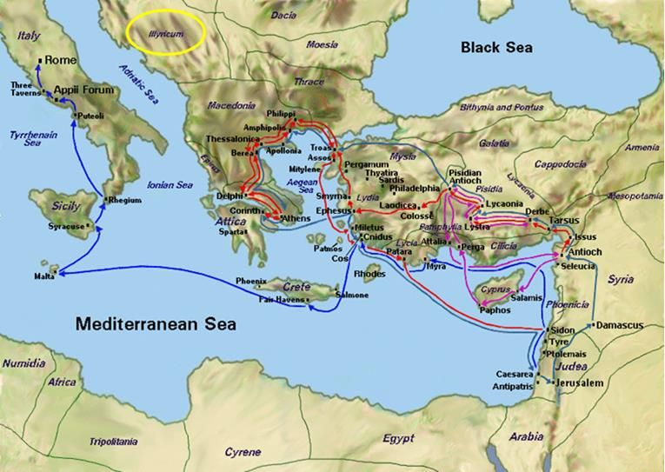
From Jerusalem to Illyricum
15:20-21 As an evangelist, Paul’s goal was to preach where the gospel had not yet been heard

Slide 7
Some “Take Aways”
Just as Jesus lived to please the Father (instead of Himself), so should we.
Our highest desire: “with one voice glorify the God and Father of our Lord Jesus Christ.”
Pray that the God of hope will fill you with joy and peace in believing!
Is there someone that you know who has never heard the gospel of Jesus?

