Slide 1
Romans 15c
Your Plans and God’s Plans
Notes:
As the book of Romans draws to a close, Paul will share some of his personal plans and greetings with his audience. But there is much for us to learn here…

Slide 2
From last time … Paul a Minister to the Gentiles
Acts 9:15 God’s appointment – Paul will bring the gospel to the Gentiles
When Paul preached to the Jews, it didn’t usually go very well (Acts 9:22-23, 28-29; 13:44-45; 17:2,5; 18:5-6)
Romans 15:15-16 Paul understood his ministry was primarily to the Gentiles.
Romans 15:20-21 Specifically, to Gentiles who had never heard about Jesus.
Notes:
As a reminder from our last look at Romans…

Slide 3
Paul’s Plans – Romans 15
15:22 – Why was Paul hindered from visiting Rome?
(Hint: Look back at 15:20-21)
Paul was focused on the mission God had given him.
15:23,24 – Why could Paul visit now?
He loves them and longs to visit them
He had completed his work northeast of the Mediterranean Sea
He wanted to reach the unreached in the northwest (Spain)
He hoped that the Roman church could help him go to Spain (probably with supplies and an escort)
15:25,26 – But first, back to Jerusalem to carry a gift for the poor
Notes:
Paul was not an “adventure tourist”
Faithfulness to your calling may hinder you from doing some things that you would like to do

Slide 4
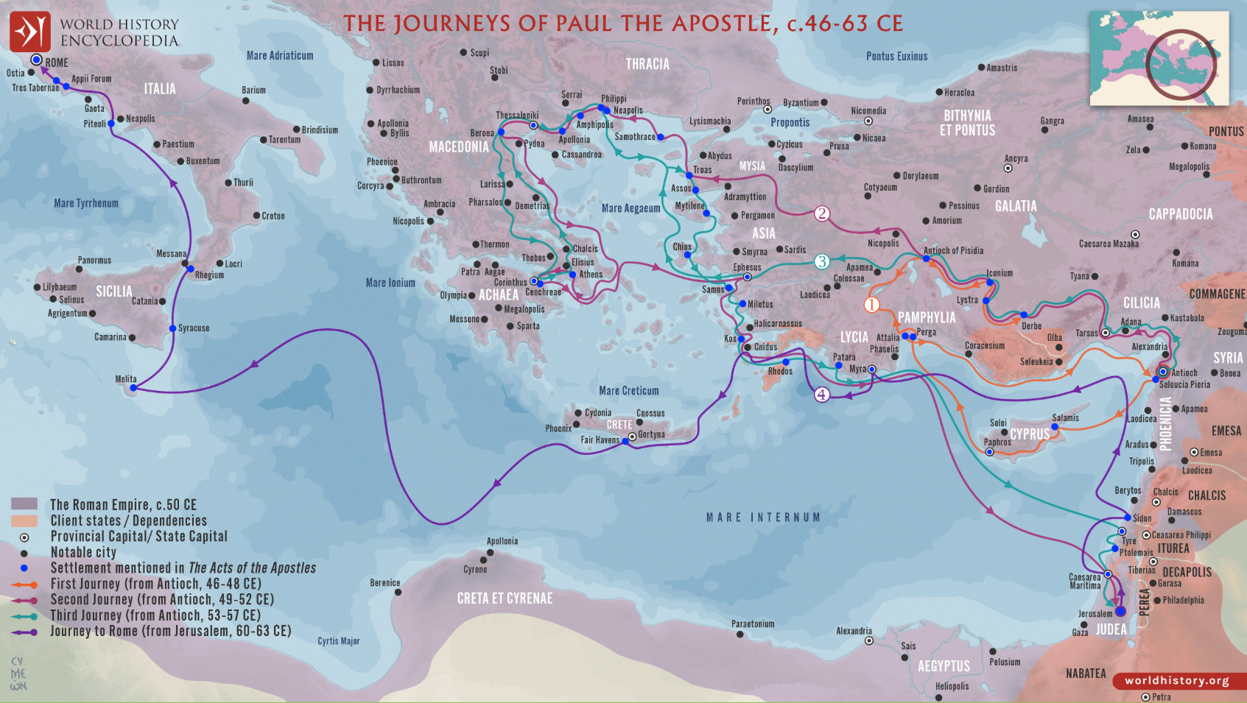
Cenchreae: Paul wrote Romans from here
Paul was picking up contributions from here
Paul planned to deliver contributions here
Finally, Paul planned visit Rome on the way to Spain

Slide 5
Guidelines for Giving – Romans 15
15:26,27 – “they were pleased to do it,” Even during severe trials, the churches of Macedonia and Achaia set an example of generous giving. See 2 Corinthians 8:1-5
V.1 God gives grace for sincere giving
V.2,3 They didn’t wait to be rich before giving
V.4 They considered it a privilege to share with needy Christians
V.5 They first gave themselves to the Lord
V.9 Remember the example of Jesus
15:27 – they desired to give to those who had blessed them spiritually (i.e. it is reasonable to pay your pastor)
Notes:
At this time (about AD 58), the Jewish believers in Jerusalem were suffering persecution and poverty due to job loss, imprisonment, and famine

Slide 6
Paul’s Plans (continued) – Romans 15
15:28,29 – Paul hoped for a smooth trip to Jerusalem and back to Rome, followed by his expected journey to Spain.
15:30-32 – Paul earnestly requested prayer for his journey:
to be delivered from violence of the Jewish unbelievers
that the offering would be acceptable to the Jewish saints
and that he could return to them, refreshed and joyful
“By God’s will…” are key elements of prayer and following Christ
Proverbs 19:21 Careful, thoughtful planning does not indicate lack of trust in God or His guidance (Jeremiah 10:23).
Proverbs 16:9 When making plans, always be open to God’s control and changes along the way (Acts 16:6-10).
Notes:
By the way, Paul did not claim that God was calling him to minister either in Rome or in Spain, but he strongly hoped for and planned both ministries.

Slide 7
God’s Answer to Prayer
Acts 20:22-23 Advance warning about what will happen
Acts 21:17-20 Paul’s offering and report was well received
Acts 21:30-32 Paul was delivered from the violent Jews
Acts 23:11 Paul will return to Rome (but not the way he expected)
Acts 28:14-16 Eventually in Rome (after trials, shipwrecks, etc.)
Philippians 1:12-14 The result was good, but not easy

Slide 8
Some “Take Aways”
It is a privilege to give to needy people – financially and spiritually
It is good to invite people to pray for your ministry (2 Cor 1:11)
Sometimes, difficult circumstances come into our lives and God uses them to advance the gospel (Philippians 1:12-14).
Make plans but always be open to God’s changes along the way. (“Hold everything in your hands lightly, otherwise it hurts when God pries your fingers open.” Corrie ten Boom)
Notes:
Corrie ten Boom's famous "open hands" quote is: "Hold everything in your hands lightly, otherwise it hurts when God pries your fingers open". It emphasizes releasing control over people, plans, and possessions, trusting God to manage them, and finding freedom and rest by not clinging tightly to worldly things that inevitably slip away or must be surrendered.
Key meaning
Letting go: The quote encourages a posture of open hands, meaning we should not clutch tightly to our desires, dreams, or even hurts.
Trusting God: It's about surrendering our grip on life to God, recognizing that anything held too tightly can become an idol or a source of pain when removed.
Spiritual Freedom: By holding things lightly, we avoid the pain of forced release and find peace, as "what we place in God's hands, that, we still possess".

