Slide 1
Romans 16
Personal Notes and Final Warning
Notes:
This chapter is unique in all of Paul’s writings, including more personal expressions of love and appreciation than any other passage in Scripture. This reminds us that the Christian life is very focused on relationships (with God and each other). But it also provides some insights into the life of the early church.
You might ask yourself: which of these people would I like to model my life after?

Slide 2
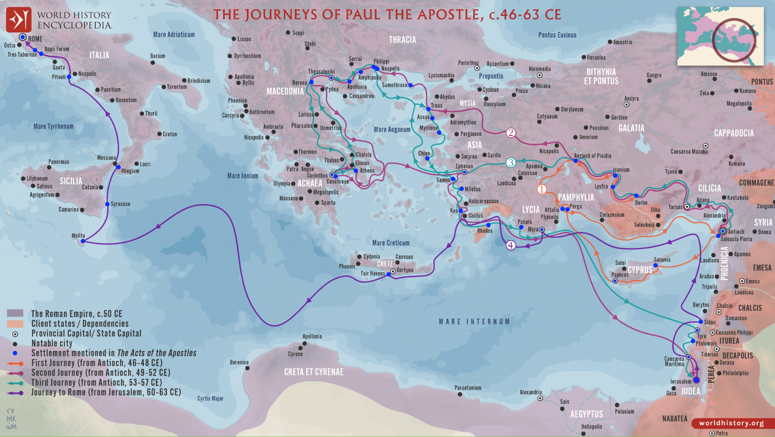
Notes:
Paul traveled all over the Mediterranean Sea area, spreading the gospel and building relationships with many believers.

Slide 3
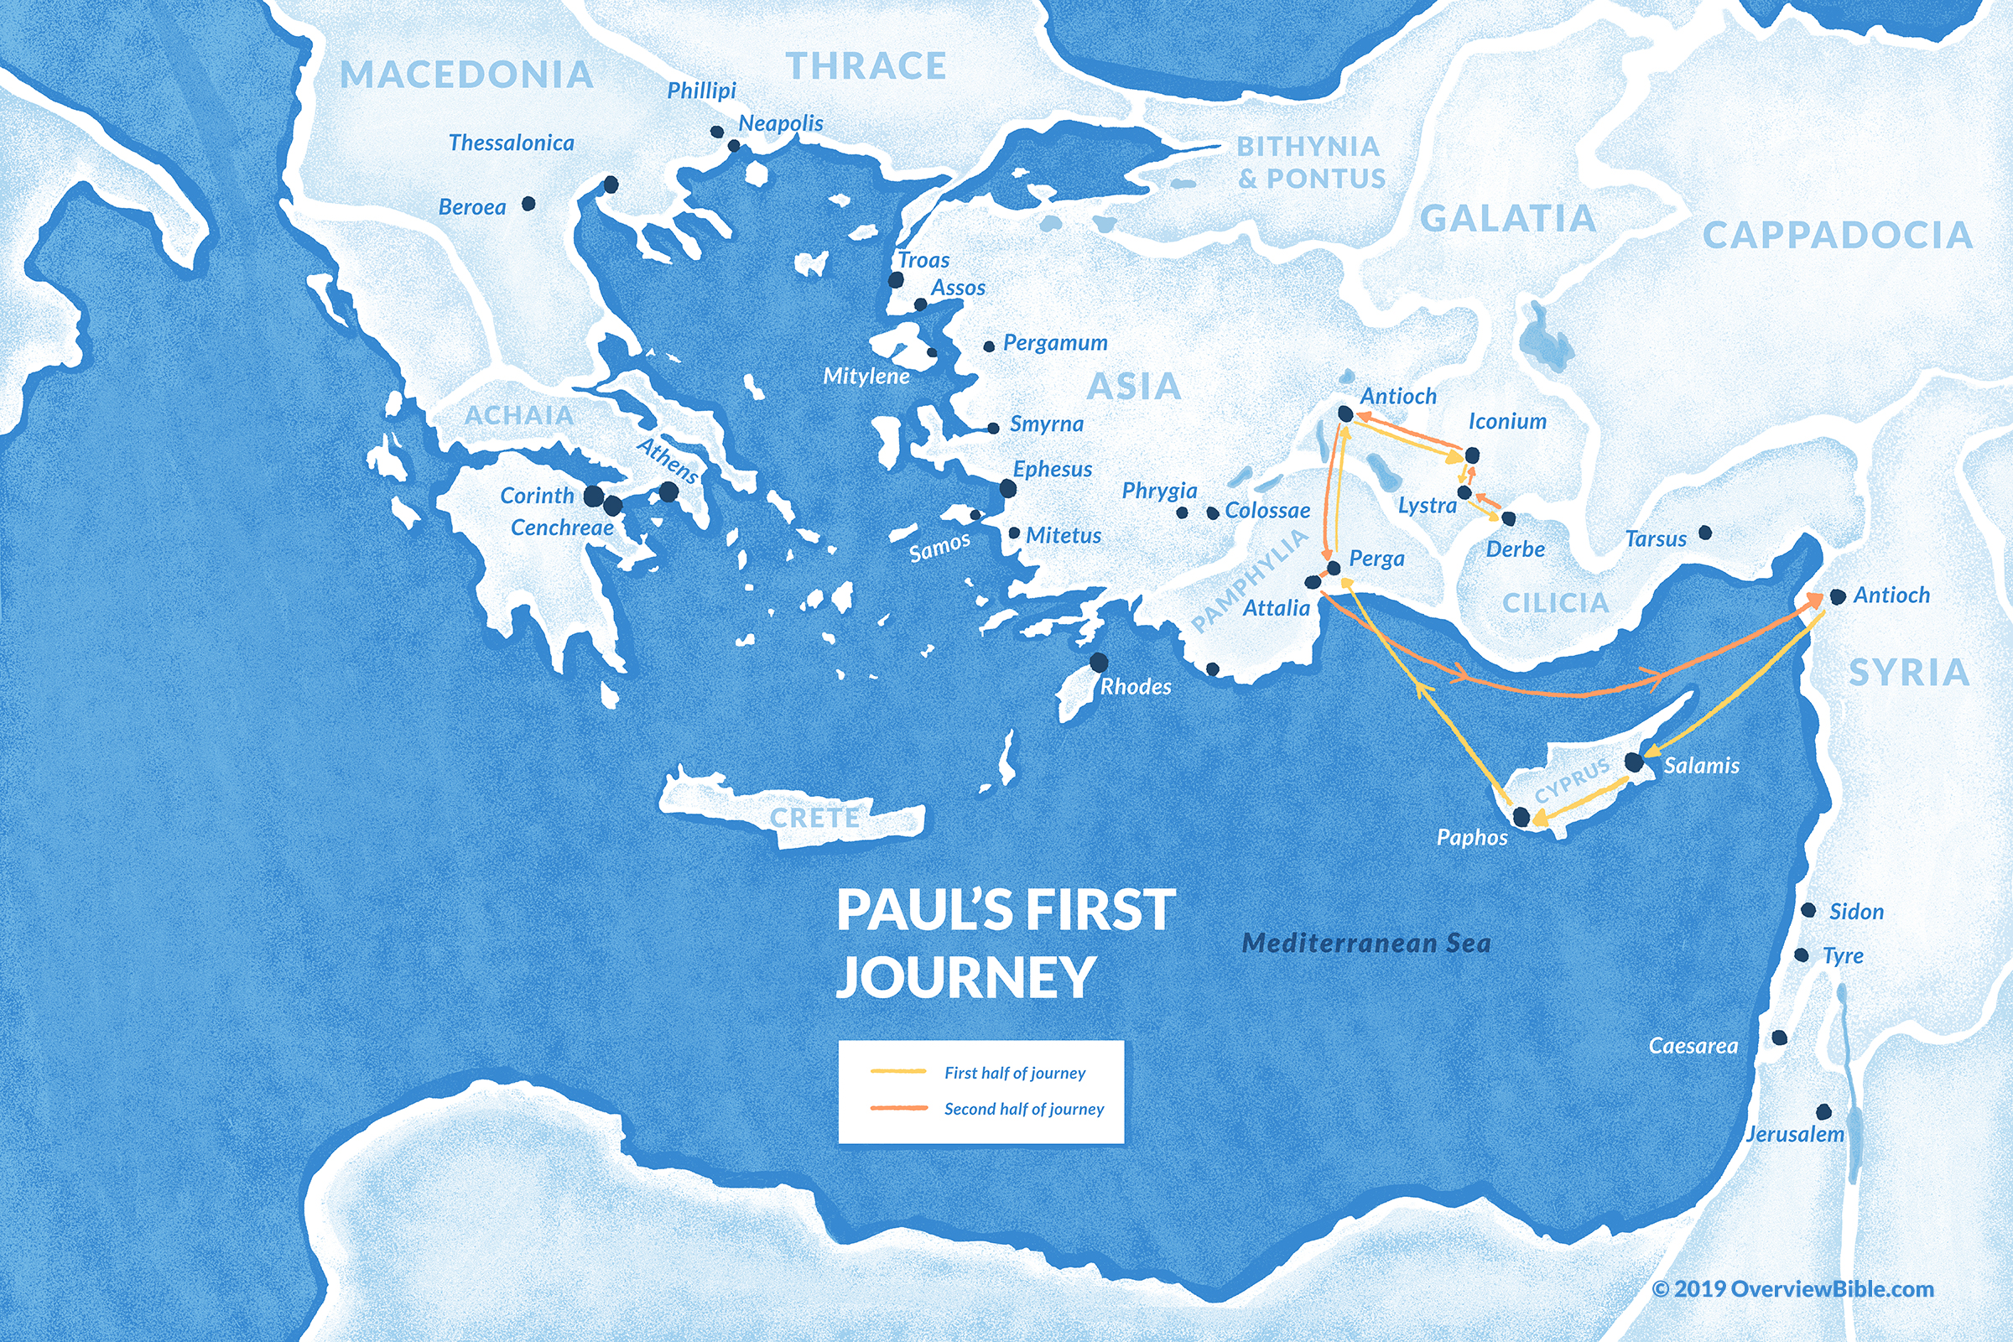
Notes:
Notice the church in Cenchrea – it was probably a “daughter church” to the adjacent larger Corinthian church.

Slide 4
People – Romans 16
V.1,2 Phoebe: welcome this sister, servant, and patron of many
  “sister” – all Christians belong to God’s family (we’re related)
  “servant of the church” – a worker in the fellowship
  “patron” – she used her influence and finances to support missions
  She was probably a businesswoman and delivered this precious letter to the Roman church
V.3-5a Prisca and Aquilla: Paul’s fellow workers
  Met Paul in Corinth and worked together (Acts 18:1-3). Left Rome when commanded by Claudius
  “risked their own necks” – kept Paul’s ministry from being cut short
  “Greet the church in their house” – moved back to Rome after Claudius died
  A good example of a husband-wife ministry team!
V.5b Epaenetus: Paul’s first convert in Asia (modern-day Turkey)
Notes:
It’s interesting that the first person mentioned by Paul was not a powerful pastor, but a servant woman.
servant - (diakonos) a neuter term which refers to people who have official roles of service in the church, sometimes translated as “deacon” (but gender neutral)
Patron (prostatis) helper, usually a wealthy person who encouraged and financially supported a cause
Susan and I appreciate the example set by Priscilla and Aquilla, a husband-wife team ministering to the churches wherever they go

Slide 5
People – Romans 16
V.6 Mary: a hard worker (kopiao), working to the point of exhaustion
V.7 Andronicus and Junia: imprisoned with Paul; saved before Paul, probably in Jerusalem before persecution forced them away
v.8 Ampliatus: a common name for slaves – now a beloved brother
v.9 Urbanus: a common Roman name – serving the church
v.9c Stachys: means “ear of corn” – unknown beloved brother
v.10a Apelles: “approved” (dokimos) = tried and tested like gold
v.10b Aristobulus: perhaps the brother of Herod Agrippa 1; he was not greeted (probably not a brother), but saved family members were

Slide 6
People – Romans 16
V.11a Herodian: probably related to Herod, now a “kinsman”
V.11b Narcissus: possibly secretary to Claudius, with saved family members (in the palace)
v.12a Tryphaena and Tryphosa: probably sisters, names mean “delicate” and “dainty” (but also hard workers in the Lord)
v.12b Persis: a convert to Christ from Persia, another hard worker for Jesus
v.13 Rufus: probably the son of Simon of Cyrene (Mark 15:21). Since Mark wrote his gospel from Rome, he knew about this relationship.
v.13 Rufus’ mother: wife of Simon, treated Paul like a son
v.13-15 Ten more saints, brothers and sisters in Jesus
v.16 “a holy kiss” – on the forehead, cheek or beard. Because many believers were outcasts from family or society, this was a precious, holy greeting

Slide 7
Paul’s Caution – Romans 16
v.17 “watch out for those who”:
  “Cause divisions and create obstacles” (Titus 3:9-11)
  “Contrary to the doctrine you have been taught” (Galatians 1:8,9)
  “Avoid them” – don’t listen to them or debate with them
v.18 “their own appetites” – false teachers are seeking personal gain
v.19 the best protection against falsehood is knowledge and obedience “to what is good” and avoid “what is evil” (Matt 10:16)
v.20 “The God of peace” already has victory over Satan (Gen 3:15)! We can look forward to the day when spiritual warfare will end!
Notes:
We need the grace of our Lord Jesus Christ as we are attacked by Satan’s emissaries while he is still in power over the world.

Slide 8
Paul’s Closing – Romans 16
v.21 Timothy, Lucius, and Sosipater send greetings to the Roman church
v.22 Tertius was Paul’s secretary
v.23 Gaius hosted Paul and the church met in his house
v.25-26 We can be strengthened by the Gospel of Jesus Christ (while the rest of the world has no certainty about life and death):
  the mystery has now been disclosed through God’s word,
  uniting all nations in salvation (Jews and Gentiles),
  bringing about the obedience of faith.
v.27 that God will be glorified forevermore!
Notes:
If you study it carefully, the closing doxology summarizes the truths expressed in the book of Romans.

Slide 9
Some “Take Aways”
God’s church is made of all kinds of people: ethnically, socially, financially, positionally, etc.
If Paul wrote a verse about you, what would you like for it to say?
Watch out for false teachers and avoid them!
Be “innocent as to what is evil” – be careful what you view on your phone! Spend time becoming “wise as to what is good.”
Find your strength and stability in the wonderful gospel – don’t seek it in anything else!

